Slide 1
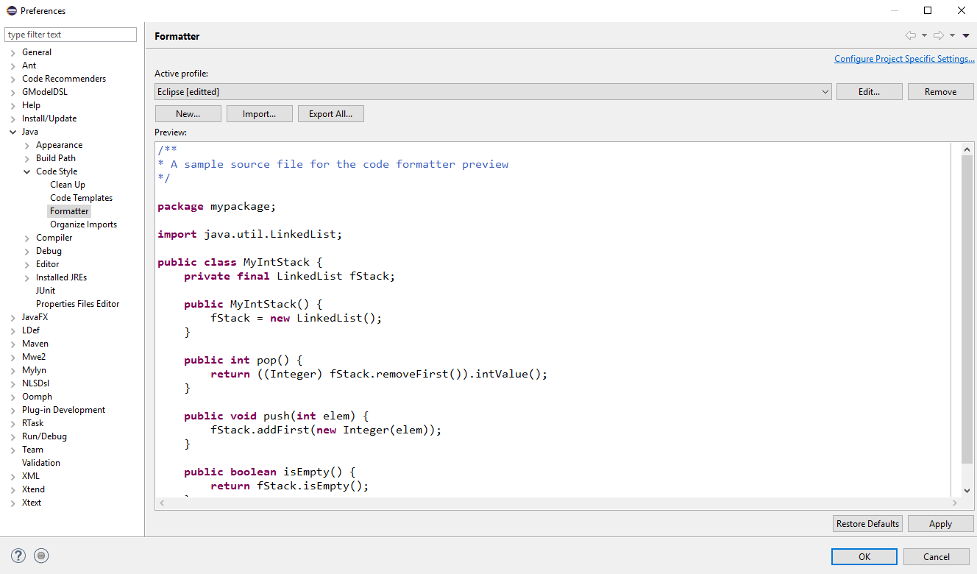
Figure 1: Preferences Window

Slide 2
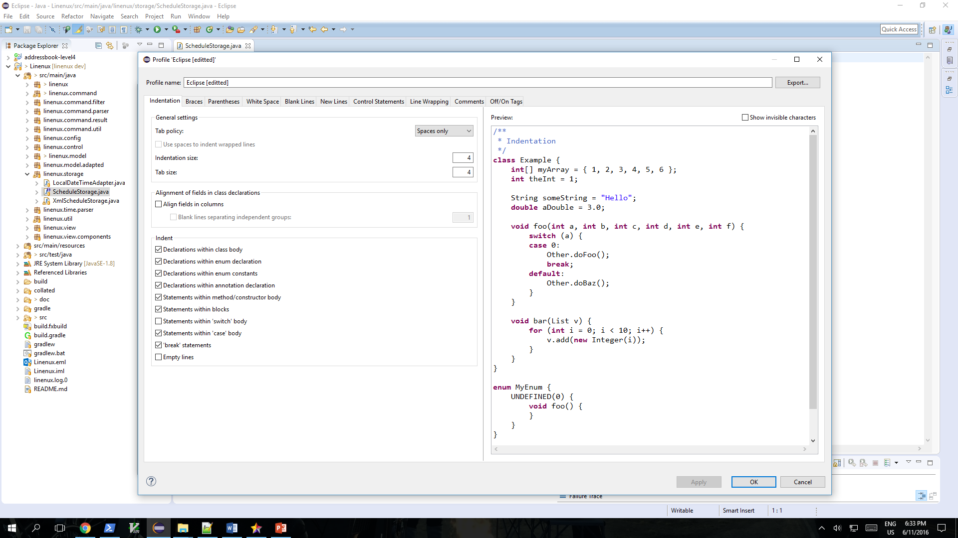
Figure 2: Profile Window

Slide 3
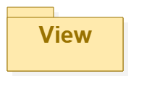
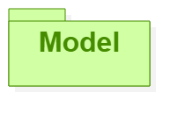
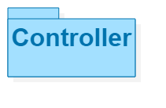
Sees
Updates
Interacts
Manipulates
Linenux
Figure 3: MVC Diagram

Slide 4
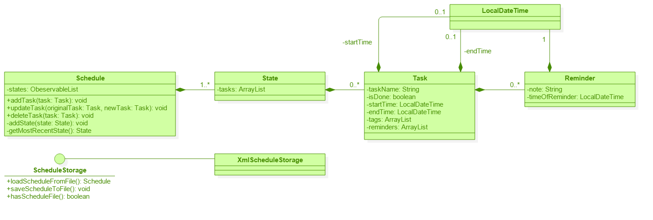
Figure 4: Model Component

Slide 5
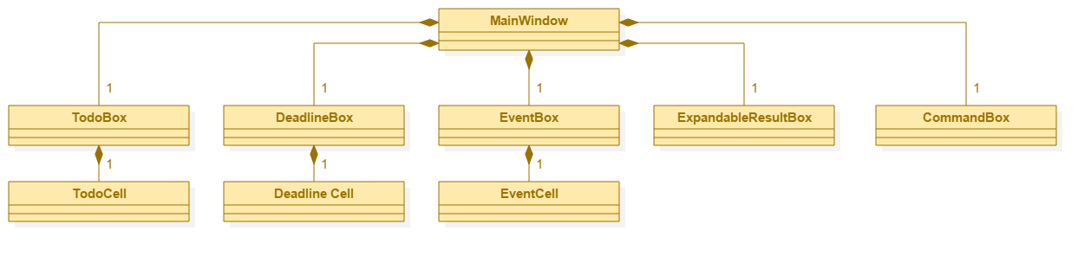
Figure 5: View Component

Slide 6
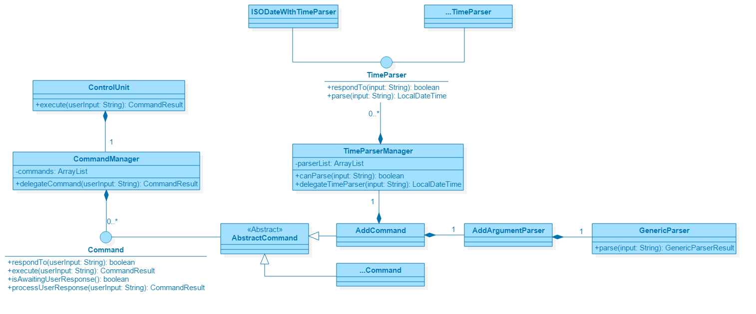
Figure 6: Controller Component

Slide 7
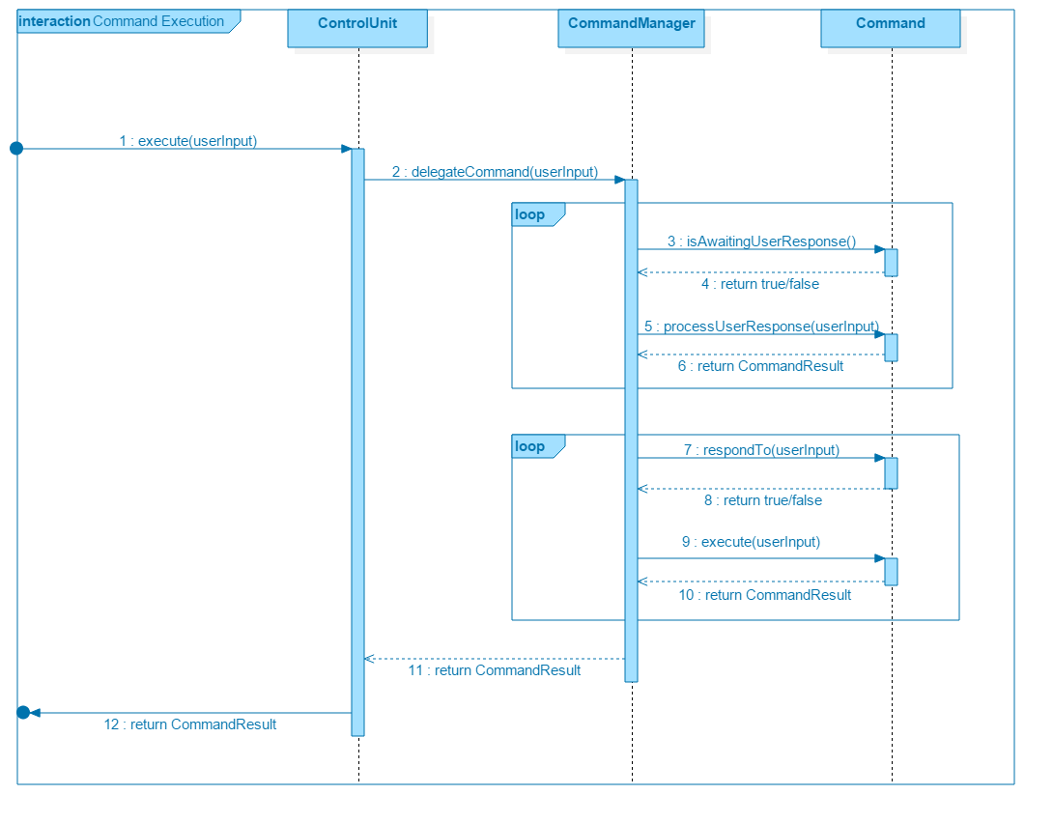
Figure 7: Command Execution Sequence Diagram

Slide 8
Linenux creates new Schedule
A
[Yes]
[No]
Linenux reads Schedule
Activity Diagram for Linenux
A
Is new file
creatable?
[No]
[Yes]
[No]
[Yes]
Is the file
readable?
Checks if there is an
existing Schedule
Display invalid command
A
Checks if any command
is awaiting response
from user.
[No]
[Yes]
User gives an input
[No]
[Yes]
Is the command
‘Exit’?
A
Checks if any command
responds to input
[No]
Is the input
valid?
Linenux display execution result
[Yes]
Linenux executes command
Display invalid input
[No]
[No]
[Yes]
Linenux creates new state in schedule
[Yes]
[No]
[Yes]
A
Does command mutate data?
Does command require user response?

Slide 9

Architecture Diagram
Web
UI
Control
Storage
Jim
Main
Model
Command

Slide 10
Main
Schedule
Task
AddCommand
ConsoleController
ControlUnit
InvalidCommand
CommandManager
<<interface>>
Command
…Command
<<interface>>
CommandResult
AddCommandResult
InvalidCommandResult
…CommandResult

