Slide 1
Figure 1: Downloading linenux.jar file

Slide 2
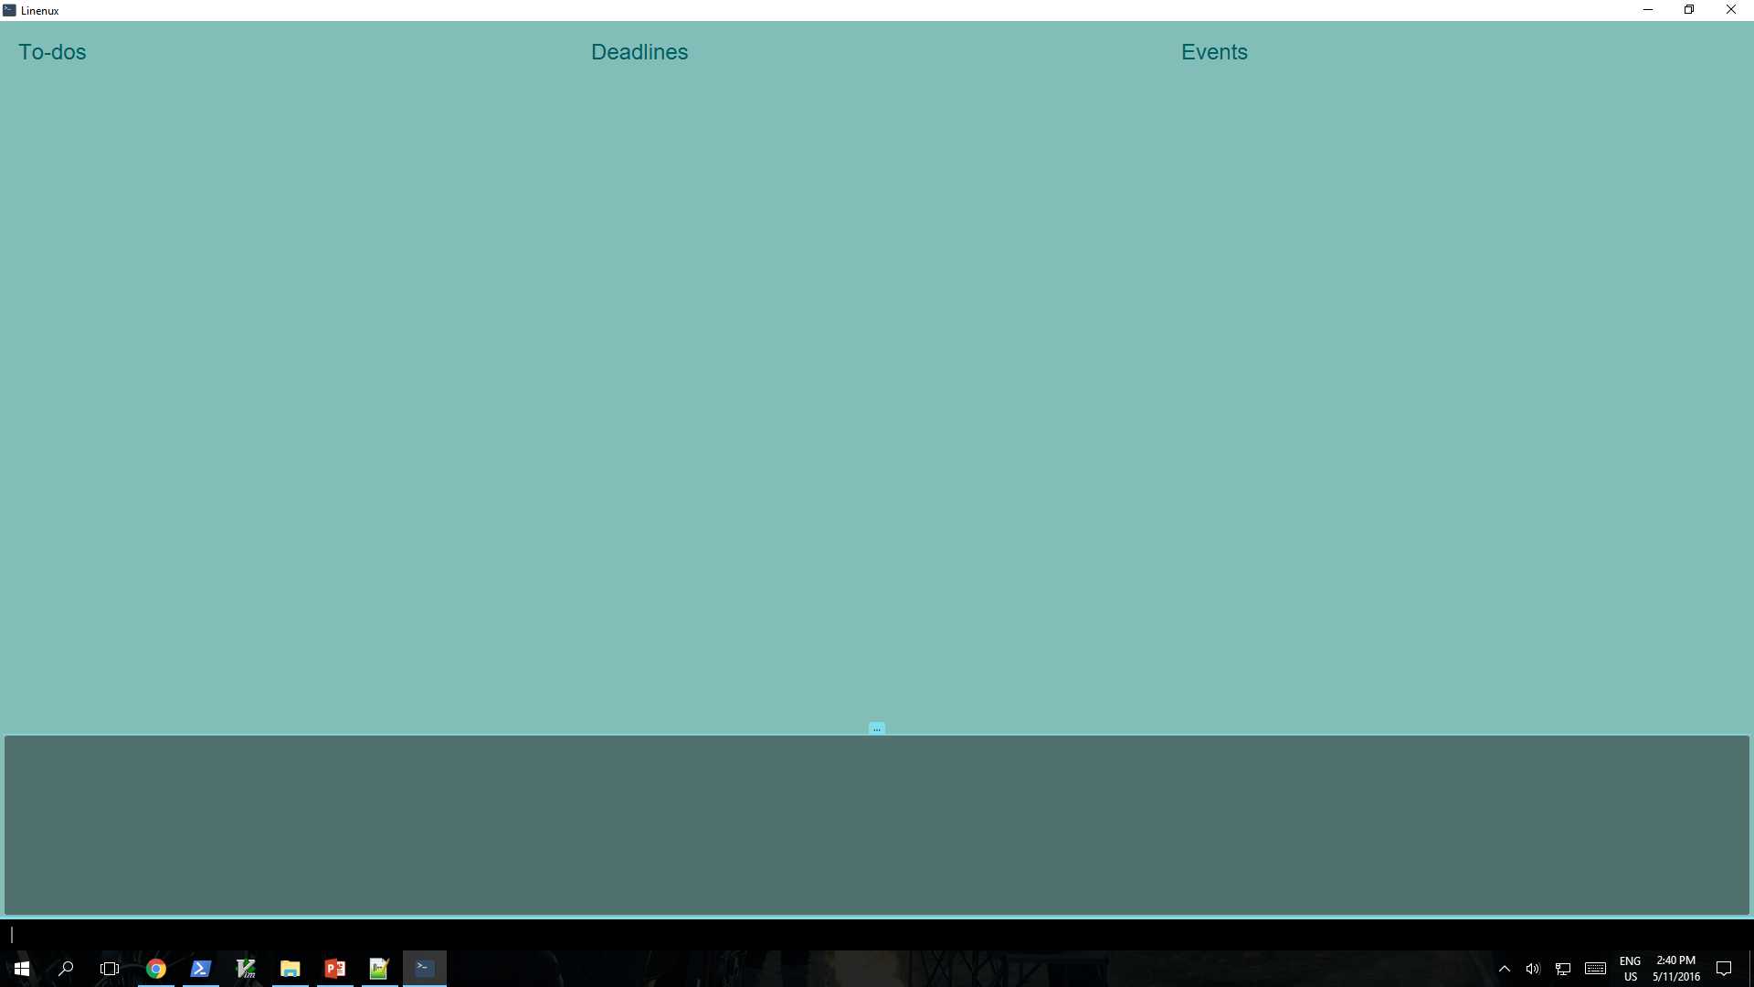
To-do Panel
Deadline Panel
Event Panel
Display Panel
Command Box
Figure 2: Main Window of Linenux

Slide 3
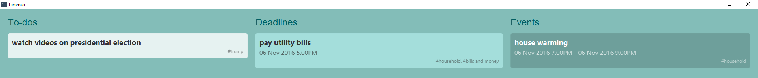
Figure 3: Adding Tasks

Slide 4
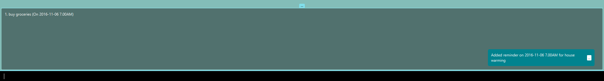
Figure 4: Setting a Reminder

Slide 5
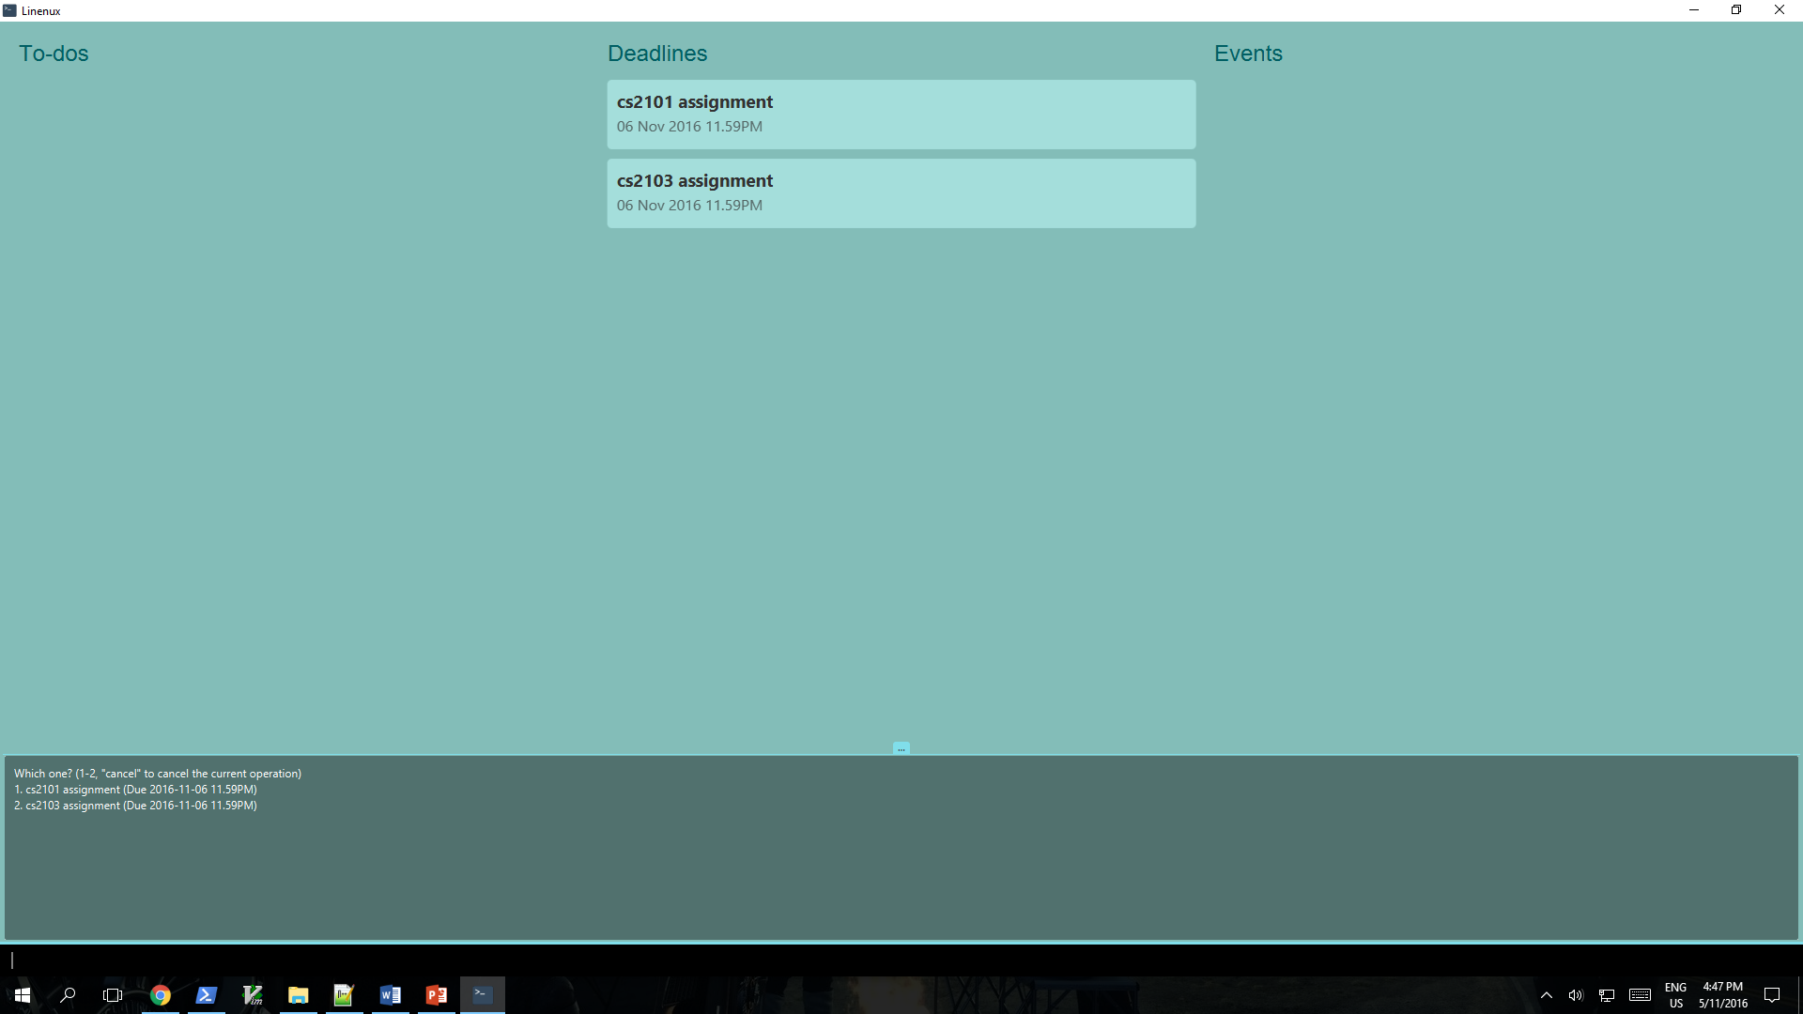
Figure 5: Multiple Tasks Found

Slide 6
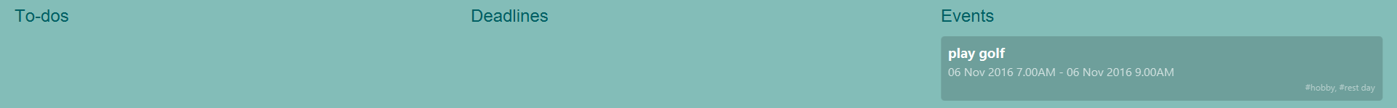
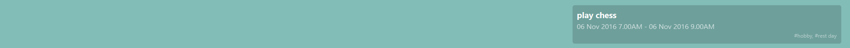


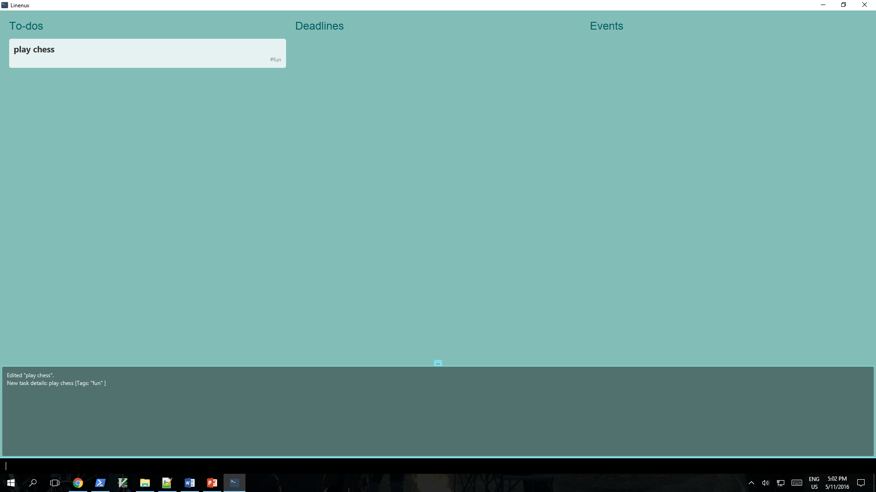

Figure 6: Task Transformation

Slide 7
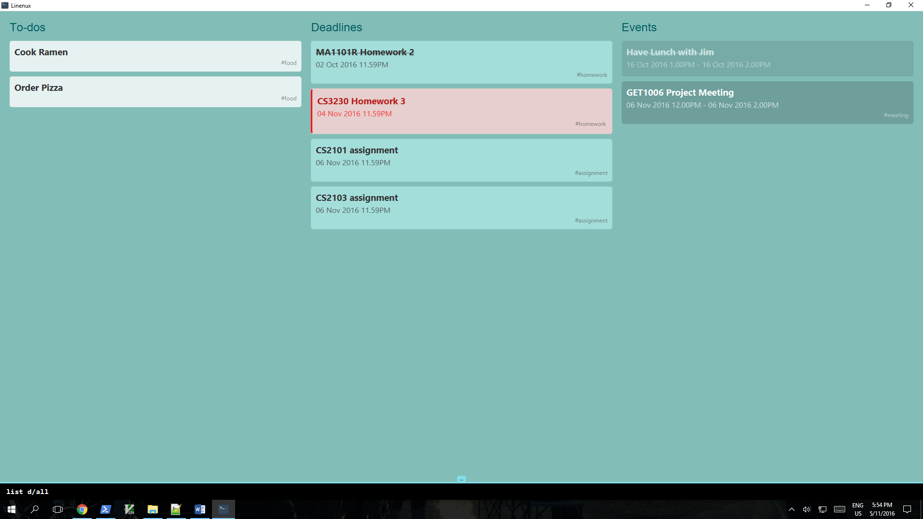
Figure 7: Listing All Tasks

Slide 8
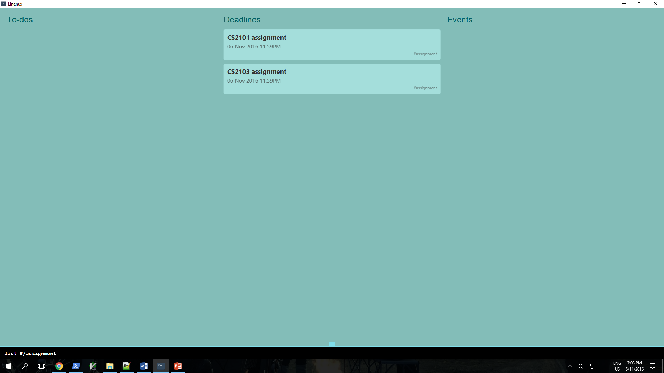
Figure 8: Listing Tasks with Assignment Tag

Slide 9
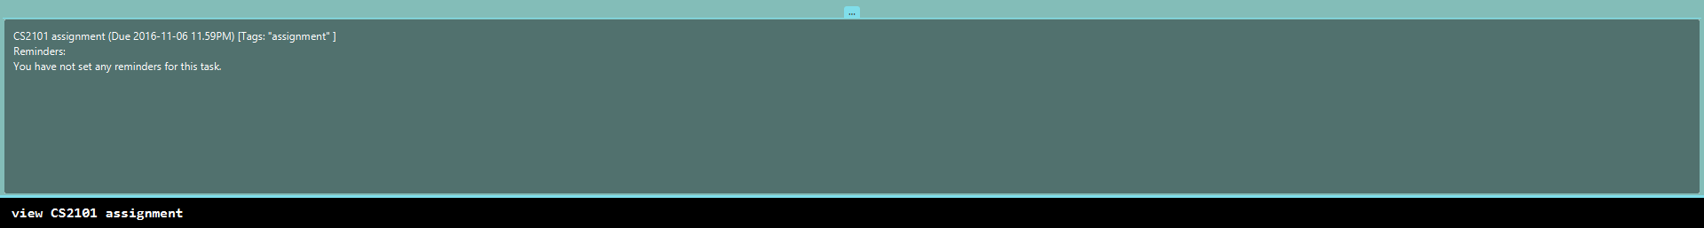
Figure 9: Viewing a Task

Slide 10

Figure 10: Freetime

Slide 11
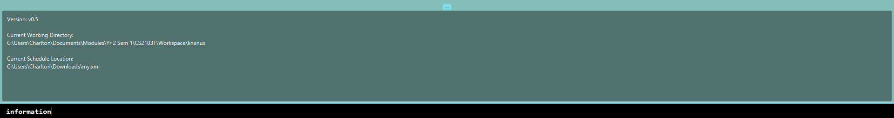
Figure 11: Program Information

Slide 12
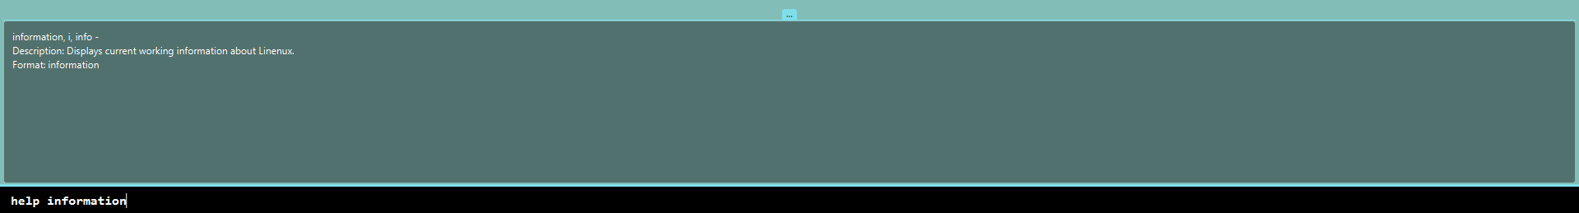
Figure 12: Help for Information Command

