Slide 1
Figure 1: Downloading linenux.jar file

Slide 2
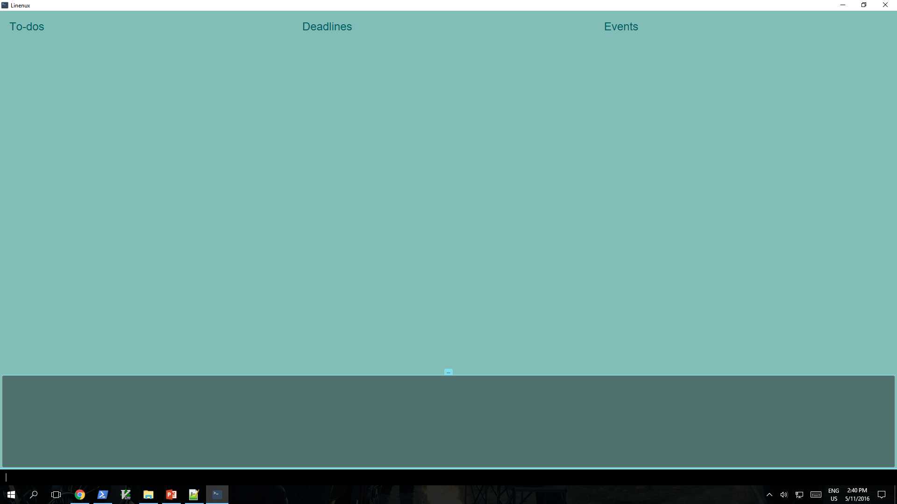
To-do Panel
Deadline Panel
Event Panel
Display Panel
Command Box
Figure 2: Main Window of Linenux

