Slide 1
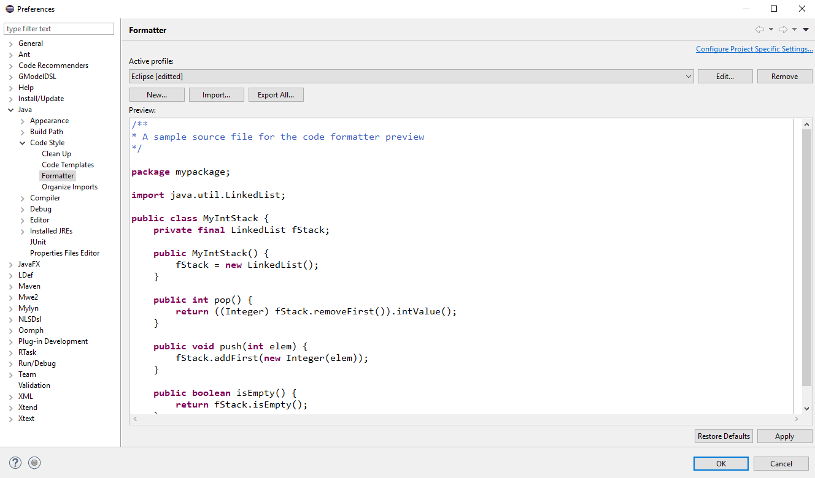
Figure 1: Preferences Window

Slide 2
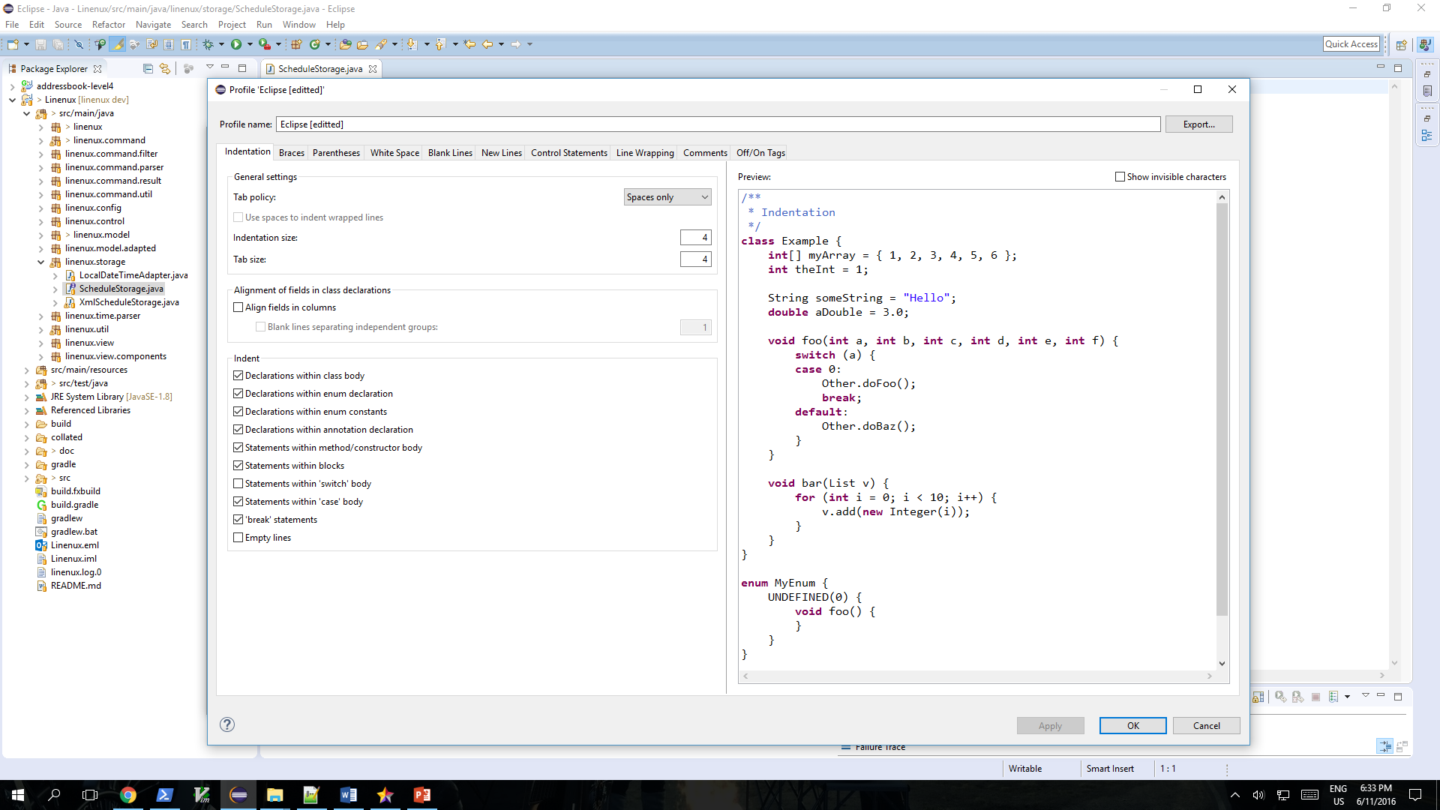
Figure 2: Profile Window

Slide 3
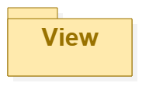
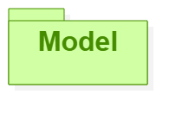
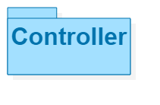
Sees
Updates
Interacts
Manipulates
Linenux
Figure 3: MVC Diagram

Slide 4
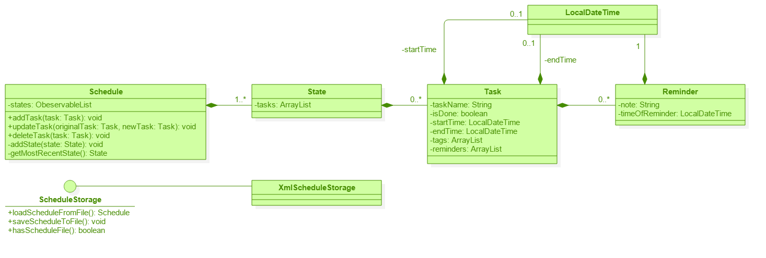
Figure 4: Model Component

Slide 5
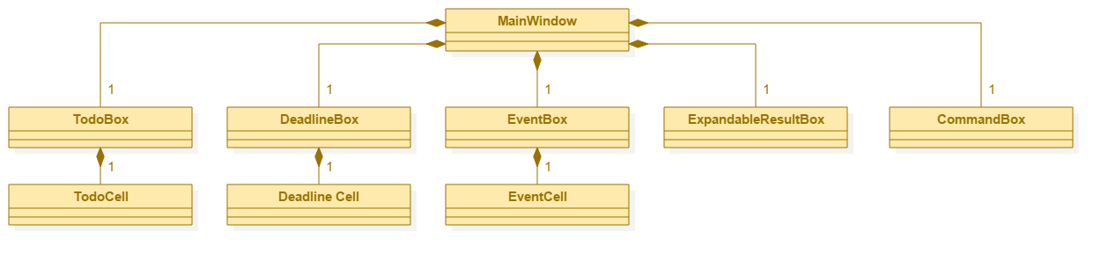
Figure 5: View Component

Slide 6
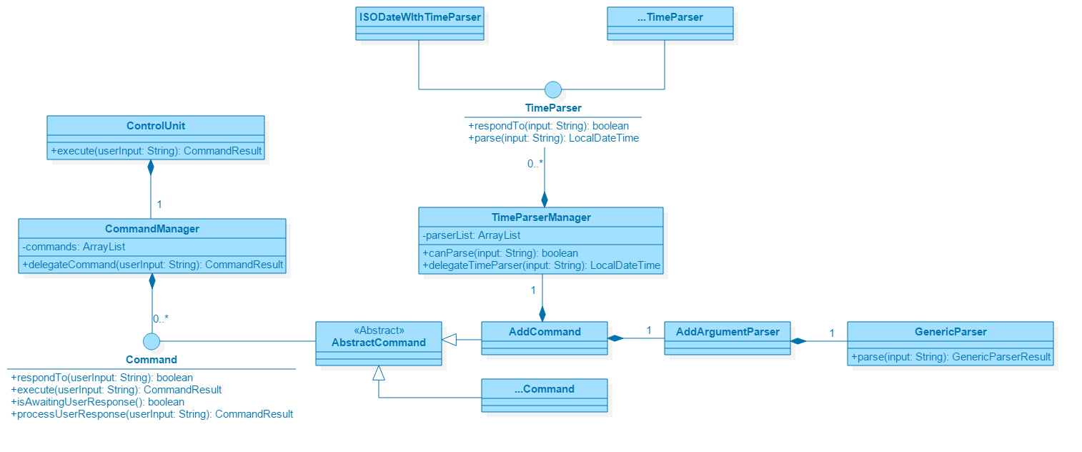
Figure 6: Controller Component

Slide 7
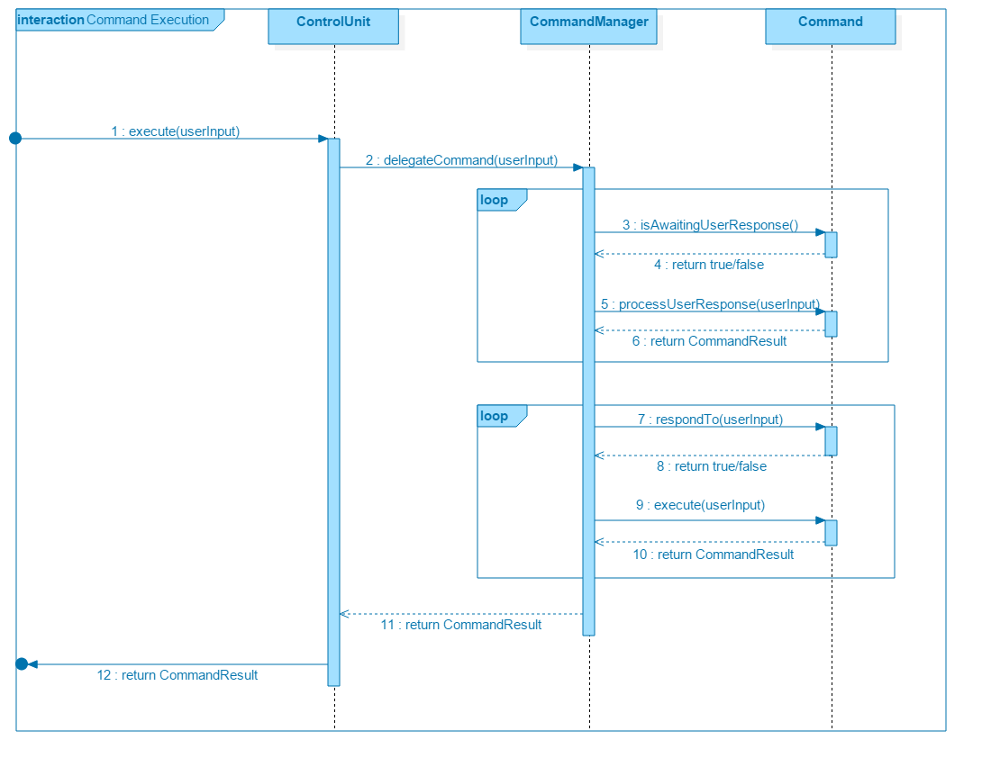
Figure 7: Command Execution Sequence Diagram

Slide 8
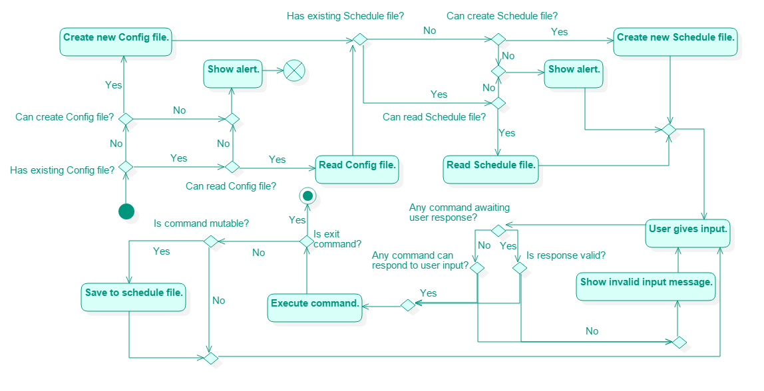
Figure 8: Linenux Activity Diagram

