Slide 1
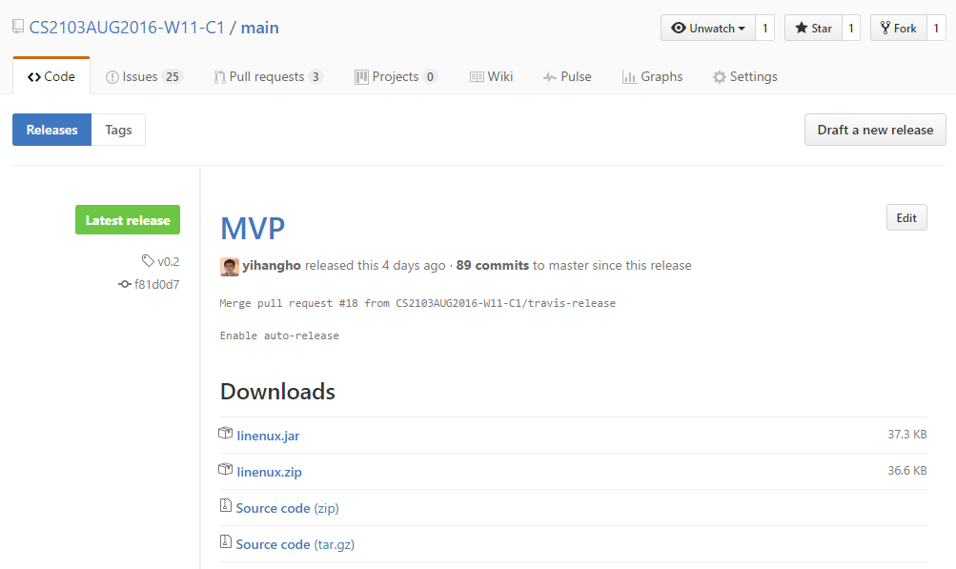
Figure 1: Downloading linenux.jar file

Slide 2
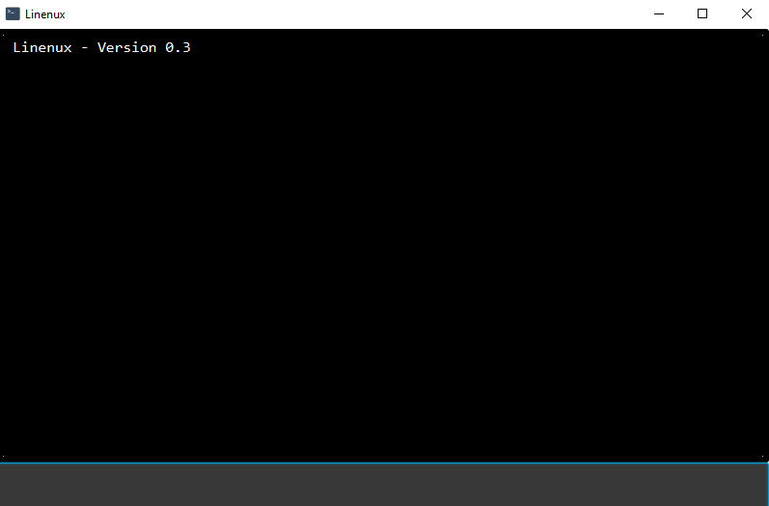
Figure 2: Linenux’s main window

