Slide 1
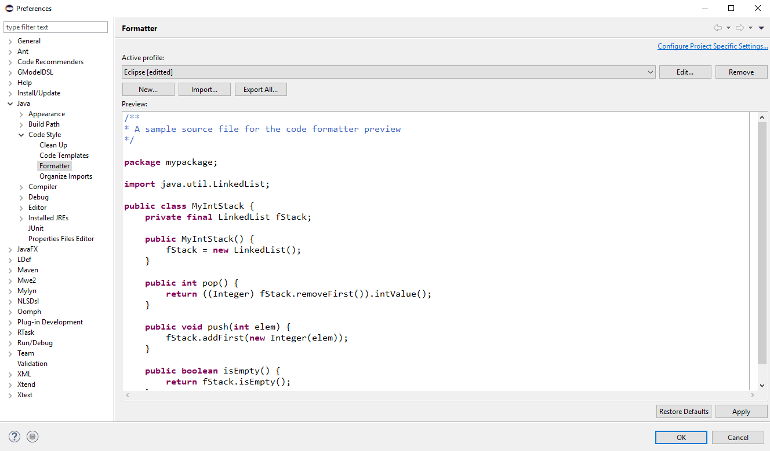
Figure 1: Preferences Window

Slide 2
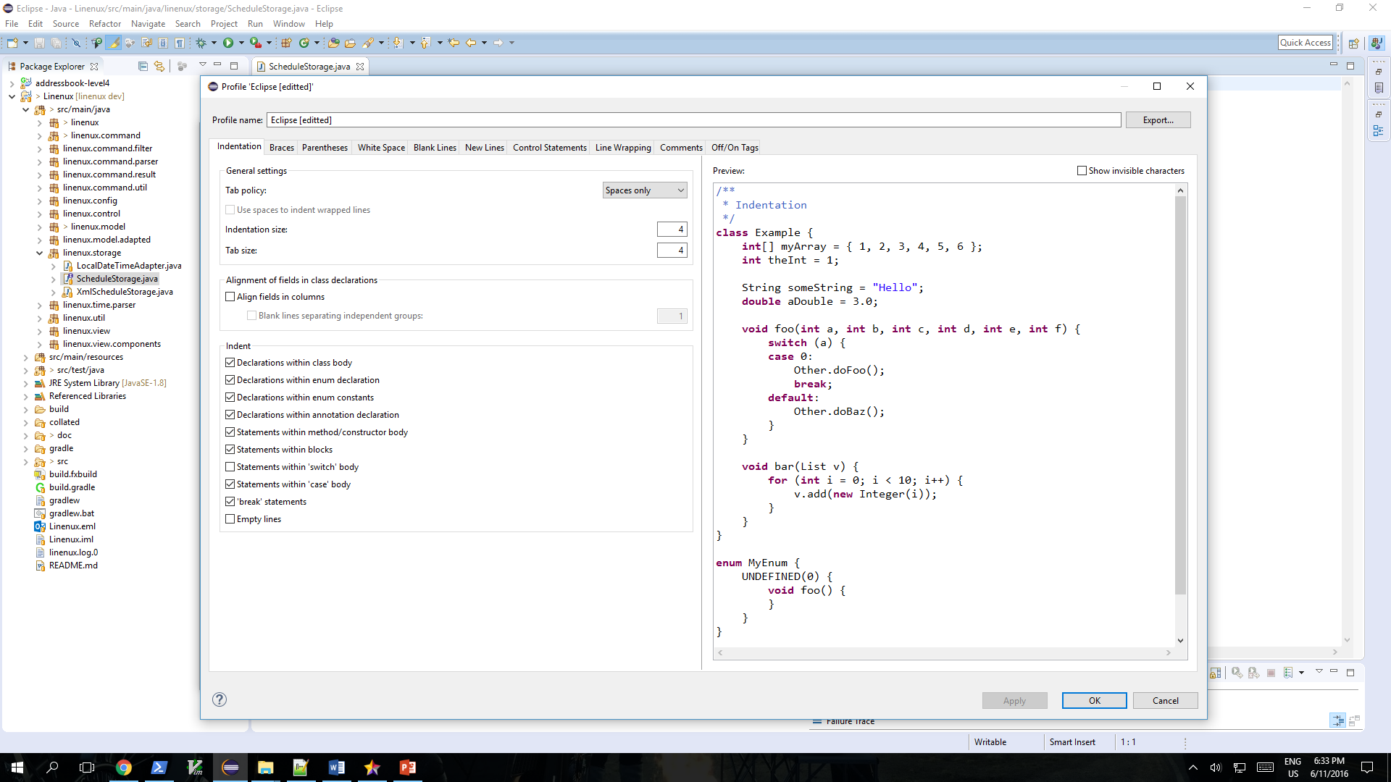
Figure 2: Profile Window

Slide 3
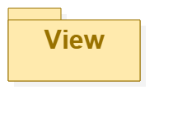
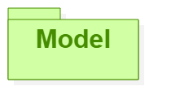
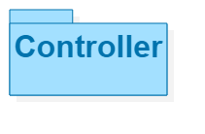
Sees
Updates
Interacts
Manipulates
Linenux
Figure 3: MVC Diagram

Slide 4
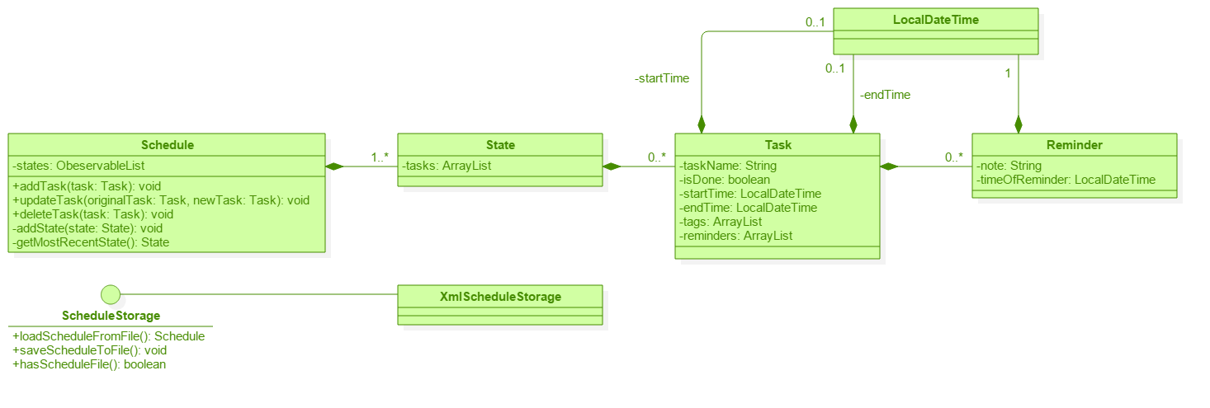
Figure 4: Model Component

Slide 5
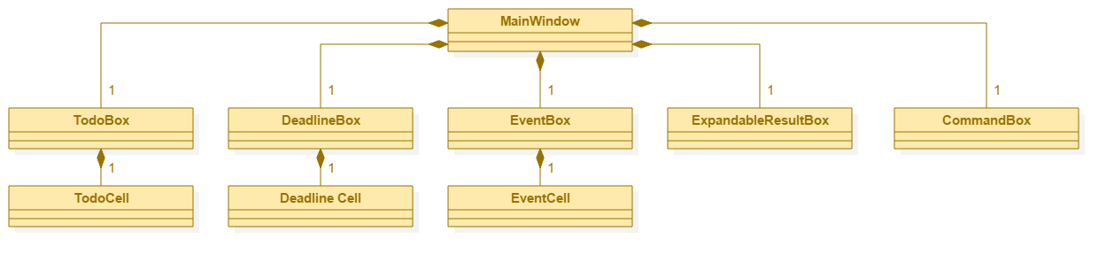
Figure 5: View Component

Slide 6
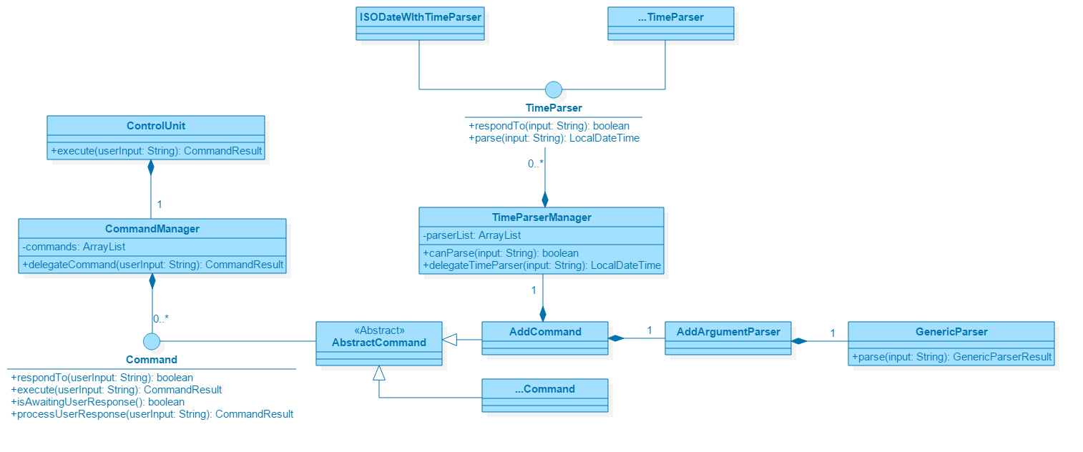
Figure 6: Controller Component

Slide 7
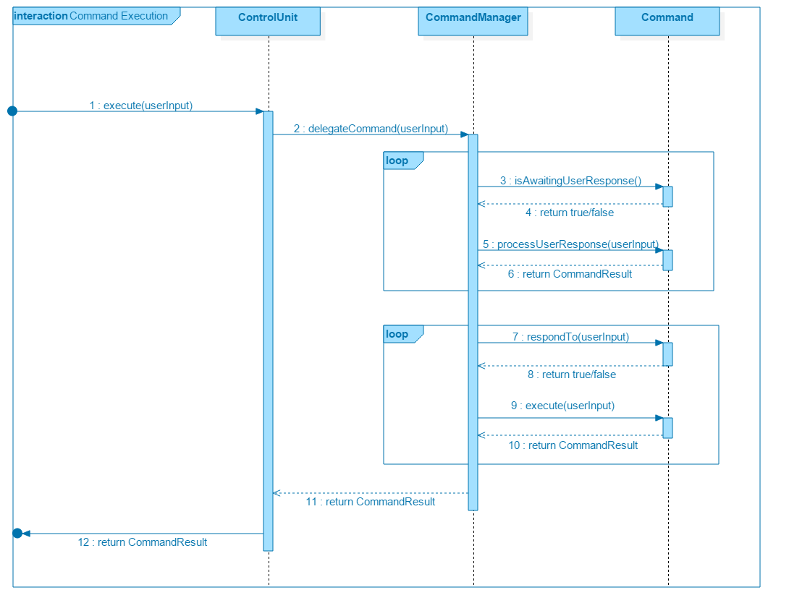
Figure 7: Command Execution Sequence Diagram

Slide 8
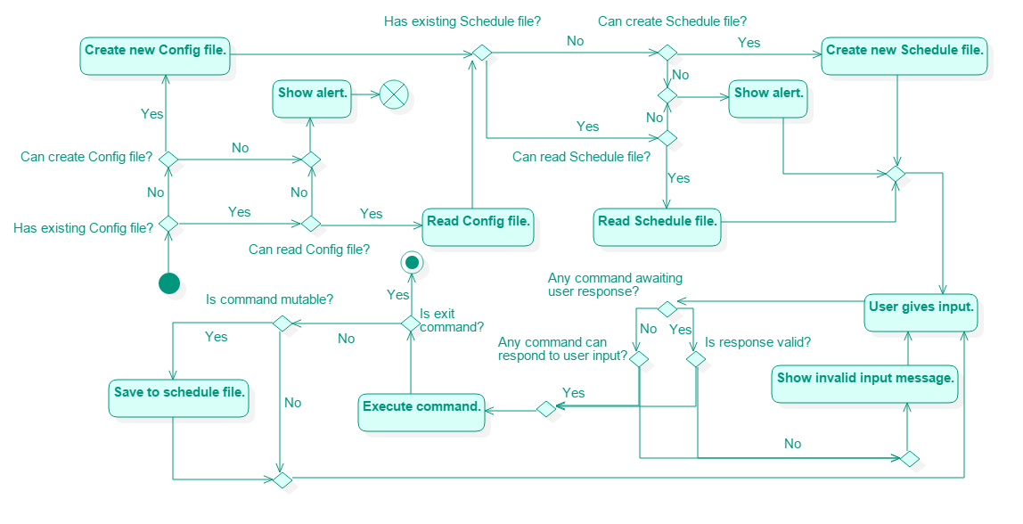
Figure 8: Linenux Activity Diagram

Slide 9
S/N | Description | Google Calendar | Wunderlist | Todoist | Fantastical
1 | Offline Support | Yes | Yes |  | Yes
2 | Calendar View | Yes |  |  | Yes
3 | Multiple Calendars | Yes
4 | Keyboard Support | Limited | Limited | Limited | Limited
5 | Cross Platform | Yes | Yes | Yes
6 | Sync to Cloud | Yes |  | Yes | Yes
7 | Free | Yes | Yes | Yes
8 | Add to-dos | Yes | Yes | Yes | Yes
9 | Add deadlines | Yes | Yes | Yes | Yes
10 | Add events | Yes |  |  | Yes
11 | Add reminders |  | Yes | Yes | Yes
Figure 9: Product Survey

