Slide 1
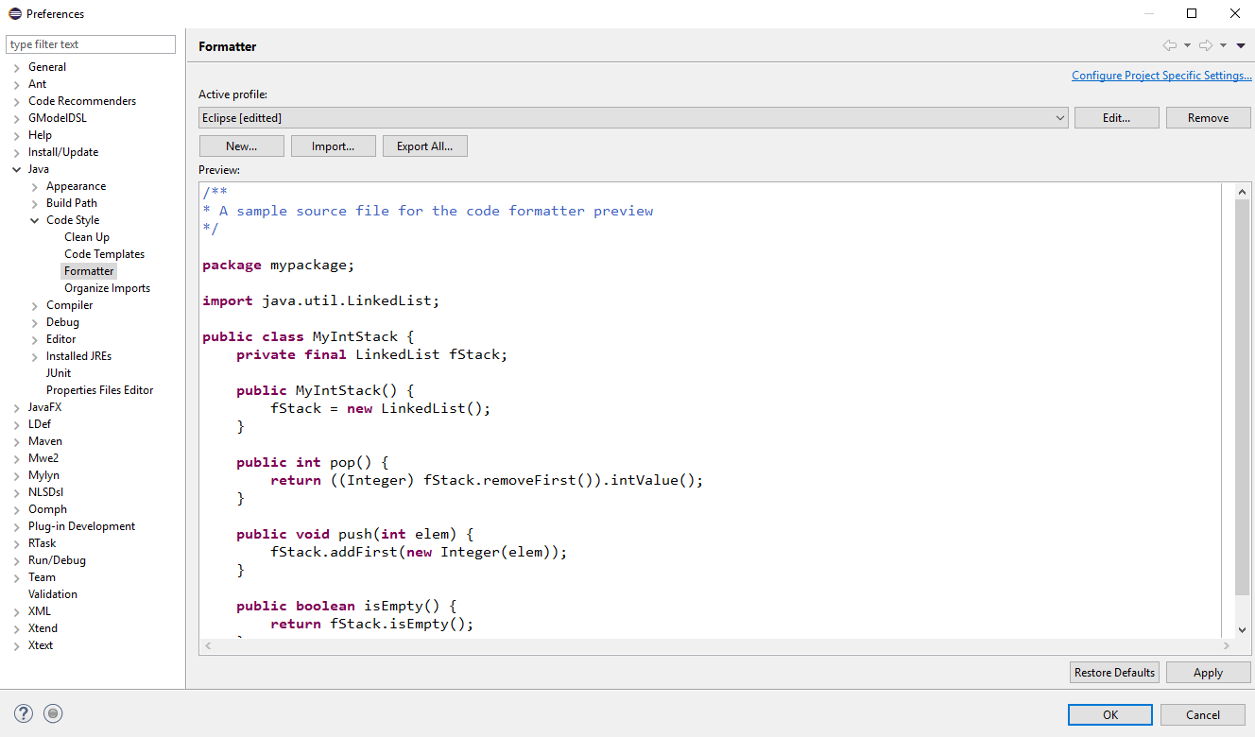
Figure 1: Preferences Window

Slide 2
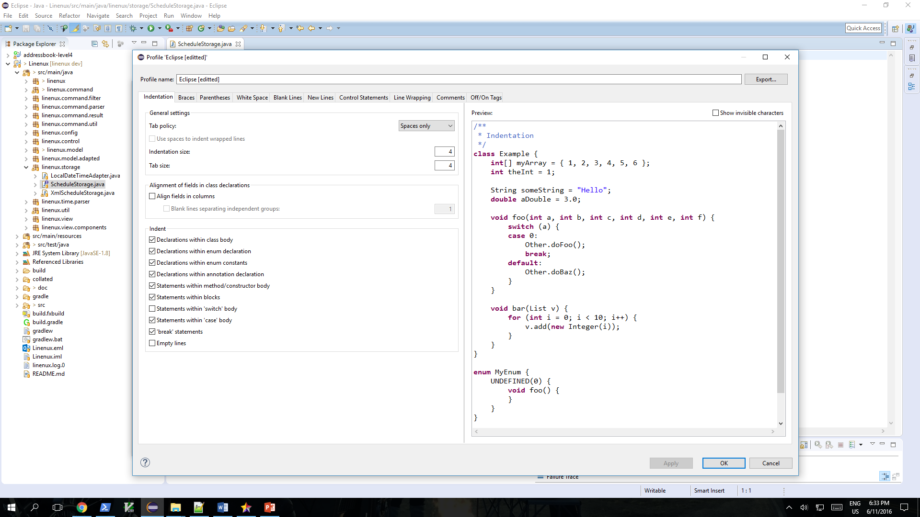
Figure 2: Profile Window

Slide 3
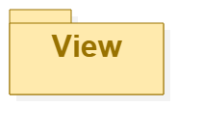
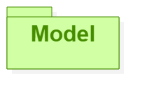
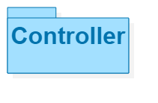
Sees
Updates
Interacts
Manipulates
Linenux
Figure 3: MVC Diagram

Slide 4
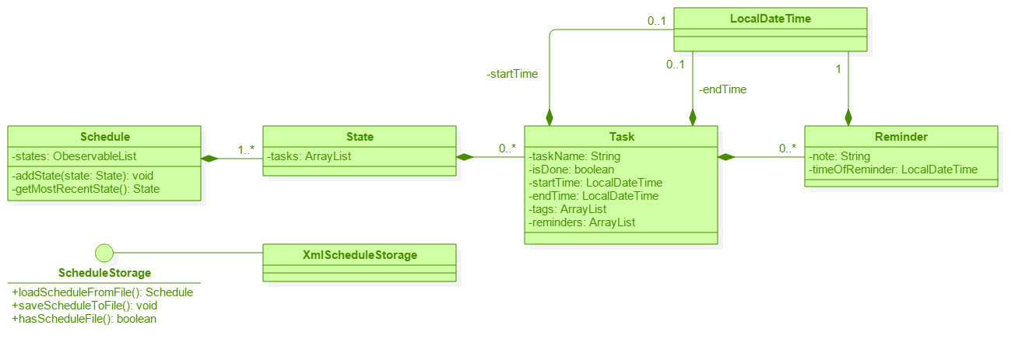
Figure 4: Model Component

Slide 5
View Diagram
View
MainWindow
MainWindow.fxml
TodoBox
TodoBox.fxml
Model
Jim
Sees
Updates
EventBox
EventBox.fxml
DeadlineBox
DeadlineBox.fxml
ResultBox
ResultBox.fxml
CommandBox
CommandBox.fxml

Slide 6
Controller Diagram
Controller
ISODateWithTimeParser
…TimeParser
MainWindow-Controller
Jim
Interacts
<< Interface>>
TimeParser
ControlUnit
TimeParserManager
Model
CommandManager
Manipulates
<< Interface>>
Command
AddCommand
ListCommand
<< Interface>>
CommandResult
…Command

Slide 7
Sequence Diagram for generic commands
:ControlUnit
:CommandManager
execute(userInput);
:
delegateCommand();
:
Loop
[Until first command that respond to userInput]
:Command
respondTo();
:
return true/false
:
FoundCommand
:Command
execute(userInput);
:
return CommandResult
return CommandResult
return CommandResult

Slide 8
Linenux creates new Schedule
A
[Yes]
[No]
Linenux reads Schedule
Activity Diagram for Linenux
A
Is new file
creatable?
[No]
[Yes]
[No]
[Yes]
Is the file
readable?
Checks if there is an
existing Schedule
Display invalid command
A
Checks if any command
is awaiting response
from user.
[No]
[Yes]
User gives an input
[No]
[Yes]
Is the command
‘Exit’?
A
Checks if any command
responds to input
[No]
Is the input
valid?
Linenux display execution result
[Yes]
Linenux executes command
Display invalid input
[No]
[No]
[Yes]
Linenux creates new state in schedule
[Yes]
[No]
[Yes]
A
Does command mutate data?
Does command require user response?

Slide 9

Architecture Diagram
Web
UI
Control
Storage
Jim
Main
Model
Command

Slide 10
Main
Schedule
Task
AddCommand
ConsoleController
ControlUnit
InvalidCommand
CommandManager
<<interface>>
Command
…Command
<<interface>>
CommandResult
AddCommandResult
InvalidCommandResult
…CommandResult

