Slide 1
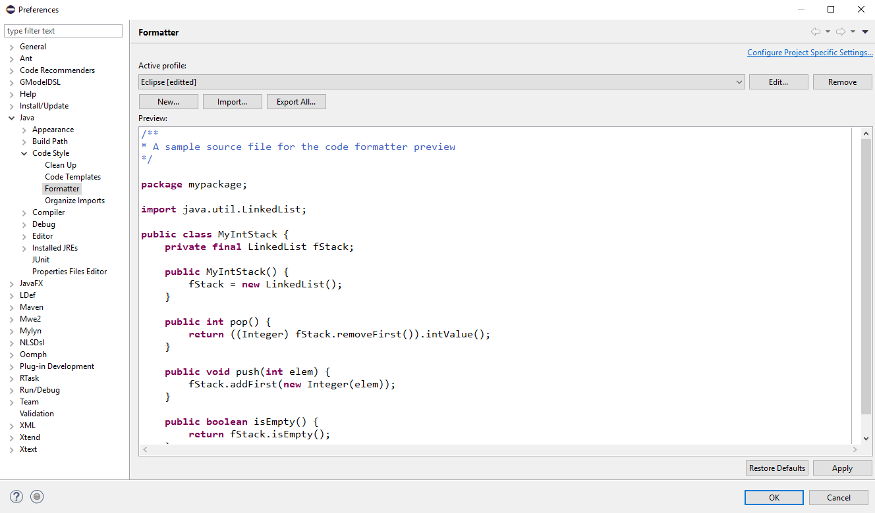
Figure 1: Preferences Window

Slide 2
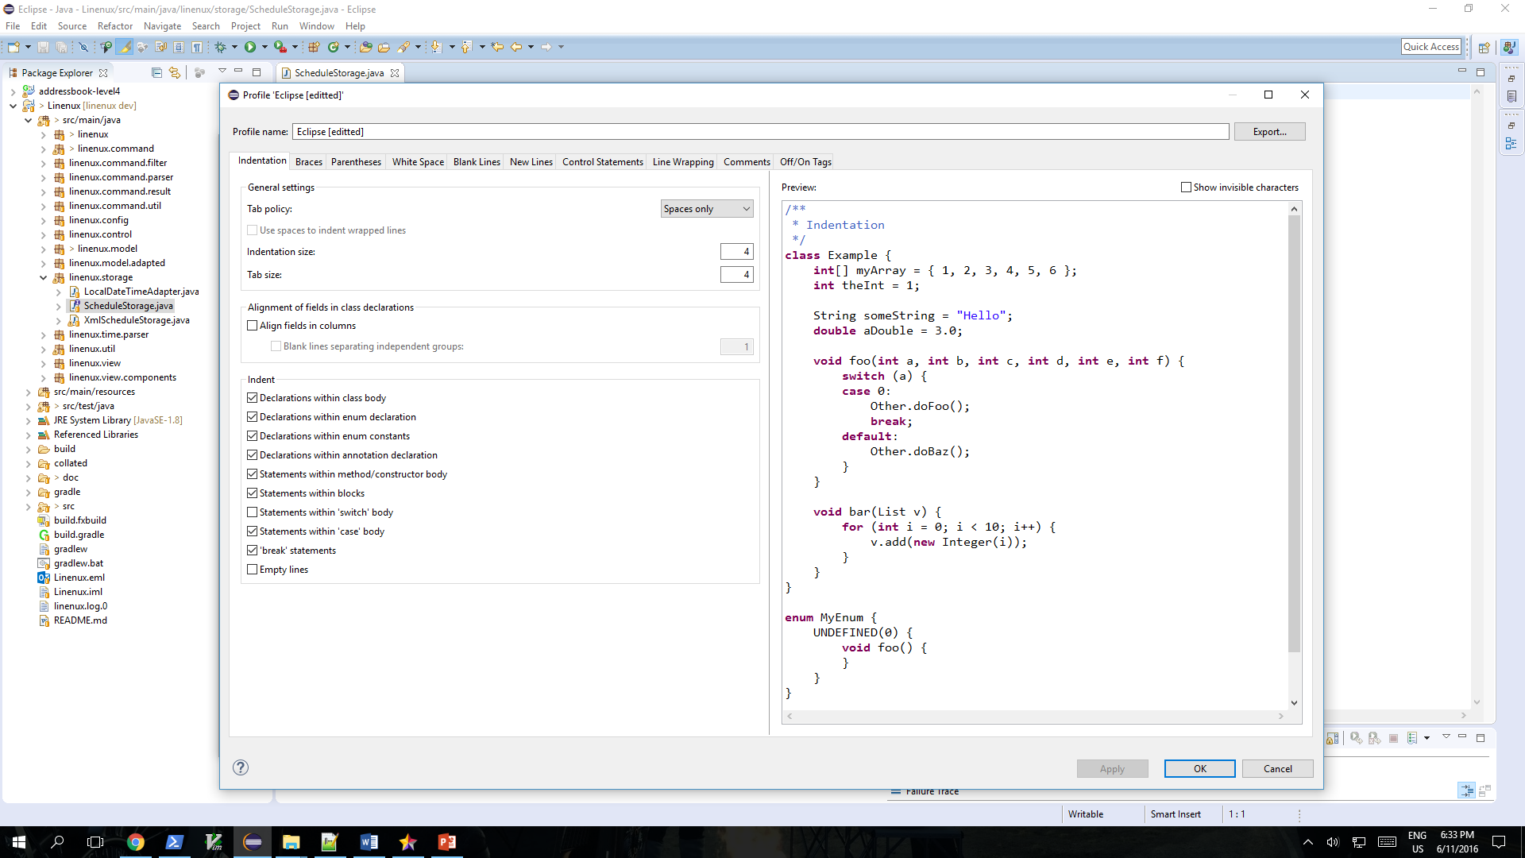
Figure 2: Profile Window

Slide 3

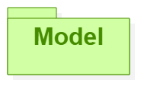
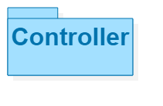
Sees
Updates
Interacts
Manipulates
Linenux
Figure 3: MVC Diagram

Slide 4
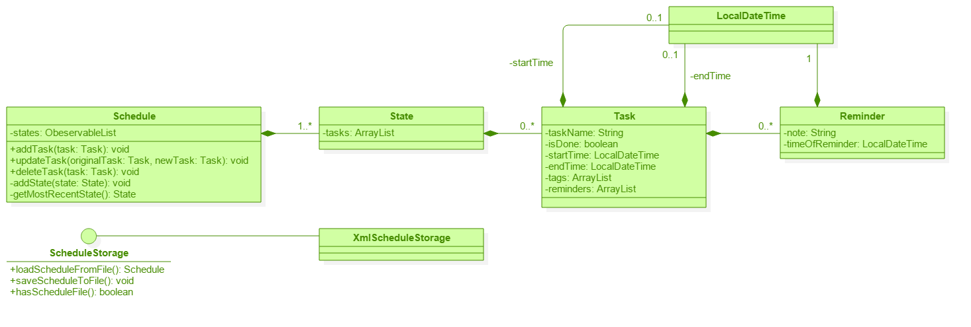
Figure 4: Model Component

Slide 5
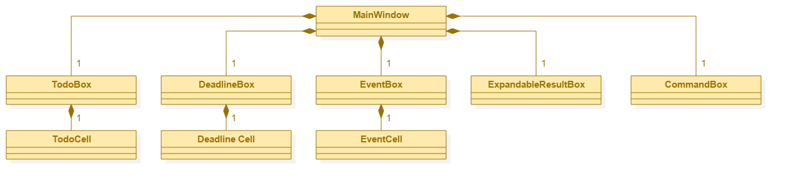
Figure 5: View Component

Slide 6
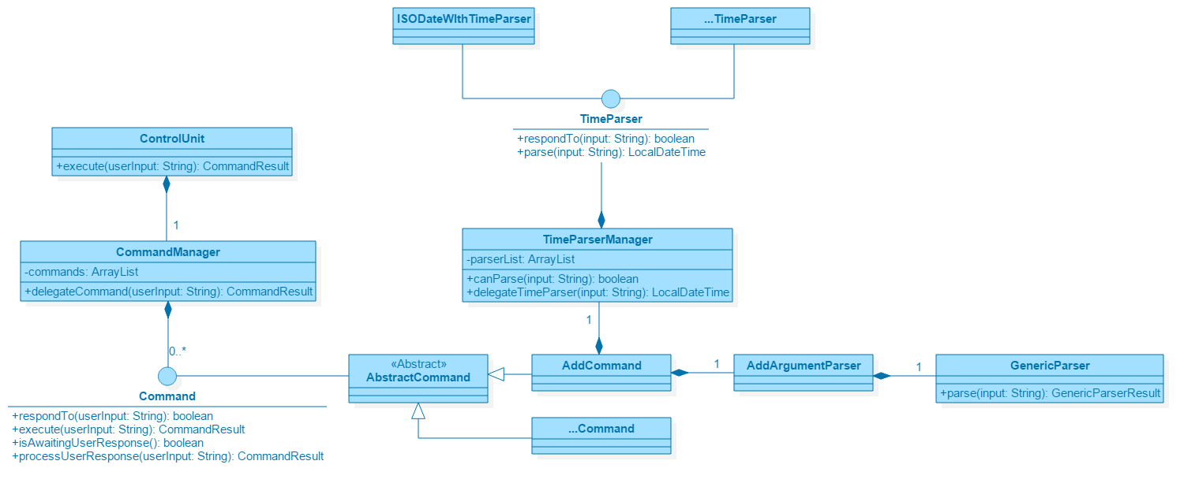
Figure 6: Controller Component

Slide 7
Controller Diagram
Controller
ISODateWithTimeParser
…TimeParser
MainWindow-Controller
Jim
Interacts
<< Interface>>
TimeParser
ControlUnit
TimeParserManager
Model
CommandManager
Manipulates
<< Interface>>
Command
AddCommand
ListCommand
<< Interface>>
CommandResult
…Command

Slide 8
Sequence Diagram for generic commands
:ControlUnit
:CommandManager
execute(userInput);
:
delegateCommand();
:
Loop
[Until first command that respond to userInput]
:Command
respondTo();
:
return true/false
:
FoundCommand
:Command
execute(userInput);
:
return CommandResult
return CommandResult
return CommandResult

Slide 9
Linenux creates new Schedule
A
[Yes]
[No]
Linenux reads Schedule
Activity Diagram for Linenux
A
Is new file
creatable?
[No]
[Yes]
[No]
[Yes]
Is the file
readable?
Checks if there is an
existing Schedule
Display invalid command
A
Checks if any command
is awaiting response
from user.
[No]
[Yes]
User gives an input
[No]
[Yes]
Is the command
‘Exit’?
A
Checks if any command
responds to input
[No]
Is the input
valid?
Linenux display execution result
[Yes]
Linenux executes command
Display invalid input
[No]
[No]
[Yes]
Linenux creates new state in schedule
[Yes]
[No]
[Yes]
A
Does command mutate data?
Does command require user response?

Slide 10

Architecture Diagram
Web
UI
Control
Storage
Jim
Main
Model
Command

Slide 11
Main
Schedule
Task
AddCommand
ConsoleController
ControlUnit
InvalidCommand
CommandManager
<<interface>>
Command
…Command
<<interface>>
CommandResult
AddCommandResult
InvalidCommandResult
…CommandResult

