Slide 1
AGENDUM
Diagrams

Slide 2
UI
Logic
Storage
Events Center
Model
Logs Center
Main
Commons
Does google calendar affect this anywhere?

Slide 3
:UI
:Logic
:Model
:EventsCenter
delete 1
execute(“delete 1”)
deleteTasks(task)
post(ToDoListChangedEvent)
:UI
:EventsCenter
:Storage
post(ToDoListChangedEvent)
handleToDoListChangedEvent()
Save to file
Update status bar
handleToDoListChangedEvent()

Slide 4
UI
UiManager
UiPartLoader
{abstract} UiPart
MainWindow
Logic
CommandBoxHistory
<<interface>>
Ui
CommandBox
ResultPopUp
UpcomingTasksPanel
TasksPanel
CompletedTasksPanel
TaskCard
FloatingTasksPanel
StatusBarFooter
Model
HelpWindow

Slide 5
Logic
CommandResult
1
produces
AliasCommand
<<interface>>
Logic
CommandLibrary
AddCommand
updates
FindCommand
checks
Incorrect Command
LogicManager
1
Parser
creates
{abstract} Command
…
executes
Model

Slide 6
Logic
:LogicManager
:Parser
:Model
execute(“delete 1”)
parse(“delete 1”)
create()
d:Delete Command
d
execute()
deleteTasks(task)
result: CommandResult
result
result

Slide 7
Model
:ModelManager
:ToDoList
:UniqueTaskList
task:Task
:EventsCenter
deleteTasks(task)
removeTask(task)
remove (task)
backupCurrentToDoList()
indicateToDoListChanged()
post(ToDoListChangedEvent)

Slide 8
Model
<<interface>>
Sync
SyncManager
0..1 Start time
<<interface>> ReadOnlyToDoList
End time
LocalDateTime
0..1
1 Last updated time
ModelManager
main 1
ToDoList
1
UniqueTaskList
<<interface>>
Model
previousLists 1..*
*
Task
1
Name
UserPref
<<interface>> ReadOnlyTask
filtered list
<<interface>> UnmodifiableObservableList

Slide 9
Storage
<<interface>> UserPrefsStorage
JsonUserPrefs Storage
<<interface>>
Storage
<<interface>> ToDoListStorage
XmlToDoListStorage
XmlSerializable ToDoList
XmlAdaptedTask
StorageManager
<<interface>> AliasTableStorage
JsonAliasTable Storage

Slide 10
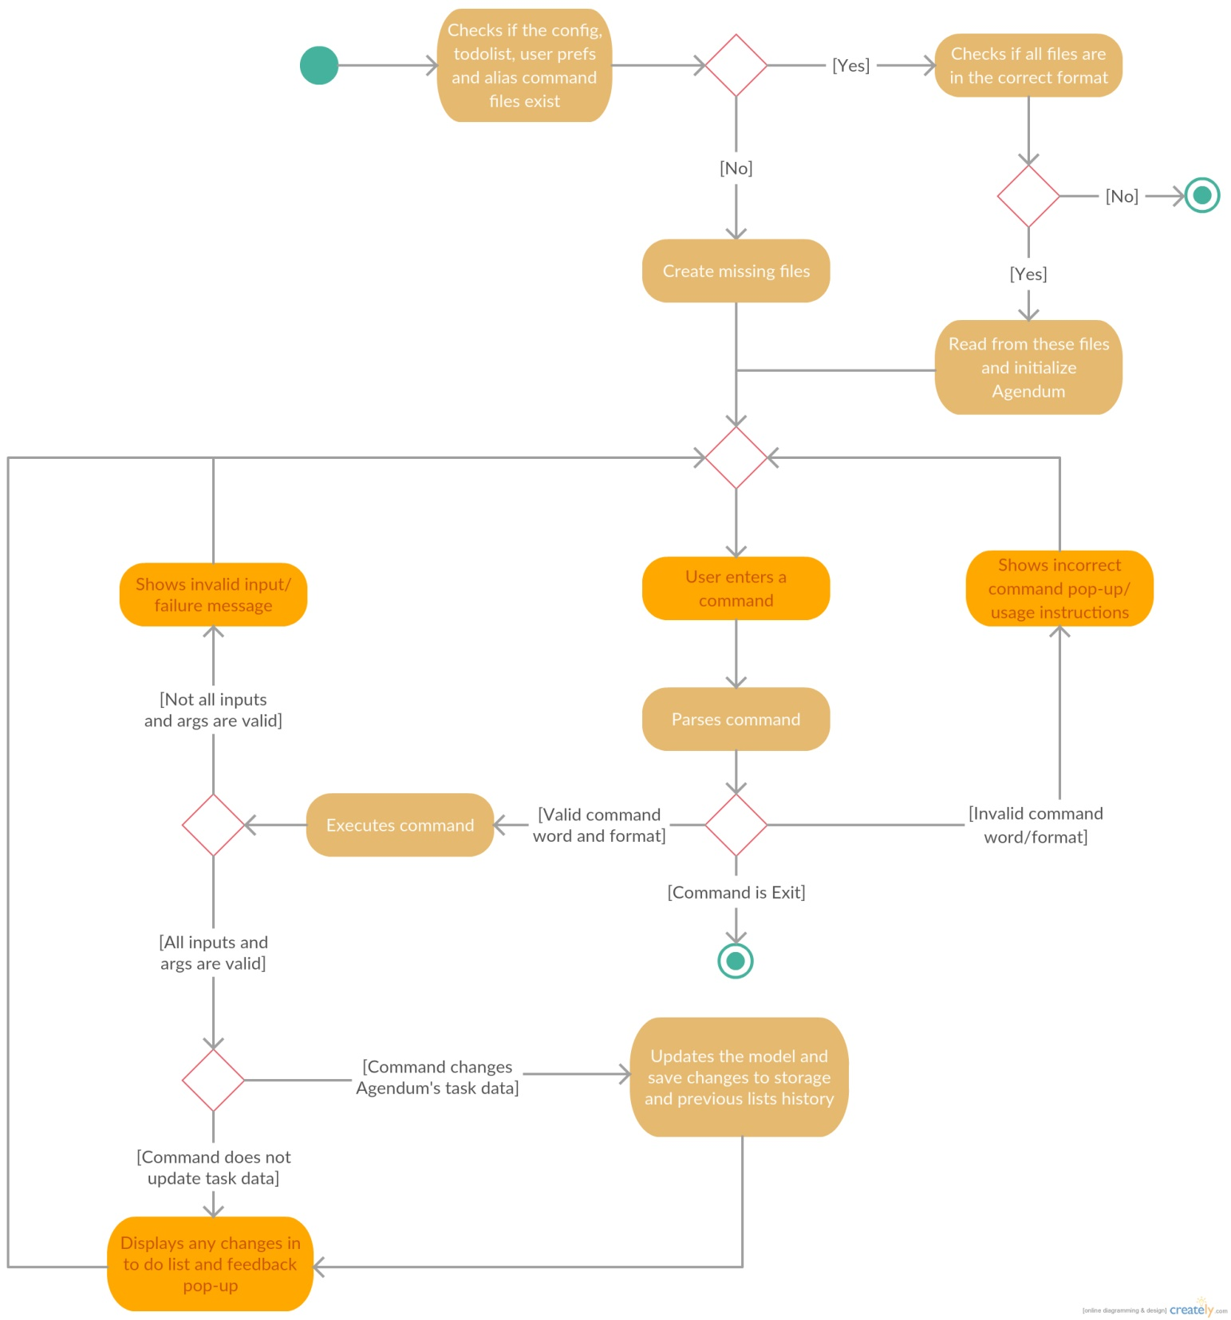

Slide 11
: MainApp
: StorageManager
: Config
: AliasTable Storage
: JsonUserPrefs Storage
: XmlToDoList
Storage

