Slide 1
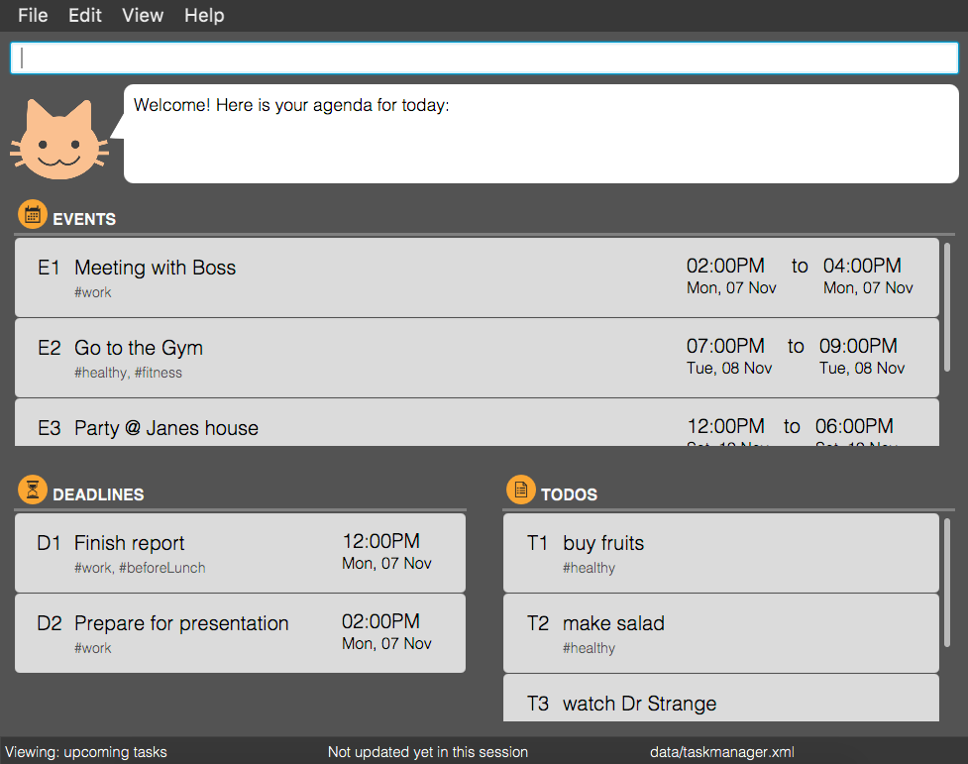
1. Command Box
2. Feedback
3. Events List
4. Deadlines List
5. Todos List
6. Current View
7. Current Path

Slide 3
Having any Java 8 version is not enough
TasKitty will not work with earlier versions of Java 8
While typing commands, I will be there to guide you
Before we move on, do take note that:
Items in <angle brackets> are parameters
Items in [square brackets] are optional
Items with … after them can have multiple instances
Tasks are split into 3 categories:
Todo: tasks without specific date and time
Deadline: task with specific end date and time
Event: task with specific start and end date and time

Slide 4
Tip! You can enter tasks in a range too!
Eg. t1-3
Tip! You can enter view or find command before edit command to narrow down the displayed list!
<index> is the index of the task shown in the most recent listing, including the prefix t for todo, d for deadline or e for event. Eg. t2, d1, e4
Tasks that partly or completely match the keywords entered will be displayed. You can also find tags using #!

Slide 5
Tasks that are marked as done will be shown in reversed order base on their <datetime>!
You are only able to undo/redo commands that change data in TasKitty. Eg. add, delete, done, etc.
If you undo and enter a valid undoable command, you can no longer redo. Please becareful!

