Slide 1
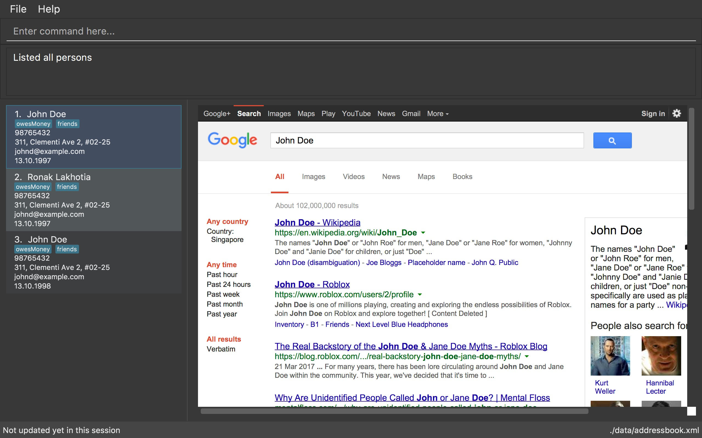
WELCOME TO WEAVER,YOUR PERSONALISED ADDRESSBOOK

