Slide 1
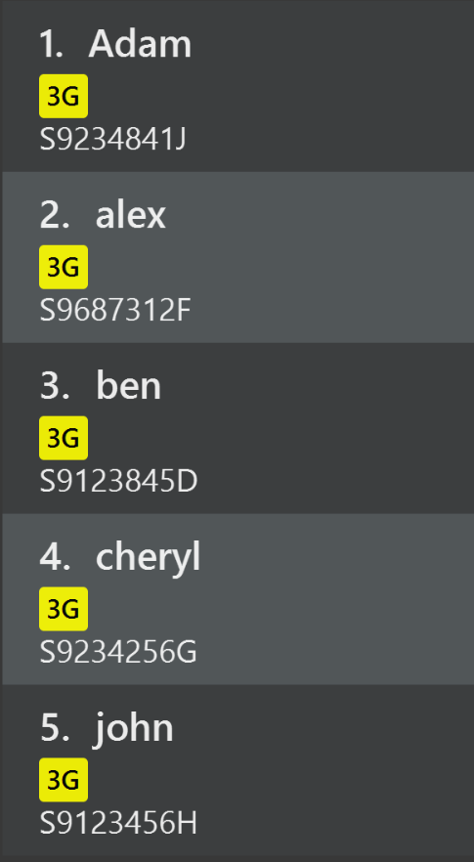

Before
After
tagreplace t/3G t/4G

