Slide 1
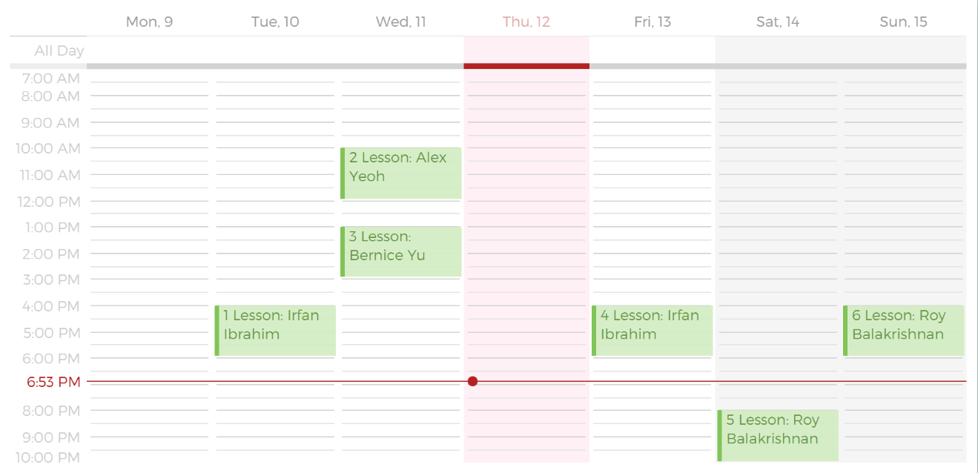
This is a Lesson in your Schedule
This is the Lesson Display Index
This is the Student you are having the Lesson with

