Slide 1
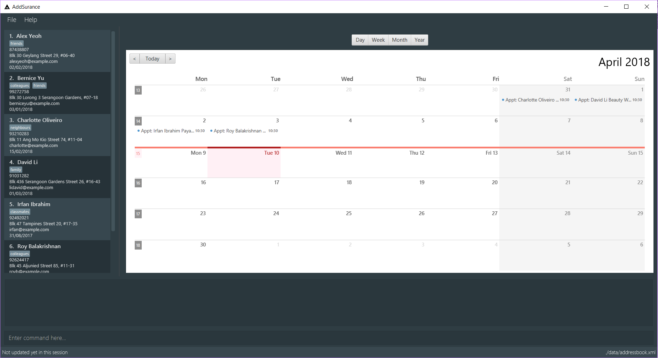
Help Tab
Click on this tab to display the help screeen
Calendar Page Switcher
Controls which view to show
File Tab
Click on this tab and select “Exit” to quit
Person List Panel
Displays contacts in the address book
Calendar Panel
Displays appointments in the address book
Result Display
Results of executed commands are displayed here
Command Box
Type in your command here
Status Bar
Shows updates and changes in the address book

