Slide 1
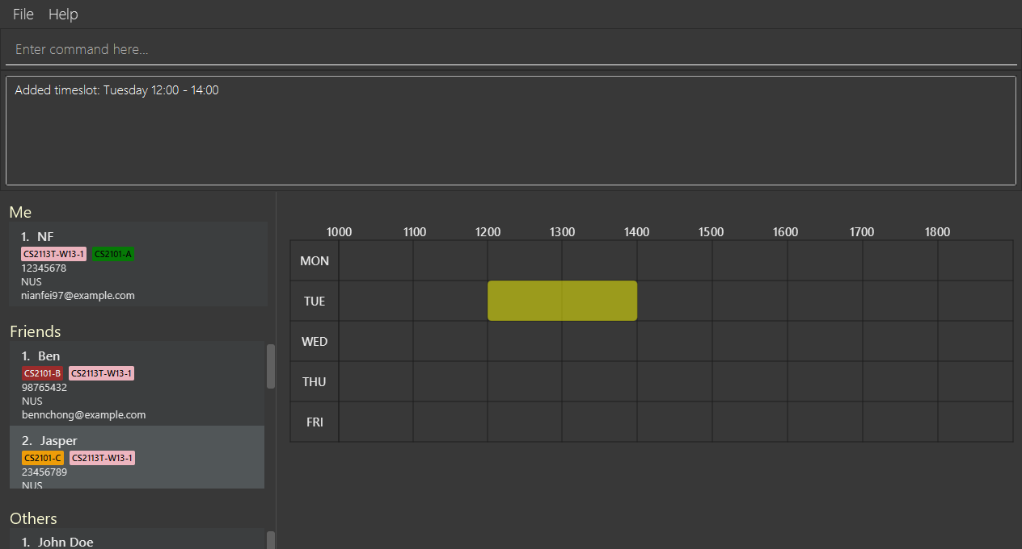
Success Message
Added timeslot

