Slide 1
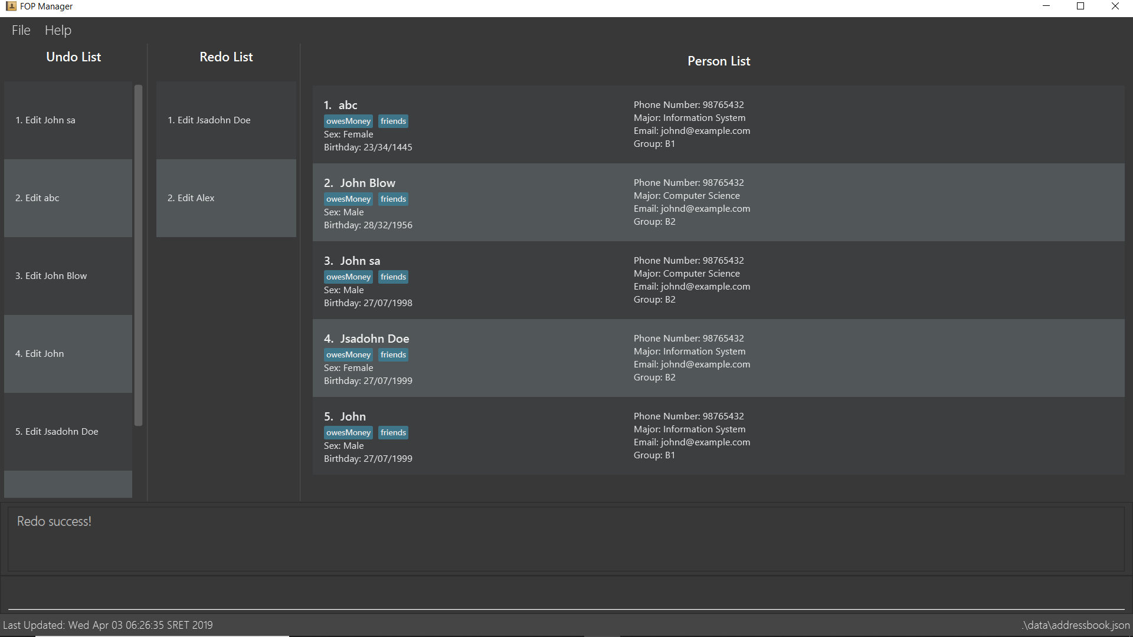
Undo/Redo list

