Slide 1
Restorable Logical topology using cross-layer optimization
Levi Yakir and Shmila Eliran

Slide 2
Background
Modern communication networks consist of a logical topology overlaid on an optical physical infrastructure.
Distinguishing between the logical and physical networks is crucial for flexibility and efficiency.
However, this distinction gives rise to important cross-layer optimization issues, such as how to guarantee smooth restoration of traffic following a failure in the physical network

Slide 3
Background
The paper: “Restorable Logical Topology in the Face of No or Partial Traffic Demand Knowledge” by Prof. Reuven Cohen and Prof.Gabi Nakibly aims to give a solution for the issue
The construction of the logical network is composed of 2 main tasks:
Link selection
Link routing
The algorithm is called ‘MM_SRLG’

Slide 4
Objectives
This Project has 3 primary goals:
1. Implementing the MM_SRLG algorithm
2. Set up a network environment, which uses a given
algorithm for the routing between its nodes
3. Build a testing infrastructure and compare the
algorithm performance against another known algorithm

Slide 5
Implementation - MM_SRLG
As described in the Paper, we implemented the algorithm in 3 steps:
Implementing MM_SRLG_cycle
Implementing MM_SRLG_arb
Uses reduction from ALG
Linear integral programming
Implementing MM_SRLG, by executing ‘cycle’ to get minimum resilience, and then ‘arb’ to use all the available lightpaths, while minimizing maximum SRLG

Slide 6
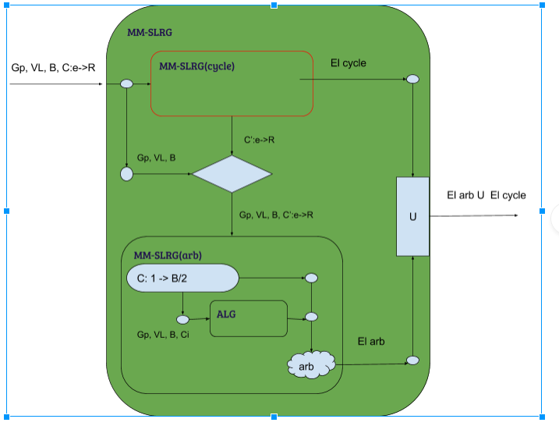
Implementation - MM_SRLG

Slide 7
Implementation - Modules & Testings
OpticalNetwork: this module representing the physical network, as well as the logical network above it.
Offers interface for routing algorithms such MM_SRLG and DisjointPaths.
Highly integrated with MN env and remote controllers: setting routing paths after network initialized, and reset them in case of link failure
Communicate with controller on another thread via serialization

Slide 8
Implementation - Modules & Testings
OpticalNetwork: this module representing the physical network, as well as the logical network above it.
After executing algorithm and retreiving logical paths - it builds routing paths between every pair of logical nodes
Basically uses lightest paths (variant)

Slide 9
Implementation - Modules & Testings
Algorithm Dry Tests: we built generic infrastructure for testing routing algorithm dry performance, and statistics calculation: number of routing paths after link removal and some approximation formula for expected BW.
We Use those tests as indication for the ‘Wet Tests’
Common interface for simply creating a custom graph - which will be loaded both to the remote controller and MN topology.

Slide 10
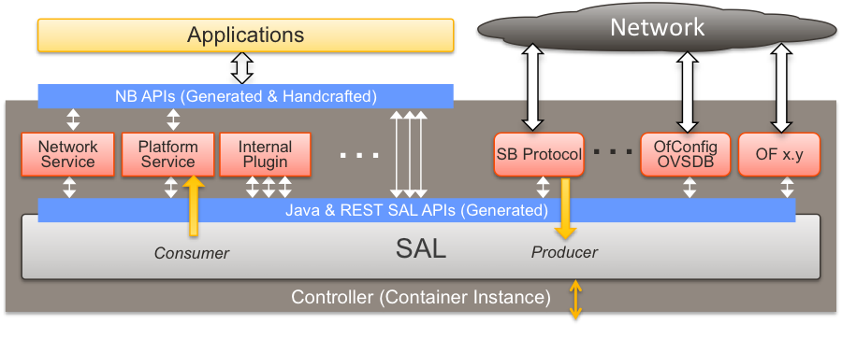
Setting up environment: Mininet Overview

Slide 11
Setting up environment: Mininet Overview
For the performance testings, we used the Mininet virtual environment
A virtual network
Implements SDN methodology: separate logics from routing devices
Offer communication with remote controllers, such POX and RYU, via OpenFlow protocol.
Ovs-ofctl tool
ovswitch

Slide 12
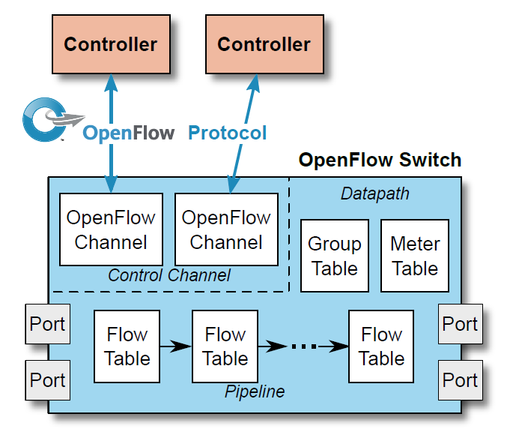
Setting up environment: Mininet Overview

Slide 13
Setting up environment: Achievements
We took RYU as the base controller, and built a routing application which set MN switches with the appropriate forwarding according to the output of the routing algorithm.
The application sync between the running OpticalNetwork and the MN topo.
In case of a failure, the controller queries the OpticalNetwork for alternative path.

Slide 14
Testings - Infrastructure:
Highly automated system for debugging, testing, generating results summary, statistics and dump logs.
Random grid graph generator, using a given seed, for simple test reproduction.
Processes communication which enables easily running testing tools on the currently working MN from different shells

Slide 15
Testings - Modes:
Dry testing
Regression: a comprehensive testing bundle, iterate over given scenarios, run MN, execute perf tests, collect results and show summary:
Different graphs
Different routing algorithms
Different link failures
Interactive: open MN env, execute MN CLI, and run manually perftests (in another shells)

Slide 16
Architecture
- inter process communication
- controller retrieve topo and recovery info
Custom Graph File or Grid Generator
OpticalNetwork
Controller
MNCore
Set up all env
Dump data (OF tables, ARP)
Monitoring
More features
Produce logical Network
Regression
For every link: fail and run All2All perf test
Produce stats and graphs
Routing Algorithm
-convert OptNet to MN topo
- setup links speed
-etc
For every link: fail and run All2All perf test
Dry Tests
For every link: fail and run check remain routes
Produce stats
Mininet
All2All perf test

Slide 17
Architecture
Routing Algorithm
Run once: get logical paths
Physical Topology
OpticalNetwork
Initialization: get initial routing paths.
When recovery is required: reset routing paths.
Controller

Slide 18
Inspecting Algorithm Performance:
We designed and built a competitor algorithm for comparing the MM_SRLG algorithm’s performance.
The Objectives:
Maximum resilience: in the average case, after a link failure, we want to see maximum connectivity
While keeping BW as high as possible
Limitation: given budget of B lightpaths to route between logical nodes

Slide 19
Inspecting Algorithm Performance:
Competitor: a smart variant of DisjointPaths algorithm.
For every logical_pair:
Find shortest path
Decrease path capacity by 1
Remove path’s edges
If stuck with unconnected pair -> add back all edges and try again. If still stuck -> move to next pair
Optimization: iterate by shortest path’s length

Slide 20
Inspecting Algorithm Performance:
The result: Pretty good algorithm :)
We found cases for the favor of both algorithms
BUT: the recovery process is actually not defined for any of them, we use the same routine, but it can be optimized .

Slide 21
Inspecting Algorithm Performance:
2nd competitor added!
A variation on MM_SRLG: we modified MM_SRLG_cycle to produce a logical cycle which sits on a physical ‘cycle’, rather than a physical tree.

Slide 22
MM_SRLG_cycle variant: algo short desc
Run DFS on the complete graph
Visit only neighbors on unvisited edges (including visited vertices)
If no options left go back to ancestor
If initial node is reached , and all logical nodes already visited - close the cycle and done.
the algorithm reserves the following:
Max SRLG lower or equal 2
Every logical node appears only once in the logical cycle (but not necessarily in the physical path)

Slide 23
Results - 3 competitors

Slide 24
1st Example: Network Topology
5
6
Logical node
B = 8
4
Non Logical node
13
14
1
3
10
4
15
16
2
12
4
11
9
10
4
7
8

Slide 25
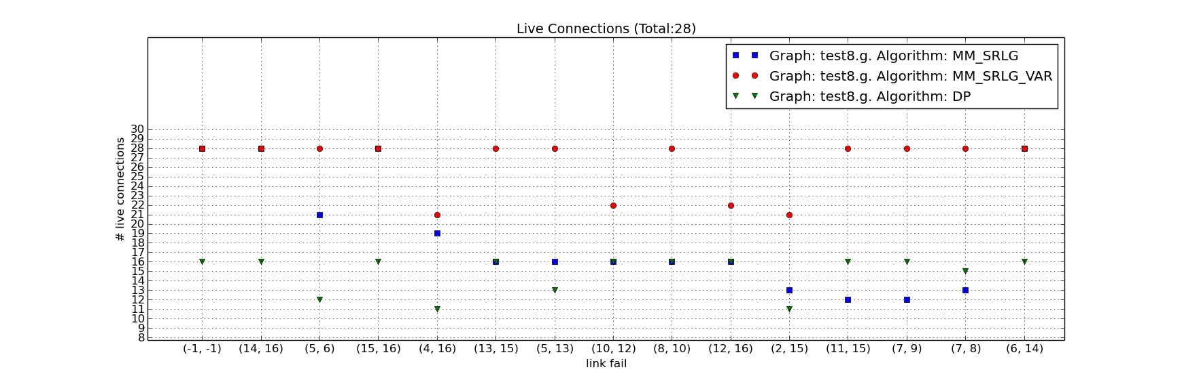
1st Example: Live Connections

Slide 26
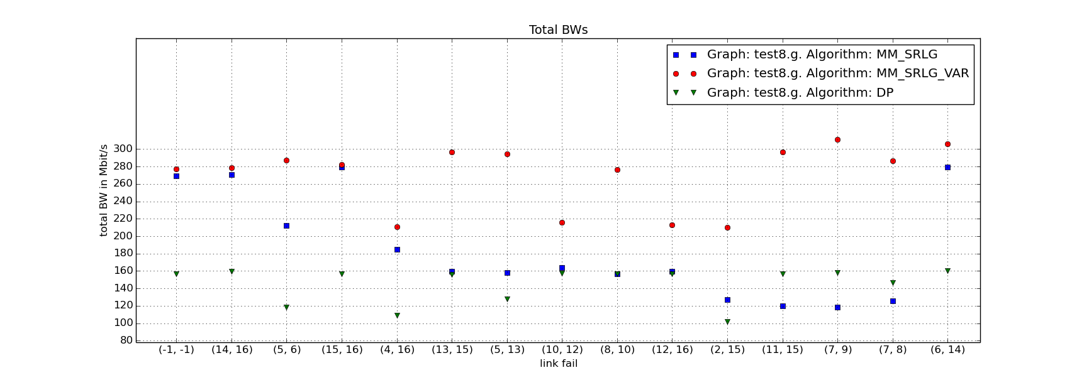
1st Example: Total BW

Slide 27
More Issues
Routing paths effect, given logical paths
Num connections / BW miss correlation
5
4
3
2
1
1
2
10
5
5
8
7
6
5
4
3

Slide 28
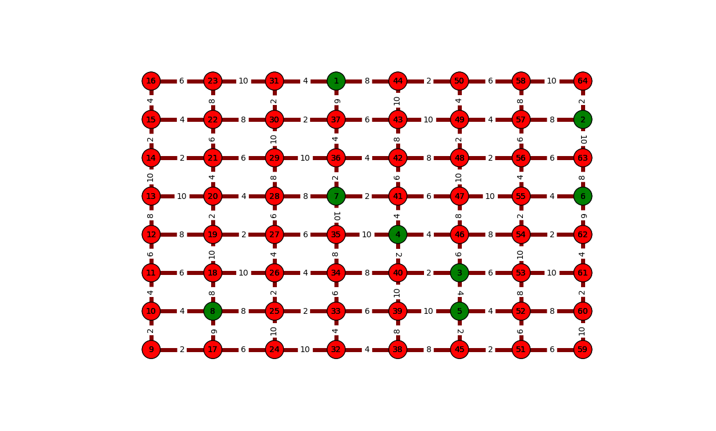
2nd Example: Network Topology
B = 12

Slide 29
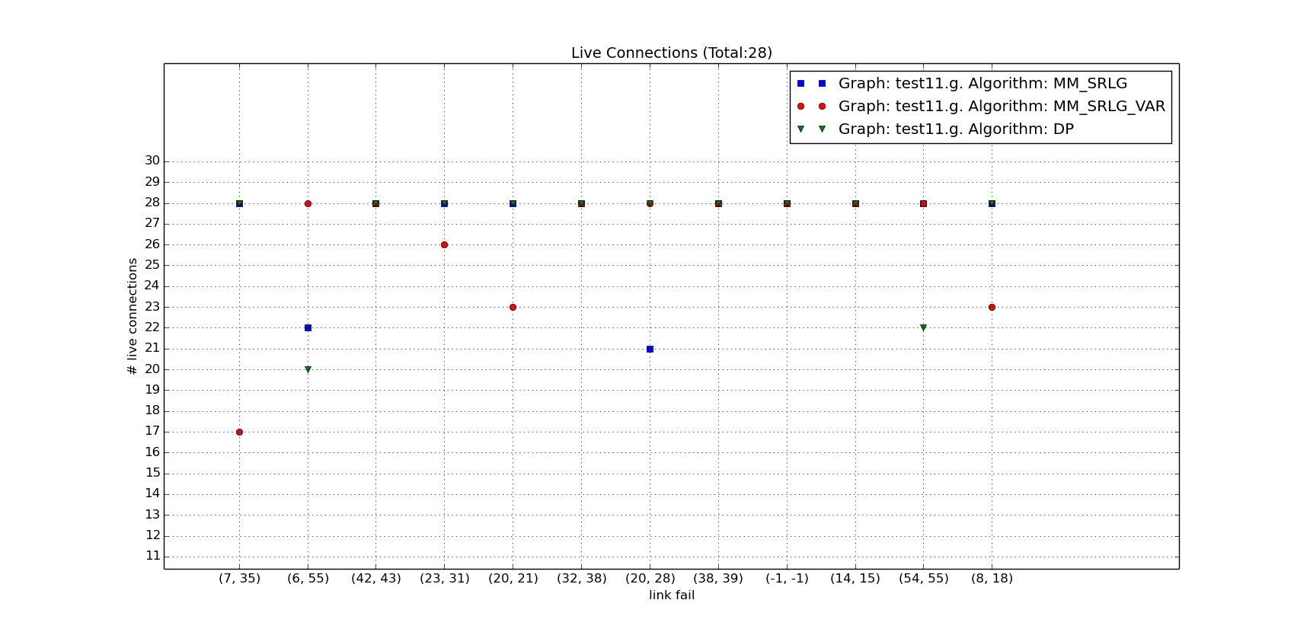
2nd Example: Live Connections

Slide 30
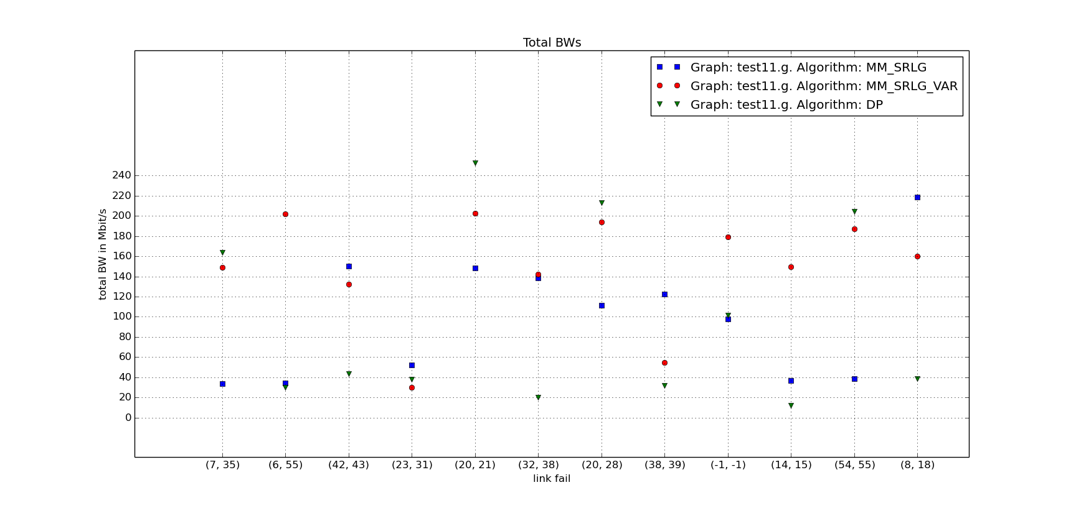
2nd Example: Total BW

Slide 31
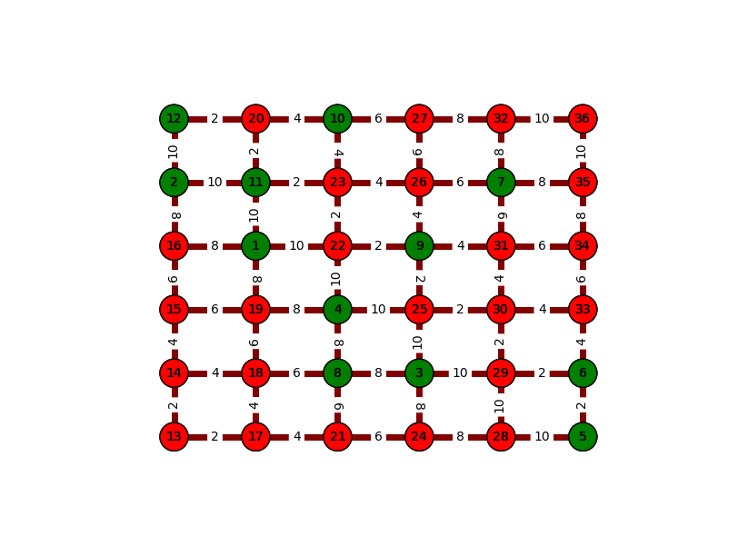
3rd Example: Network Topology
B = 20

Slide 32
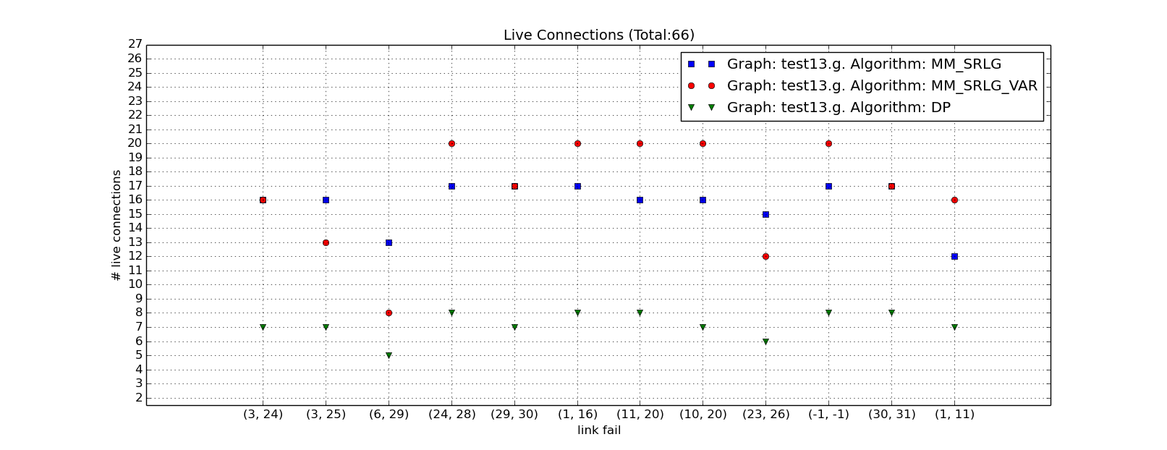
3rd Example: Live Connections

Slide 33
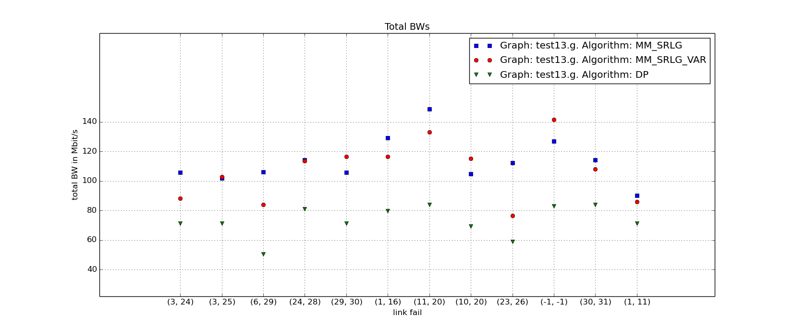
3rd Example: Total BW

Slide 34
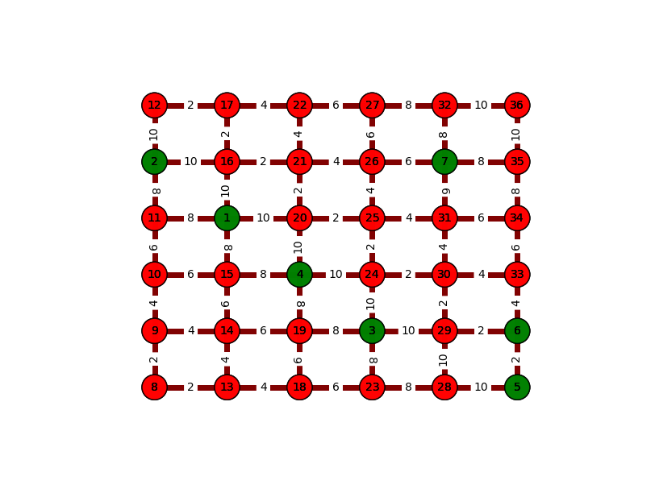
4th Example: Network Topology
B = 7

Slide 35
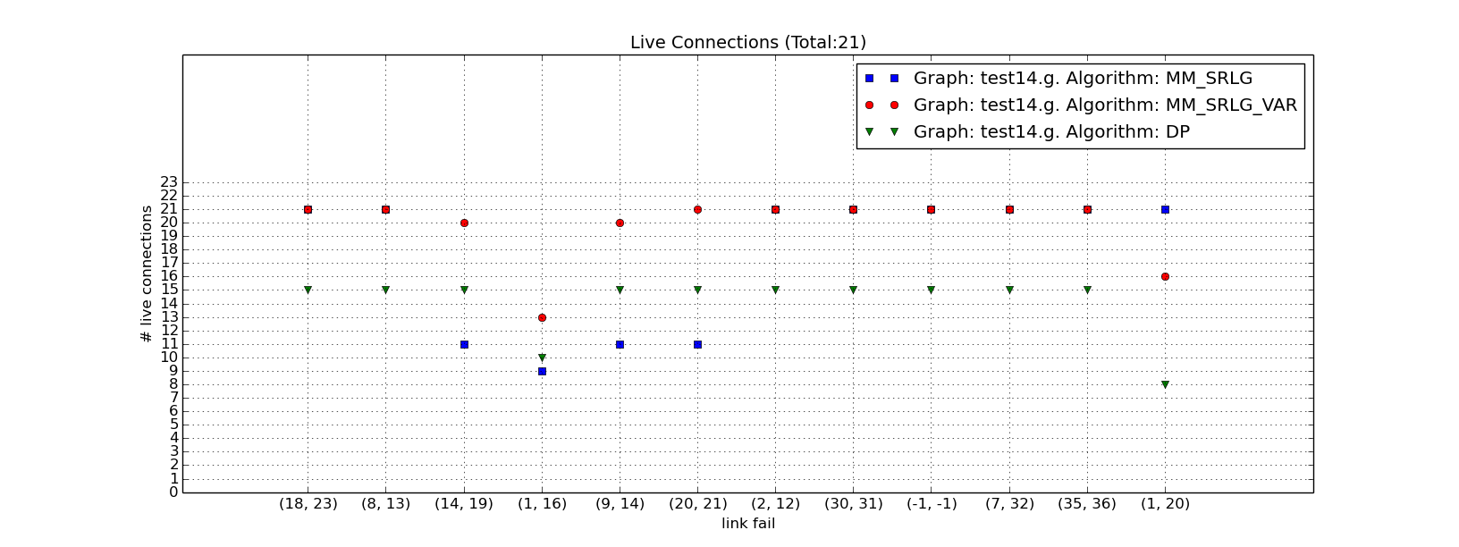
4th Example: Live Connections

Slide 36
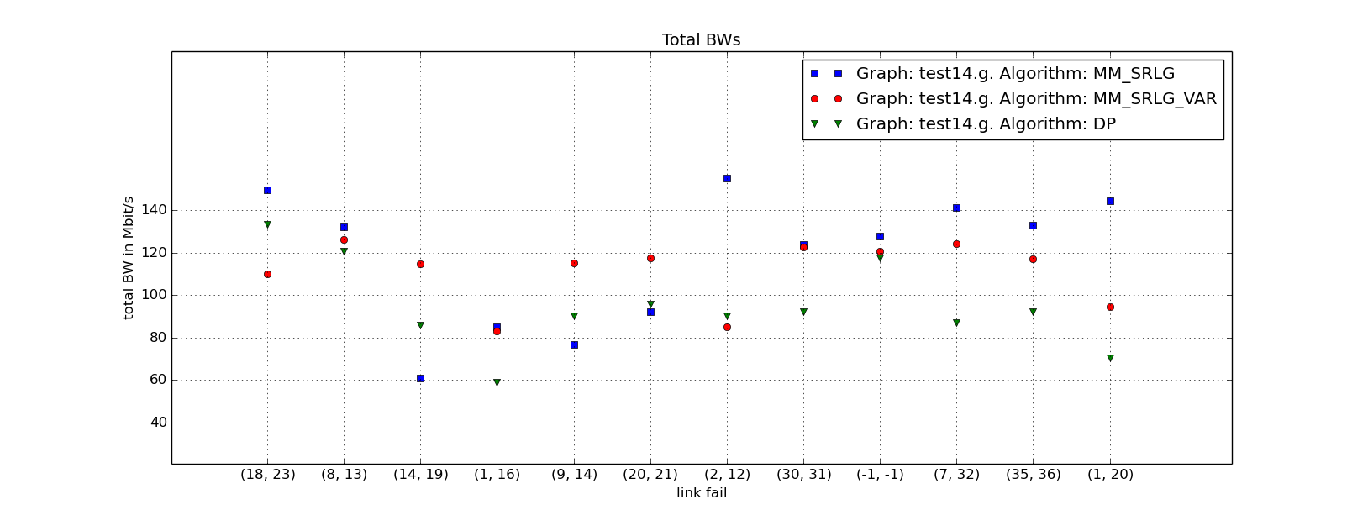
4th Example: Total BW

Slide 37
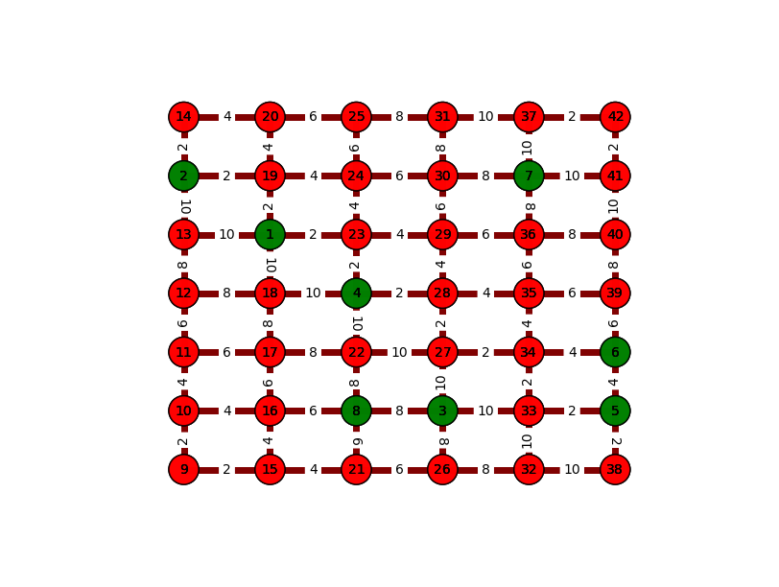
5th Example: Network Topology
B = 13

Slide 38
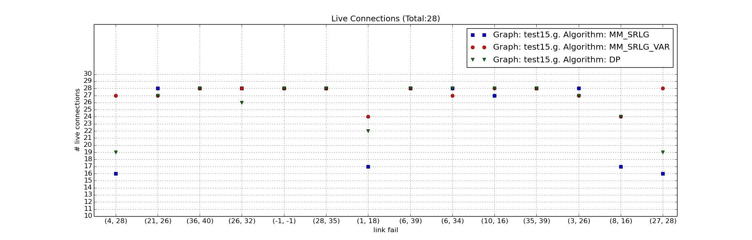
5th Example: Live Connections

Slide 39
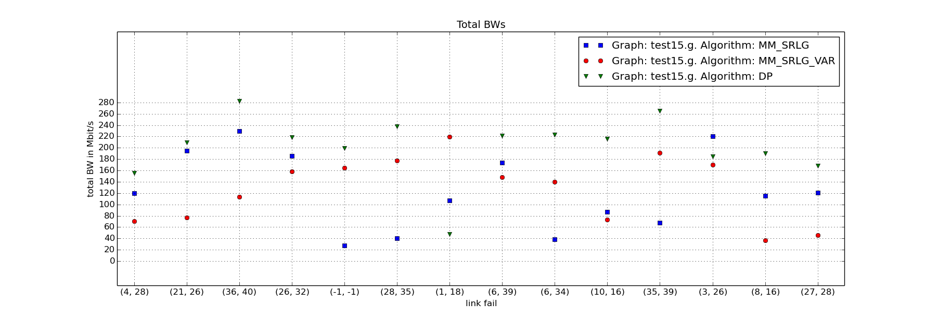
5th Example: Total BW

Slide 40
Conclusions
According to examples 4 and 5, we see that for small budget DP shows worse results, which gets better as budget increasing, as we expected (DP does not promise full baseline connectivity)

Slide 41
Results - MM_SRLG Only

Slide 42
1st Example: Network Topology
5
6
Logical node
B = 8
4
Non Logical node
13
14
1
3
10
4
15
16
2
12
4
11
9
10
4
7
8

Slide 43
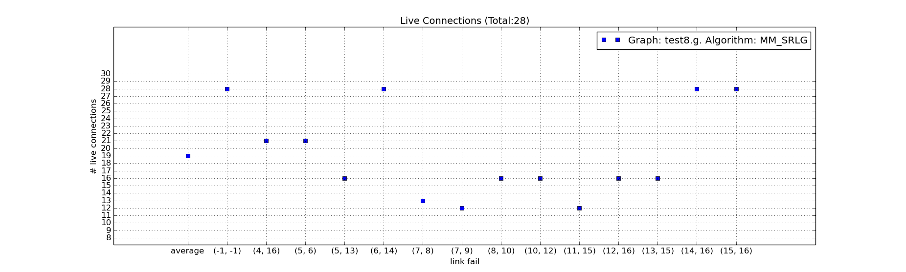
1st Example: live connections

Slide 44
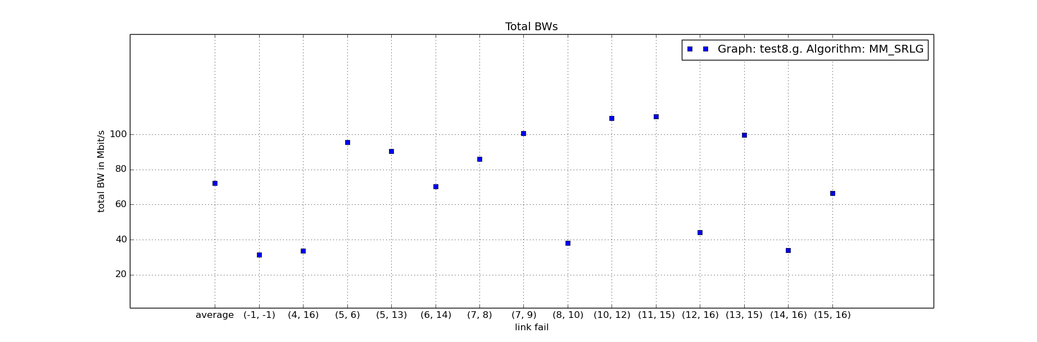
1st Example: Total BW

Slide 45
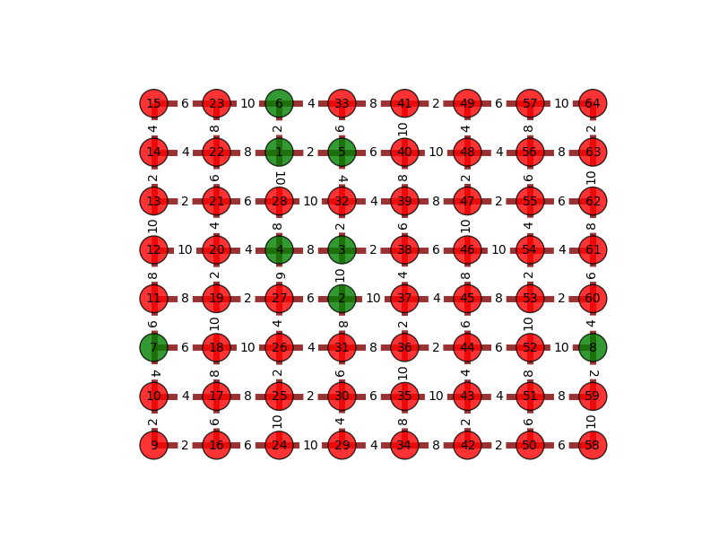
2nd Example: Network Topology
B = 12

Slide 46
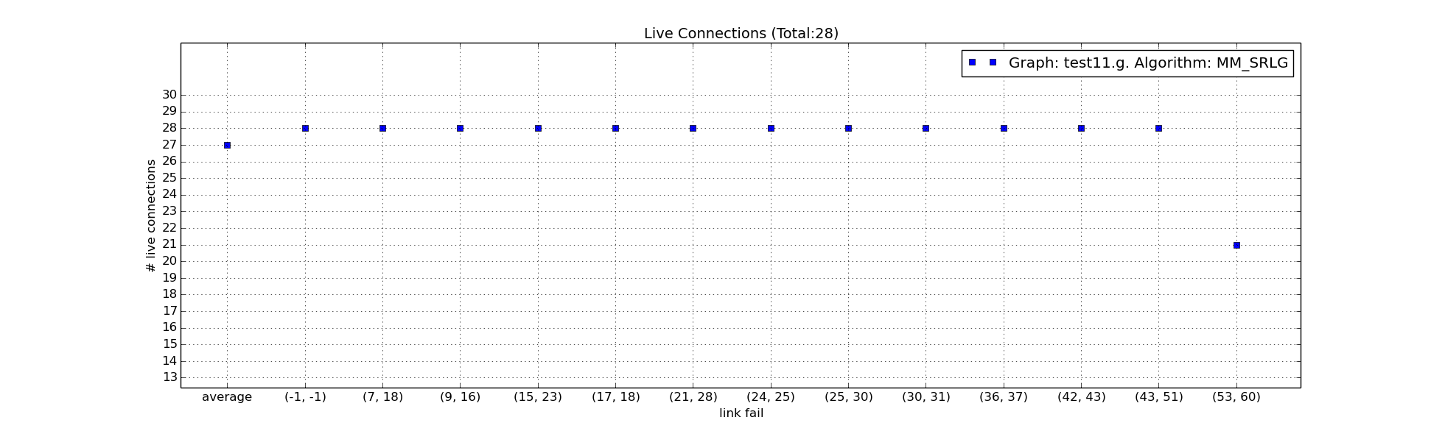
2nd Example: Live Connections

Slide 47
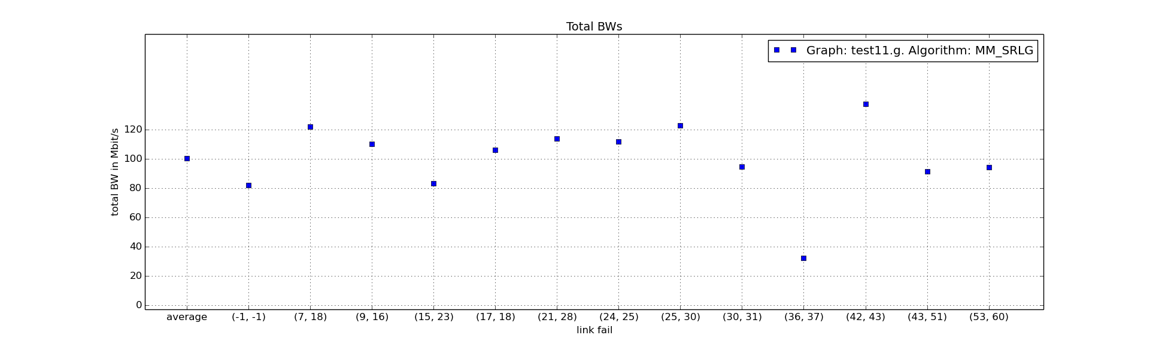
2nd Example: Total BW

Slide 48
3rd Example: Network Topology
B = 7

Slide 49
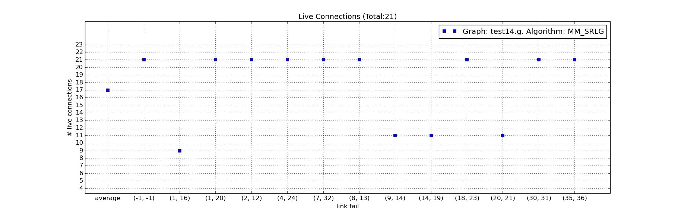
3rd Example: Live Connections

Slide 50
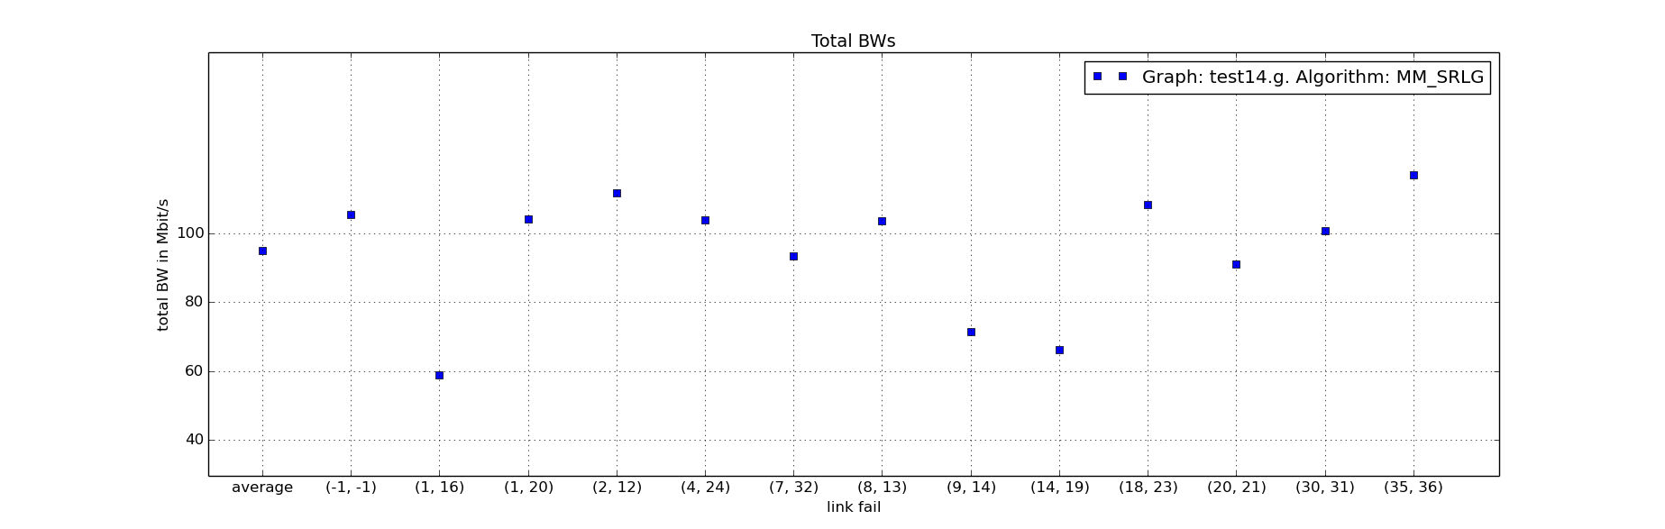
3rd Example: Total BW

Slide 51
4th Example: Network Topology
B = 13

Slide 52
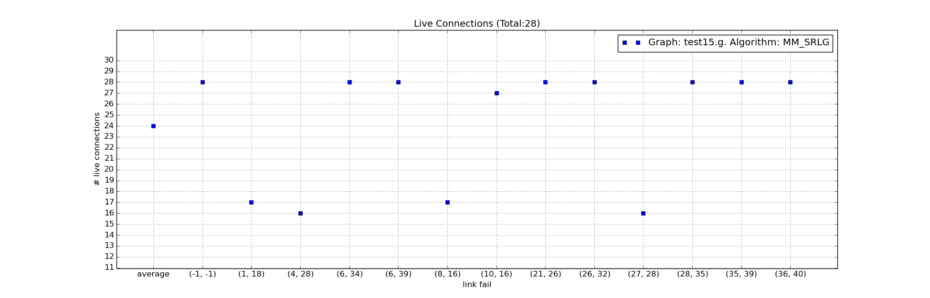
4th Example: Live Connections

Slide 53
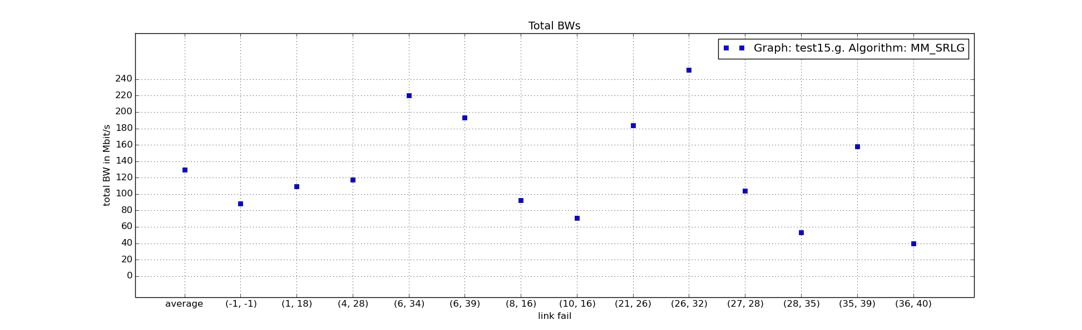
4th Example: Total BW

Slide 54
Achievements : the code...
OpticalNetwork Git repo: https://github.com/gitprof/optical_network
RYU forked branch:
https://github.com/gitprof/ryu
Also: MN bug fix, and new features that can be added, s.t iperf regression, custom topo creation, monitoring, all in one tool.

