Slide 1

BGP hijacking
Roey Maor and Michal Cohen

Slide 2
Introduction
experiment with VIRL to simulate real life BGP attacks, study these attacks and reach general conclusions regarding them
What was the radius of influence?
In what manner did the ISP cooperated with the attacker?
How long did it take the attack to propagate?
In which situations such attack is impossible?
Is it easy to track the origin of the attack (Is it even possible)?
In which scenarios such attack is relatively easy?

Slide 3
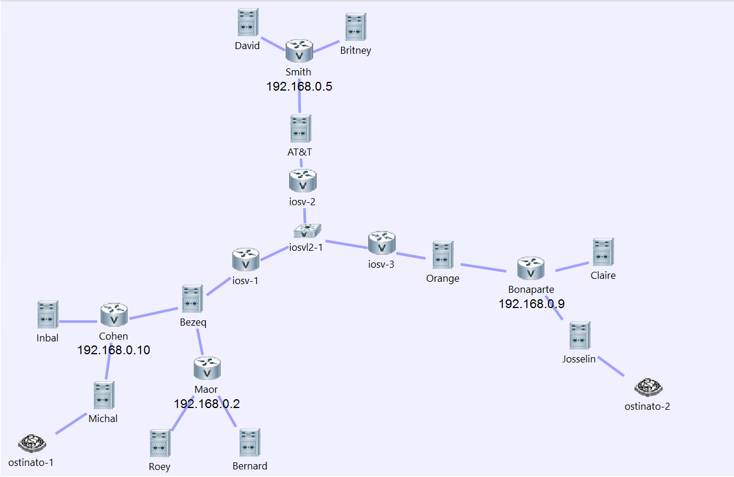
Architecture
routem
switch
server
ostinato
router

Slide 4
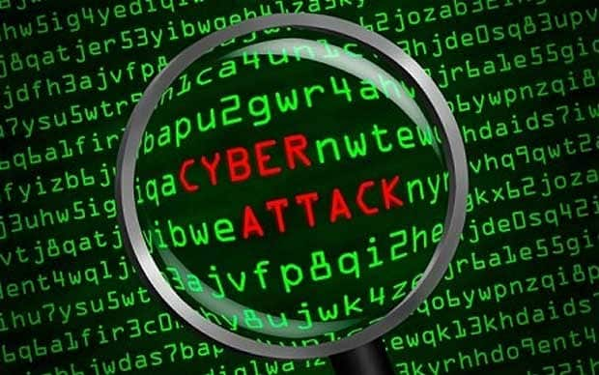

Project planning
Simulating various simple BGP usage scenarios.
Simulating a real life “Black whole” attack.
Investigating different scenarios of the attack.
Simulating a simple BGP “MITM” attack.

