Slide 1



WORKING WITH WEB/MOBILE AUTHORING TOOLS
cinecraftz.com
By
Sudharsan A
Arsath Noordeen A
Rahul V
Kannan S P
Absal

Slide 2


TOOL USED – KOMPOZER
  A WYSIWYG HTML editor for designing web pages without deep coding.
  Allows drag-and-drop layout creation, text editing, and image placement.
  Supports CSS styling and multiple page linking.

Slide 3
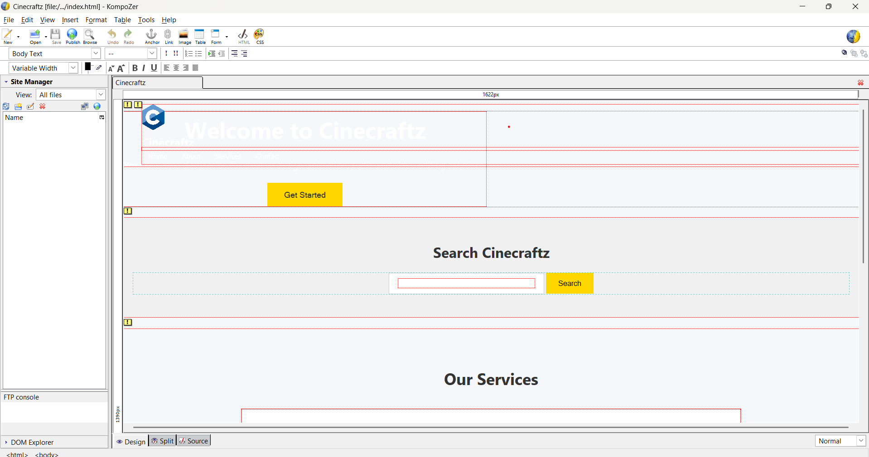

Slide 4

WHAT WE DID IN KOMPOZER
  Created 4 main pages: Home, About, Services, Contact
  Added images, banners, buttons, and forms
  Designed responsive layout for desktop and mobile
  Implemented navigation menus and hyperlinks between pages

Slide 5
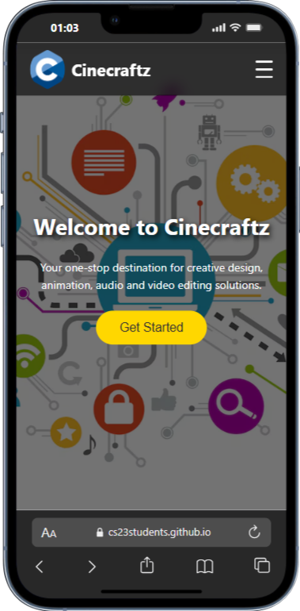
ABOUT PROJECT
  A creative website offering Web Design, Animation, Audio & Video Editing services
  Engaging Home page with hero banner & search bar
  About Us page with team showcase
  Services page highlighting detailed service cards
  Contact page with form for user messages

Slide 6

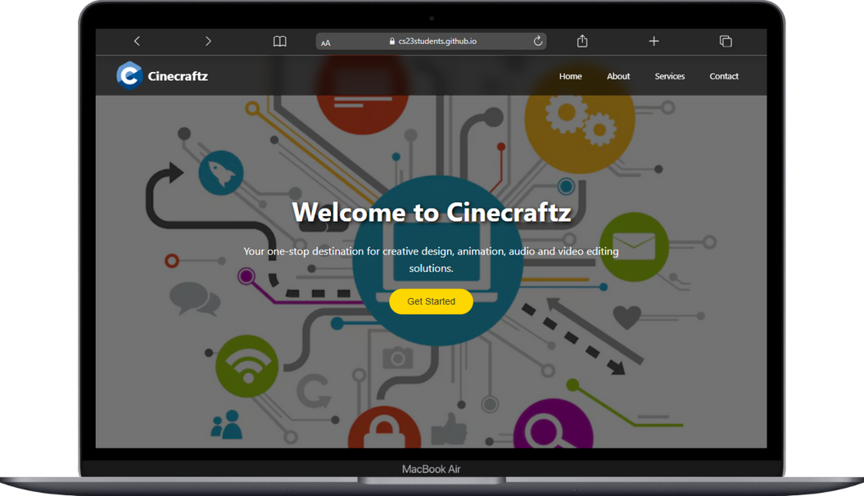
FEATURES
  Fully designed in KompoZer using WYSIWYG interface
  Responsive design for all devices
  User-friendly navigation with links & buttons
  Attractive UI with banners, cards, and team section

Slide 7
THANK YOU

