Slide 1
AI Assignment 3: Game Playing
Algorithms
Minimax
αβ-pruning
Environment used - Chess
CS24M101 - A Sai Jagadeesh
CS24M111 - G Kavyasri

Slide 2
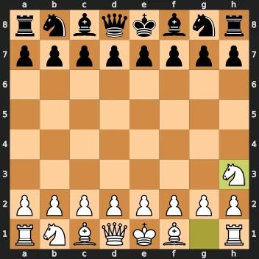
Minimax
Winner: White (Agent)
Total moves: 75
Nodes evaluated: 813339

Slide 3
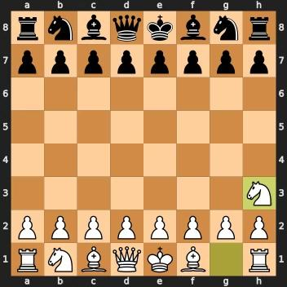
αβ-pruning
Winner: White (Agent)
Total moves:81
Nodes evaluated: 154270

Slide 4
Evaluation Function
Material Heuristic:
Pawn = 1 | Knight = 3 | Bishop = 3
Rook = 5 | Queen = 9 | King = 0
Game-Over Overrides:
Checkmate: +9999 if you deliver mate; –9999 if you are mated
Draw/Stalemate/Insufficient Material: 0
Color Sign:
Sum +value for your pieces, –value for opponent’s
Positive → agent ahead; Negative → opponent ahead
Overall Score: > 0 → White (if agent=White) ahead = 0 → Equal < 0 → Black ahead

Slide 5
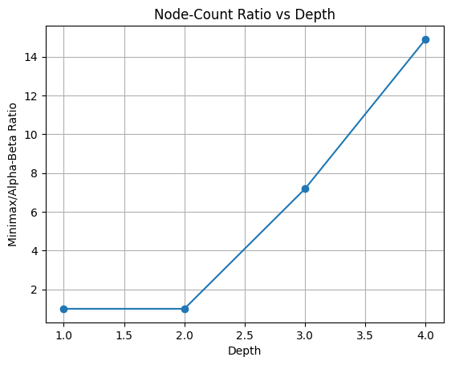
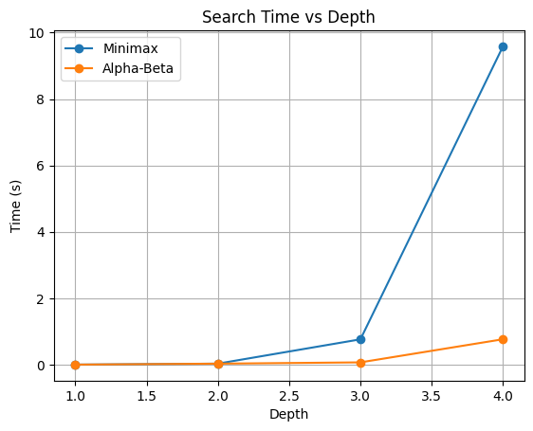
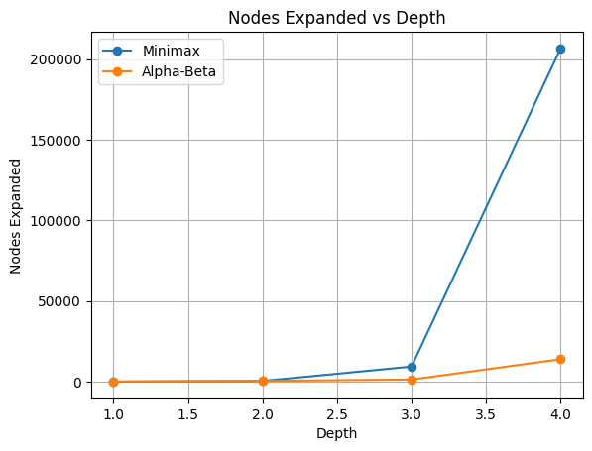
PLOTS

Slide 6
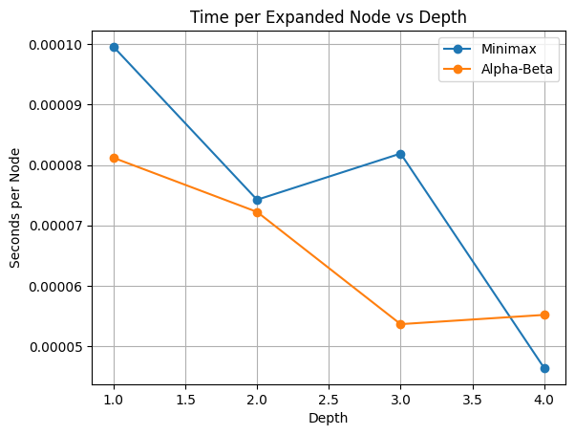
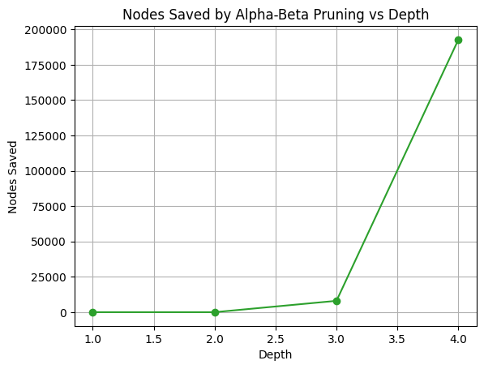
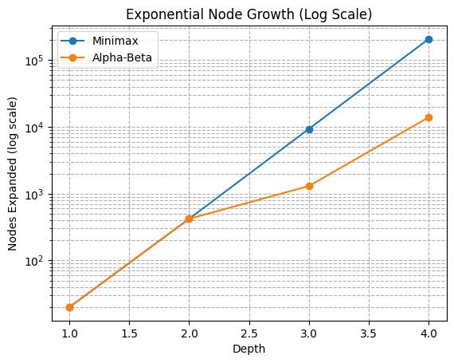
PLOTS
Saved(d)=nodes_mm(d)−nodes_ab(d)

Slide 7
Evaluation Function:
Material count: Pawn = 1, Knight/Bishop = 3, Rook = 5, Queen = 9
Checkmate: ±9999, Draw = 0
Pruning Efficiency & Explanation
Minimax visits every node → exponential growth in both time and node-count as depth ↑
Alpha-Beta prunes entire subtrees that cannot improve the evaluation → far fewer nodes, much faster searches
Why These Results?
Time plot: Alpha-Beta runs much faster as depth grows because pruning cuts entire subtrees, whereas Minimax visits every node.
Node plot: At depth 4, Minimax might explore ∼O(b⁴) nodes, while Alpha-Beta often explores far fewer (best‐case ≈O(b²)).
Ratio plot: The increasing Minimax/Alpha-Beta ratio directly visualizes pruning efficiency.

