Slide 1
AI Assignment 3: Game Playing
Algorithms Implemented:
1. Minimax
2. αβ-pruning
Environment used - Chess
CS24M101 - A Sai Jagadeesh
CS24M111 - G Kavyasri

Slide 2
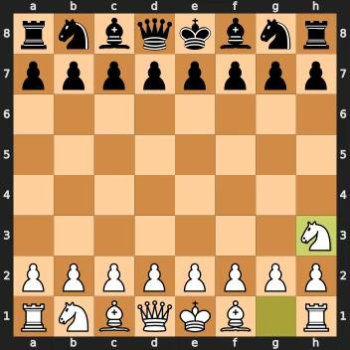
Minimax
Minimax
Exhaustively searches the game tree to a fixed depth, choosing the move that maximizes the worst-case outcome under optimal opponent play
Assumes both players play optimally: the maximizing player picks the move that maximizes the minimum score the opponent can force.
Guarantees an optimal choice at the root, at the cost of examining every node in the search tree.
Results of the Game:
Winner: White (Agent) wins by checkmate
Total moves: 75
Nodes evaluated: 813339

Slide 3
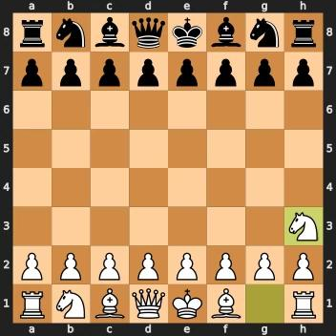
αβ-pruning
Alpha-Beta Pruning
Extends Minimax by carrying two bounds (α for the best-already-found max score, β for the best-already-found min score) to skip (“prune”) branches that cannot influence the final decision.
Whenever a move is proven worse than a previously examined alternative, its entire subtree is discarded.
Achieves identical results to Minimax with far fewer node evaluations, enabling deeper searches in the same time.
Results of the Game:
Winner: White (Agent) wins by checkmate
Total moves:81
Nodes evaluated: 154270

Slide 4
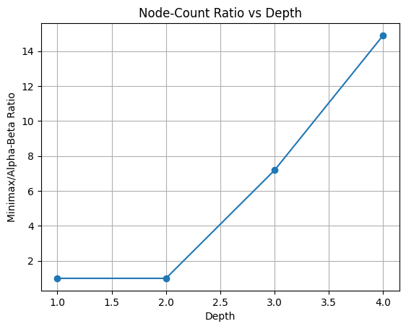
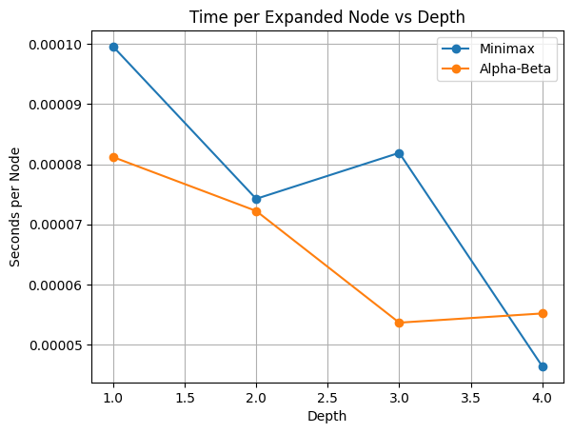
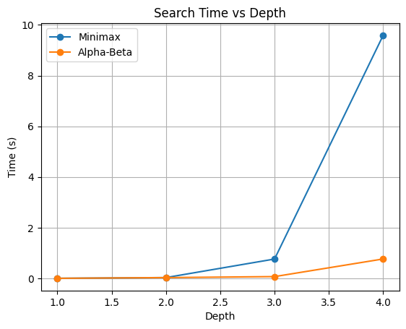
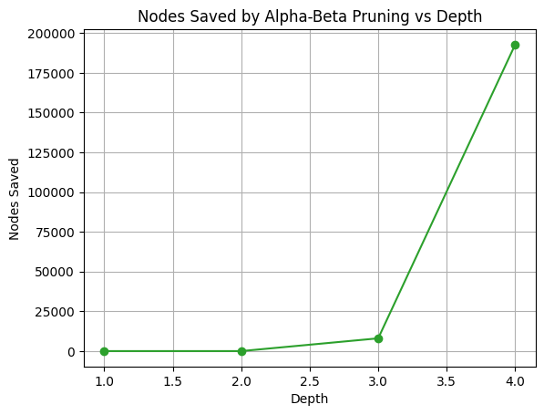
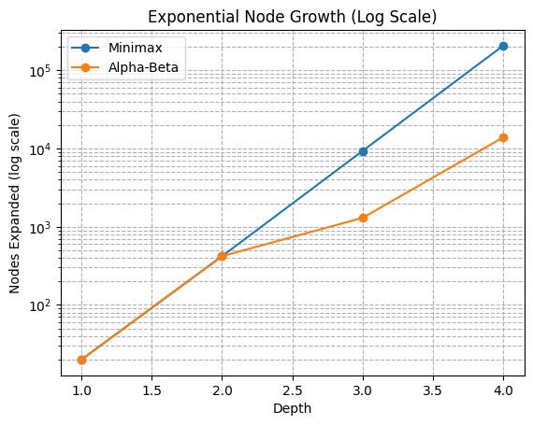
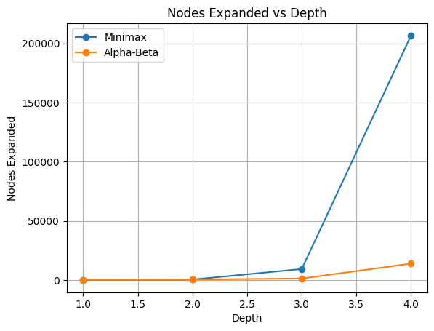
PLOTS
Saved(d)=nodes_mm(d)−nodes_ab(d); where d-depth

Slide 5
Results
Pruning Efficiency & Explanation
Minimax visits every node → exponential growth in both time and node-count as depth ↑
Alpha-Beta prunes entire subtrees that cannot improve the evaluation → far fewer nodes, much faster searches
Evaluation Function
Material Heuristic:
Pawn = 1 | Knight = 3 | Bishop = 3
Rook = 5 | Queen = 9 | King = 0
Game-Over Overrides:
Checkmate: +9999 if you deliver mate; –9999 if you are mated
Draw/Stalemate/Insufficient Material: 0
Why These Results?
Time plot: Alpha-Beta runs much faster as depth grows because pruning cuts entire subtrees, whereas Minimax visits every node.
Node plot: At depth 4, Minimax might explore ∼O(b⁴) nodes, while Alpha-Beta often explores far fewer (best‐case ≈O(b²)).
Ratio plot: The increasing Minimax/Alpha-Beta ratio directly visualizes pruning efficiency.
Color Sign:
Sum +value for your pieces, –value for opponent’s
Positive → agent ahead; Negative → opponent ahead
Overall Score: > 0 → White (if agent=White) ahead = 0 → Equal < 0 → Black ahead

