Slide 1
Trigonometry

Slide 2
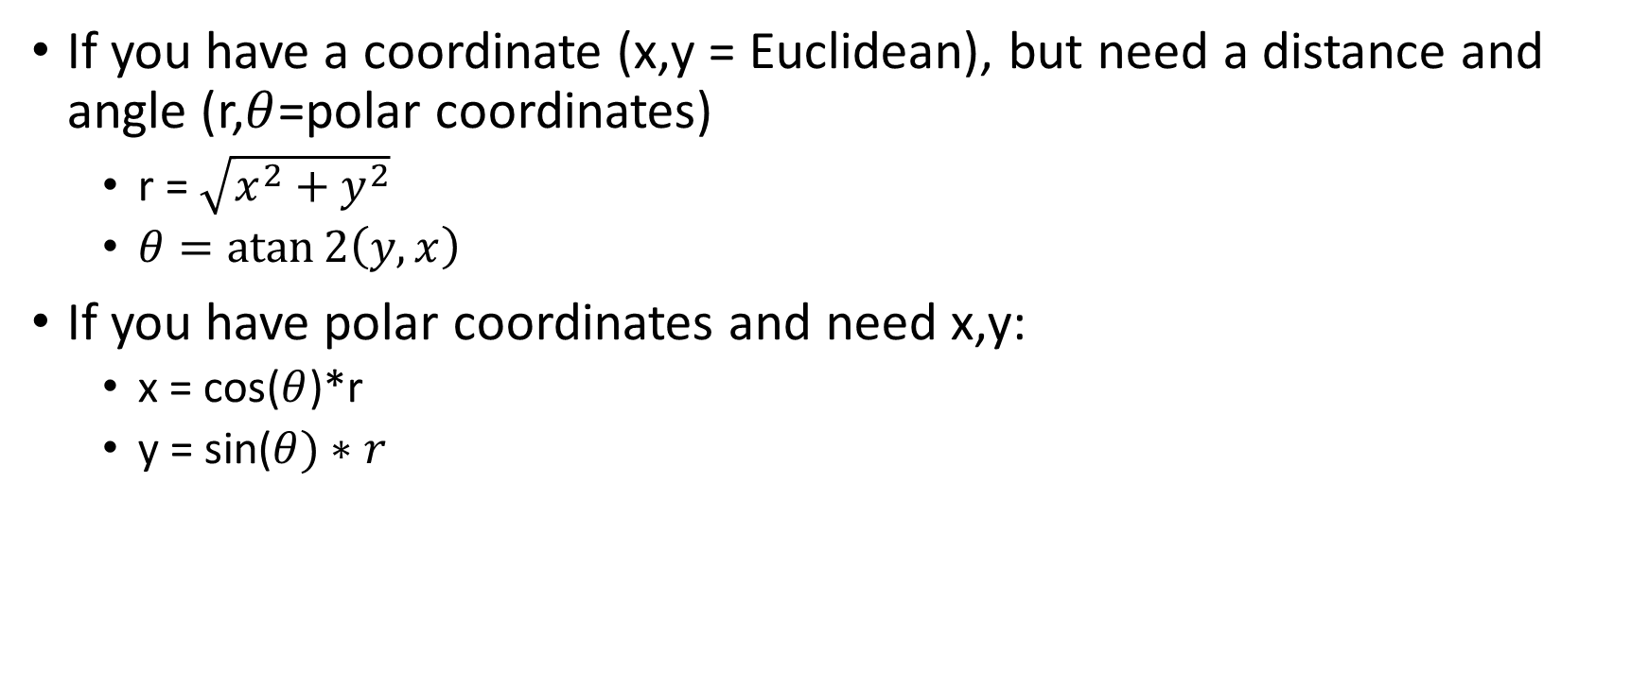
What you really need to know
If you have a coordinate (x,y = Euclidean), but need a distance and angle (r,$θ$=polar coordinates)
r = $\sqrt{x^{2}+y^{2}}$
$θ=\operatorname{atan}{2\left(y,x\right)}$
If you have polar coordinates and need x,y:
x = cos($θ$)*r
y = sin($θ)∗r$

Slide 3
Rotating on a Canvas

Slide 4




