Slide 1
CalvinFitness
Ethan Clark, Russell Clousing, Mark Davis, Matt Kotva, Mitch Stark

Slide 2
Vision
Android application that simplifies the process of planning, executing, and sharing a workout
Reduce use of paper and/or Excel charts
Allow workouts to be shared across application
Promote social accountability

Slide 3
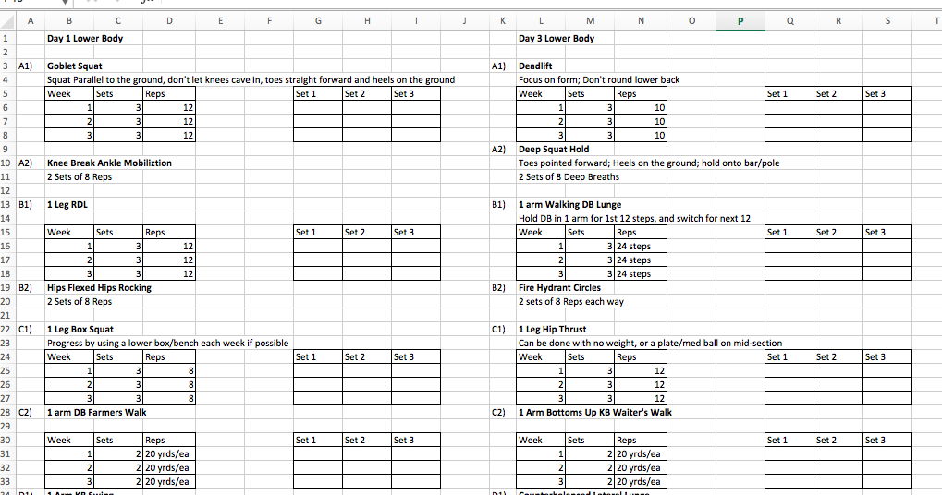
Current Baseball Workout

Slide 4
Demonstration

Slide 5
Design
Key User Stories
Database Schema
Usability Test Summary

Slide 6
Key User Stories
As a lifter, I want to personalize my workout to fit my needs and record my progress.
As a novice lifter, I want to be able to create and follow workouts.
As a lifter trying to improve, I want to be able to view past completed workouts.
As an athlete during on and off season, I want to be able to receive workouts from my coaches and for them to see my progress.

Slide 7
Design
Key User Stories
Database Schema
Usability Test Summary

Slide 8
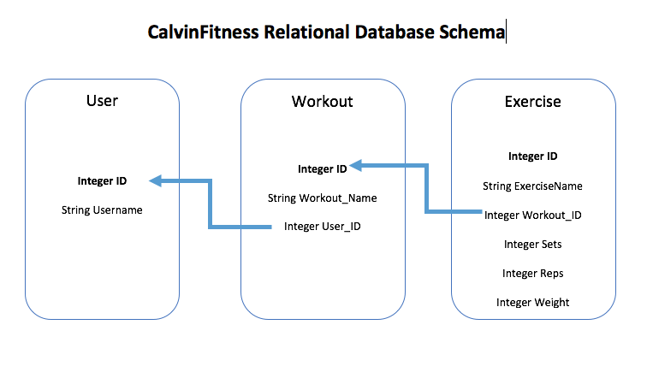
Database Schema

Slide 9
Design
Key User Stories
Database Schema
Usability Test Summary

Slide 10
Usability Test Takeaways
How to share workouts
Decided on sharing to everyone
Clarity in Create Workout activity
Where to save workouts from Find Shared Workouts

Slide 11
Design
Key User Stories
Database Schema
Usability Test Summary

Slide 12
Deployment Diagram

Slide 13
Assessment
Future Work
Strengths:
Sharing Workout
View Shared Workouts & Save to Device
Weaknesses:
Editing Existing Workouts
Workout – Date Completed
Store secure passwords for users
No duplicate usernames
Complete only partial workout

Slide 14
Questions

