Slide 1
CS308 POLLUTION DETECTOR
Team Members:
1. Ayush Deothia (Team Leader) (120050025)
2. Arpit Singh (120050037)
3. Jayesh Bageriya (120050022)
4. Avinash Malviya (120050024)
5. Zubin Arya (120050036)

Slide 2
Project Overview
The project is to create a small carbon dioxide level detector which can be fit into vehicles, rooms or offices of factories which will alarm a buzzer if its level increases above a certain threshold. Plus, the readings are sent via wi-fi module to a server (which can be there in the nearest service centre and the corresponding people can come and have a look at it).

Slide 3
Requirements/Task Specifications
Detecting the carbon dioxide level through air quality sensors
Sending the readings via wi-fi module to a server
Storing and displaying of the readings from the server
Getting the alarm to buzz when the readings go above a certain threshold

Slide 4
Project Plan
The project had three parts: detecting air quality, sending readings via wifi-module to server and displaying those readings.
Detecting the air quality was done by Jayesh and Avinash. It was done by 5 April.
Sending readings via wi-fi module was done by Arpit and Zubin. It was done by 6 April.
Displaying those readings was done by Ayush. It was done by 5 April.

Slide 5
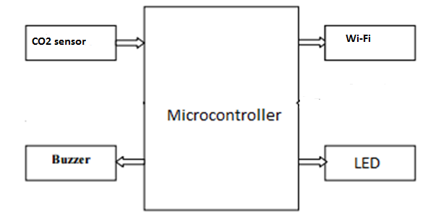
Block Diagram

Slide 6
Block Diagram Description
The CO2 sensors detect the CO2 level which are then sent to the server via the wi-fi module.
If their level goes beyond a certain threshold, the alarm buzzer starts ringing.
The LED keeps changing its color depending on the state of the wi-fi module(if it is connected or not) and the CO2 level.

Slide 7
Innovation and Challenges
We had a challenge that how we will safely test whether the readings change while changing the CO2 level.
For this, we brought ENO, dissolved it in water and put that near the air quality sensor.
We saw that there was a change in the reading and that means the system was working.

Slide 8
Task Completed
The project had three parts: detecting CO2 level, sending readings via wifi-module to server and displaying those readings.
In detection of CO2 level, the sensor we had measured the air quality as a whole and so we were not able to get the correct reading of CO2 level. To tackle this, we set some correction value and decreased it from the obtained value.

Slide 9
Task Completed
In wifi module section, we were not able to establish the connection but after debugging the code for a long time, we found some errors and got it to work properly.
In displaying of the readings on the webpage, there was not much problem faced. We were able to do it easily.

Slide 10
Review and Performance Metrics
When only the LED is red and alarm is not ringing, the wifi is not connected. After this when the wifi gets connected, the LED turns green. When the CO2 level goes above 600 ppm, the LED turns yellow and after that when the CO2 level goes above 800ppm, the LED turns red and the alarm starts ringing.
For testing, we brought ENO, dissolved it in water and put it near the air quality sensors.

Slide 11
Review and Performance Metrics
We saw that there was the LED changed from green to yellow (as CO2 level started increasing) and it turned with the ringing of the alarm when the CO2 level reached above 800ppm. The readings could be seen on the webpage too. The whole test worked fine as expected.
The new reading is detected every 1 second which is then shown on the graph in the webpage.
The wifi module takes around 10 seconds to connect initially.

Slide 12
Re-usability features
We have commented our code well for others to follow it and followed the necessary standards.
Our code is modular. We have made separate functions for different tasks.
For detecting air quality and connecting the wifi module, we have separate functions. For displaying the readings, we have a separate function.
So if a person needs to get a code for a portion (or edit a portion) like connecting wifi, then he can just take the corresponding function and also the depending functions. If he just wants to get the graph feature, then there is a separate file containing that code.

Slide 13
Future Enhancements
We can use better air quality sensors to get more accurate CO2 level.
We can use even more number of air quality sensors for better reading.
We can use better wifi module that connects even quicker than the current one.

