Slide 1
Product Sorter
Team:
Siddharth Patel 120050001
Abhinav Gupta 120050029
Dheerendra Rathor 120050033
Anant Gupta 120050086

Slide 2
Project Description
A chip sorter is a machine that removes the bad (over cooked/burnt) potato chips from the good ones
This is done by visually distinguishing them, because the burnt chips are reddish brown while the perfectly cooked ones are almost white
This can be very helpful in ready to eat manufacturing industries since it helps reduce manpower and also human errors in the sorting process

Slide 3
Requirements/ Tasks
Equipments required: conveyer belt, USB camera, motor, arm
They perform the following tasks:
The camera will take the photo of the chip on the conveyer belt
Image of the chip will be processed
If it’s a bad chip then the motor will rotate 180 degrees and back, so the arm attached to it will knock the chip off the belt
Otherwise motor won’t move

Slide 4
Project Plan
Task Completion dates:
1. Raspberry Pi Setup : 23/03/2016
2. Image Processing and LED Actuator : 30/03/2016
3. TIVA-RPi interfacing via UART, Servo Motor : 05/04/2016
Work Division:
Image processing part done by Abhinav Gupta and Anant Gupta
Raspberry pi setup and interfacing done by Siddharth Patel and Dheerendra Rathor

Slide 5
Signals and Flow
The process begins with the switch SW1 being manually pressed on TIVA.
TIVA, via UART, sends a signal to Raspberry Pi to click a picture.
On receiving the UART signal, the Rpi takes a photo using the USB Camera and processes it to determine if there’s a bad chip underneath it
It sends the appropriate response via UART to TIVA (the angle by which to move the servo motor, 0 in case of a good chip or no chip), and then the angle 0 to bring the motor back
Upon receiving the angles, the TIVA executes the action on the servo motor using PWM

Slide 6
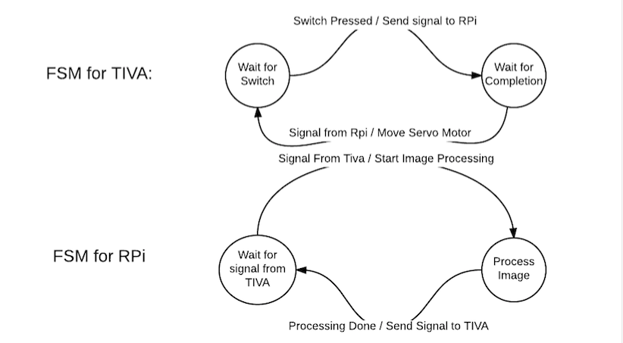
FSM

Slide 7
Innovation and Challenges
Challenges:
The biggest challenge was to make the algorithm most efficient because the processor (raspberry pi) was very slow
And the second challenge was to make the code function properly in variable lighted surroundings
Innovation:
We used an original algorithm for detecting good chips from bad

Slide 8
Task Completed
Setting up the raspberry pi
Image Processing Algorithm
Problem: Dependency on Lighting Conditions
Solution: In factory setting, lighting conditions are constant
Problem: Speed
Solution: Use a faster processer instead of Rpi
Interfacing TIVA and Rpi using UART
Actuating the LED via Rpi and the servo motor via TIVA

Slide 9
Evaluation
We used real potato chips for testing. We created defective chips by burning parts of normal chips. We used a blue background when detecting the chip.
We used multiple normal chips to calibrate the model and cross-validated our results.
We also tested the working of the system for various degrees of burning in burnt chips.

Slide 10
Reusability
The image processing code is modular, object oriented, configurable and cleanly divided into functions.
This allows easy changes to the code for testing. It also allows convenient profiling of the code.

Slide 11
Future Enhancements
This project was just a subcategory of the bigger version of the sorting machine
With better mechanical structure and a good processor, this project can be used for industrial applications
And with slight change in the image process code, this project can not only be used in potato chip sorting but in any kind of visual based sorting
For example, visual sorting can be used in separating the defective parts from the final lot in any industry like metal industry or food industry

