Slide 1
CS308 Investor Pitch Seed Sowing Bot
Team No. 22
Harish Koilada
Venkatesh Duppada
Akshay Veer
Vinay Chandra

Slide 2
Project Statement
In this project we aim to build a bot which automates sowing seeds in rooftop farming with which we can dig soil at regular intervals and then sow the seeds. This is aimed to reduce lot of manual labour in digging and sowing of seeds.

Slide 3
Tasks
Seed sowing consists of two main operations. - Digging a hole in the soil - Placing the required number of seeds in the slot
These two operations need to done at regular intervals to maximize the crop for a given plot. Our work will reduce manual labor and time required to sow seeds and do it more efficiently.

Slide 4
Project Plan
Design of the mechanisms and corresponding components, 3d printing - Akshay and Harish
Code, working and calibration, XBee module and magnetometer - Venkatesh and Vinay
Grid movement and digging mechanism without the component was completed by 1st demo.
All others were completed by final demo.

Slide 5
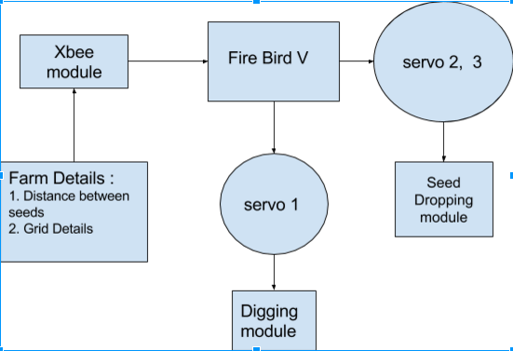
System Design

Slide 6
Innovation and Challenges
The single seed drop mechanism which includes two servos is a challenge to create and innovate.
Other challenges included the manual calibration of the bot. Without this calibration, the bot would not go in a straight line.

Slide 7
Task Completed
Digging Mechanism is achieved using linear servos and a 3d printed digger
Seed sowing required design of single seed dropping mechanism which proved to be difficult to implement. Finally, a mechanism where a single seed is collected and then dropped is developed using multiple servos
Manual calibration took many runs with different configurations to find the sweet spot

Slide 8
Test Plan
The sowing mechanism is tested by starting the bot and then marking where the digger points to. After the digging, by marking the points where seeds are dropped, we can make sure that the seed drop is coinciding with the location of digging.
The bot is started only when the character ‘8’ is pressed in the XBEE console.

Slide 9
Performance Metrics
The straight line following of the bot is important because the digging position and seed sowing location must coincide with each other.
Also, the following of the grid can also be considered as a performance metric because we require the bot to follow a grid structure.

Slide 10
Re-usablility features
Line follower code can be used in other projects.
Movement and motion of the bot is written in functional methods that can be used in other modules although it is limited to FireBird.
XBee code can also be directly used in other projects without much changes.

Slide 11
Future Enhancements
Magnetometer can be implemented for better navigation in straight lines.
App can be created for giving inputs of distances between seed sowing using the XBee module.

