Slide 1
CS308 Investor Pitch AutoPark
Abhishek (120050008),
Syamantak (120050016),
Rajesh (120050079),
Soma (120050080)

Slide 2
Problem statement and short description
AutoPark is a parking control manager which can issue parking tickets and fines if rules are violated. There will be a booth associated with a parking spot.
When a vehicle enters the area, the booth will identify the type of the vehicle (car, bike etc.) and correspondingly allocate (if free) a parking spot to it for a fixed time limit.
The user will be issued a ticket stating the spot number.
If the user tries to park in a different spot or if he exceeds the time allocated to him the he will be fined accordingly as the booth knows the info of the user which user has to provide during the entry.
There will be sensors present at the spots to ensure whether the spot is free or not and if the correct vehicle is in it or not.

Slide 3
Requirements and task specifications
We used the following equipment's in our project: TIVA board, proximity sensor x1, RFID sensor x1, RFID tag x3, servo motor x1, USB camera x1
The proximity sensor was used for detecting incoming vehicles and usb camera captured their images, RFID tag and sensor was used for identifying purposes, servo motor acted as the gate.

Slide 4
Project Plan and Work Division
The work division was as follows :
Abhishek : implementing servo motor and combining components together
Syamantak : implementing usb camera to do image processing
Rajesh and Soma : implementing the RFID tags and sensors

Slide 5
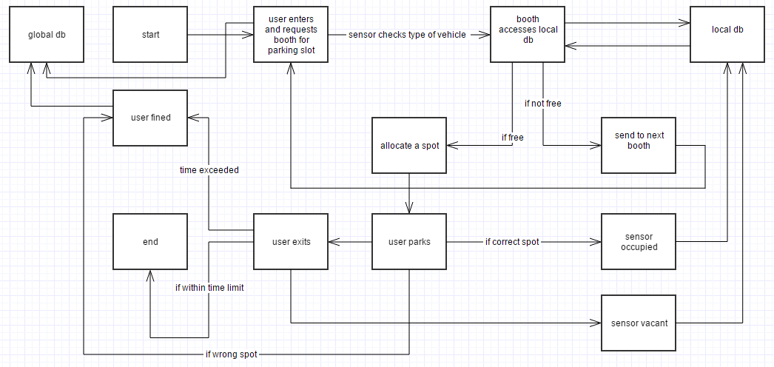
Workflow Block diagram

Slide 6
Challenges faced
There are a few risks/challenges that we may face in the implementation of our project:
If a person owns more than 1 vehicle then we would ideally not want to allocate spots for both his vehicles so as to save spots for others as otherwise this system could be exploited by a rich user spamming all his vehicles in a given zone and not leaving others a space to park.

Slide 7
Challenges faced
Maintenance will also be a challenge due to the large number of booth’s and sensors. Due to this every week during certain hrs. the booth’s will not be functional and users may cause havoc during these hours. We will try to schedule maintenance during off peak hrs. to prevent this.

Slide 8
Task Completed
We have successfully completed the image processing of the vehicles and tags get issued appropriately when a vehicle arrives
The servo motor also opens when a tag is issued and closes after some time
When a car is parked/leaves a LED glows to indicate this

Slide 9
Test Cases
We had 4 test cases :
1. If car1 arrived and spot was free then tag1 was issued and car parked and green led glows
2. If car2 arrived and spot was free then tag2 was issued and car parked and red led glows
3. If a car comes and no spot is free then on GUI it shows that no spot is free
4. If a non allocated RFID tag is scanned then error is shown on the terminal (GUI)

Slide 10
Re-usability features
The code is well written and split into functions thus making it reusable and easily extendable.
New parts and functions can be easily added to existing model.

Slide 11
Future Enhancements
Some of the future enhancements that can be made to our project are that if we add more RFID sensors then we can simulate the working of a parking lot with many cars at once.
Also real time image processing can be done but requires a stronger processor as the algorithm is complex.

