Slide 1
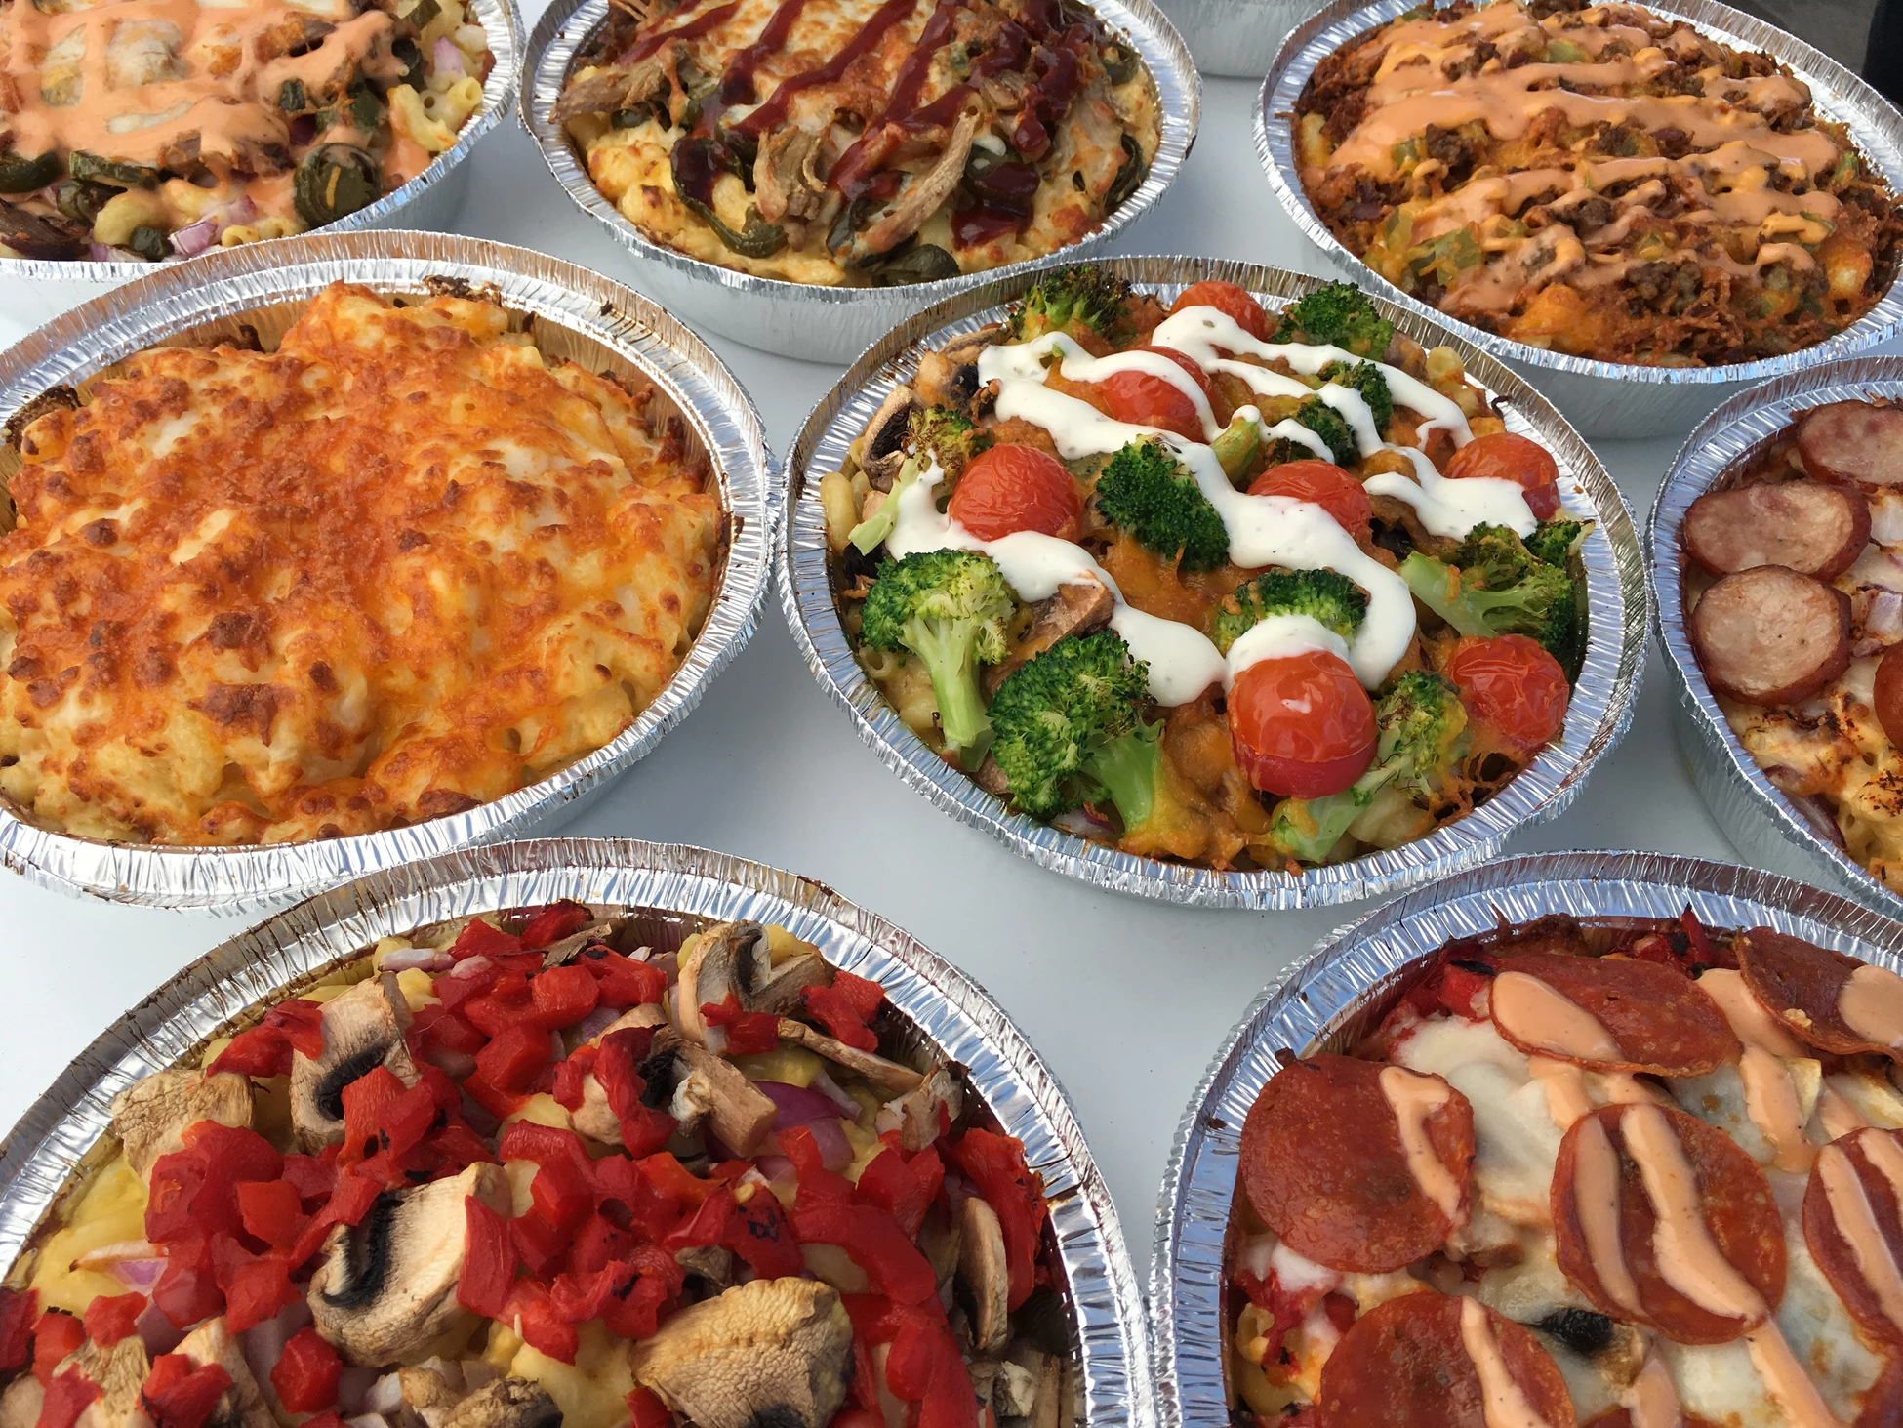
Mac and Cheezary
CS310 – Programming Mobile Apps
Class Project

Slide 2

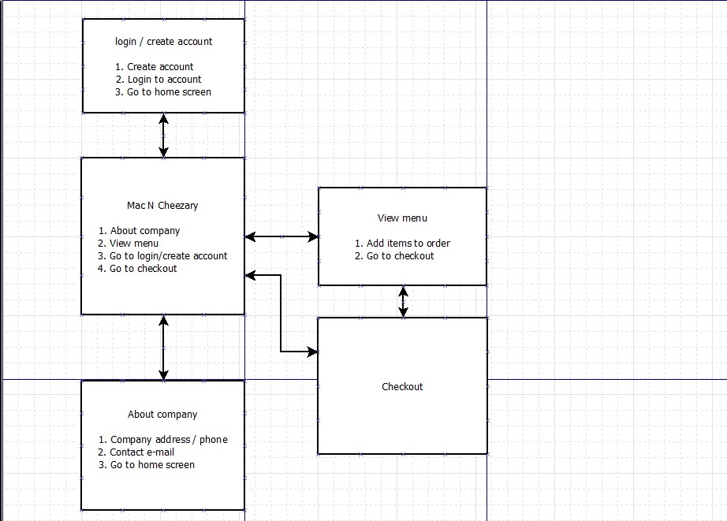
Tentative Flowchart

Slide 3
Home page (homeActivity)
Mac and Cheezary logo / background
Buttons to change to the other screens
Top menu bar that should be static on all pages to navigate to other pages
Owner: Trevor Cullingsworth

Slide 4
Menu page (menuActivity)
Menu Items
Prices
Pictures
Descriptions
Need to add buttons to change to other pages
Add spinner to each item to allow user to add multiple quantities of item
Add button to add item orders to shopping cart
Top menu bar that should be static on all pages to navigate to other pages
Owner: Edmund Rainville

Slide 5
About Us page (infoActivity)
Have same information as on web page (https://macncheezary.com/)
Have link to webpage and google map
Top menu bar that should be static on all pages to navigate to other pages
Owner: Ruslan Radnaev

Slide 6
Database ?
Setup database (maybe – if time permitting)
Customer account info
Customer orders
Previous orders
Inventory
Owner: Craig Connor / class

Slide 7
Checkout / Shopping cart page (checkoutActivity)
Show customer order
Payment option section
Confirm order – email to customer
Allow edit of order
Top menu bar that should be static on all pages to navigate to other pages
Owner: Craig Connor / class

Slide 8
Standardizations
Page name standards:
homeActivity
menuActivity
infoActivity
checkoutActivity
Background name: bkgdCheezary.jpg
Owner: all

Slide 9
Standardizations (continued)
Widget previews:
Owner: all
Widget | Preview | Example
Button | btn | btnClose
List | lst | lstMenu
TextBox | txtBx | txtBxCustomer
CheckBox | chkBx | chkBxSendEmail
RadioButton | radBtn | radBtnEtcetera
etc. | --- | ---

