Slide 1

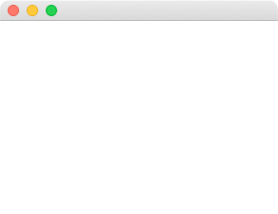


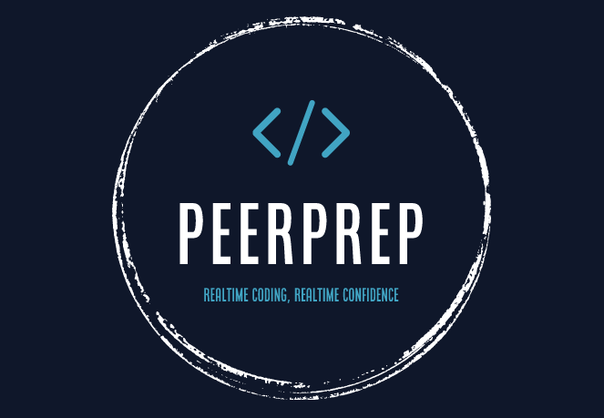






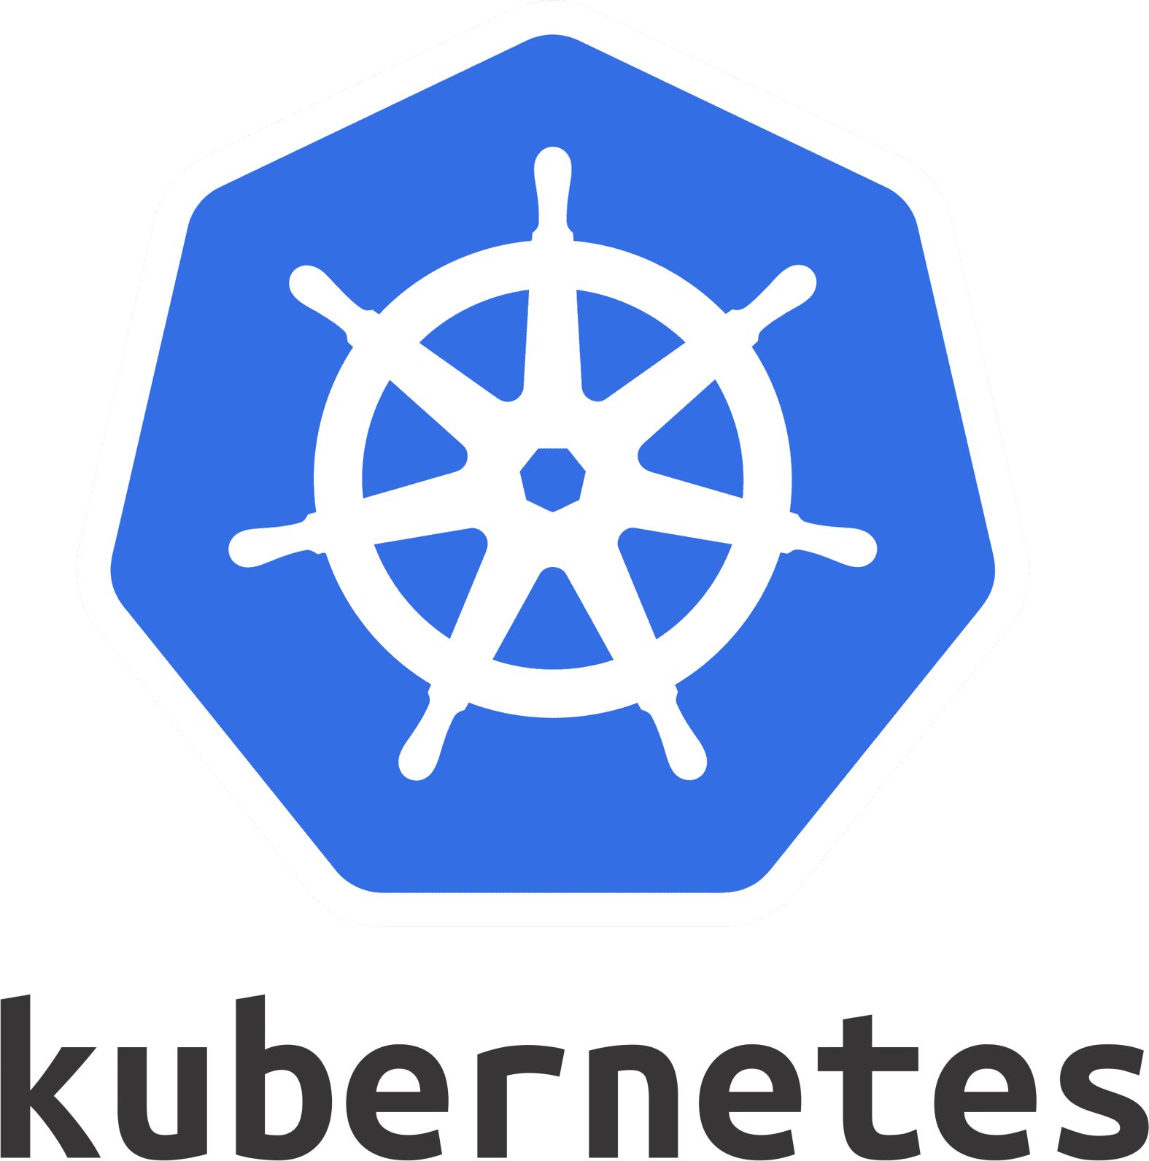

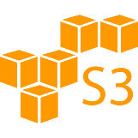

Next.js Cloud Monolith
Question Service
Prisma ORM
tRPC Router
User Service
Client
Matching Service
Database
cloud managed cluster
Website
Code Session Service
Code Execution Service
Auth. Data, Questions, History etc
Evaluation Service
Microservices
REST APIs, SSEs
Image API
Code Execution API

