Slide 1
Relay
A beta-testing portal for small software teams
CS3227 Mini Project 4
zheng-jj
Whimsyturtle
zheng-jj
1 / 17
Notes:
Speaker: zheng-jj
Target: 0:30 | Running time: 0:00-0:30
We built Relay, a beta-testing portal for small software teams. It connects the person preparing tests with the people trying a build and reporting what happened.
We will first follow those two roles through the app. Whimsyturtle will then explain the development workflow he designed. I will present my development-setup experiments, and he will finish with his experiment on the context supplied to the app's AI features. Our common question is how to get useful results from AI while keeping its resource use under control.
Sources:
workflow/specs/PRODUCT-SPEC.md
MP4.md

Slide 2
A clear testing loop for small teams
From acceptance criteria to results on a specific build
Prepare
Publish
Test
Review
Retest
Test Coordinator
Beta Tester
Draft tests from criteria
Clarify observations
AI supports each role. People review and save.
zheng-jj
2 / 17
Notes:
Speaker: zheng-jj
Target: 2:30 | Running time: 0:30-3:00
Start with a concrete situation: a team has a new build, some acceptance criteria, and a few people willing to test it. The coordinator needs to turn the criteria into test cases. Testers need to know what to try and how to describe what happened. Once a fix arrives, the team needs to distinguish the old result from the result on the new build.
Relay makes that loop explicit. The coordinator prepares a round, publishes it against a build, reviews submitted results, requests retesting where needed, and closes the round. The tester sees the published cases and records outcomes and observations. The software under test runs outside Relay.
Follow the diagram once using a simple to-do app: adding a task should put it at the top of the list. A tester sees it at the bottom, reports that result, and later tests a fix. We keep the build context with the earlier result.
The two AI features support different points in that loop. The coordinator gets draft test cases from selected criteria. The tester gets questions about missing reproduction details. In both cases the person reviews the suggestion and chooses the next action. That gives each role a small, relevant AI task rather than an open-ended chat box.
Sources:
workflow/specs/PRODUCT-SPEC.md:7-12,29-31
docs/UserGuide.md

Slide 3
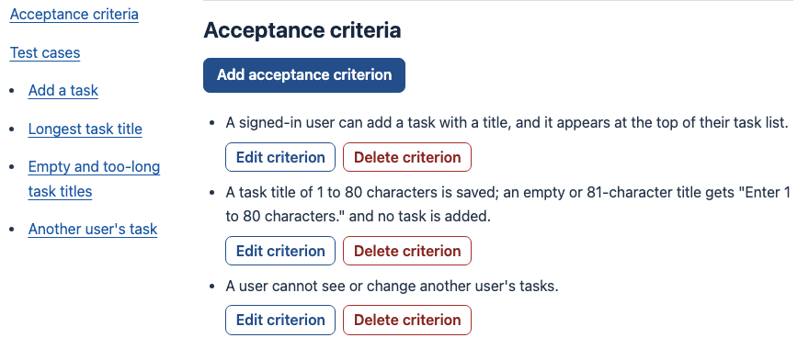
The coordinator prepares and runs a round
Draft
Open
Closed
zheng-jj
3 / 17
Notes:
Speaker: zheng-jj
Target: 2:00 | Running time: 3:00-5:00
I will focus on the Test Coordinator features I worked on. A round starts in Draft. This is where we add acceptance criteria and test cases, and link each case to the behaviour it checks. Publishing names the build and opens the round to testers. Published criteria and cases stay fixed, so the test has a stable meaning while results arrive.
DEMO CUE, about 60 seconds: use a prepared round. Point out one acceptance criterion and its linked case, then show the Open round and its build label. Move to a prepared results page and show one submitted result. If the live app is slow, use the actual app screenshot on this slide.
Retesting changes the current build for the selected cases. Earlier results keep their original build context. Closing makes the round read-only. The screenshot shows the actual Draft round and its acceptance criteria. Point out the real editing controls, then explain how a failure on an earlier build and a pass on a retest remain separate records.
The main design point is that publication, retesting and closure have explicit states. The UI and tests can check those transitions rather than relying on everyone remembering which version they tested.
Sources:
docs/UserGuide.md:179-245
workflow/specs/product/rounds.md
docs/images/draft-round.png

Slide 4
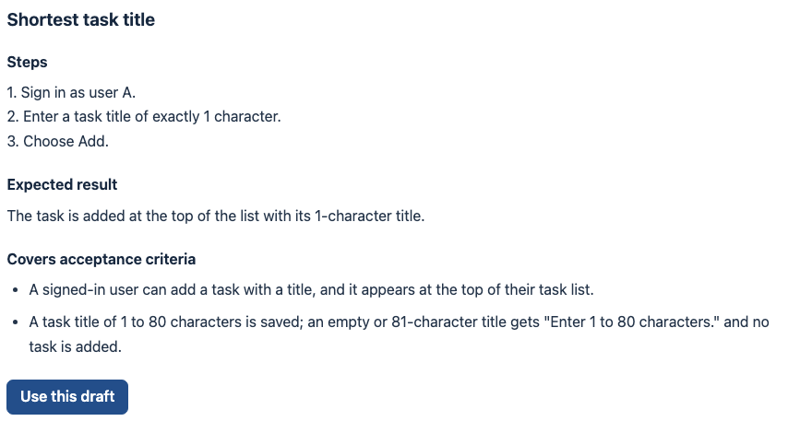
AI drafts, the coordinator decides
Select criteria
Review draft
Add test case
zheng-jj
4 / 17
Notes:
Speaker: zheng-jj
Target: 3:00 | Running time: 5:00-8:00
The coordinator's AI feature starts from selected acceptance criteria. The actual app screenshot shows a suggested shortest-title test: enter one character, add the task, and check that it appears at the top of the list. It turns the minimum title-length boundary into numbered actions and an observable expected result. Point to the linked criteria and Use this draft button.
DEMO CUE, about 90 seconds: show selected criteria, then a prepared suggestions response. Choose Use this draft and point out that a normal New test case form opens with the fields filled in. Review the steps and criterion links before choosing Add test case. Keep a prepared response ready so the demonstration does not depend on provider latency.
The AI response is only a suggestion. Drafting does not add a case to the round, and selecting a suggestion still leaves a separate save action. A structured parser checks the response format and limits before the UI presents it. If AI is unavailable, the coordinator can continue adding cases manually.
This is a concrete example of human oversight and a bounded AI feature. We give the model a small source, ask for a specific output shape, and keep the state-changing action with the user. I will now hand over to Whimsyturtle for the tester side of the same round.
Sources:
docs/UserGuide.md:159-177
src/ai/drafting.py:27-55
workflow/specs/ai/test-drafting.md
docs/images/ai-suggestions.png

Slide 5
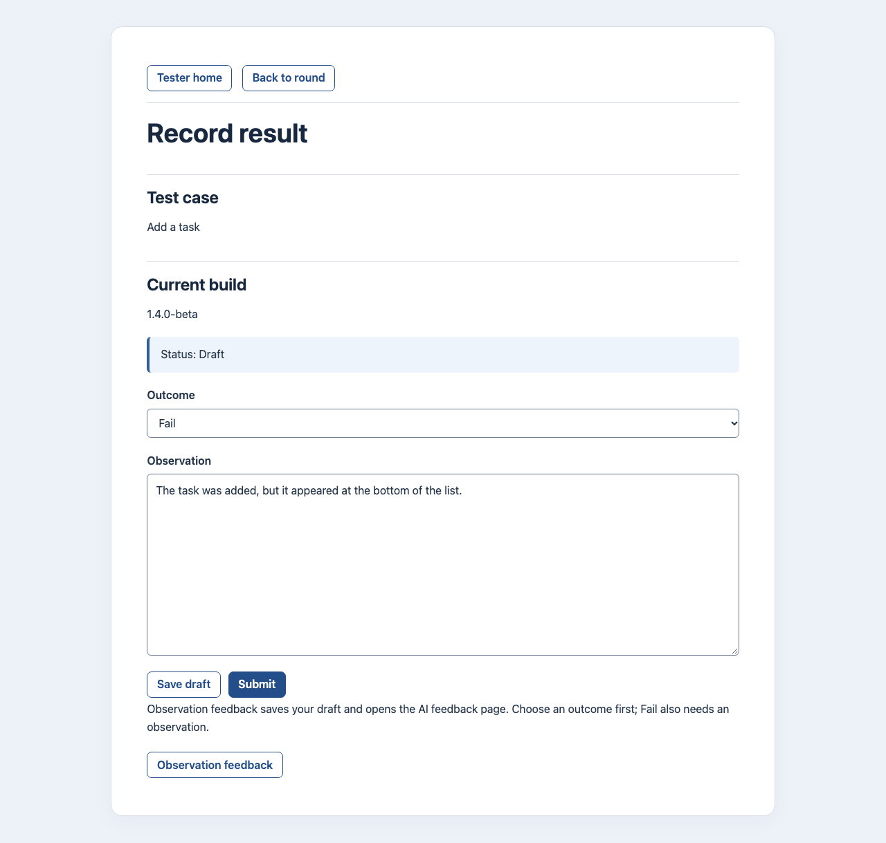
The tester records what happened
Read case
Try the build
Save draft
Submit
Whimsyturtle
5 / 17
Notes:
Speaker: Whimsyturtle
Target: 2:00 | Running time: 8:00-10:00
I worked on the Beta Tester side. A tester opens a published round, reads a case, tries the software outside Relay, and records Pass or Fail with an observation. They can save a private draft before submitting it. A submitted result then appears in the coordinator's review.
DEMO CUE, about 60 seconds: switch to a separate tester session. Open the prepared case, enter a Fail observation, and save a draft. Show that the outcome, observation and build are visible together. Keep the example simple: the task appeared at the bottom of the list instead of the top.
My results keeps earlier results associated with the build they concern. When the coordinator requests a retest, the current build gets a separate result entry. The older submission remains available. This helps the tester explain both the original problem and whether the fix worked.
There are also explicit boundaries around ownership and state. Testers see their own drafts and results. A changed build or a closed round can make an old form ineligible for submission. Those checks keep the saved record consistent with what was actually tested. The next slide shows how AI helps the tester improve the observation before submission.
Sources:
docs/UserGuide.md:247-309
workflow/specs/product/results.md
docs/images/record-result.png

Slide 6
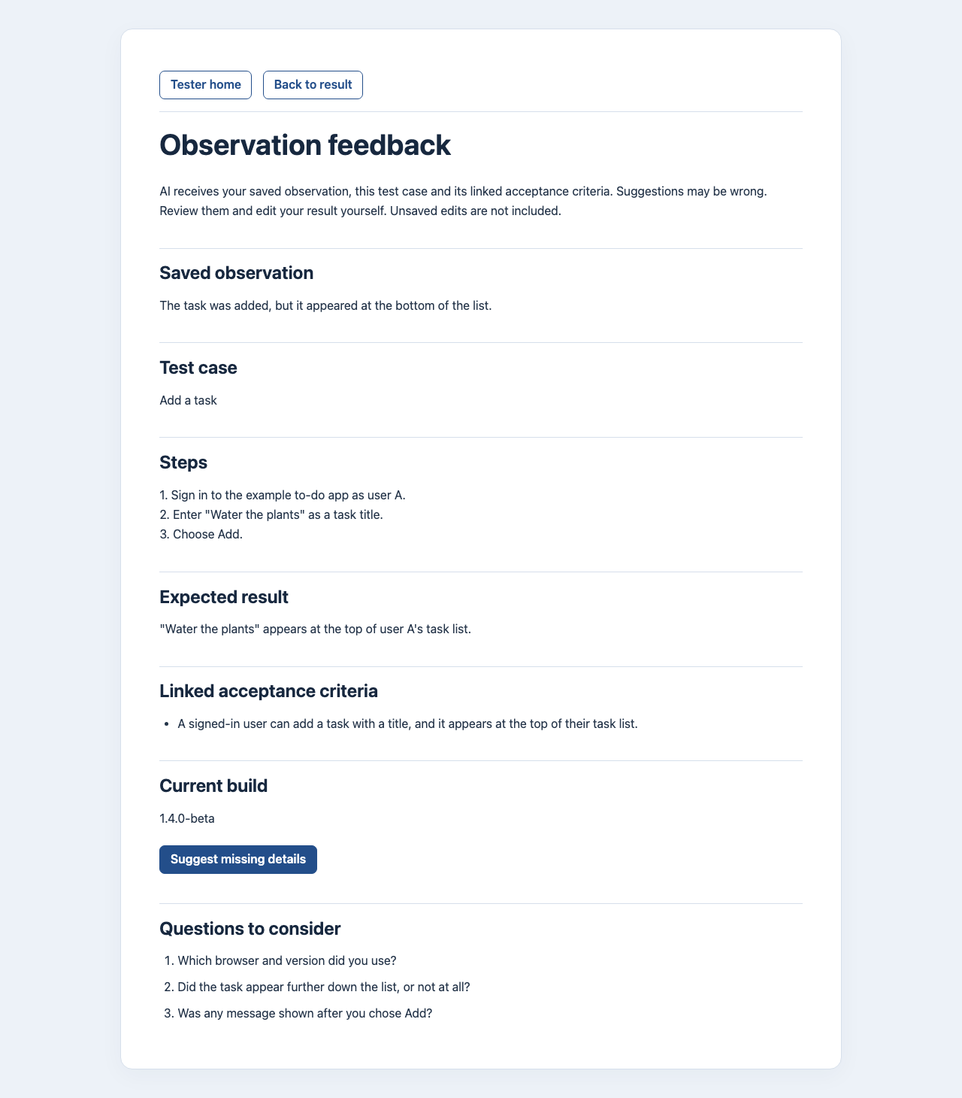
Feedback asks for missing details
Saved observation
Questions
Edit yourself
Quotas Deadline Manual fallback
Whimsyturtle
6 / 17
Notes:
Speaker: Whimsyturtle
Target: 2:00 | Running time: 10:00-12:00
The feedback feature compares the tester's saved observation with the case and its linked acceptance criteria. It asks clarifying questions about missing reproduction details. For example, the report may describe an export mismatch without establishing which filter was active. A useful question targets that gap.
DEMO CUE, about 45 seconds: choose Observation feedback from the result entry. Point out the saved source shown on the feedback page, then use a prepared response to show Questions to consider. Return to the result and edit the observation manually. Opening the feedback page and requesting AI feedback are separate actions.
The two actual app excerpts show the saved observation and Questions to consider. These questions illustrate the interface and still need human review. The app selects the authorized source records, sends bounded text to the shared gateway, validates the returned question structure, and presents the questions to the tester. The tester still chooses Pass or Fail, edits the observation, and submits.
The gateway shares operational controls across both AI features: quotas, a deadline, and fixed failure outcomes. There are no automatic provider retries. A service failure leaves the manual path available. These controls address resource-aware use inside the app. Later, my experiment asks a different question: whether the selected context actually helps the answer.
Sources:
src/ai/feedback.py:14-47,69-91
docs/UserGuide.md:286-299
workflow/specs/ai/llm-gateway.md:31-86
docs/images/observation-feedback.png

Slide 7
A coordinator keeps the slice on track
Spec-Anchored Development
Coordinator: scope, dispatch, checkpoints
Verifier
Spec + plan
Builder
Fixed
candidate
Security review*
Findings and repairs
* Selected by risk. Humans decide merge and release.
Whimsyturtle
7 / 17
Notes:
Speaker: Whimsyturtle
Target: 2:00 | Running time: 12:00-14:00
I designed the development workflow around small, reviewable slices. The coordinator first scopes the human request, identifies the relevant specifications, and chooses the review effort for the risk. The builder updates the specification and plan before implementation. It then builds and checks the behaviour in coherent checkpoints.
Once there is a fixed candidate, an independent verifier checks it against the requirements and test evidence. A security reviewer joins where the risk calls for specialist review. Findings return to the builder for repair, and changed inputs need fresh review evidence. Humans retain merge and release decisions.
In lecture terms this combines Orchestrator-Subagent coordination with a Generator-Verifier repair loop. The useful separation is between producing a candidate and independently challenging it. Each role has a focused task, relevant context, and an explicit handoff.
The process is Spec-Anchored Development: specifications evolve with the app, and criterion-marked tests connect intended behaviour to implementation. We do not automatically generate the whole app from a specification.
Use the diagram to follow one pass, then trace the repair path once. The roles are a way to distribute attention. Their names alone do not enforce isolation, so the repository also uses scope checks and records what candidate and checks a review actually covered.
Sources:
workflow/README.md:3-18,46-68
workflow/skills/slice.md
CS3227 Notes.md:819-834,912-939,979-1016
Human ownership clarification in this conversation

Slide 8
Small context, explicit handoffs
Retrieve relevant paths
Carry decisions forward
AGENTS.md
Example: observation-feedback slice
Candidate + relevant criteria
Relevant specs
Actual checks
Slice plan
Findings + decisions
Next step
Code + tests
Risk-based roles Focused checks Tokens + elapsed + repairs
Whimsyturtle
8 / 17
Notes:
Speaker: Whimsyturtle
Target: 2:00 | Running time: 14:00-16:00
The context design is just as important as the role diagram. AGENTS.md routes the agent to the relevant homes for facts. Product behaviour belongs in the specs, slice decisions and next steps belong in the plan, and executable evidence belongs in tests. Agents retrieve the sections they need rather than receiving the whole conversation.
For the observation-feedback slice, the builder needed the tester requirements, AI contract, relevant routes and tests. The reviewer needed the fixed candidate, the required behaviour, actual check results and unresolved findings. A compact handoff carries those facts forward without asking the next agent to reconstruct the session.
That connects to Just-in-Time Retrieval, Progressive Loading and Structured Note Taking. It also avoids duplicated facts drifting apart. The plan says what is next; the review says what was inspected and what remains open.
Resource awareness means choosing appropriate review effort, using focused checks during implementation, and measuring the coordinator plus delegated sessions. We track tokens, elapsed time, retries and repair rounds alongside quality. Reusing passing evidence only makes sense while the code, inputs and environment remain unchanged.
That was the process I designed for Relay. Zheng-jj then investigated how different agent setups compare, including how much repeated context loading and extra coordination cost on controlled tasks.
Sources:
AGENTS.md:One home per fact,Handoff
workflow/README.md:56-101
workflow/plans/23-observation-feedback.md
CS3227 Notes.md:1089-1125,1129-1167

Slide 9
How much process does a coding task need?
14 setups across four Relay tasks
Same task
Changed setup
Tests + review
Task 1 prompt excerpt
Actual candidate code, r1-mp4
“Refuse only the text-direction embedding, override and isolate characters: U+202A to U+202E and U+2066 to U+2069.”
if any(ord(char) in
BIDI_CONTROLS
for char in text):
Retained in the mutation fixture
zheng-jj
9 / 17
Notes:
Speaker: zheng-jj
Target: 1:45 | Running time: 16:00-17:45
My experiment evaluated alternatives to the workflow Whimsyturtle just described. I compared fourteen setups across four Relay tasks, changing workflow structure, model choices, methodologies and add-ons. Each run used an isolated clone and test database. The task and the human decisions were held fixed for each comparison.
This slide shows a real prompt excerpt from the first task. It asks the agent to reject specific text-direction controls while allowing other direction marks. The retained candidate line is actual code from the r1-mp4 run, preserved in its mutation fixture. It gives a concrete sense of the work being measured.
Evaluation went beyond the agent's final message. We ran hidden acceptance tests and full verification. We deliberately changed five behaviours and checked whether the candidate's own tests caught those broken variants. Fresh reviews supplied another quality measure.
The later tasks increased difficulty, including concurrent behaviour. There were 135 counted runs overall, with different numbers of repeats and incomplete coverage across the setup/task combinations. The next table uses one task and one model to make the comparison easy to read.
Sources:
experiments/agent-setups/agent-setups.zip :: agent-setups/README.md:33-108
archive :: agent-setups/inputs/task-prompt.md:17
archive :: agent-setups/results/mutations/r1-mp4.json:2-9
archive :: agent-setups/method.md:52-100

Slide 10
Fewer handoffs reduced cost and time
Task 1 on Opus. Median cost and elapsed time.
Setup | Cost, US$ | Time, min
MP4 baseline | 8.97 | 30
MP3 six roles | 5.77 | 22
Solo | 3.35 | 13
superpowers | 4.14 | 12
Green: lower than MP4. All passed full verification. API list prices.
zheng-jj
10 / 17
Notes:
Speaker: zheng-jj
Target: 2:00 | Running time: 17:45-19:45
This is task one on Opus. The table reports median cost and elapsed time, using the experiment's recorded API list prices. Green means lower than the MP4 baseline on this task. We show several representative setups rather than every combination.
MP4 cost 8.97 dollars and took thirty minutes. Solo cost 3.35 dollars and took thirteen minutes. Superpowers cost 4.14 dollars and took twelve minutes. All the runs in this table passed full verification. The differences are large enough to make the coordination overhead worth investigating.
Across the tasks they ran, single-session Opus setups averaged 43 to 65 percent lower cost and 45 to 60 percent less time than MP4. Repeated context loading accounted for a substantial part of the gap. The cost breakdown attributed roughly half of MP4's cost to subagent context, and those runs launched nine to twelve subagents per task. Each fresh session needed to reload instructions, specifications and code.
Do not read this as a universal ranking from one table. For example, MP3 looks cheaper here, while its average relative cost across all four tasks was slightly above MP4. My practical lesson is that decomposition has a resource cost, and that cost should earn its place through better outcomes.
Sources:
experiments/agent-setups/agent-setups.zip :: agent-setups/README.md:81-95,114-156
archive :: agent-setups/results/runs.csv, task 1

Slide 11
Reviews found gaps after green tests
Measure | Observed result
Hidden tests | Every counted run passed
Planted bugs | Almost all caught all five
Independent review | 58 Medium+ findings, including 5 High
Original candidate
Deliberately broken variant
if any(...):
if False:
zheng-jj
11 / 17
Notes:
Speaker: zheng-jj
Target: 1:30 | Running time: 19:45-21:15
The test measures reached a ceiling: every counted run passed hidden tests and full verification. Almost every candidate's own tests also caught all five deliberate bugs. That tells us the setups could satisfy the tested behaviours, but it did not separate their overall quality very well.
The code example makes the mutation check concrete. The original candidate checks for the forbidden characters. The deliberate variant changes that branch to if False. If the candidate's tests still pass after that change, they are not proving the control works. In r1-mp4 the tests caught all five planted bugs.
Independent reviews still found fifty-eight Medium-or-higher findings across the counted runs, including five High findings. Many involved requirements, tests and records drifting apart. Some covered behaviour outside the hidden tests.
This is why I kept several quality measures. A green suite is useful evidence for what it checks. Review can challenge assumptions and coverage that the suite does not contain. The outcome is more informative when we look at resource use together with those findings.
Sources:
experiments/agent-setups/agent-setups.zip :: agent-setups/README.md:77-108
archive :: agent-setups/results/mutations/r1-mp4.json:5-10
archive :: agent-setups/results/runs.csv, r1-mp4

Slide 12
One building session, independent review
Experimental recommendation: ideal v7
One building
session
Consistency
check
Independent
review
Requirements Decisions Tests Code
Extra process needs evidence of value
zheng-jj
12 / 17
Notes:
Speaker: zheng-jj
Target: 1:45 | Running time: 21:15-23:00
The experimental recommendation was ideal v7. One session handles building, then a consistency check compares requirements, decisions, tests and code before an independent reviewer checks the candidate. High-risk work still gets a security reviewer. This is the experiment's recommendation; the repository workflow remains the one Whimsyturtle described.
The consistency check responds to the failures the reviews actually found: stale claims, weakened tests and unconfirmed decisions. It is an example of changing the process based on observed gaps.
I also tried four additional rules in v8. Where v7 and v8 were both evaluated, v8 cost more on every model without consistently producing fewer findings. So the final package retained v7. Extra instructions and extra process need measurement too.
The cheaper models passed their tested hidden suites, but often attracted more review findings. That makes independent review particularly useful when exploring lower-resource builds.
In the lecture's terms, this is Valuemaxxing: judge the outcome against its total resource use. These were four tasks in one repository with decisions supplied upfront, so I would carry the lesson about measuring overhead into future work rather than promise a universal best setup. Whimsyturtle will now show the corresponding context question inside the app.
Sources:
experiments/agent-setups/agent-setups.zip :: agent-setups/README.md:184-203,280-313
archive :: agent-setups/ideal/v7/README.md:78-105
workflow/README.md:58-68
CS3227 Notes.md:1129-1167

Slide 13
Does extra context improve the answer?
12 scenarios
3 models × 3 conditions × 5 repeats
540 attempts
Relevant only
App clutter
Off-topic text
Six drafting + six feedback scenarios. Same production prompts and parsers.
Whimsyturtle
13 / 17
Notes:
Speaker: Whimsyturtle
Target: 1:15 | Running time: 23:00-24:15
My experiment asks a related question at the product level. We already select a small source for drafting and feedback. What changes if the same task arrives with irrelevant background?
I used twelve synthetic scenarios: six drafting and six feedback scenarios. Each ran on three requested models, under three context conditions, with five repeats. That produced 540 attempts. Relevant-only had the task information. App clutter added unrelated app descriptions. Off-topic added benign unrelated passages. The two additions were approximately five hundred words each.
The scenario, production prompt and parser stayed fixed across conditions. I froze source and request hashes, randomized execution order within each repetition block, and used no retries. Requested temperature was zero, but the pilot had still shown variation, so the repeats measured stability.
The evaluation first checked the production parser, then used a rubric to assess accepted answers. This connects the Context Paradox to a controlled comparison: a larger input can contain less useful signal for the task.
Sources:
experiments/app-context/app-context.zip :: experiments/app-context/full-comparison/method.md
archive :: experiments/app-context/repeatability-results.md
CS3227 Notes.md:283-286,600-649

Slide 14
The prompt asks for the missing evidence
Production prompt excerpt
“If no useful detail is missing, return no questions.”
Synthetic F2 input, shortened
Constructed calibration answer
Case: Apply Available, then export CSV.
Report: Opened Items and exported. An Unavailable row appeared.
{"questions": [
"At the moment Export CSV was selected, what filter selection did Items show?"
]}
Input summarized from F2. Answer quoted from cal-19.
Whimsyturtle
14 / 17
Notes:
Speaker: Whimsyturtle
Target: 1:15 | Running time: 24:15-25:30
Here is the prompt's central instruction and a concrete synthetic input. The test case says to apply the Available filter before exporting. The observation says the tester opened Items and selected Export CSV, then saw an Unavailable row. It does not establish which filter was active.
The sample output asks exactly that question. This is a constructed calibration answer retained in the fixture, not a live model quotation. It shows the output shape and the intended behaviour without relying on a transient response.
The distinction matters: intended test steps are context about what to do, while the observation is evidence about what the tester reports doing. A useful question asks for the missing filter state. Asking again about the supplied browser would add no value.
For quality grading, I used GPT-6.1 Sol with scenario checks and model/condition labels hidden. I calibrated the rubric on constructed good and flawed answers before grading the run. The semantic grades are model-assessed. The JSON parser checks structure; this separate assessment checks whether the questions are useful and grounded.
Sources:
src/ai/feedback.py:29-47
experiments/app-context/app-context.zip :: experiments/app-context/calibration/fixtures.json, F2 and cal-19
archive :: experiments/app-context/full-comparison/method.md:Grading and reuse

Slide 15
Clutter usually hurt drafting
All checks met, out of 30 attempts per cell
Drafting
Feedback
Model | Relevant | Clutter | Off-topic
Llama 8B | 12 | 2 | 0
Qwen 35B | 29 | 20 | 25
x-test-2 | 30 | 30 | 29
Model | Relevant | Clutter | Off-topic
Llama 8B | 0 | 0 | 0
Qwen 35B | 9 | 2 | 5
x-test-2 | 5 | 9 | 5
Against relevant-only: red lower, green higher, grey unchanged. Model-assessed quality.
Whimsyturtle
15 / 17
Notes:
Speaker: Whimsyturtle
Target: 2:00 | Running time: 25:30-27:30
Each cell counts attempts that passed the parser and every scenario check, out of thirty. Colour compares the added-context condition with relevant-only for the same model and task. Red is lower, green is higher, and grey is unchanged. Failures remain in the denominator.
Start with drafting. Qwen met all checks on twenty-nine of thirty relevant-only attempts, twenty with app clutter, and twenty-five with off-topic text. Llama dropped further, with timeouts and schema failures contributing to that result. The requested x-test-2 model was stable on these drafting cases.
Feedback was harder and did not follow one direction. Qwen declined with clutter, while x-test-2 improved from five to nine successful attempts. The more important product finding came from the individual criteria: the two complete-report scenarios needed no questions, yet every accepted answer still asked unnecessary ones. Each scenario had forty-three accepted answers.
A second example illustrates context pollution. For a refresh task, one Llama answer with app clutter added unrelated tests about astronomy, textiles, gardening and audio. That is a paraphrase recorded in the report. It covered the requested action but failed usability and grounding.
The lesson is to inspect the actual failure mode. Parser acceptance, requirement coverage and usefulness answer different questions. These results support selective context and further feedback-prompt evaluation, without requiring a general model ranking.
Sources:
experiments/app-context/app-context.zip :: experiments/app-context/full-comparison/results.md:Quality, including failures; What the individual checks revealed; Four concrete examples, paraphrased
archive :: experiments/app-context/full-comparison/judgments/draft-24.json

Slide 16
More input always had a token cost
Drafting: app clutter compared with relevant-only
Model | Success change | Input tokens / call | Mean latency
Llama 8B | −33.3 pp | +582 | +5.66 s
Qwen 35B | −30.0 pp | +580 | −0.30 s
x-test-2 | 0.0 pp | +574 | +0.08 s
pp = percentage points. Paired scenario averages; measured token counters.
Whimsyturtle
16 / 17
Notes:
Speaker: Whimsyturtle
Target: 1:30 | Running time: 27:30-29:00
This table compares app clutter with relevant-only for drafting, paired on the same scenario and model. Added context increased measured input by roughly 574 to 582 tokens per call. Quality fell for Llama and Qwen and stayed unchanged for x-test-2. Latency did not move consistently: it rose for Llama, changed little for Qwen, and rose slightly for x-test-2.
That is a useful resource result even when quality stays the same. The app pays for the extra input without necessarily getting a better draft. The latency values describe this run, including transport and cleanup, rather than isolating model inference.
Across the full run, 465 attempts passed the parser, twenty-one failed it, and fifty-four timed out. Token counters were unavailable for those timeouts, so I do not treat the observed token sum as complete consumption.
There were twelve distinct synthetic scenarios, and five repeats within each combination. The semantic grades came from a model. Those are the main limits I would state aloud. The practical conclusion is still direct: select useful evidence, measure quality and resources together, and test proposed prompt changes against the same kinds of failures.
Sources:
experiments/app-context/app-context.zip :: experiments/app-context/full-comparison/results.md:What changed when background was added; Tokens and time; Limits and next steps

Slide 17
Useful AI needs focused context and review
In development
In the app
Fewer handoffs
Independent review
Relevant context
Human decisions
Evaluate quality against the resources spent
Whimsyturtle
17 / 17
Notes:
Speaker: Whimsyturtle
Target: 1:00 | Running time: 29:00-30:00
Relay gives the coordinator and tester separate AI assistance inside one testing loop. The people still review and save the results.
The two experiments looked at different places where adding more creates a cost. Zheng-jj measured development setups and found substantial overhead from repeated agent context loading. His experimental recommendation kept independent review while reducing handoffs. My experiment found that irrelevant app context usually hurt drafting and consistently increased measured input tokens. It also exposed feedback questions that were unnecessary even with a complete report.
Together, those findings connect to resource-aware use: supply context that supports the task, keep useful checks, and evaluate the resulting quality against the resources spent. That is the approach we would carry into the next iteration of Relay. Thank you. We are ready for questions.
Sources:
workflow/specs/PRODUCT-SPEC.md
experiments/agent-setups/README.md
experiments/app-context/README.md
CS3227 Notes.md:1141-1147

