Slide 1

Sprint 1
Members: Aldo Jaramillo, Jeremy Oliver, Ryan Hiller, Ben Mettlach, Tate Wongweeratorn, Justin Treece (me), Wesley Kramer

Slide 2

Requirements
We have the main requirements sorted out
In short, we need everything to run a web page
Initial requirements
Landing/Login page
Class schedule scanner
Implement google maps transport API

Slide 3
Constraint
Getting a domain, a web host, and database host
These all cost money or time
The biggest constraint will be working with IT
We don’t know if we will ever be able to set up an authentication with IT
because of this the schedule scanner cannot be a web scraper but it must use a downloaded html file instead which isn’t user friendly.

Slide 4
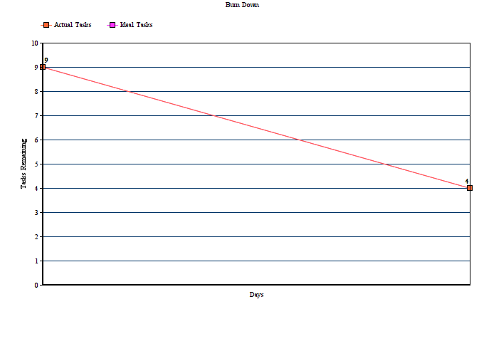

Slide 5
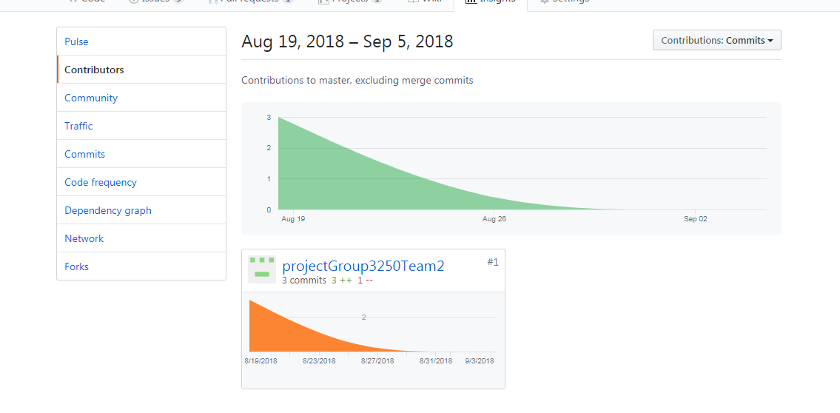

Slide 6









Slide 7
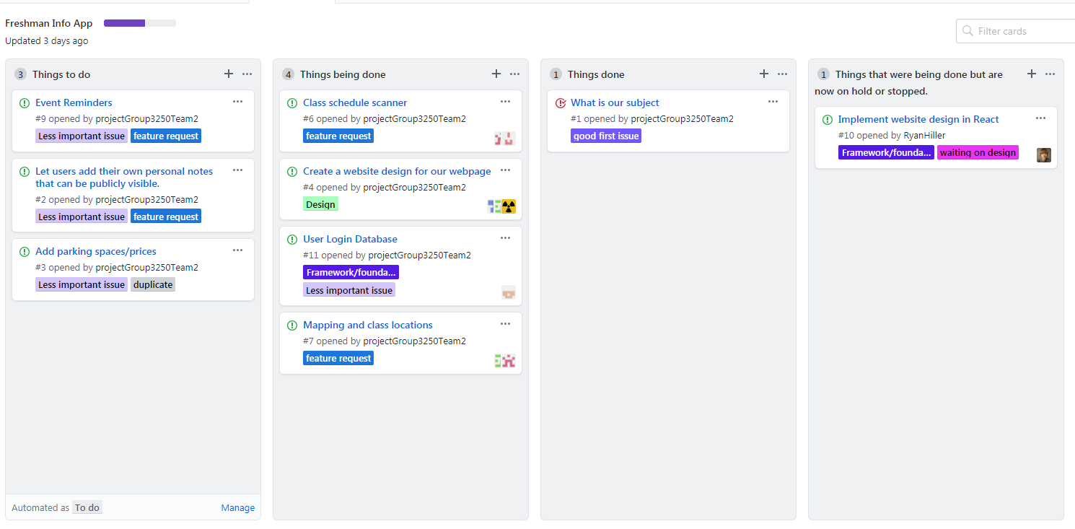

Slide 8

Progress
Have a basic design
Determined our language and stack (MERN)
Brainstormed and learned ways to approach our topics of choice
Set up our ways of communication organization and more
Set up a general look at our plan

Slide 9


Slide 10
Technical Learning/People Learning (my opinions)
People, can be hard to inform everyone at the same time or get quick responses at all times. Different schedules make for difficult planning
Technically this project will be pretty challenging since most of us have little to no experience with JavaScript let alone React, Express, Node and MongoDB
There were a few things like parking where we will most likely leave to implement later since its already on a website.

Slide 11
Percentages
Justin: 20%
Jeremy:20%
Wesley: 8%
Ryan:8%
Tate: 18%
Aldo: 12%
Ben: 14%

