Slide 1

Readary Aisha Ashfaque
Dante Moreno
Emily Wojciechowski
Joel Francis
Junaid Hashmi
Priscilla Adomako

Slide 2
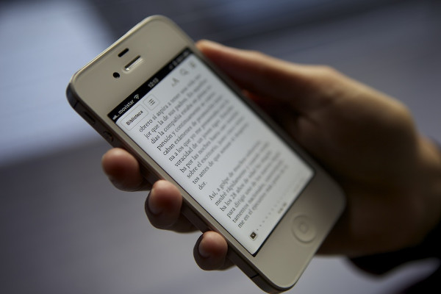
Objective
Creating an app that readers can use to find new books and writers can use to increase their audience and chances of getting their books published.

Slide 3


Comparisons
Similar to Wattpad and Goodreads
Major differences of Readary
Select library integration
Direct-connect with authors
Notification mute controls

Slide 4
Functional Requirements
user with author account shall be able to submit book titles along with one summary and cover of that book to be added to the repository.
user shall be able to:
search for books based on genre, author, reviews and ratings, or other tags or a combination of the four
add and remove genres, authors, or other tags and interests from book preferences
system shall generate each day (for each user) a new list of books based on user’s preferences and the books each user has tagged.

Slide 5
Non-Functional Requirements
Product Requirements
Usability
Users shall be able to access all functions from the main menu in less than 3 clicks.
Users shall be able to increase the font size for the entire user interface.

Slide 6


Non-Functional Requirements
Organizational Requirements
Environmental
The system shall be compatible with both iOS and Android.
Development
The system shall be developed using the programming language Java.

Slide 7

Non-Functional Requirements
External Requirements
Legislative
The system shall implement and abide by copyright laws for each book that is requested to be submitted to the repository.

Slide 8
Architectural design
Apps Interface
Web Interface
The central part of Readary is a centralized DBMS. Therefore, our architectural choice is a central repository pattern.
REPOSITORY
User
Authentication &
Preferences
Likes/Dislikes
Reviews & Critiques
Author/Publisher
Books/Summary
Analytics
Web Services and 3rd party interfaces
Admin

Slide 9
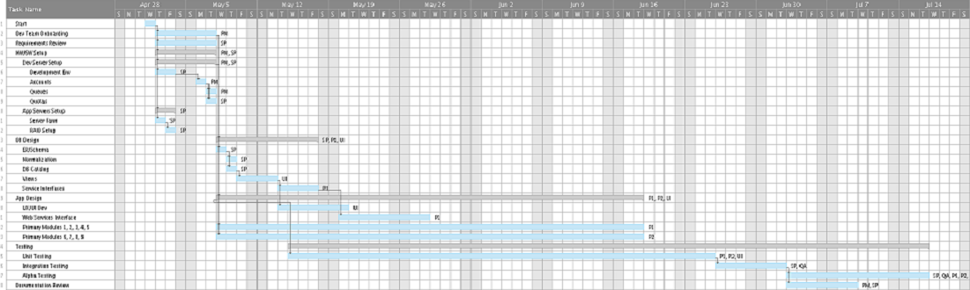
Timeline

Slide 10
Cost Overview
High-level breakdown of overall cost
Hardware | Cost
Hardware | $ 55,350
Software | $ 9,970
Personnel (6) | $ 278,000
Training | $ 6,000
Total: | $ 349,320

Slide 11
Cost Estimation Method (Function Point)
Gross Function Point
793 FP
Processing complexity adjustment
1.06 PCA
Function Point
840.58 FP
Estimated effort (E)
57 person-weeks
Project Duration (D)
10 weeks

Slide 12
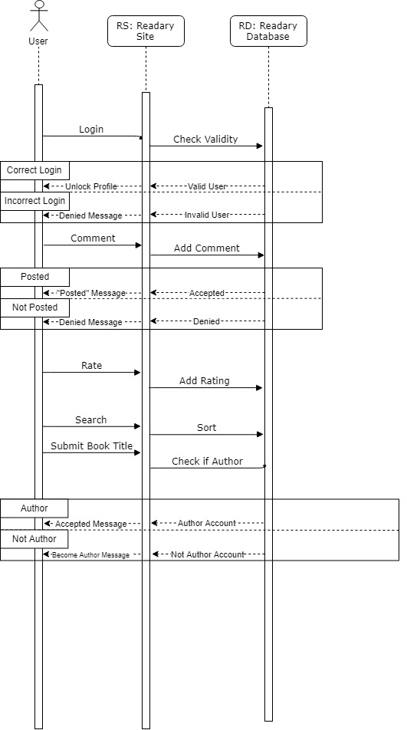
Sequence Diagram

Slide 13
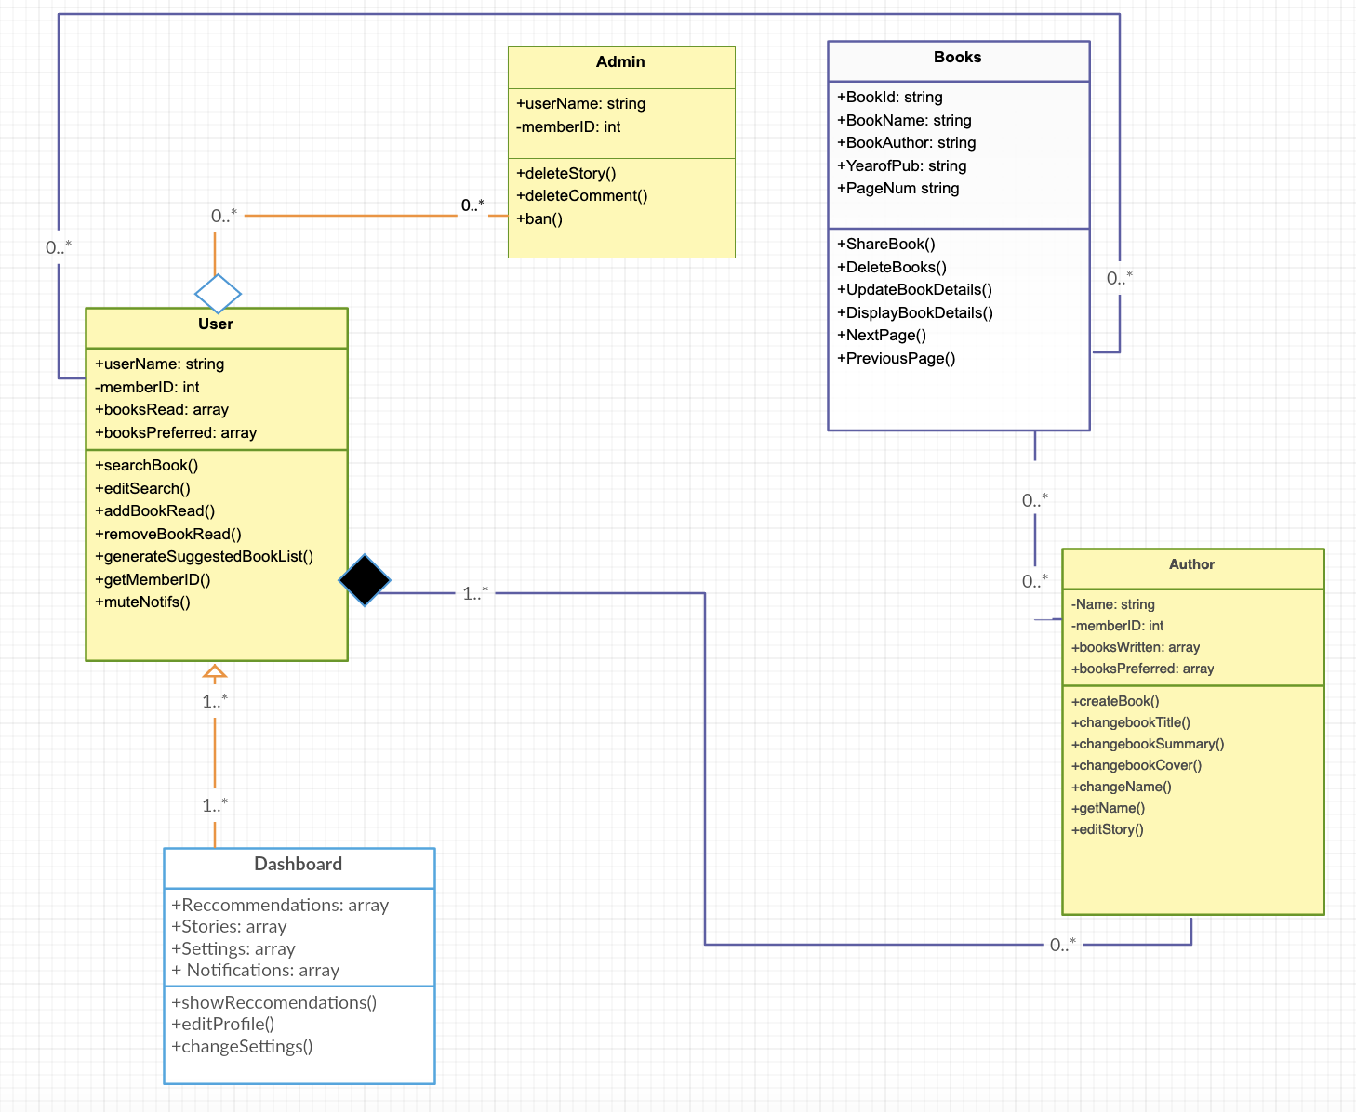
Class Diagram

Slide 14
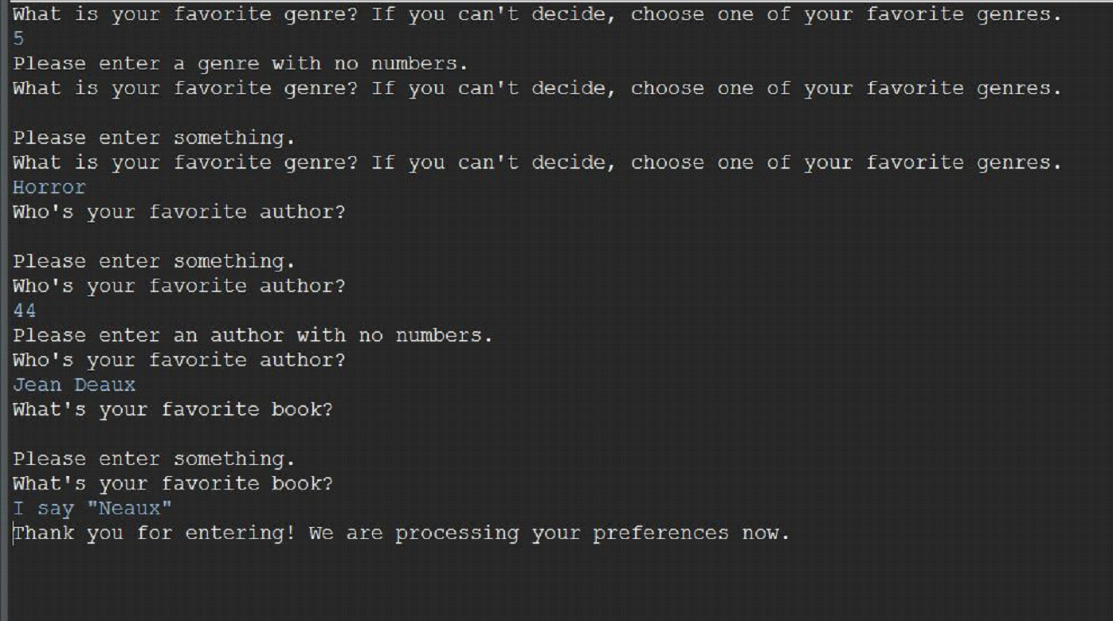
Output of Test Plan

Slide 15
Questions?

