Slide 1
DECK MAP — HIDDEN (do not present)
TL6 L1 — Your Code Leaves the Nest. Blank Office Theme master (BC adds formatting). Just after the first TL1 status report.
THEME: TL6 owns everything that happens when your work meets reality — a real build, a real device, a real audience. L1 = MEASURE + HARDEN. L2 = DEPLOY (2nd platform/phone) + DemoDemons + QR showcase.
OWNERSHIP: CI is TL1's (already built). CD is TL6's. Do NOT re-teach CI.
STRUCTURE: podium phase (~30) -> deliberate EMPTY-PODIUM dispersed team phase w/ visible timer (~15) -> reconvene (~5).
BLOCKS: (lecture) reading a build/deploy failure log · (follow-along, whole class) profile vs a phone frame budget using your TL3 stress-scene FPS break · (projected demo) phone-deploy walkthrough · (dispersed, per team) deploy the stress SCENE to a volunteer's ANDROID phone, read the break on-device (laptop fallback for iOS/no-phone) · (follow-along) demo-safe build hardening.
FPS BREAK RULE (matches TL3): sample starting FPS (feature present, before escalating), stop at HALF. Device-fair; phone gets its own baseline. Physics-violation break is the 4-pt tier / more hardware-independent.
LEC source: profiler-reading + build-failure diagnosis + on-device deploy help (per team) — supplements TL6's DemoDemons-coordinator LECs. NOTE MODES: word-for-word spoken on teaching slides; must-do/how-to-research on follow-alongs.

Slide 2
Your Code Leaves the Nest
TL6 — Lecture 1 · Deployment & CD · measure it, harden it
Notes:
[SPOKEN]
"Welcome to TL6's first lecture. Here's how to think about our whole role on the team: TL6 owns everything that happens when your work stops being a comfortable thing on your own machine and has to survive out in the real world - a real build, a real device, a real audience. We're the leaves-the-nest role.
That's two lectures. Today, L1, we get your work READY to leave the nest: we measure whether it can survive a phone, and we harden it so a demo can't humiliate you. In L2, a few weeks from now, it actually leaves - we deploy to the phone with real controls, and you show it off. Today is measure and harden."
[Then a short intro.]

Slide 3
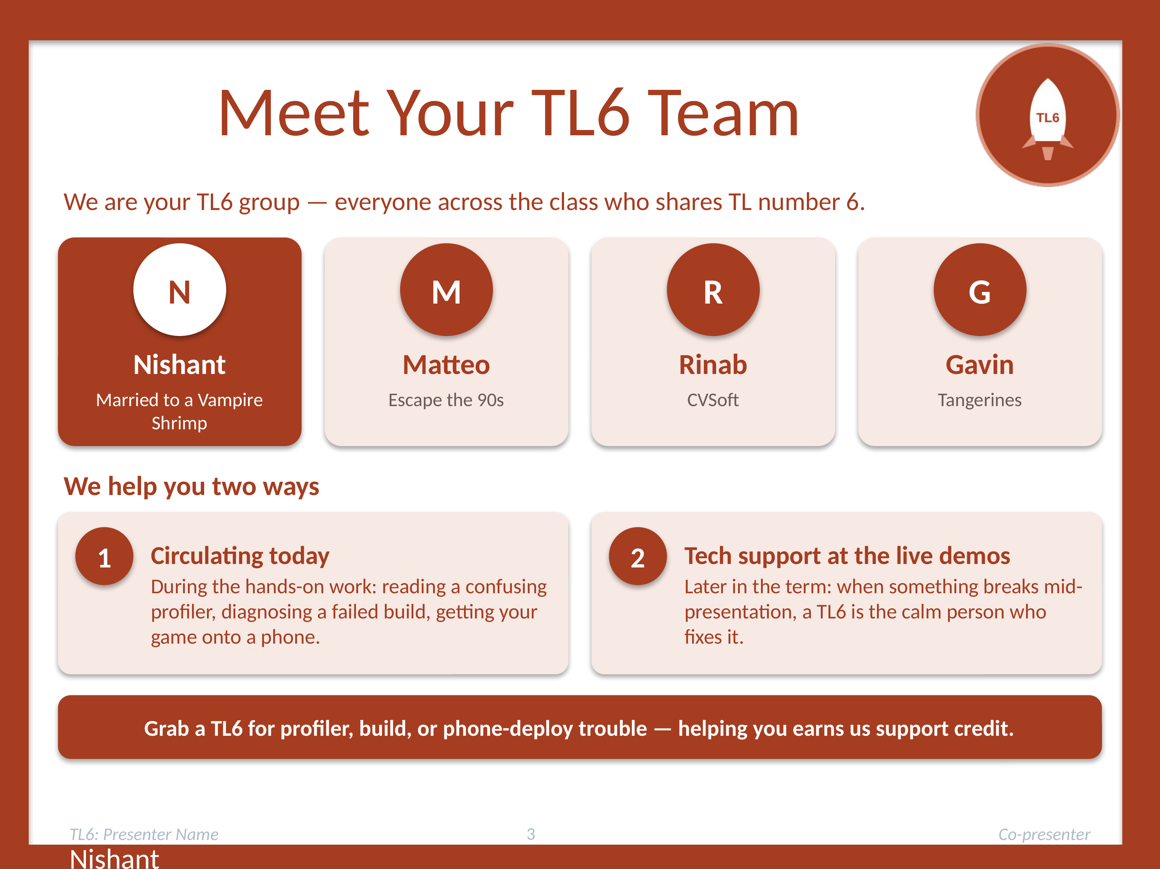
Meet Your TL6 Team
We are your TL6 group — everyone across the class who shares TL number 6.
Each of us will introduce ourselves by name.
We help two ways: circulating during today's hands-on work, AND running tech support during the live demos later.
Grab us for profiler, build, or phone-deploy trouble — helping you earns us support credit.
Nishant
Notes:
[SPOKEN — TL6 cohort up front; names.]
"Quick introductions - and TL6 is a role you'll be leaning on in two different ways this semester, so it's worth knowing us.
[Each TL6 says name + team.]
"First, like every TL group, we're circulating to help during today's hands-on parts - reading a confusing profiler, diagnosing why a build failed, getting your game onto a phone. Grab us; helping you earns us support credit. Second - and this is unique to us - we're the ones who run tech support during the live demos later in the term. When something breaks mid-presentation, a TL6 is the calm person who fixes it. So we're the deployment-and-disaster crew. Today's the deployment half."]

Slide 4
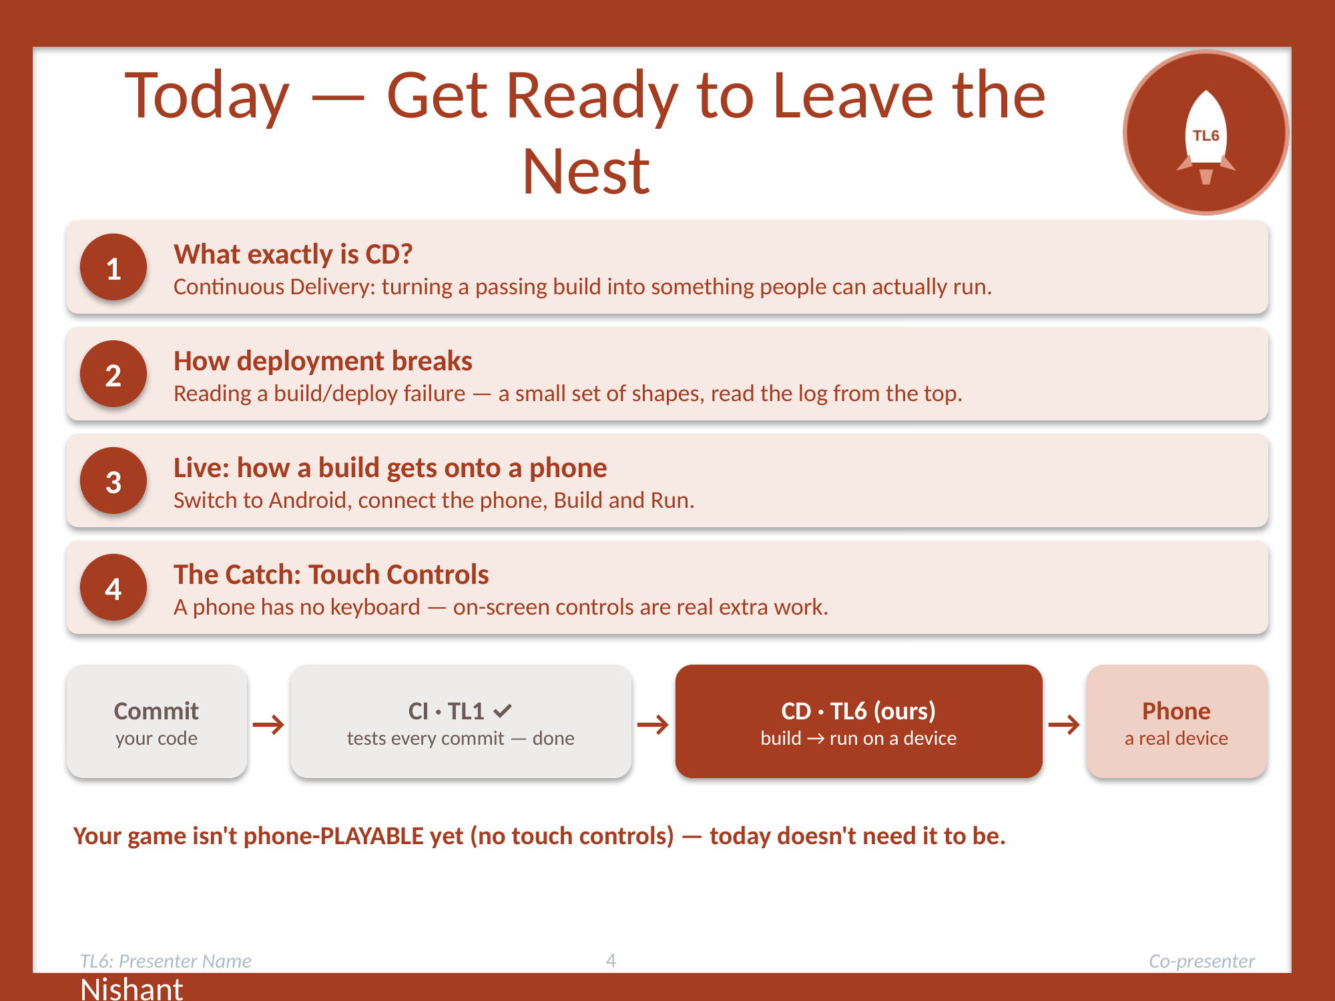
Today — Get Ready to Leave the Nest
1 — What exactly is CD>
2 — How deployment breaks: reading a build/deploy failure.
3 — Live: how a build gets onto a phone.
4 — The Catch: Touch Controls
CI is TL1's (already running). We own CD. Your game isn't phone-PLAYABLE yet (no touch controls) — today doesn't need it to be.
Nishant
Notes:
[SPOKEN]
"Here's the hour. First, a bit about how deployment breaks and how to read a failure - because a build fails differently than code fails. Then the hands-on core: you'll profile your own feature and find out whether it could survive a phone, using the stress scene you built for TL3. I'll show you, live, how a build actually gets onto a phone. Then you'll break into your teams and do it for real - get one breaking point off an actual phone. And we'll finish by hardening your feature so it can't embarrass you in a demo.
Two things to know up front. One: CI - the automated testing on every commit - that's TL1's, and it's already running; we're not touching it. We own the OTHER half, CD: turning a green build into something a human can actually run. Two: your game isn't playable on a phone yet - no touch controls - but that's fine, because everything today either runs on your own machine or runs a self-driving test that needs no controls."]

Slide 5

CI Is TL1's. CD Is Ours
Continuous Delivery keeps a verified build ready for release.
CI (TL1)
CD (TL6)
Checks each commit
Confirms code builds
Runs automated tests
Produces a runnable build
Validates it on real devices
Keeps it ready for the demo
Green CI means the configured checks passed.
Device and demo checks still matter.
Matteo
Notes:
Matteo Starting:
Continuous Delivery means keeping software in a condition where the team can release it reliably when needed. In our class, TL1 already handles the CI (continuous integration) process. Their checks tell us whether the code builds and whether the configured automated tests pass.
TL6 focuses on what happens to that passing code. We need a runnable build, evidence that it works on the device we plan to use, and a stable version for our demonstration. A green CI result is useful evidence, but it only covers the checks that the pipeline actually contains. Tests can miss a bug, and an Editor test might never exercise phone input or a hosted Web build.
In team CDA's game Escape the 90s, for example, the movement code might pass its tests on a laptop. We still need to export the game and make sure another person can launch it and play it. That is the delivery problem we are discussing.

Slide 6
How Continuous Delivery Works
1
Package the game
Create a runnable build for the selected platform.
2
Deploy to a test environment
Place the build on a test computer, phone, or server.
3
Validate the build
Check gameplay, required assets, and performance on the target device.
4
Keep it ready for release
Store the verified version. The team approves when to release it.
Automation makes the workflow repeatable on each change.
Matteo
Notes:
Here is a simplified CD workflow after CI has passed. First, package the game for a specific target. The output is the actual build that someone will run. Next, deploy that build to a test environment. For us, that could mean a teammate's computer or phone.
Then validate that exact build. Can it load the required scenes? Do the controls work? Does representative gameplay perform well on the target hardware? Some checks can run automatically, while human playtesting still adds useful evidence. If a check fails, we fix the problem and repeat the workflow.
Finally, keep the verified version available for release. The team can choose the release time instead of rebuilding in a panic immediately before a demonstration. A full CD pipeline automates the repeatable build and staging steps.

Slide 7
Delivery vs. Deployment
Both prepare and test changes. The release decision differs.
Continuous Delivery
Continuous Deployment
Build and test automatically
Keep the update ready
A person approves release
Build and test automatically
Release each passing update
No manual release approval
For our class: keep a verified build ready for each demonstration.
Matteo
Notes:
CD can stand for Continuous Delivery or Continuous Deployment, so it helps to distinguish them. Both can automate the work that prepares and tests an update. The difference is the final release gate.
With Continuous Delivery, the verified update is ready, but a person or team chooses when to make it available to users. With Continuous Deployment, every update that passes the required checks goes live automatically. There is no separate manual release approval.
For this class, a useful goal is having a verified playable build whenever we need to demonstrate the game. We can still choose which version to show and when to publish it. We do not have to release every passing change immediately to apply Continuous Delivery principles.

Slide 8
CD in Our Unity Project
1
Export a playable build
Choose a target in Build Profiles and include the required scenes.
2
Run it outside the Editor
Try the exported game on another computer or the target phone.
3
Test the experience
Check controls, scene loading, and frame time during gameplay.
4
Keep a stable demo version
Label the tested build and commit. Keep a working backup.
Example failure: keyboard input works, but touch controls are missing.
Matteo
Notes:
Now connect the idea to our Unity games. First, export a build for the target platform and include the scenes that the demonstration needs. Running the project in the Editor is a useful development check, but the exported game is the product that our audience will use.
Second, open that build outside the Editor. Try it on another computer or phone so that we can discover assumptions tied to our development machine.
Third, test the experience. Check movement and other core controls, scene loading, and performance during representative gameplay. Use frame time and profiling evidence from the target device when available. Phone input needs special attention because keyboard controls alone do not give a touchscreen player a way to move.
Finally, label the tested build and the commit it came from, and retain a verified backup. That gives us a specific version we can demonstrate and a way to recover if a newer build causes trouble.

Slide 9
Ready to Ship: Our Checklist
1
Launches on the target device
A teammate can open the exported build without the Unity Editor.
2
Core gameplay and controls work
Keyboard or touch input works for the platform we plan to show.
3
Required scenes and assets load
The demo can reach its scenes without missing content.
4
Performance meets the team's target
Measure on the target device with representative gameplay.
5
Demo link or QR code opens the build
A new visitor can reach the tested version.
6
A verified backup build is available
We can return to a working version if the demo breaks.
Team-agreed criteria make 'ready' something we can verify.
Matteo
Notes:
This is a proposed checklist made specifically for our class. It makes release readiness something we can actually test. Start with launch: can a teammate open the exported build on the device we plan to use? Then try the core gameplay and the controls for that platform.
Next, visit the scenes needed for the demonstration and check that the expected assets load. Measure representative gameplay against a performance target that the team has chosen. We should set that target for our actual device and game instead of inventing one universal FPS number.
Also check the audience's access path. If we use a hosted link or a QR code, have another person open it and confirm that it reaches the correct version. Keep a verified backup build available so we can return to a working version if needed.
These are just suggested acceptance criteria. Once the team agrees on them, we have a clearer answer as to whether the game is ready. I will now be passing it off to Rinab, as the next section shows how to diagnose a build or deployment failure when one of these checks does not pass.

Slide 10
Reading a Build / Deploy Failure
A build fails differently than code fails, but only in a few shapes.
When code fails
When a build fails
A test goes red
Points at one function/line
Easy to spot, easy to rerun
A wall of scary red text
Often works fine in the editor
Looks worse than it really is
Rinab
Notes:
Code fails one way: a test goes red. A BUILD fails differently, and the errors look scary until you know the handful of shapes they come in. Let me give you the map so you're not lost when it happens, and it will happen.

Slide 11
The Four Shapes of a Build Failure
Missing reference/asset
A scene not added to Build Profiles, case sensitivity mismatch on an asset, etc.
1
Wrong target or architecture, missing SDK, or a module you never installed.
2
Wrong platform setting
Signing & permissions
Especially on mobile: a device won't run an app that isn't signed.
3
Usage of anything from the UnityEditor namespace will compile in the editor but will not work in the build.
4
A compile error the editor forgave
Rinab
Notes:
Most of the time Unity builds your game with no trouble. When it doesn't, it's almost always one of three things.
1. A missing reference or asset: something the editor had but the build couldn't find. The classic one is a scene that was never added to Build Profiles, or a file that never got committed to Git.
2. A compile error the editor was lenient about, like editor-only code that works when you press Play but not in a finished build.
3. Browser limits, which only apply to web builds. Some code that works on desktop, like multithreading or writing files, doesn't work in a browser.

Slide 12
Read the Log From the TOP
The FIRST error is usually the real one. The rest is fallout.
Open the Console after a failed build
Find the FIRST red error and ignore the pile below it
Match it to a shape, then fix it and rebuild
Rinab
Notes:
The skill is the same as reading a red test: don't panic, open the build log, and read from the TOP. The first error is usually the real one; everything after it is fallout. Match it to one of the three shapes, fix it, and rebuild.
One more thing for web builds: the Unity Console can show no errors and the game can still fail to load in the browser. Press F12 to open the browser's developer console and read the first red error there. A blank page often means index.html was opened straight from a folder, which browsers can block, so host it instead. If you get stuck, grab a TL6; that's exactly what we're for.

Slide 13
Building for a Phone (WEB)
Unity builds WEB as a .html file with Build and TemplateData
Build Profiles (older Unity: Build Settings) → WEB → Switch Platform.
Set Player Settings (company, product, version) → Build → the .html IS your WEB game.
Once built there should be an option to host on unity play.
Gavin
Notes:
[SPOKEN — merges the original 'building for a phone' + 'APK not AAB' slides.]
"The mechanics. Unity builds to Android as a single installable file called an APK. You go to Build Profiles - older Unity calls it Build Settings - select Android, and Switch Platform. Set your Player Settings: company name, product name, version. Then Build, and Unity produces the .apk. That file IS your phone game.
One note: Unity builds an APK by default, and that's exactly what we want - an APK can be downloaded and side-loaded straight onto a phone. The Google Play store wants a different format called AAB, but we're not publishing to a store, just sharing a download link. Android 6 and up runs an APK, which covers essentially every phone in the room."]

Slide 14
The Catch: Touch Controls
Your laptop game uses the keyboard (WASD, space, arrows). A phone has no keyboard.
A touchscreen needs on-screen controls: buttons, a joystick, or gestures — real extra work.
Without touch controls the game will appear on phones but you will not be able to move.
Plan for it early — it's the thing most likely to leave your game un-playable at the demo.
Gavin
Notes:
[SPOKEN]
"Here's the honest reason some phone builds won't be ready, and why Leaves the Nest deliberately did NOT run the game on a phone yet. Your laptop game uses the keyboard - WASD, space, arrows. A phone has no keyboard. A touchscreen needs on-screen controls: buttons, a joystick, gestures. That's real extra work. If you don't add touch input, the APK installs and launches - but nobody can move. So plan for it early; it's the single thing most likely to leave a team's game un-playable at the demo."]

Slide 15
One Movement Path, Two Input Sources
// The clean way: keyboard AND touch call the SAME method.
// Don't write the game twice.
public void MoveLeft(bool pressed) {
_movingLeft = pressed; // one place, one truth
}
// UI Button: OnPointerDown -> MoveLeft(true)
// OnPointerUp -> MoveLeft(false)
// Keyboard : A down -> MoveLeft(true), up -> MoveLeft(false)
Gavin
Notes:
[SPOKEN — the touch-input pattern, kept from the original.]
"The clean way to add touch without rewriting your game: route both the keyboard and the on-screen buttons into the SAME movement method. Here, both call MoveLeft. Unity's UI Button has OnPointerDown and OnPointerUp events - press to start moving, release to stop - and you point those at the exact same methods your keyboard already calls. Write the game logic once; let two input sources call it. Touch becomes a thin layer on top, not a second copy of your game. Teams that skip this end up maintaining two control schemes and regretting it."

Slide 16
Arcade Demo Mode — the Idle Timer
// A dead booth is an empty screen. Auto-play when idle.
float _idle;
public float idleLimit = 120f; // 2 minutes
void Update() {
if (Input.anyKey || Input.touchCount > 0)
_idle = 0f; // someone's playing
else
_idle += Time.deltaTime;
if (_idle > idleLimit)
PlayDemoReel(); // auto-play a recording
}
Gavin
Notes:
[SPOKEN — arcade demo mode, kept.]
"One touch that makes the showcase feel alive. At the final demo, machines sit idle between players, and an empty screen is a dead booth. Arcade demo mode: after no input for a couple of minutes, the game auto-plays a recording of itself. The room looks alive - every screen running a game whether or not someone's at it, just like a real arcade. The shape is simple: track time since the last input; if it passes your idle limit, roll the demo reel - a captured video, or replayed recorded inputs. You pick the idle time; a couple of minutes is typical. It's a small thing that makes the whole room feel like an arcade instead of a computer lab."

Slide 17
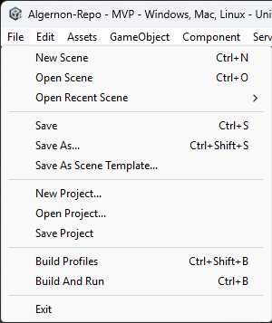
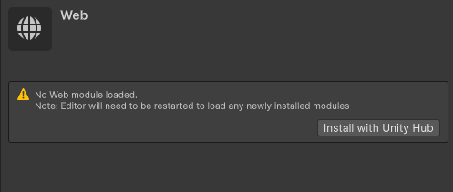
Web Build Tutorial
Click file
Then Build Profiles
Another window should pop up
Look down the list of build profiles for WEB
Click onto it and it will either ask you to download or you already have it downloaded
Do not recommend doing now as it takes a second
Once downloaded and installed it will ask you to restart unity, after that click onto WEB again and you can click build, and chose a folder location
Gavin

Slide 18
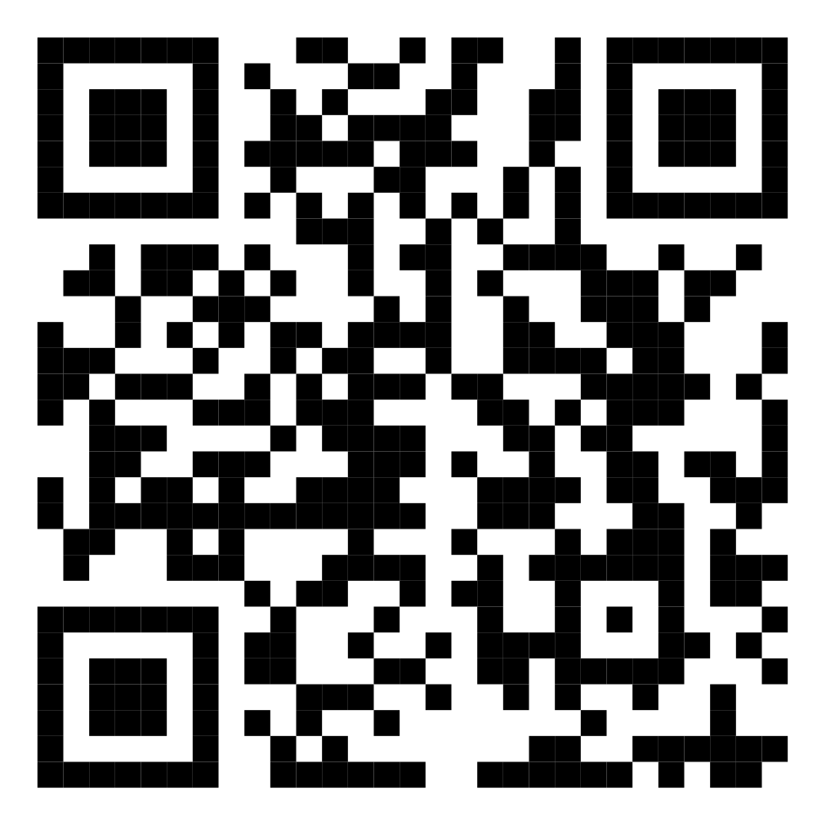

Web Build Tutorial
To publish the game:
Search "UnityPlay" on the internet
Click and login to your account
Scroll down and find "upload your UnityWebGL Game"
Now go to your folder that you built into
Compress the whole folder to a .zip for uploading
Drag and drop the compressed folder
From there you can also add a title, description, and even a thumbnail
Lastly click save at the bottom
Note: I recommend to save it unlisted as we will need to break copyright at some point and we don’t want to get in real trouble
Lastly for the QR code:
Search "link to QR code generator" on the internet
Find one to your liking
Copy the link from your uploaded and saved game
Paste it into the website
Then you can take it and add it on to your poster, I used paint
Gavin

Slide 19
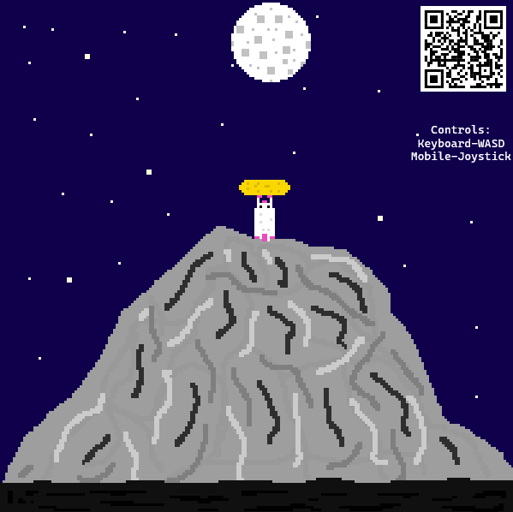
Algernon Poster
Gavin

Slide 20
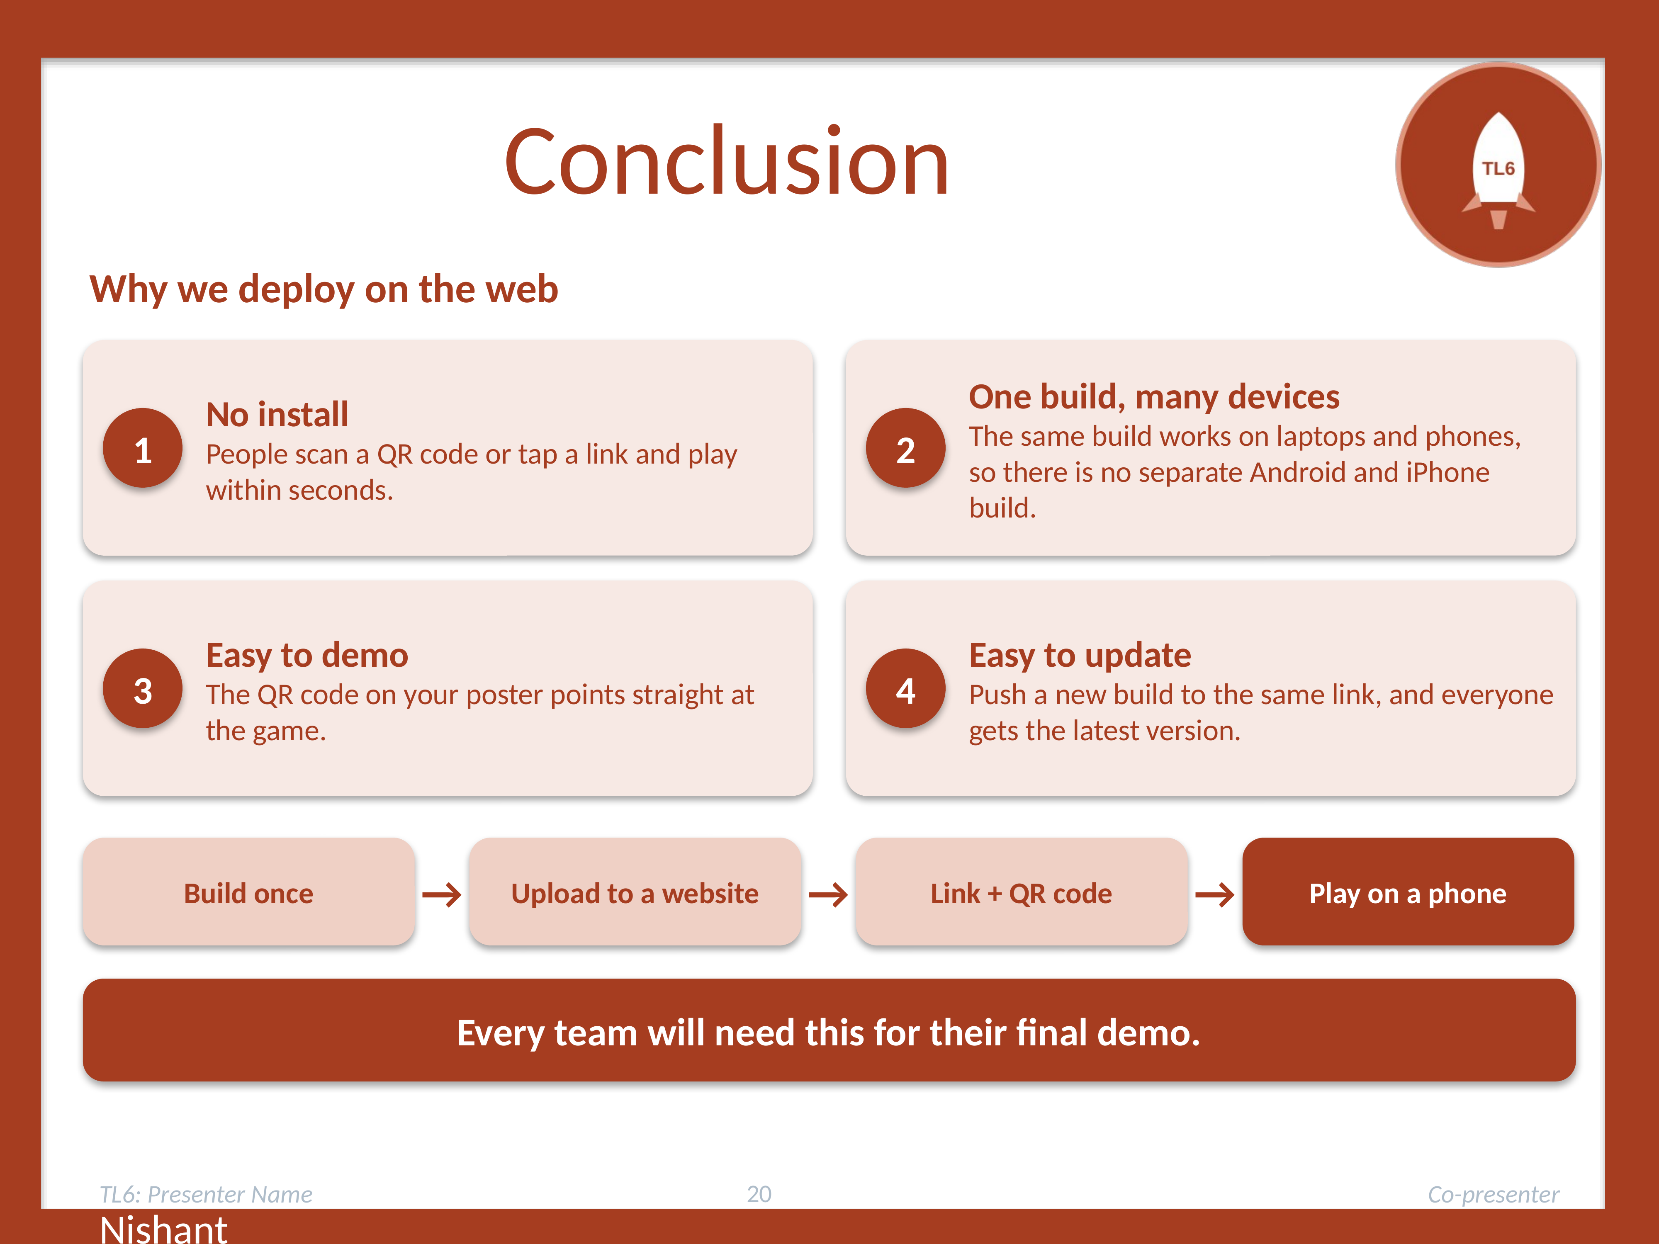
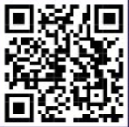
CONCLUSION
Why we're doing it this way
No install: people scan a QR code or tap a link and play within seconds.
One build, many devices: the same build works on laptops and phones, so there's no separate Android and iPhone build.
Easy to demo: the QR code on your poster points straight at the game.
Easy to update: push a new build to the same link, and everyone gets the latest version.
Every team will be needing this for their final demo.
Nishant

Slide 21
Lecture 2

Slide 22
Now — In Your Teams (TL6s take over)
Each team's TL6 leads. Get ONE breaking point off a real phone. 12 minutes on the clock.
Name
Notes:
[SPOKEN — the handoff to the dispersed phase. The podium goes deliberately empty; every TL6 is now with their own team. A visible countdown IS the podium while no one is at it.]
"Now it gets hands-on and I'm going to step back. Each team's TL6, take over - you're going to walk your team through exactly what I just showed, on one of your phones.
Here's the target, and it's deliberately small so you're not stuck forever: get ONE breaking point off a real phone. One team member with an Android phone runs the stress scene on it; the whole team watches and reads the number off the phone screen. If your team only has iPhones or no usable phone, run it as a development build on a laptop instead and read the number there - you still get a real breaking point, just not on phone silicon.
You've got twelve minutes - the timer's on the screen. When it hits zero, one number written down, we come back together. TL6s - go."
[BC: start a visible 12-min countdown on the projector. The podium is empty ON PURPOSE - the timer + the one-number target hold the room. One TL6 returns to the podium when time's up to run the reconvene. iOS/no-phone teams use a laptop dev build.]

Slide 23
Watch: How a Build Gets onto a Phone
[Projected demo — one TL6, on a real Android phone, once for everyone]
Switch build target to Android · add the stress scene · connect phone (developer mode + USB debugging) · Build and Run.
The scene self-drives: escalates the load and reports its breaking point ON the phone screen. No controls needed.
Common snags: phone not detected (USB debugging off) · target still set to PC. Your team's TL6 knows both.
Name
Notes:
[SPOKEN — projected demo by the presenting TL6, done ONCE for the whole class before they disperse into teams. Show it on your own Android phone, projected.]
"Before you break into teams, watch me do this once, so you've seen the whole path before you try it. I'm going to take a stress scene and get it running on this actual phone.
[Do it live, projected. Narrate each step:]
- Switch the build target to Android in Build Settings.
- Add the stress scene to the build.
- Connect the phone by USB, with developer mode and USB debugging on.
- Build and Run - Unity compiles it, installs it, and launches it on the phone.
- The scene runs itself - it escalates the load and reports its breaking point right there on the phone screen. No controls needed; it self-drives.
[Then:] That's the whole path. In a second, each team's TL6 is going to walk you through doing exactly this on one of your phones. Watch for the two common snags: the phone not showing up - that's usually USB debugging off - and the build target still set to PC. Both are quick fixes, and your TL6 knows them."]

Slide 24
Follow Along — One Breaking Point off a Real Phone
In your team. Your TL6 leads. ~12 minutes. Target: ONE breaking point, on-device.
Android phone available:
• Build & Run the stress scene to the phone (as demoed). It self-drives.
• Read the breaking point off the PHONE screen. Note the phone model.
iPhone-only / no phone:
• Run the stress scene as a development build on a LAPTOP; read it there.
Write down: the load at the FPS break (half the phone's starting FPS) and, if reached, the physics-violation break.
Name
Notes:
[FOLLOW-ALONG — DISPERSED, per team, ~12 min, empty podium + visible timer. Each team's TL6 leads. This is where TL6s earn LECs (leading their team through a real device deploy).]
YOU MUST ACCOMPLISH:
- The team gets the stress scene running on ONE real Android phone (or, fallback, a laptop dev build for iOS/no-phone teams).
- The team reads at least ONE breaking point off the device: the FPS break (load at which the phone's FPS hit half its own starting FPS), and the physics-violation break if reached.
- Write it down WITH the device (phone model, or 'laptop dev build') - the number is meaningless without the hardware, especially the FPS one.
- Everyone on the team has SEEN a real on-device breaking point, not just a laptop prediction.
TIMING (the empty-podium mechanic):
- A visible 12-min countdown on the projector runs the room while BC/podium is empty.
- The completion target is deliberately ONE number, so teams know exactly when they're done and don't sprawl.
- When the timer ends, one TL6 returns to the podium to reconvene.
IF YOU DON'T ALREADY KNOW HOW (TL6 leads; this is LEC territory):
- Android deploy: search "Unity Build and Run Android USB" and "enable USB debugging Android developer options".
- Phone not detected: USB debugging off, or a data-only cable issue, or the target still set to PC.
- iOS is impractical in class (needs a Mac + Apple signing) - iPhone teams use the laptop dev-build fallback, no exceptions needed.
- TL6s: leading your team through this hands-on, on a real device, is exactly the one-on-one help that earns a LEC. This is your block.

Slide 25
Back Together — Now Harden It for the Demo
Share: what breaking points did teams see on a real phone? (TL6 uses these for final-build platform limits; L2 puts them on the phone playably.)
Now the OTHER half of TL6's job — the demo. DemoDemons was RECOVERING from a break; this is PREVENTING one.
A demo-safe build: no debug console spam · fails GRACEFULLY on a missing asset (no crash) · a known-good fallback state.
Spend the last few minutes hardening your own feature.
Name
Notes:
[SPOKEN — reconvene at the podium (~5 min in), then lead into the last hands-on: demo-safe hardening.]
"Come on back. Quick share - what breaking points did teams see on a real phone? [Take a few numbers.] Good - hold onto those; TL6 uses everyone's numbers to set the platform limits for the final build, and in L2 we put these on the actual phone with real controls.
Last thing today, and it's the OTHER half of TL6's job - the demo. You've all seen the DemoDemons lecture on recovering when a live demo breaks. This is the preventive side: build your feature so it's LESS LIKELY to break in front of an audience in the first place. A demo-safe build has no debug console spam cluttering the screen, it fails GRACEFULLY if an asset is missing instead of crashing, and it has a known-good state you can always fall back to. Let's spend the last few minutes hardening your own feature that way."]

Slide 26
Follow Along — Make Your Feature Demo-Safe
Harden YOUR feature against a live-demo disaster:
• Silence debug spam — no Console errors/warnings flooding a build.
• Fail gracefully — a missing asset or bad state shows a fallback, never a crash.
• Known-good state — a reliable starting point you can always return to on stage.
This is the PREVENTIVE twin of DemoDemons (which is about RECOVERING when it breaks anyway).
Name
Notes:
[FOLLOW-ALONG — demo-safe hardening. Preventive complement to DemoDemons (TL6 L2 territory is the reactive side).]
YOU MUST ACCOMPLISH:
- Your feature produces no flood of debug/console errors or warnings in a build.
- Your feature fails GRACEFULLY: a missing asset, null reference, or unexpected state shows a fallback or a caught, handled message - it does NOT crash the app.
- Your feature has a known-good state you can reliably return to (so if a demo goes sideways, you can reset to something that works).
- You can name, for your feature, the single most likely thing to break in a demo and what you did about it.
IF YOU DON'T ALREADY KNOW HOW:
- Silencing/handling errors: wrap risky calls (asset loads, external refs) in try/catch or null checks with a sensible fallback. Search "Unity handle missing asset gracefully" / "C# try catch Unity".
- Debug spam: strip or gate Debug.Log behind a flag for builds. Search "Unity disable Debug.Log in build".
- Known-good state: a reset method / reload of a clean scene. Search "Unity reset scene to initial state".
- This connects forward to DemoDemons: today you make it LESS likely to break; that lecture teaches the team to RECOVER calmly when something breaks anyway.

Slide 27
DECK MAP — HIDDEN (do not present)
TL6 L2 — Ship It & Wrap Up. Blank Office Theme master (BC adds formatting). Near end of term, days before code-complete / oral exams.
MERGE of original TL6 L1 (deployment, CI DROPPED - that's TL1's) + original TL6 L2 (pair programming + oral-exam prep). Reconciled with new TL6 L1 'Leaves the Nest' (profiling/hardening) - do NOT repeat that here.
ARC: L1 Leaves the Nest = MEASURE + HARDEN. L2 (this) = it ACTUALLY leaves (phone deploy + QR/arcade showcase) AND wrap the project (pair programming, oral-exam prep).
PART A - Ship to a phone: CD framing (CI is TL1's), build APK, touch controls (one movement path/two input sources), QR + poster, arcade demo mode, play games.
PART B - Pair programming: two deadlines (Tue lecture / Thu freeze), why Agile (compressed), driver & navigator, how pairs quietly fail, the deliverable, the LOCATOR write-up (20-50 words), how pairs get decided (TL6 recommends -> BC assigns Thu -> code freezes).
PART C - Oral-exam prep (capstone): run your game, know your commits, bring your Gantt (estimated vs actual - ties to TL4), code frozen since Thu.
NOTE MODES: word-for-word spoken; code-reference slides for the touch-input and idle-timer snippets. Theory compressed vs originals; mechanics + logistics kept intact.

Slide 28
From Lecture 1
2 — Profile your feature: could it survive a phone? (using your TL3 stress scene)
4 — In teams: get one real breaking point off an actual phone.

Slide 29
Ship It & Wrap Up
TL6 — Lecture 2 · Onto a phone, into the arcade, and ready for the exam
Notes:
[SPOKEN]
"Welcome to TL6's second and final lecture. Last time - Leaves the Nest - you measured whether your feature could survive a phone and you hardened it so a demo can't humiliate you. Today it actually leaves the nest: we get your game onto a phone, put it behind a QR code, and turn the room into an arcade. And because we're near the finish line, we also cover the two things that get you across it: pair programming to close the last gaps, and how to prepare for your oral exam.
So today has two halves - shipping, and wrapping up. Both are about getting to done."
[Then a short intro.]

Slide 30
Your TL6 Team — the Home Stretch
Same TL6 group from Leaves the Nest — circulating to help.
Today is the home stretch: ship to a phone, form pairs, prep for orals.
Grab us for the phone-build especially — that's where hands get stuck.
At the final showcase, TL6 runs tech support and keeps the arcade alive.
Name
Notes:
[SPOKEN — brief; cohort met in L1.]
"Same TL6 crew. We're circulating today as always, but this lecture is a bit different - it's less a new skill to drill and more the logistics of finishing: getting onto a phone, forming pairs, prepping for orals. Grab us for the phone-build part especially; that's where hands get stuck. And remember our other role - we run tech support during the demos, so at the final showcase, we're the ones keeping the arcade alive."]

Slide 31
Today — Ship It, Then Wrap It
PART A — Ship it: get your game onto a phone, behind a QR code — the arcade.
PART B — Pair programming: close the last gaps (two deadlines this week).
PART C — Oral-exam prep: how to defend what you built.
Theme: getting to done, and being ready to defend it.
Name
Notes:
[SPOKEN]
"Here's the hour, in two halves. First, shipping: your game runs on your laptop - that's platform one - and today we get it onto a phone, platform two, behind a QR code, so anyone can install and play it. That's the arcade. Second, wrapping up: pair programming, which is how you close the last unfinished gaps in the next few days, and then how to prepare for your oral exam. Two deadlines this week drive the pairing, so we'll be specific about those.
Both halves are about the same thing: getting to done, and being ready to defend what you built."]

Slide 32
Part A — Ship It to a Phone
CI is TL1's. This is CD: a passing build becomes a game on a phone.
Name
Notes:
[SPOKEN — section divider]
"First half: shipping. In Leaves the Nest you profiled and hardened your feature. Now we deliver it - turn a build into something a stranger can install and play on their own phone. That's Continuous Delivery, the CD half, and it's TL6's job. TL1 already owns CI - the automated testing on every commit - so we're not touching that. We pick up where a green build leaves off."]

Slide 33
CI Is Done — This Is the CD Half
TL1 wired up CI: every commit built & tested automatically. That's theirs — not today.
Today is CD (Continuous Delivery): turn a CI-passing build into something people can play.
For us that means a SECOND platform: laptop AND phone.
Leaves the Nest measured if it COULD run on a phone; today you put it there.
Name
Notes:
[SPOKEN — the original L1 framing, pointed at the new L1 + TL1's CI.]
"Quick orientation. TL1 wired up Continuous Integration weeks ago - every commit built and tested automatically. That's the CI in CI/CD, and it's theirs. Today is the CD - Continuous Delivery - taking a build that passed CI and turning it into something people can actually play. For us, that means a second platform: your game runs on your laptop, and now on a phone. In Leaves the Nest you measured whether it COULD survive a phone; today you actually put it there."]

Slide 34
Building for a Phone (APK)
Unity builds Android as a single .apk file — one installable package.
Build Profiles (older Unity: Build Settings) → Android → Switch Platform.
Set Player Settings (company, product, version) → Build → the .apk IS your phone game.
APK, not AAB: APK side-loads straight onto a phone (AAB is for the Play store — not us). Android 6+ runs it.
Name
Notes:
[SPOKEN — merges the original 'building for a phone' + 'APK not AAB' slides.]
"The mechanics. Unity builds to Android as a single installable file called an APK. You go to Build Profiles - older Unity calls it Build Settings - select Android, and Switch Platform. Set your Player Settings: company name, product name, version. Then Build, and Unity produces the .apk. That file IS your phone game.
One note: Unity builds an APK by default, and that's exactly what we want - an APK can be downloaded and side-loaded straight onto a phone. The Google Play store wants a different format called AAB, but we're not publishing to a store, just sharing a download link. Android 6 and up runs an APK, which covers essentially every phone in the room."]

Slide 35
Follow Along
Could It Survive a Phone?
On YOUR OWN machine. Open your TL3 stress scene + the Unity Profiler.
The frame budget: 60 FPS = 16.7 ms/frame; 30 FPS = 33 ms/frame.
• A phone has far less headroom than your laptop — the SAME load costs more there.
Measure your feature's per-frame cost: frame time, draw calls, GC allocations.
Recall your FPS break: you cut your STARTING FPS in half (device-fair — phone gets its own baseline).
Question to answer: how close is your feature to the phone's budget BEFORE the game is even finished?
Rinab KC
Notes:
[FOLLOW-ALONG — whole class, own machine. Profile the feature against a phone frame budget. Uses the TL3 stress scene. No phone needed for THIS block (that's the next, dispersed block).]
YOU MUST ACCOMPLISH (how you know you're done):
- Open your TL3 stress scene and the Unity Profiler on your own machine.
- Read your feature's per-frame cost: frame time (ms), draw calls, and GC allocations (garbage per frame).
- State your feature against the frame budget: 60 FPS = 16.7 ms/frame, 30 FPS = 33 ms/frame. A phone has far less headroom than a laptop, so the same load costs proportionally more there.
- Recall/record your FPS break from the stress scene - the load at which FPS dropped to HALF your starting FPS. That rule is device-fair: on a phone you'd sample the phone's own starting FPS and halve THAT.
- Answer: how close is your feature to a phone's budget already? Where's your biggest per-frame cost?
WHY THIS (no phone needed here): you can predict phone-readiness on your own machine - the Profiler tells you frame time, draw calls, and allocations regardless of device. The actual on-phone run is the NEXT block, per team. This block is universal and needs no hardware.
IF YOU DON'T ALREADY KNOW HOW:
- Profiler: search "Unity Profiler tutorial" and "Unity Profiler CPU frame time". Window -> Analysis -> Profiler.
- Frame budget: 1000 ms / target FPS = ms per frame you can afford (16.7 at 60, 33 at 30).
- GC allocations matter on mobile (GC spikes = stutter): search "Unity reduce GC allocations per frame".
- TL6s circulate: reading a profiler is confusing the first time - this is prime help/LEC territory. Help people find their single most expensive line.

Slide 36
The Catch: Touch Controls
Your laptop game uses the keyboard (WASD, space, arrows). A phone has no keyboard.
A touchscreen needs on-screen controls: buttons, a joystick, or gestures — real extra work.
No touch input = the APK installs and launches, but nobody can move.
Plan for it early — it's the thing most likely to leave your game un-playable at the demo.
Name
Notes:
[SPOKEN]
"Here's the honest reason some phone builds won't be ready, and why Leaves the Nest deliberately did NOT run the game on a phone yet. Your laptop game uses the keyboard - WASD, space, arrows. A phone has no keyboard. A touchscreen needs on-screen controls: buttons, a joystick, gestures. That's real extra work. If you don't add touch input, the APK installs and launches - but nobody can move. So plan for it early; it's the single thing most likely to leave a team's game un-playable at the demo."]

Slide 37
One Movement Path, Two Input Sources
// The clean way: keyboard AND touch call the SAME method.
// Don't write the game twice.
public void MoveLeft(bool pressed) {
_movingLeft = pressed; // one place, one truth
}
// UI Button: OnPointerDown -> MoveLeft(true)
// OnPointerUp -> MoveLeft(false)
// Keyboard : A down -> MoveLeft(true), up -> MoveLeft(false)
Name
Notes:
[SPOKEN — the touch-input pattern, kept from the original.]
"The clean way to add touch without rewriting your game: route both the keyboard and the on-screen buttons into the SAME movement method. Here, both call MoveLeft. Unity's UI Button has OnPointerDown and OnPointerUp events - press to start moving, release to stop - and you point those at the exact same methods your keyboard already calls. Write the game logic once; let two input sources call it. Touch becomes a thin layer on top, not a second copy of your game. Teams that skip this end up maintaining two control schemes and regretting it."

Slide 38
The QR Code, the Poster & the Arcade
Host the .apk at a public link (TL6's behind-the-scenes job — how-to provided).
Generate a QR code pointing at the download.
Your final-demo POSTER carries: the controls + the QR code.
Scan → install → play on your own phone. All teams present at the demo, ready or not.
Name
Notes:
[SPOKEN — merges QR/poster + 'preview of final demo'.]
"Once you've got an APK, host it somewhere with a public link - that's the TL6 behind-the-scenes job, how-to provided - and generate a QR code pointing at that download. At the final demo, your team's POSTER carries two things: your game's controls, and that QR code. Someone scans it, installs the APK, and plays your game on their own phone. That's the goal.
And what you see today is a preview of demo day: every game that's ready has a poster with controls and a QR code. All teams must be present at the final demo - ready or not, you're part of the arcade. The QR download is what turns 'come watch my game' into 'install my game and play it yourself.'"]

Slide 39
Arcade Demo Mode — the Idle Timer
// A dead booth is an empty screen. Auto-play when idle.
float _idle;
public float idleLimit = 120f; // 2 minutes
void Update() {
if (Input.anyKey || Input.touchCount > 0)
_idle = 0f; // someone's playing
else
_idle += Time.deltaTime;
if (_idle > idleLimit)
PlayDemoReel(); // auto-play a recording
}
Name
Notes:
[SPOKEN — arcade demo mode, kept.]
"One touch that makes the showcase feel alive. At the final demo, machines sit idle between players, and an empty screen is a dead booth. Arcade demo mode: after no input for a couple of minutes, the game auto-plays a recording of itself. The room looks alive - every screen running a game whether or not someone's at it, just like a real arcade. The shape is simple: track time since the last input; if it passes your idle limit, roll the demo reel - a captured video, or replayed recorded inputs. You pick the idle time; a couple of minutes is typical. It's a small thing that makes the whole room feel like an arcade instead of a computer lab."

Slide 40
Part B — Pair Programming
Close the last gaps together — and meet how industry actually builds.
Name
Notes:
[SPOKEN — section divider / pivot to the wrap-up half.]
"Second half: getting the project to done. All term you've worked traditional, waterfall-style. In these last days we pivot to the way industry actually builds - pair programming - and we use it to close the last unfinished gaps in your games. There are two deadlines this week that drive how pairs form, so let's be precise about them first."]

Slide 41
This Week: Two Deadlines
TODAY (Tue) — this lecture: how pairing works + your deliverable.
BEFORE THU — tell your TL6 any unfinished code (pair-programming possibilities).
THU (status update) — code FREEZES (no changes until after orals) + pairs assigned.
Don't wait: get your unfinished pieces to your TL6 before Thursday.
Name
Notes:
[SPOKEN]
"Two deadlines this week, and they matter. Today, Tuesday, this lecture: you leave knowing how pairing works and what your deliverable is. Between now and Thursday, your one job is to tell your TL6 any pair-programming possibilities - meaning any code you did NOT finish: a half-built feature, a rough edge, anything someone could pair with you on. Your TL6 uses those to recommend logical pairings. Then Thursday, at the status update, two things happen at once: the code FREEZES - no more changes until after the oral exams - and the pairs get assigned. So don't wait: get your unfinished pieces to your TL6 before Thursday."]

Slide 42
Why Agile, Why Pairing — the Short Version
Waterfall all term (clear ABET artifacts); industry runs Agile — pairing is core Agile (from XP), and ABET too.
What it is: two programmers, one computer, rotating partners — collective ownership (fix bugs, don't blame).
Why it works: every line reviewed as written · encourages refactoring · spreads knowledge (no single point of failure).
“Half as fast?” Mixed evidence — but fewer false starts, bugs caught early, knowledge-sharing worth it. Not the waste it looks like.
Name
Notes:
[SPOKEN — COMPRESSED from the original's 3 theory slides (why Agile / what it is / isn't it half as fast). Keep it brisk.]
"Quick why, then we get practical. All term we've done waterfall - plan, document, build, test - on purpose, because it produces the clear artifacts ABET accreditation wants. But industry mostly runs Agile: short cycles, constant collaboration, less paperwork. Pair programming is a core Agile practice from Extreme Programming, and it's part of ABET too - so today is your bridge from how school tracks software to how the working world builds it.
What is it? Two programmers, one computer, writing code together, with rotating partners so everyone works with everyone. It builds collective ownership - the code belongs to the team, not one author - so bugs get fixed, not blamed. Why it works: every line is reviewed as it's written, it encourages refactoring, and it spreads knowledge so there's no single point of failure. And the obvious objection - isn't that half as fast? The honest answer: the research is mixed, but pairs have fewer false starts and catch bugs early, and even when it's a little slower the knowledge-sharing is often worth it. It's not the waste it looks like."]

Slide 43
Driver & Navigator
DRIVER — has the keyboard, writes the code, focused on the line in front of them.
NAVIGATOR — reviews each line as it's typed, thinks a step ahead, holds the big picture.
Switch roles OFTEN — every 20–30 min or each small task.
Same driver all day = an audience, not a pair.
Name
Notes:
[SPOKEN — the core mechanic.]
"The core mechanic - two roles, learn them. The DRIVER has the keyboard and writes the code, focused on the line in front of them. The NAVIGATOR watches every line as it's typed, thinking a step ahead - spotting errors, questioning the approach, holding the big picture. And the key rule: switch roles often. Every twenty or thirty minutes, or after each small task. If the same person drives all day, you don't have a pair - you have an audience."]

Slide 44
How Pairs Quietly Fail
Disengagement — one person drifts, checks out.
“Watch the master” — the junior defers to the expert and stops contributing.
Silence — if the pair goes quiet, collaboration has stopped (talking IS the work).
Fix for all three: put the LESS experienced person in the driver's seat more often — it forces conversation.
Name
Notes:
[SPOKEN]
"Pairs don't fail loudly - they fail quietly, so watch for three things. Disengagement: one person drifts, checks their phone, tunes out. The 'watch the master' trap: if one is far more experienced, the junior defers and stops contributing - which defeats the point. And silence: if a pair goes quiet, collaboration has stopped, because here, talking IS the work. The fix for all three is the same: when in doubt, put the LESS experienced person in the driver's seat more often. It forces the conversation and keeps both people engaged."]

Slide 45
Your Pair-Programming Deliverable
Pick an unfinished aspect in SOMEONE ELSE'S code (not your own).
Best pairing: one person from that code's team (not the owner) + one outsider who's done similar work.
~3 hours of real pair work → run the auto-tester afterward to confirm nothing broke.
Do NOT change anyone else's code before the oral exams.
One of you writes it up and submits to Canvas (see next slide — it's not an essay).
Name
Notes:
[SPOKEN]
"Your actual deliverable. Find a partner and pick an unfinished piece in SOMEONE ELSE'S code - not your own. The ideal pairing is one person from the team that owns the code, but not the owner, plus one person from outside who's done something similar - inside context meets outside perspective. Put in about three hours of genuine pair work. Then run the auto-tester to prove you didn't break anything. And the hard rule: do NOT modify anyone else's code before the oral exams. One of you writes it up and submits to Canvas - and the write-up is not what you'd expect, which is the next slide."]

Slide 46
The Write-Up Is a Locator Note
Max 300 words — but 20–50 is plenty. It is NOT an essay.
Just: who was in the pair, what you changed, and WHERE to find it.
At the demo, Dr. BC walks game to game with a printout, finding each pair's update to mark it.
At least one person per pair stays by the updated game until it's marked.
The note exists so your update is found and marked fast — short and specific wins.
Name
Notes:
[SPOKEN]
"This is the part people over-do, so listen closely. The write-up has a max of 300 words - but I'm honestly expecting twenty to fifty. It is NOT an essay about pair programming. It's a locator note: who was in the pair, what you changed, and WHERE to find it in the game. Here's why that's all it needs to be: at the final demo, Dr. BC walks game to game with a printout of every write-up, hunting down each pair's contribution to mark it. So at least one person from your pair stays near the game you updated until it's marked. The note exists purely so your update gets found and marked fast. Short and specific beats long and vague, every time."]

Slide 47
How Pairs Get Decided
Your TL6 recommends the logical pairings for the team.
TL6 brings them to Thursday's status update; Dr. BC assigns the official pairs there.
Once pairs are set, the code FREEZES.
Before Thursday: know what's unfinished and who'd fit — get it to your TL6.
Name
Notes:
[SPOKEN]
"How pairs actually form. As your TL6, part of my job is recommending the logical pairings for our team - who should work with whom, on what unfinished piece - and I bring those recommendations to Thursday's status update. Dr. BC assigns the official pairs there, using my recommendations as the starting point, and once pairs are set, the code freezes. So before Thursday: know what's unfinished in our team and who'd fit each piece, and get that to me. The pairing follows naturally from what you've told me."]

Slide 48
Part C — Prep for Your Oral Exam
Individual. You defend YOUR contribution, live — code frozen since Thursday.
Name

Slide 49
Prep for Your Oral Exam
It's INDIVIDUAL — you defend YOUR contribution, live.
Run your game; point to where your code executes; walk your methods from the entry point (show, don't describe).
Know your commit history — open your repo beforehand; show what you built and when.
Bring your Gantt / estimates — compare estimated vs actual, reflect honestly (your TL4 tracking comes home).
Code frozen since Thursday — no last-minute edits. Defend what's in the repo.
Name
Notes:
[SPOKEN — the capstone. Ties back to TL4 (Gantt) and TL3 (running tests) - the whole course converges here.]
"Last thing, and it's the one that pulls the whole course together - how to prepare for your oral exam. First, it's individual: you personally defend YOUR contribution, live. So be ready to run your game and point to exactly where your code executes - walk the examiner through your methods, step by step, from your entry point. Don't just describe it; show it running. Second, know your own commit history - open your repo beforehand so you can show what you built and when. Third, bring your Gantt and your time estimates, because you'll compare what you estimated against what it actually took, and reflect honestly on yourself as an estimator - that's the tracking you set up with TL4 coming home to roost. And remember the code's been frozen since Thursday, so there are no last-minute edits: what you defend is what's in the repo. Prepare to talk about it, not change it. Run a passing test live, know your commits, own your estimates - that's the exam."]

Slide 50
Let's Play Some Games
Every game that's ready: put your QR code up — we scan and play right now.
This is the arcade moment — the point of the second-platform build.
Not ready? That's your signal: touch controls + the build pipeline stand between you and demo day.
Ship it, pair up, prep to defend — and let's play some games.
Name
Notes:
[SPOKEN — closer / the arcade payoff.]
"That's TL6, and that's the finish line in sight. For every game that's ready today - put your QR code up, and we'll scan and play right now. This is the arcade moment, the whole point of the second-platform build. If your game's not ready, that's your signal: touch controls and the build pipeline are what stand between you and demo day, and you've got just days left.
So: ship it to a phone, pair up to close the gaps, prep to defend your work - and let's play some games."]

