Slide 1

Dolphyn Small Business Insights
Team Math Majors Unite:
Georgia Channing, Harry Channing, Shannon Hall, Owen Queen

Slide 2

Introduction
Machine Learning is becoming an increasingly prevalent tool in business development
SMBs don’t always have access to competent data practitioners
The goal was to develop an easy to use and understand tool for delivering data insights
Approach: make a readable UI that gives a basic overview of ML tools, then accepts data input for model computation (done on the back end)
Pivoted away from image processing so as to create a more diversely usable product
Successfully completed preprocessing steps, pivoted away from prediction

Slide 3

Customer Value
Not every business has money to throw at data scientists
Every business collects a deluge of data
Easy-to-understand business insight computation could provide tremendous value to cash-strapped SMBs
Pivoted away from image processing around Sprint 3 – less widely applicable
Pivoted away from prediction around Sprint 4 – too much variability on needs of different customers

Slide 4

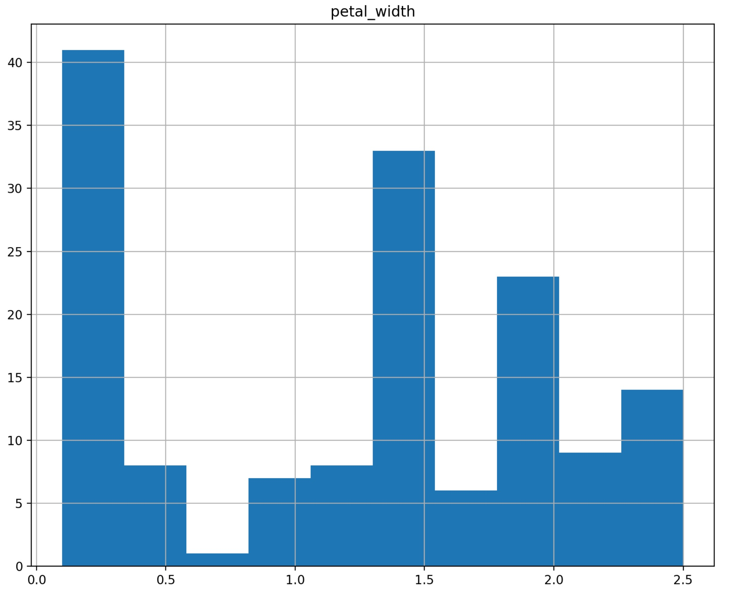
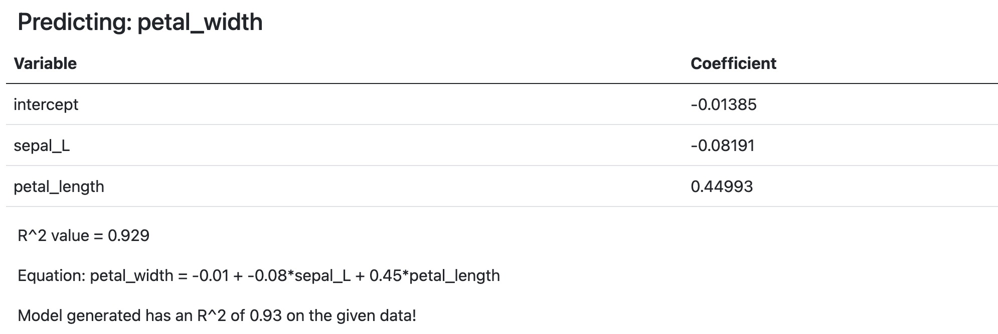
Technology
Django frontend
Python (pandas, os, numpy, matplotlib, skit-learn) backend
Column Drops and Manipulation
PCA, T-SNI, Linear Regression, Histograms

Slide 5

Team
Backend design -- Ms. Channing
with small contributions from Mr. Channing and Mr. Queen
Presentation development, graphical design, and communication between frontend/backend groups -- Mr. Channing
Frontend UI design implementation -- Mr. Hall
Frontend-backend merger – Mr. Queen
Largely static roles

Slide 6

Project Management
Most goals were not completed on time
Underestimated difficulty of certain undertakings
Using new languages
Busy semesters for everyone
Some cramming in final weeks
General goals were met of creating an easy-to-use ML tool

Slide 7

Reflection
Things that went well:
Friendly dynamic
Everyone willing to lend a hand when possible
Everything got done
Difficulties:
Siloed work efforts
Busy schedules all around
Interim steps for improvement sometimes unclear
Project was largely a success:
Easy-to-use ML turn for model development
Completed the base of what we set out to do
Room for model improvement or additional explainability

