Slide 1
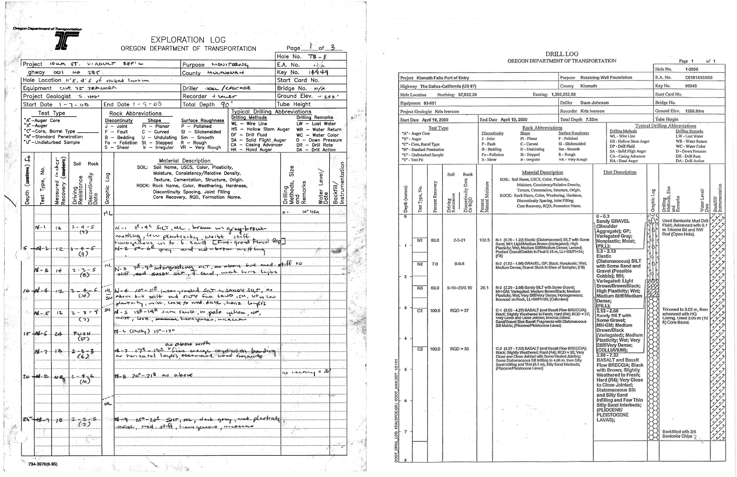

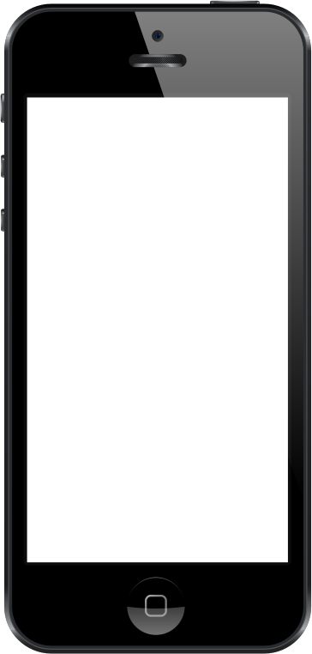

CS 36
BLAMO
Logging Boreholes
Borehole Logging Application Made for Oregon
Acknowledgements
When working outside of an office, the method we use to record data is very important. This data is not collected just for fun, it will be used for analysis, reports, research, and may be used as evidence to justify important decisions.
The process through which we collect this data should therefore be efficient and free from errors, so that an undue effort is not necessary and the integrity of the data is preserved.
We would like to thank T. Matthew Evans, Ph.D, a Professor from the School of Civil and Construction Engineering at Oregon State University. For his contributions to the application, including but not limited to, the catchy name.
We would also like to thank graduate student Victoria Dutille, for providing rock/soil descriptions used in this application. Along with the format for outputting the csv.
Figures below could be replaced with flowchart of application.
This Photo by Unknown Author is licensed under CC BY-SA
Figure: Either photo of matt, or image from Victoria’s project showing what our outputted data is being used for.
Figure 1: Example of old handwritten form
Figure 2: Example of drill log document
Figure 3: Homepage of app, or other page
Improving Workflow
Better Outcomes
We have developed a mobile application that will eliminate the need for a handwritten form (figure 1), and can produce a professional drill log document (figure 2), without the need for commercial software.
This way, data will only be entered once and can be entered in the field. The user interface is designed to simulate the workflow of the old handwritten form in order to facilitate learnability.
The user interface is written with a target audience of people with lots of technical experience with soil and rock analysis.
This application allows the user to select a cloud provider to store drill log documents and make data transfer from the mobile device used in the field as easy as possible.
This application has auto-save and auto-backup features to prevent data loss.
Our development was targeted at mobile devices running Android, with the a port to iOS in order to target the most potential users.
Additionally, this application also outputs a csv file of the data to be used by graduate student in order to create a map of drilling sites with a drill log document attached to each site.
Photo of team
Evan Amaya; CS Senior
amayae@oregonstate.edu
Alexander Smith; CS Senior
smithal5@oregonstate.edu
Sean Spink; CS Senior
spinks@oregonstate.edu
James Trotter; CS Senior
trotter@oregonstate.edu

