Slide 1

Quality Assessment for Local Banking Apps
Supervisor name
Dr. SULTAN S. ALQAHTANI

Slide 2
Team members
ID | Email | Name
440013537 | yktaltuki@sm.imamu.edu.sa | Yousef Khalid Alturki
440018676 | zunzizi@sm.imamu.edu.sa | Ziyad Mohammed Al-Enizy
440013633 | Moalsharif@sm.imamu.edu.sa | Mohammed Omar Alsharef

Slide 3
Content
INTRODUCTION
APPLICATION OVERVIEW
STATIC ANALYSIS TOOLS
CHALLENGS AND LESSONS
SECURITY
DOCMENTATION
UML DIAGRAM
READABLE
CONCLUSION

Slide 4
Introduction
The purpose of the workshop is to analyze the quality of the source code of local bank applications to practice what we learn in Software Engineering 2 course by using MobSF (Mobile Security Framework) as the main tool and some other additional tools that help us analyze the application to work on AlRajhi Bank - Android version – and try to improve it.

Slide 5
Application overview
ALRAJHI | APPLICATION NAME
4.2 | VERSION
23/9/2021 | DATE OF ANALYSIS
ANDROID | MOBILE OPERATING SYSTEM

Slide 6
Static analysis tools
Use analysis tools application to find bugs and errors , use multiple tools is more efficiency because some tools maybe lead to false positive test.
There are four tools we using in this work shop , three of the for analyze and one for UML diagram
MOBSF tool
Generate PDF report and source code.
Qark tool
Generate HTML report
AndroBug tool
Generate text document report
Smartdraw website
Generate UML diagram for source code

Slide 7
Challenges and lessens
We learned many things about analysis tools, the differences between them, and how they work in real applications in Android Java versions.
First we tried to download several analysis tools in windows environment for Alinma bank but they did not work, so we move on MACOS environment and tried to run it, but they did not work also.
We thought Alinma bank has some issues or the tools do not support kotlin language, so we decided to download AlRajhi bank and try to run the tools, but we got the same thing in Alinma bank.
After we read about these tools and why they did not work in these applications, we discovered that there are two types of tools, static and dynamic.
The reason dynamic tools did not work because the applications that have other communications to other servers.

Slide 8
Secuirty
Secure coding involves writing code in a high-level language to prevent potential vulnerabilities (which could expose data or cause harm within a targeted system).
The steps of analysis secure coding:
Step 1: run MOBSF Tool
Upload android apk file to the tool to give us static analysis of the code and source code.
Step 2: download source code
Download source code to computer and open it with IDE.
Step 3: discover source code
Discover the source code to find security issue.
Step 4: use sub tools
Use the sub tools we have to see if give the same issues in MOBSF or MOBSF lead to false positive test.
Step 5: search about issues
MOBSF and sub tools gives some security issues and we are search about issues to get more information about it.
Step 6: find solutions ( if exist)
After we get more information about the issue, we try to get solution for the issue.

Slide 9
Permissions
Permissions can give apps control of your phone and access to some features using it or may possibly run in the background, some of these permissions grantee automatically or ask the user to grantee the permission.
Some applications require permissions to function properly, and without permissions, the application does not work properly or cannot use the application.

Slide 10
Permissions
Type of permissions
Install-time
permissions
Normal
permissions
Signature
permissions
Runtime
permissions

Slide 11
Permissions
Each type of permissions have different access to the features by ask the user to get the permission or automatically when install the application.
In MOBSF tool shows there are some permissions are dangerous permissions which called Runtime permissions.
The dangerous is potential for misuse the application by access to some data that should be more private data for the user.

Slide 12
Permissions
Some examples of dangerous permission misuse:
Camera: the app can secretly turn on your camera and record what’s going on around you.
Location: the app can secretly track your location to build a profile on your daily habits
Audio: the app can secretly record what’s going on around you, including private talks
Storage: the app can secretly read, change, and delete any of your saved documents, photos, and other files.
AlRajhi bank asks for these permissions , and should keep the private user data-sensitive information protected because there is a privacy concern for something that should be just a Bank app.

Slide 13
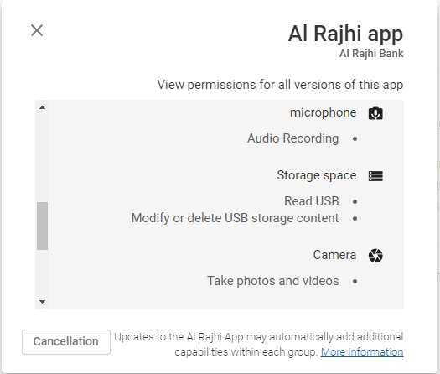
Permissions
These are some of the permissions requested by the application, which can be found in the Google Play Store at the end of the application information.

Slide 14
Temporary file (CWE-532)
Temporary files are the kind of files that store temporary data that is created by the programs
The MOBSF tool shows there is unsecured to written sensitive information in the temporary file, but this leads to false positives test because there are no security issues and no sensitive information written in temporary file
Alrajhi application use OpenSSL to create SSL certification to encrypt the data transfer , credit card transactions and logins.

Slide 15
Temporary file (CWE-276)
SSL certification creating a temporary file for temporary keys used for one purpose , so it is difficult to decrypt past messages because the key was temporary and discarded (once the session terminated) and throw it into a temporary file.
SSL certification is very important in Alrajhi bank to protect the data and gives users high privacy as should be.
The Qark and AndroBug tools do not show any security issues in temporary file.

Slide 16
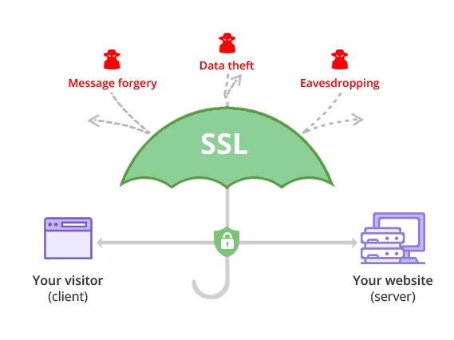
Temporary file (CWE-276)
The credit card transactions in Alrajhi Bank send from client to server during data transfer, the SSL keeps the data encrypted from attackers until the data be delivered safely.

Slide 17
Intents (CWE-927)
Intents is a messaging object you can use to request an action from another app component. Intent use for activities, services, and Delivering a broadcast.
Intents are a way of telling Android what you want to do like ( receive SMS message or share photo with other applications). Intents can be used to signal to the Android system that a certain event has occurred. Other components in Android can register to this event via an intent filter.

Slide 18
Intents (CWE-927)
Type of intents
Explicit intents
Implicit intents

Slide 19
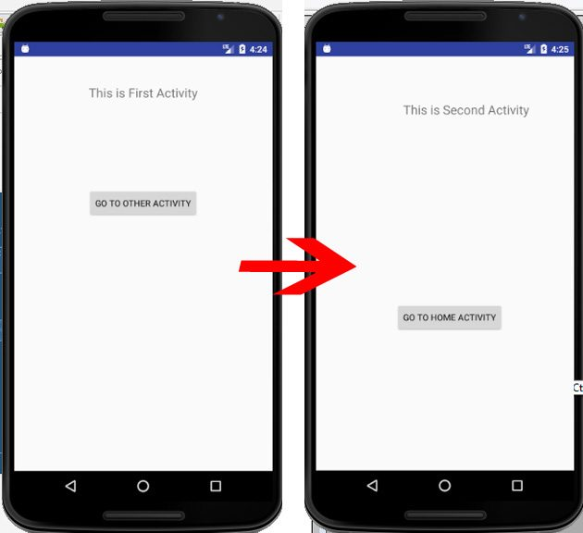
Intents (CWE-927)
Explicit intents: communication between two activity inside the application by specific the target component.
This is example of Explicit intents.
When we click to GO TO OTHER ACTIVTY will show another page or activity in same application we use it.

Slide 20
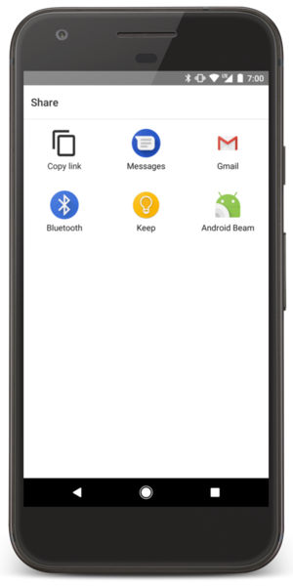
Intents (CWE-927)
Implicit intents: communicates between two activities of different application, Implicit intents do not name a specific component.
This is example of Explicit intents.
Share using a different app depending on their current situation, like when share a photo will show all applications in your device that support photos and can share with it.

Slide 21
Intents (CWE-927)
Using an implicit intent to start a service is a security hazard because you cannot be certain what service will respond to the intent, and the user cannot see which service starts.
For sensitive data of users use do not use implicit intent because the message when shared maybe some applications can interrupt the message.

Slide 22
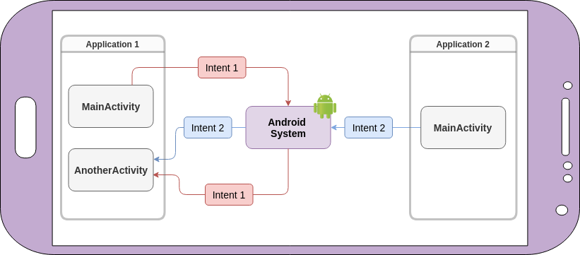
Intents (CWE-927)
In implicit intent does not specify a component that receives a message and insecure ways of using implicit intents may allow malicious applications to intercept or forge intents.

Slide 23
Intents (CWE-927)
AlRajhi bank should keep sensitive data of users more private and protected.
Should not be share sensitive data via implicit intent like ( user name , password , … ), because some application maybe interrupt the user data which is more dangerous if hackers can use these data.
In the source code we notice some intents use public method instead of protected method, should use protected methods because cannot be accessed from outside class to protect sharing with other apps on the device.

Slide 24
SQL-Injection (CWE-89)
A code injection technique that might destroy the database, SQL injection is one of the most common web hacking techniques and it is a powerful attack because it provides access to application databases.
The OWASP rank injection as their number 1 security concern.

Slide 25
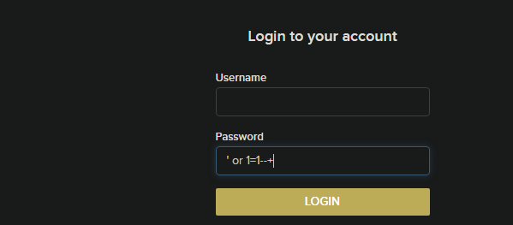
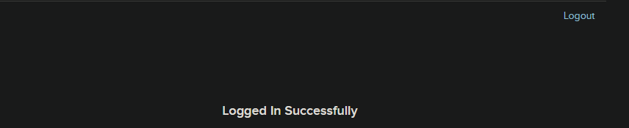
SQL-Injection (CWE-89)
In the password field we put ‘ or 1=1--+.
--+ is used to ignore the rest of the command.
Data base will check if the value which receive from password field is true or not, since 1=1 always true will receive the true value from database, then will allow to login to the account.

Slide 26
SQL-Injection (CWE-89)
MOBSF report shows that there is a dangerous issue in the SQL database, but this leads to false positives test.
Steps we did to get false positives test:
Run Qark tool to generate the security issues report, but did not show any issues in SQL database.
Run AndroBug tool to generate the security issues report, but did not show any issues in SQL database.
Use the vulnerability in the application and did not work.
Search in the source code about SQL-Injection vulnerability but we did not find it.
That is means that the AlRajhi application has prevented this vulnerability.

Slide 27
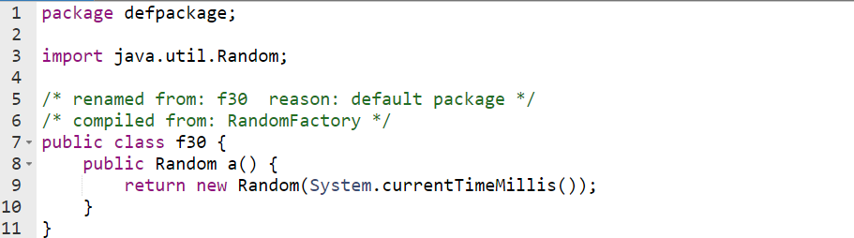
Generate Random Values (CWE-330)
When software generates predictable values, it may be possible for an attacker to guess the next value that will be generated and use this guess to impersonate another user or access sensitive information.

Slide 28
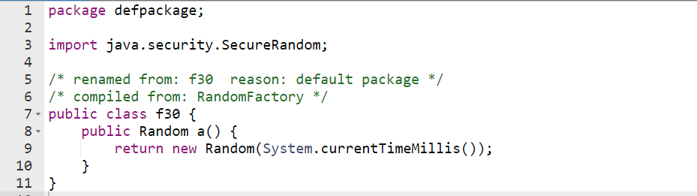
Generate Random Values (CWE-330)
The application must use SecureRandom to generate account numbers.
SecureRandom produces non-deterministic output, so it's hard to predict.

Slide 29
Data Storage(CWE-276)
External storage is the memory space such as SD card can also store application data, there’s no security enforced upon files you save to the external storage.
All applications can read and write files placed on the external storage and the user can remove them.
In AlrajhiBank application a sensitive data shouldn't store on external storage it can be modified or read by other apps, It is better to use internal storage to save sensitive data.

Slide 30
Data Storage(CWE-276)
By Incorrect permissions attacker can be access to sensitive information in external storage such as (passwords , account number).
To avoid modifying or reading data in external storage, you should:
Encrypt any sensitive data that it writes to external storage.
Perform input validation on any data that it reads from external storage.
Requires the user to grant their permission to access the resource.

Slide 31
Webview Enables Content Access
Android WebView is a system component that lets Android apps display web content inside them without opening a dedicated browser.
WebView file access is enabled by default.
If the WebViews take in untrusted input, this can allow for data theft.

Slide 32
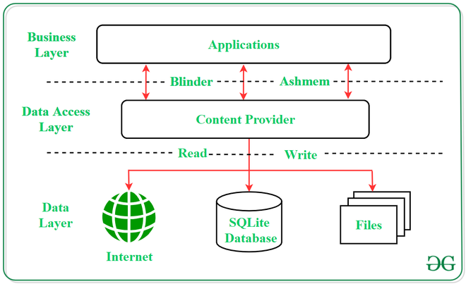
AlrajhiBank application does not disable Content Provider access from WebViews, this can cause access to sensitive data.
Webview Enables Content Access

Slide 33
Log File (CWE-532)
log file is data file that contains information about usage patterns, activities, and operations within an application. The benefit of log file is for developers while analyzing data processing inside apps and easy to make sure the results are correct and keeping track of crashes and errors.
Log file may also store sensitive data like passwords, names or numbers.
Using a log file in Al Rajhi Bank to record events, transfers, deposits, loans, customer and employee information, numbers of credit cards, passwords, messages, and communications between communication software applications.
Should be more careful about sensitive data of employees and customers, so that attackers do not eavesdrop on the information by hacking the log file and obtaining sensitive data.

Slide 34
Log File (CWE-532)
Examples of sensitive data in Al-Rajhi Bank:
Names, email addresses, and phone numbers are all these sensitive data that attackers can use by modifying it or deleted.
Personally Identifiable Information (PII): that could be misused for identity theft Social Security numbers, credit card numbers, and bank account numbers

Slide 35
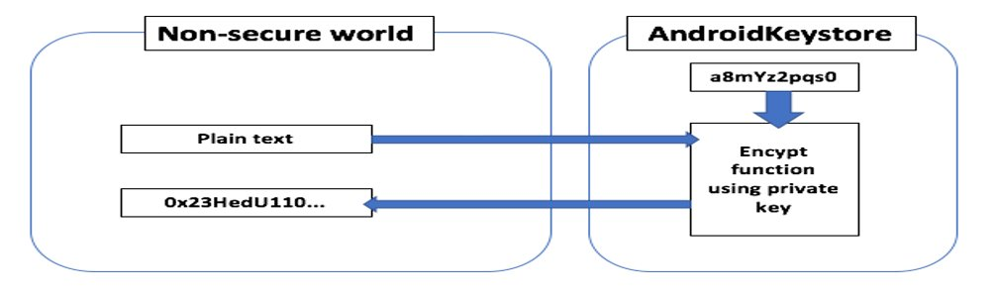
Log File (CWE-532)
When the app saves sensitive data in log files attackers can drop the database and have access to all the needed information, so it will be easy to access sensitive data.
The solution for this problem uses tool KeyStore. This tool is part of Android security tools, it is designed for handling and storing encryption keys with most common and secure algorithms. Keystore contains Keystore passwords to put passwords that are readable by the specific group and contains private and sensitive information.

Slide 36
Cleartext Traffic (CWE-319)
is information that is stored or sent in an unencrypted form, and it lacks security, reliability, and protection against tampering. It means that an attacker able to see traffic from the network and can read, modify or corrupt the transported content.
There are some genral issue for Cleartext traffic:
No Encryption of Sensitive Data when transferred.
Transfer passwords in cleartext.
Al-Rajhi application enabled cleartext traffic, and after applying a tool MobSF on the application it showed that it is a high issue, as it may cause problems when transfer sensitive information of the organization or customers.

Slide 37
Cleartext Traffic (CWE-319)
Some issues caused by cleartext traffic to the app:​
When transferring sensitive data of organization or customers, the attackers may be eavesdrop to the information and modify or delete it.
sensitive data For organization:
Sensitive information about the organization, whether it is loans or the number of employees and their personal information or password numbers for accounts, all of this information is sensitive information that harms the company when hacked by attackers.
sensitive data For customer:
- Deleting or modify the account number.
- Taking the customer’s numbers, and the numbers can be taken advantage of by defrauding him through messages.
- Freezing customer account.

Slide 38
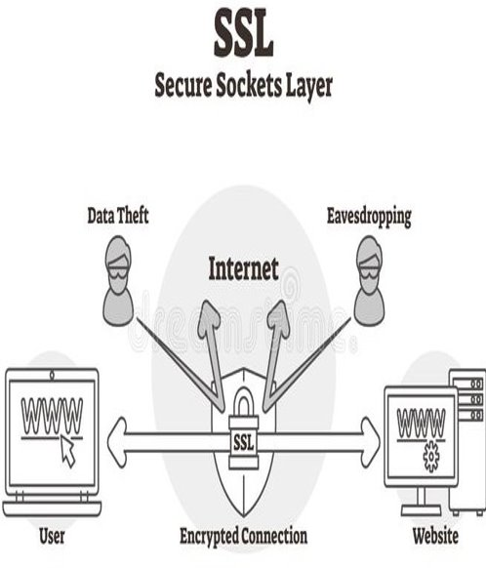
Cleartext Traffic (CWE-319)
One of the proposed solutions when transferring sensitive data, is to transfer it via protocols encrypted, reliable and difficult to hack. SSL is one of example for these protocols.
Secure Sockets Layer (SSL) is a protocol for transmitting private documents. SSL uses an encryption system that uses two keys to encrypt data a public key known to everyone, and a private key known only to the recipient of the message.

Slide 39
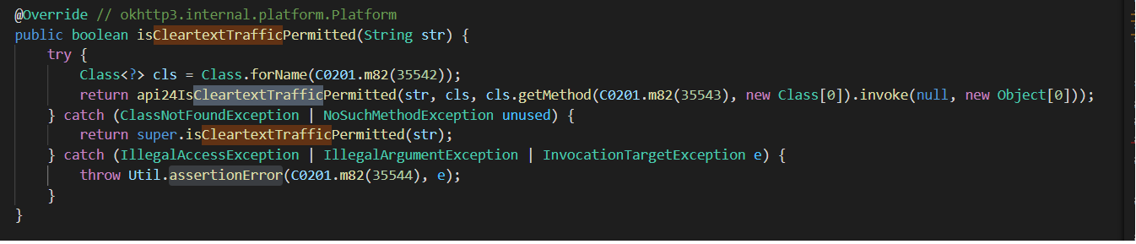
Cleartext Traffic (CWE-319)
CleartextTraffic: [android:usesCleartextTraffic=true]
isCleartextTrafficPermitted: is one of the options in Android’s Network Security Configuration file. And this method lets us to check if cleartext network traffic is permitted for all network communication from this process or not.
When cleartext network traffic is not permitted, the platform's components will refuse this process's requests to use cleartext traffic.
Here will return Boolean value (true or false), whether cleartext network traffic (for example HTTP, DownloadManager, and MediaPlayer) is permitted for communicating with (str) or not.

Slide 40
Dynamic Code Loading
By using AndroBug tool, shows the Al-Rajhi Bank app use Dynamic Code Loading, and show it high issue.
Dynamic code loading may be misuse by attackers, may load source code into a free library, and run malicious applications by loading dynamic code.
And the benefit of dynamic Code Loading allows an app developer to load additional code from free library at runtime, and Al-Rajhi bank App can use DCL to upgrade specific parts of app without letting the user know. Al-Rajhi bank App may show different content to a person depending on if they use the free or premium version, Dynamic code loading can display the correct content.

Slide 41
Dynamic Code Loading
But there are some dangerous uses by (DCL) that may cause problems for Al-Rajhi Bank. Dynamic loading may not cause a direct problem to the Al-Rajhi application, but the hacker could use a flaw in the Al-Rajhi Bank application to pull and steal the application's source code from free libraries that store some of the code.
The proposed solution to avoid hacking free libraries and obtaining the important codes for the Al Rajhi Bank application doesn’t save the important codes in the libraries.

Slide 42
Documentation
Code with good documentation is far more valuable than code without. Good documentation makes the review go more smoothly and makes it more likely that the review will do its intended purpose. Good code documentation, helps programmers and testers understand the code quickly and save time.
Documentation helps software development to keeps software quality at high levels by makes it easy to transfer projects and make the code comments clean, readable, and familiar.

Slide 43
Documentation
We have Three steps for check the documentation:
Step 1: discover code will see all the functions in the code.
Step 2: check the documentation check if the code meets the documentation requirements in all its respects.
Step 3: improve if the code is not documented, we will improve the code as possible to be documented.

Slide 44
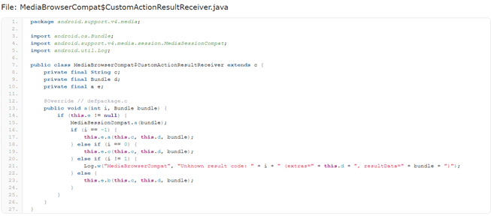
Documentation
in this class used letters instead of names, and do not use the documentation to explain what the method do, this makes the class difficult to understand.

Slide 45
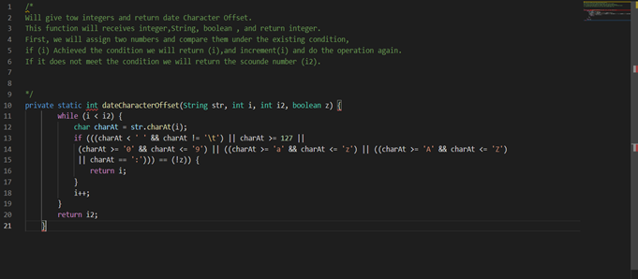
Documentation
In this case, the class don't have documentation and I will improve it to be documented.
After reading the documentation, it becomes clear to us that the code works and understands it faster, and here lies the value of the documentation.

Slide 46
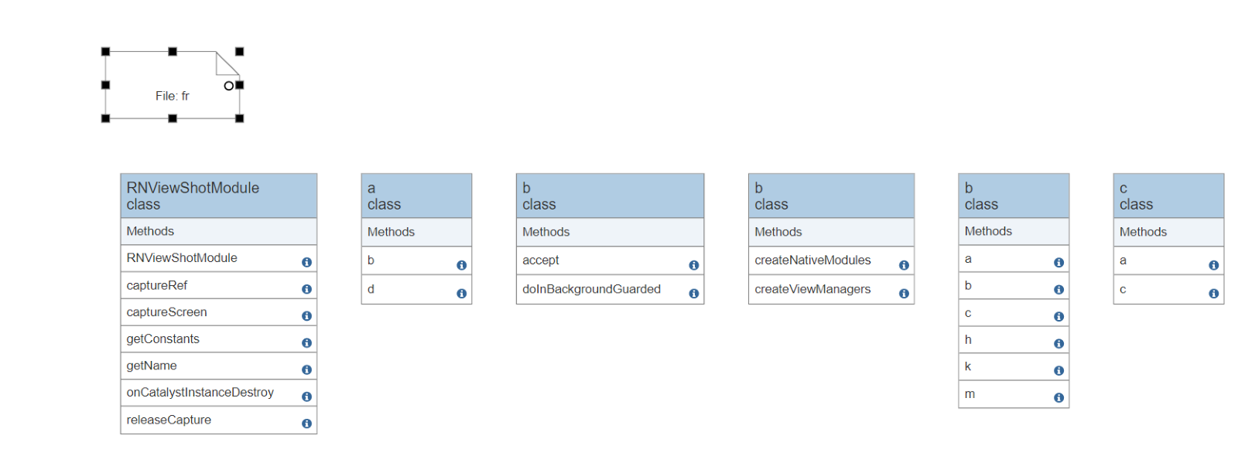
UML diagram
we use class diagram to explain data models for information systems, no matter how simple or complex the code. Better understand the general relationship between classes.
After seeing the code and implementation class diagrams on code, I see a lot of class extend(inheritance) from libraries, and the libraries have advantages and disadvantages. It is mistake to depend on libraries because they may be hacked by attackers and may cause stored information to be lost and leaked, and it is expensive and complex.

Slide 47
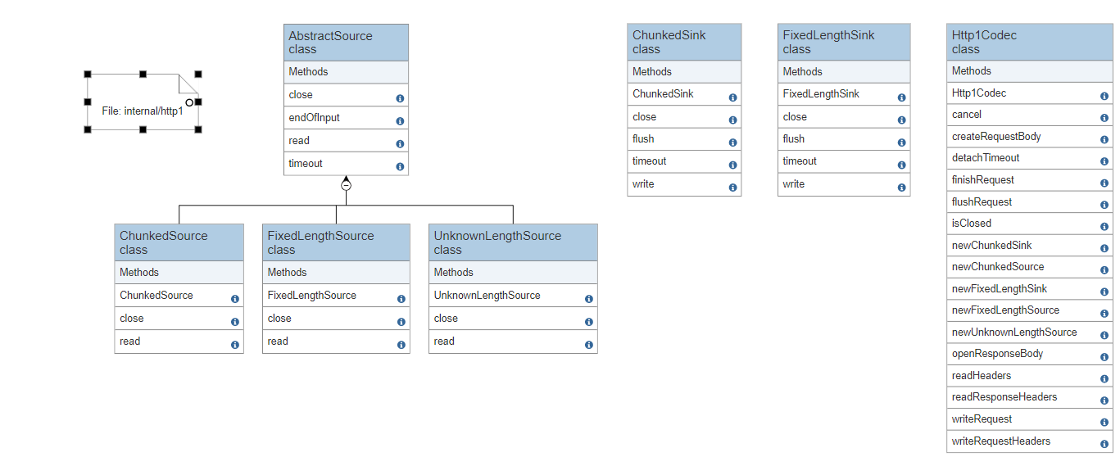
UML diagram
Another example for Class Diagram:
Here the class have inheritance from each other inside the class:
The problem here is that if the superclass has a problem or an error, this causes a problem to all its subclass and may stop working completely due to a problem in the superclass. And this problem called Single Point Of Failure.

Slide 48
READABILITY
Source code readability is a property that describes how easily a given code can be read and understood.
Readability can affect software quality, especially maintainability.
Programmers must have a good sense of writing readable code.
Following established design patterns for the language and library, For example, avoid repeating code ( DRY Don't Repeat Yourself).

Slide 49
Some practices for writing readable code:
READABILITY
Commenting & Documentation
Single Responsibility Principle
Consistent Indentation
Meaningful identifiers

Slide 50
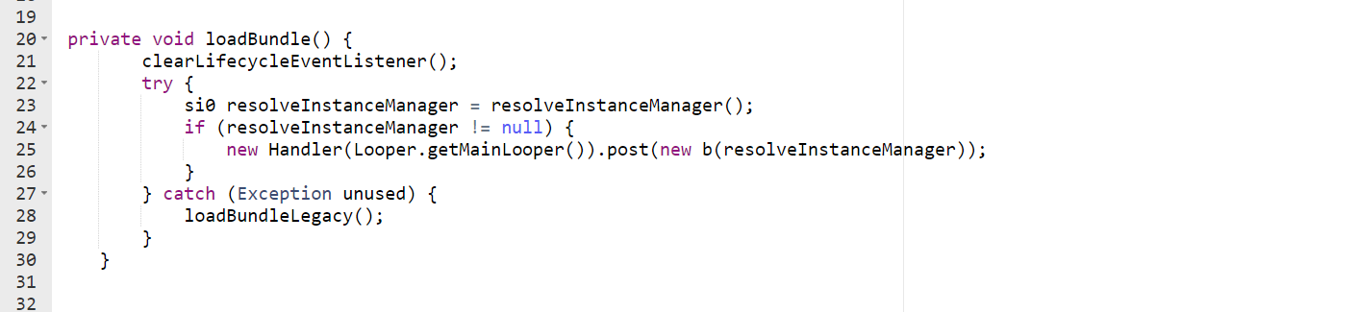
READABILITY
Source code has been used practices of readable code:
Coherent Indentation
Coherent Identifiers
CamelCaseIdentifiers style

Slide 51
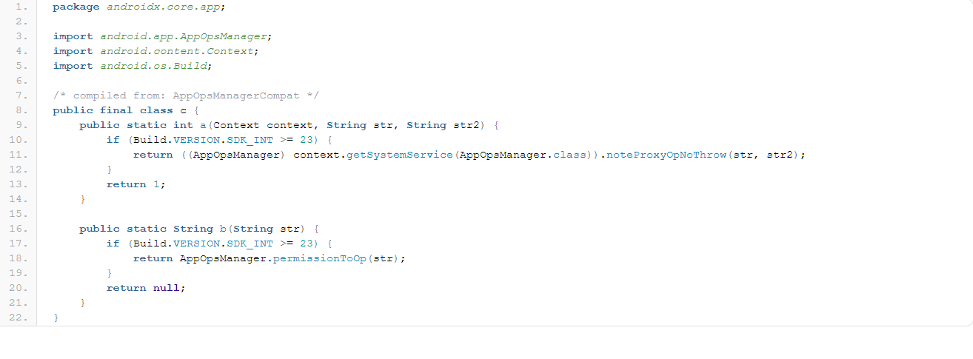
In source code has some of the abbreviations in the names, for example, writing the first letters of the word only, which can cause some errors in changing some variables or modifying them.
READABILITY

Slide 52
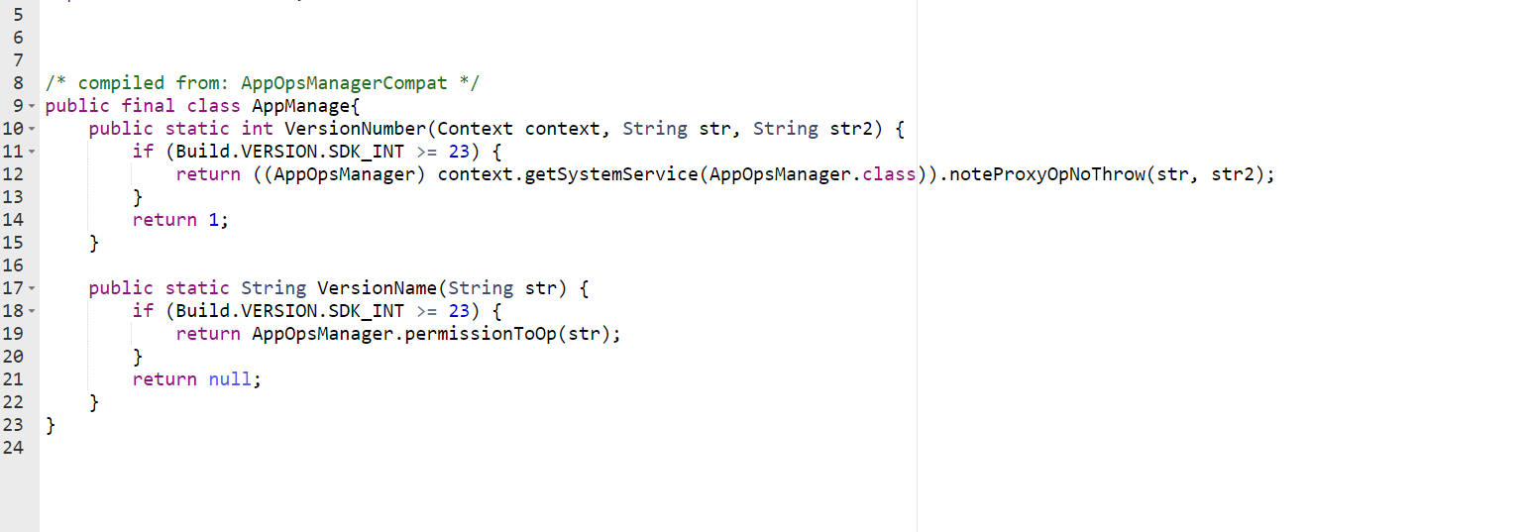
To avoid this from happening, it is better to Use meaningful identifiers
READABILITY

Slide 53
Conclusion
In this work shop, we worked on studying and analyzing the Al-Rajhi application to try to know the extent of the quality and safety of the application, We found some errors and problems whose risks range from high to low risks, which could cause penetration of the application and access to sensitive information, and then we worked on analyzing it and finding some solutions to reduce risks

Slide 54
References
https://developer.android.com/guide/topics/permissions/overview
https://www.hostinger.com/buy-cheap-ssl-certificate
https://www.geeksforgeeks.org/android-implicit-and-explicit-intents-with-examples/
https://snyk.io/blog/exploring-android-intent-based-security-vulnerabilities-google-play/
https://www.geeksforgeeks.org/authentication-bypass-using-sql-injection-on-login-page/
https://www.geeksforgeeks.org/content-providers-in-android-with-example
https://www.dreamstime.com
https://camo.githubusercontent.com

