Slide 1
Journalism@CCSU
A solution for the CCSU Journalism Department
Team one | John O’Kelly, Owen Morrissey, Steve Lesicka, Chris Kobierowski

Slide 2
Requirements | What did the product owner ask for?
Dr. Vivian B. Martin, Professor and Chair, CCSU Journalism Department
Community and content driven website for department
Design
Simple, modern approach
Mobile ready
Emphasis on multimedia
User friendly, easy navigation
Customization
Social media integration

Slide 3
Oops | In over our heads
First iteration was completed using Glassfish with Java servlets and JSP
Underestimated
Volume of work required
Difficulty of persisting server-side settings across all computers
Overestimated
Knowledge of systems and design
Work rate
Story | Value
1. Post Content Link | 2
7. View Content | 21
8. Create Account | 13
Total | 36

Slide 4

The Switch | Becoming one with WordPress
Re-evaluated requirements
Can their hosting provider even host it?
What was more important: the design or implementation?
Switch to WordPress was necessary
Platform the department and product owner was familiar with
Address product owner’s concern
Nearly 100% of hosting providers have 1-click install
Not all was lost
Able to keep most of original frontend design

Slide 5
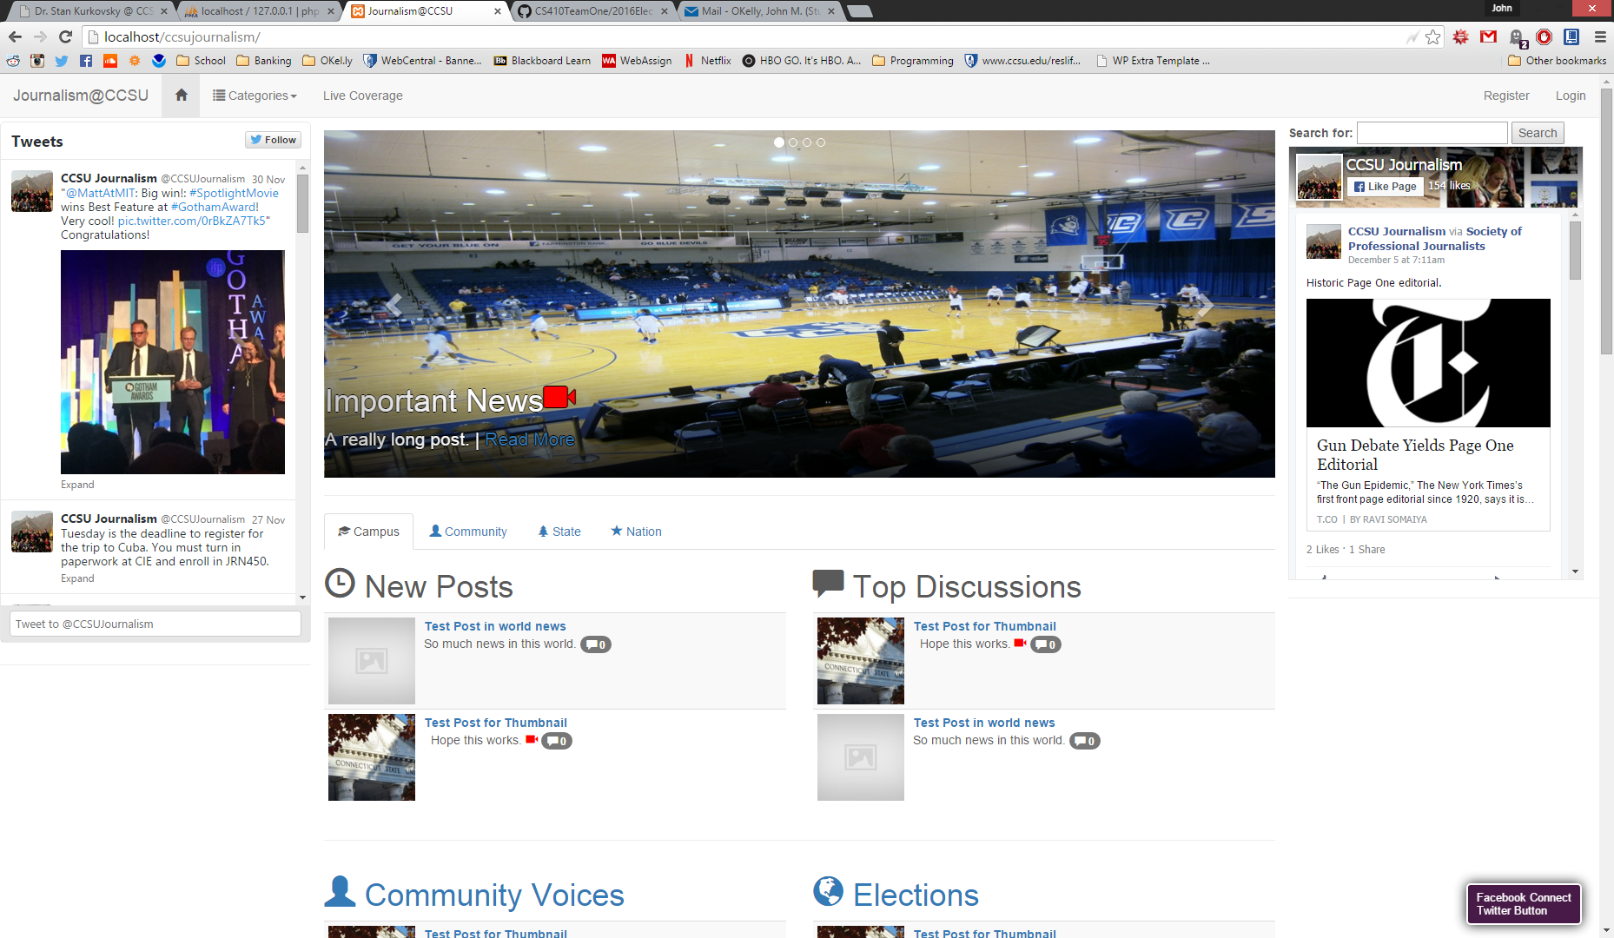
A Solution | Design and Implementation
WordPress as content management system
Multimedia oriented design using Bootstrap
Simple navigation
Mobile ready
Customizable displays
Sidebar
Category order
Emphasis on Content

