Slide 1

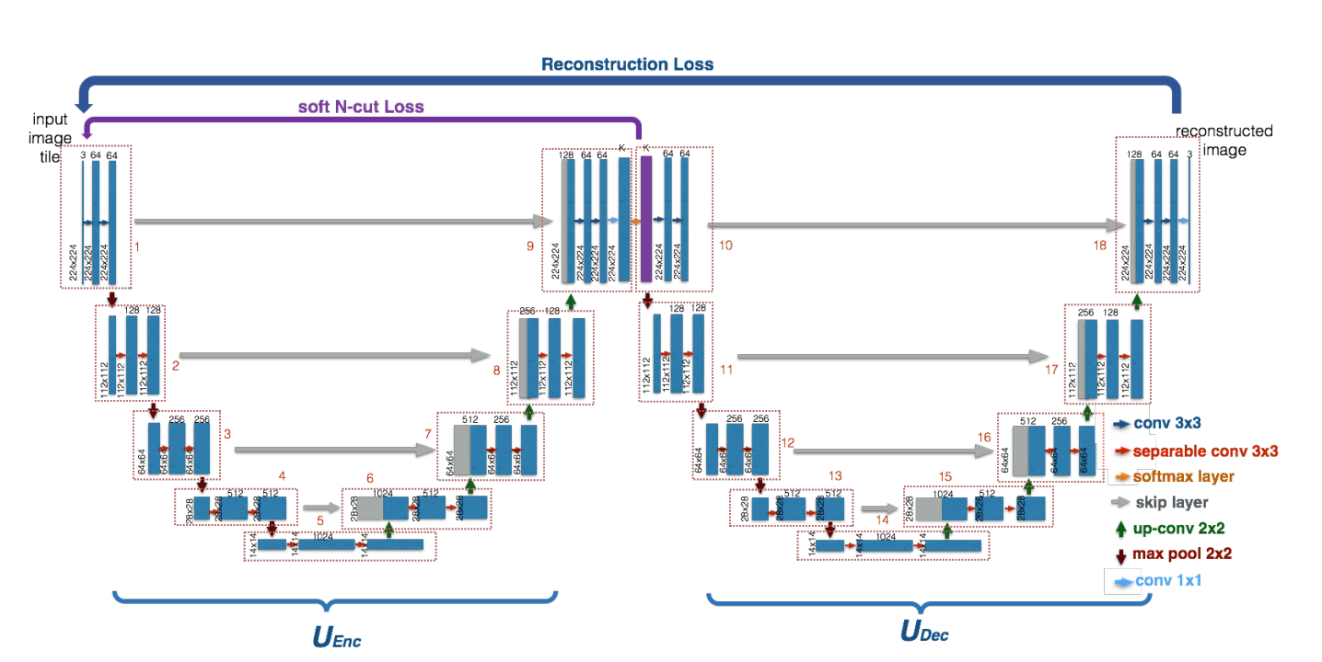
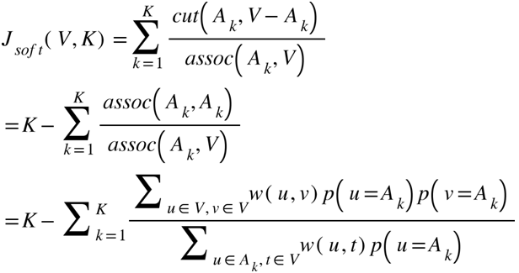
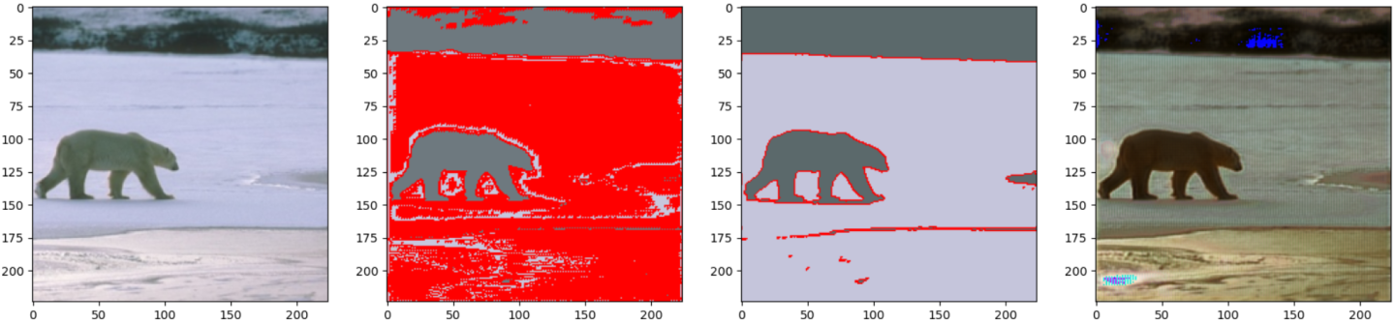
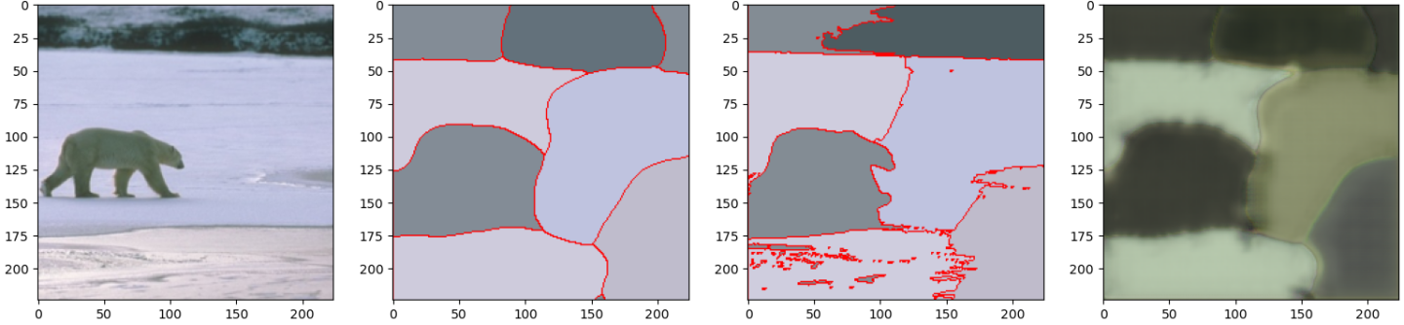
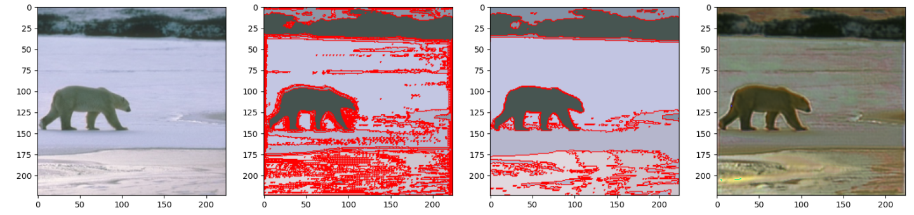
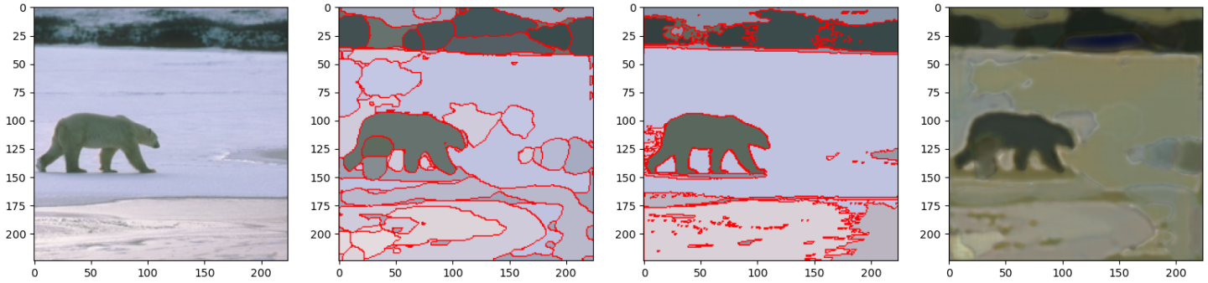
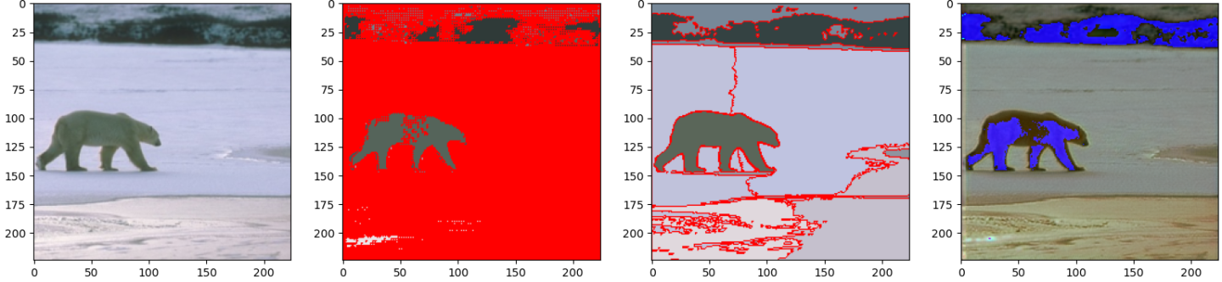
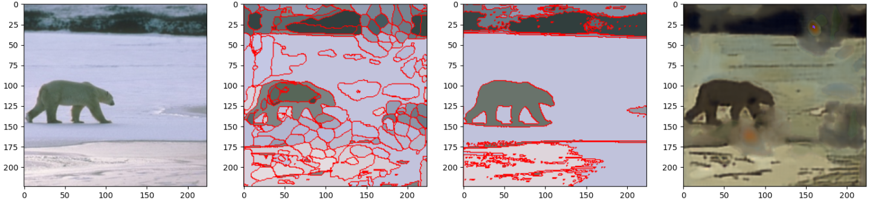
W-Net: A Deep Model for Fully Unsupervised Image Segmentation
Simon Tulling, Natalia Karpova
General W-net architecture
W-Net is an auto-encoder consisting of two auto-encoders. It consists of two connected auto-encoder networks, both having almost similar architecture. The only difference are the amount of channels in the input and output images. The first auto-encoder encodes the image into k segmented image, afterwards the second auto-encoder attempts to reconstruct it back into the original image using the segmented image.
Posprocessing is applied to an image after initial segmentation for the encoder is done. Postprocessing includes 2 main steps, namely:
1. Conditional Random Field
2. Hierarchical Segmentation
CRF is used to increase smoothness within a segmented image such that the final outcome will have sharper boundaries but more even reconstruction inside regions.
Two types of losses
The paper makes use of 2 different loss functions. The main reconstruction loss is calculated in the end of W-Net pipeline:
In addition to the reconstruction loss, soft N-Cut Loss is used on the output of encoder:
Final results: white bear image example
Only reconstruction loss
Reconstruction and Soft N-Cut loss
Input
After U encoder
After CRF
Input
After U encoder
After CRF
Output
After U encoder
Output
k=5
k=5
k=20
k=20
k=64
k=64
Conclusions:
When using reconstruction loss only, image reconstruction is better, yet segmentation is not
Hierarhical segmentation is missing and might be crucial for more accurate reconstruction
Amount of classes around 20 seems to be the best k values
CRF does heavy lifting
We would like to thank our supervisor Attila Lengyel for his help during this project
Email: n.karpova@tudelft.nl
Notes:
<number>

