Slide 1
Software Architecture
CS 4311
MICROKERNEL

Slide 2
Team 2 WIHRD
Jesus Ramos Favela - Lead Programmer
Ian Hudson - System Analyst
Ricardo Pineda - Lead Designer
Diego Garcia - System Architect
Wan Koo - V&V Supervisor

Slide 3
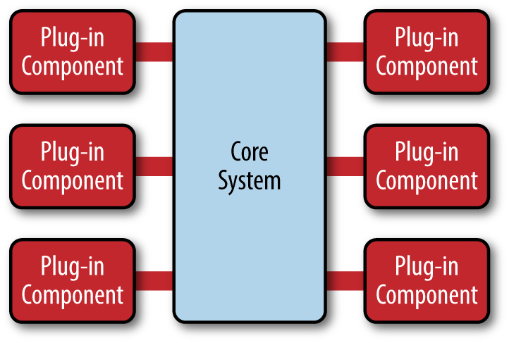
What is it?
The Microkernel architectural pattern applies to software systems that must be able to adapt to changing system requirements. It separates a minimal functional core from extended functionality and customer-specific parts. The microkernel also serves as a socket for plugging in these extensions and coordinating their collaboration, hence its common nickname the Plug-In Pattern.

Slide 4
What problem does it solve?
Allows to add custom services and functionality without affecting the core system.
It helps avoid jeopardizing the system when a service crashes or fails.
Allows the system to be easily extensible and functional with new components or pieces of functionality.

Slide 5
How does it solve the problem?
The user and kernel services are stored in different address space. The user services are kept in the user address space and kernel services are kept in the kernel address space. This provides minimal services of process and memory management. The microkernel separates a minimal function core from extended functionality.

Slide 6
Who are the actors (i.e., main elements)?
There is two main elements within microkernel, which are, a core system and plug-in modules.
Core system: contains only what is needed to make the system operational.
Plug-in modules: are independent components that contain custom code which adds features to enhance the core system with more capabilities. Ususally plug-ins are independent of one another but can also be designed to require of another plug-in. This is not always good because you want to avoid dependency issues.

Slide 7
How do they relate to each other?
The core system must know the list of plug-in modules that are available and in what way to access them. Registry is a common way to keep track of plug-ins because it contains information about each module, including its name, data contract, and access protocol details. There is a variety of ways to connect plug-in modules to the core system, depending on the type of application it can range from OSGi (open service gateway initiative), messaging, web services, to even direct point-to-point binding. Adaptors can be created if the contract between the core system and plug-in modules is custom and plug-ins are created by a third party.

Slide 8
What are the strengths and drawbacks?
Strengths:
Extensibility
Agibility
Responsiveness
Ease of development and Maintenance
Ease of Testing
Porability
Drawbacks:
Too many inter-process communication
High complexity
Scaling is difficult at the core level

Slide 9
Example applications?
Popular in 1980s due to memory and storage limitations of computer systems genesis.
Still used in some server OSes.
Major OSes such as Windows and OS X still incorporate the usage of microkernels.

Slide 10
Security Implications!
Microkernels are secure due to these reasons,
Separation of the drivers from each other and the kernel. A failed driver cannot affect the kernel.
Drivers being separate processes can run in a different protection ring.
Microkernels are typical safe as a failing driver can be restarted without the rest of the system being affected.

Slide 11
Sources:
1. Buschmann, F. (2001). Pattern-Oriented Software Architecture (Vol. 1). Retrieved from https://ff.tu-sofia.bg/~bogi/knigi/SE/Wiley - Pattern-Oriented Software Architecture - Volume 1, A System of Patterns.pdf
2. Christensson, P. (2015, February 26). Microkernel Definition. Retrieved 2020, Apr 10, from https://techterms.com
3. Richards, Mark. “Software Architecture Patterns.” O'Reilly Online Learning, O'ReillyMedia,Inc., www.oreilly.com/library/view/software-architecture-patterns/9781491971437/ch03.html.

