Slide 1


EVENT-
DRIVEN
ARCHITECTURE
Team 7 Runtime Terror: Eder Rodriguez, Jose Gallardo, Itzel Rivas, Gilbert Alvarez, Nusrat Sarmin

Slide 2
What is Event-Driven Architecture?
Message based architecture consisting of single-purpose event processing components that listen to events and process them asynchronously.
Consists of two main topologies: Mediator and Broker

Slide 3
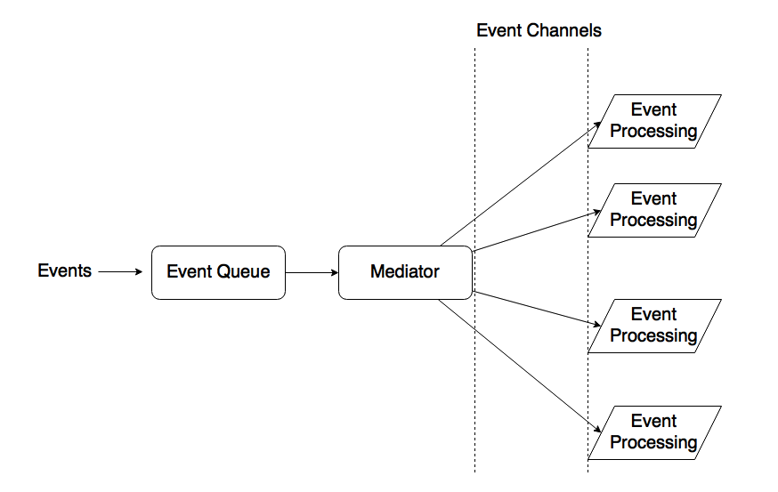
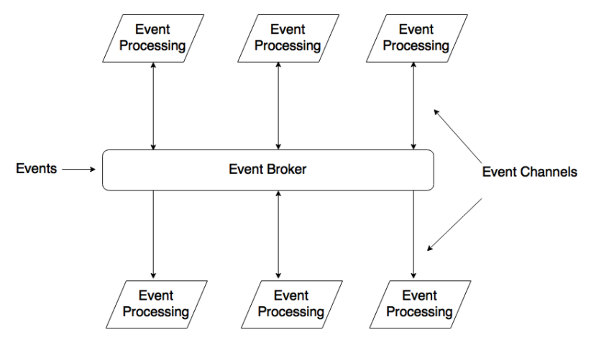
Topologies
Mediator
Broker
Has a single event queue in which the mediator passes the events to the relevant event processor.
Involves no event queue, it is the event processers that are responsible for obtaining the events.
Notes:
Topology: arrangement of systems on a computer network. In this case it is the arrangement of how the event handlers execute according to the event that took place.

Slide 4
Problems it Solves
Loose Coupling
Independently Scale Microservices
Handle Speed Mismatch
Fault Tolerant
Producer Simplification
Scalability
Traceability
Immutability

Slide 5


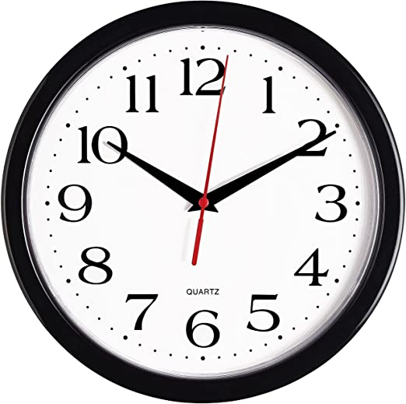
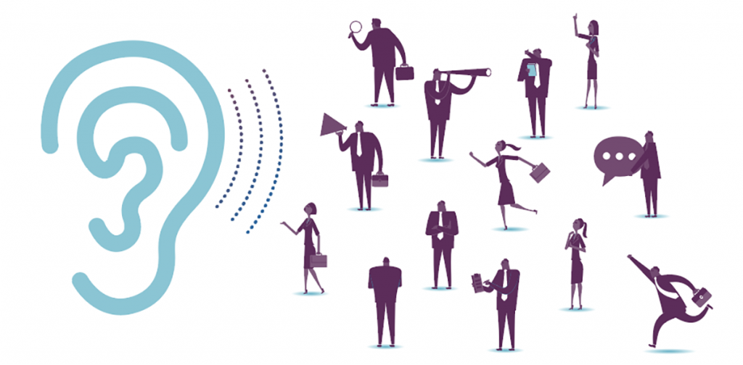
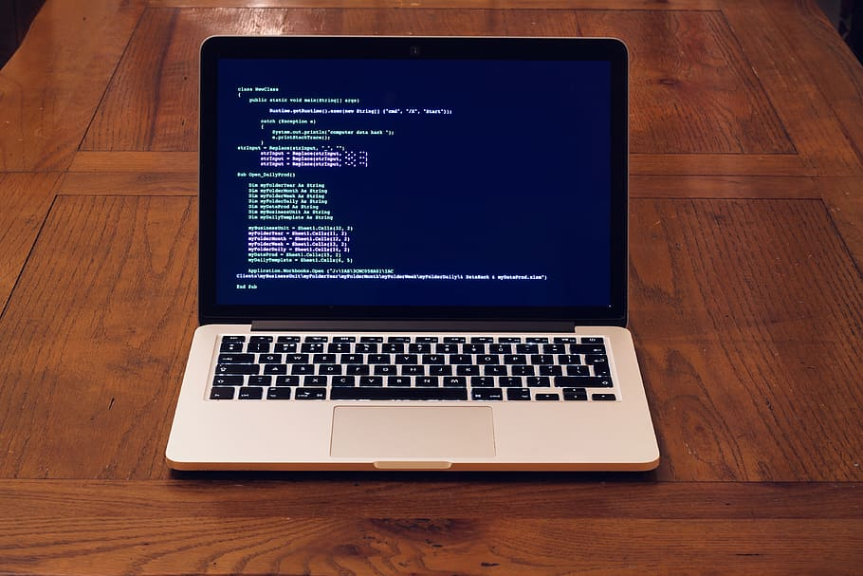
Main Actors (elements)
Event
an action that has occurred (user or system generated) that can be identified by the program.
Event-Listener
a function that waits for an event to occur.
Event-Handler
a routine (function) that gets called when the listener has detected an event. It executes code based on the type of event.

Slide 6

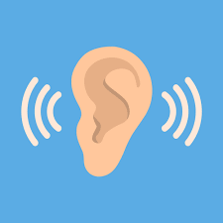
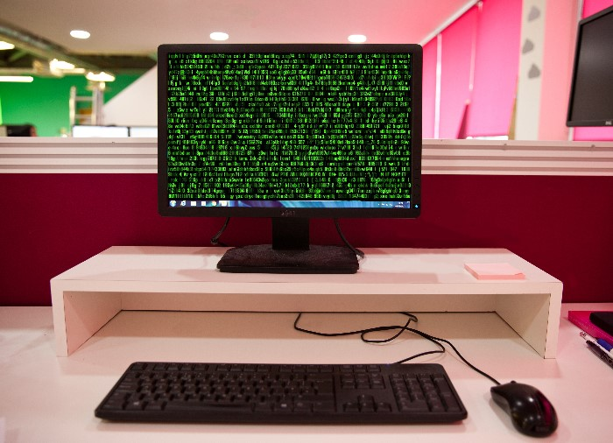
How do the elements relate to each other?
event
A user or system generated event occurs.
The listener then detects an event occurring and calls the event handler.
The event handler then executes a function based on the event that occurred.
listener
handler

Slide 7
Strengths and Drawbacks
Strength – An application will not be stopped waiting for an event to happen, the application could set up a listener, so that it will be notified when the event happens. Therefore the application will be able to perform other task, rather than blocking just to wait for the event.
Drawbacks – The disadvantages of EDA include security risks and increased complexity. Because EDA systems are often extremely loosely coupled and highly distributed: we don't always know exactly what components are part of the system and the dependencies between them

Slide 8
Example Applications
GPS navigation system: system displays fastest route according to events. If an event such as a traffic accident occurs, system will re-route to the new fastest route.
Video games: most video games require input from a controller to perform an action in the game such as moving, performing an attack or opening a menu.

Slide 9
Security Implications
A lot of incoming data can make it difficult for traceability (locate a problem).
Unauthorized access to objects.
Execution of malicious code
Event interception
Modification of running application.
Event-driven security is far from being a truly impenetrable wall. Hackers evolve and adapt rather quickly.

Slide 10
Sources
https://searchapparchitecture.techtarget.com/definition/event-handler
https://www.computerhope.com/jargon/e/event-listener.htm
https://searchapparchitecture.techtarget.com/definition/event
https://towardsdatascience.com/event-driven-architecture-pattern-b54fc50276cd
https://subscription.packtpub.com/book/application_development/9781787287495/1/ch01lvl1sec9/software-architecture-patterns
https://medium.com/@brad.mcallister123/event-driven-architecture-64d1a620dca4
https://opensource.com/article/19/10/event-driven-security//security
https://link.springer.com/content/pdf/10.1007/978-0-387-35586-3_11.pdf

Slide 11
Thank you !

Slide 12
QUIZ TIME
1. What are the names of the two topologies for Event Driven Architecture?
2. Name the three main components of an Event Driven Architecture?
3) When is it not feasible to utilize Event-Driven architecture?
4) Would Event-driven architecture be useful for a system that utilizes a printer to print documents?
5) Would voice assistants utilize Event-Driven architecture?
Notes:
Answer1: Mediator and Broker
Answer2: User/Event, Listener, Handler
Answer3: when you have a lot of different events that are not related to each other occurring all at the same time.
Answer 4: Moderator
Answer 5: Yes/they usually wait for user generated commands to occur and handle the event based on the task a user asked for.

