Slide 1
Microkernel Architecture
T10 TeamWork
Charlie Juarez
Angelica Marquez
Andrew Munoz
Aaron Rodriguez

Slide 2
What is it?
Also known as the plug-in architecture pattern, microkernel is an architectural pattern that is greatly used for implementing product based applications. [1]
Contains two types of architecture components, a core system and plug in modules. [1]
System logic will be divided between the plug in modules and core system. The core system will contain the minimum amount of functionality to make the system operational. [1]
Enables additional features to be implemented in the system as plug-ins to the core system. [1]
[1] Richards, M. (n.d.). Software Architecture Patterns. Retrieved April 10, 2020, from https://www.oreilly.com/library/view/software-architecture-patterns/9781491971437/ch03.html

Slide 3
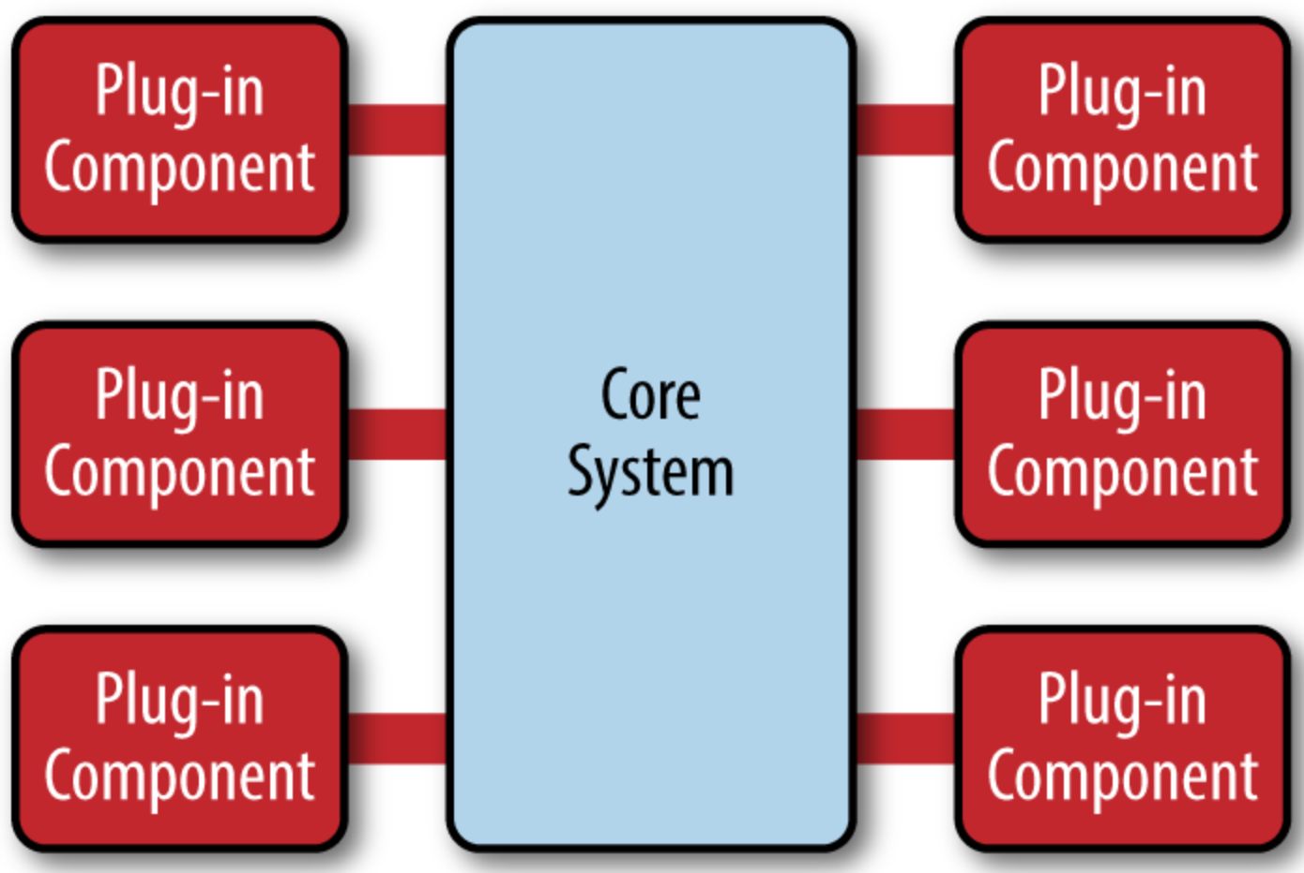
What is it? (continued)
[1] Richards, M. (n.d.). Software Architecture Patterns. Retrieved April 10, 2020, from https://www.oreilly.com/library/view/software-architecture-patterns/9781491971437/ch03.html

Slide 4
What problem does it solve?
It solves the problem of separating the minimal logic of the system from addons that will be developed during and after the release of the product. [1]
Good portability: since only the microkernel needs to be modified when porting the system to a new environment. [2]
High flexibility and extensibility: as modifications or extensions can be done by modifying or extending internal servers. [2]
Separation of low-level mechanisms (provided by microkernel and internal servers) and higher-level policies (provided by external servers): improves maintainability and changeability of the system. [2]
[1] Richards, M. (n.d.). Software Architecture Patterns. Retrieved April 10, 2020, from https://www.oreilly.com/library/view/software-architecture-patterns/9781491971437/ch03.html
[2]Sheta, D. (2009, August 27). Microkernel Architecture Pattern & Applying it to Software Systems. Retrieved April 10, 2020, from https://www.viralpatel.net/microkernel-architecture-pattern-apply-software-systems/

Slide 5
How does it solve the problem?
The core system contains the minimal functionality needed to run the system. Keeping any rule changes from affecting the whole system. [3]
Utilizes a plug-in based pattern where the plug-in modules include additional functionality and are isolated and independent of each other. [3]
The core system keeps track of which plug-ins are available via a registry. Updated when plugging in components to the core system or removing them. [3]
Contracts are essentially the input and output which allows data to be exchanged although the core system and the plug-in may not be of the same type. [3]
It separates a minimal functional core from extended functionality and customer-specific parts. [4]
[3] Software Architecture Patterns — Microkernel Architecture. https://medium.com/@priyalwalpita/software-architecture-patterns-microkernel-architecture-97cee200264e.Accessed 10 Apr. 2020
[4] Microkernel Pattern. (2010, March 5). Retrieved April 10, 2020, from http://rezagh.wikidot.com/microkernel-pattern

Slide 6
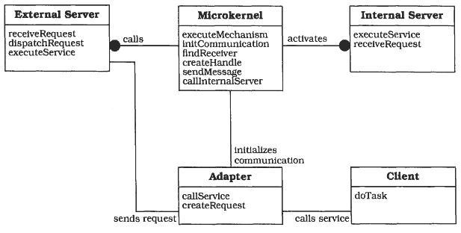
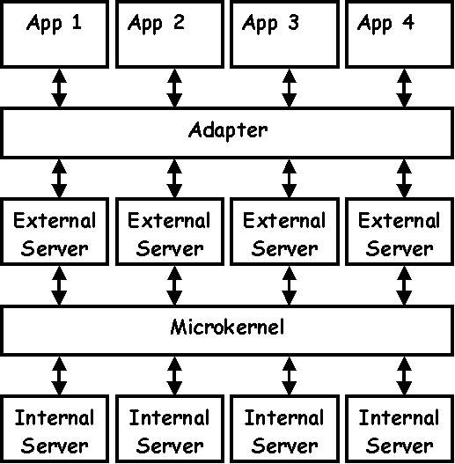
Who are the actors (i.e., main elements)?
[4] Microkernel Pattern. (2010, March 5). Retrieved April 10, 2020, from http://rezagh.wikidot.com/microkernel-pattern
[5] Microkernel. Retrieved April 10, 2020, from http://www.dossier-andreas.net/software_architecture/microkernel.html

Slide 7
Who are the actors (i.e., main elements)?
Internal servers (subsystem): Extends the functionality provided by the microkernel. It represents and encapsulates a separate component that offers additional functionality. [4]
External servers (personality): Is a component that uses the microkernel for implementing its own view of the underlying application domain. Different external servers implement different policies for specific application domains. [4]
Adapters (emulators): Represent an interfaces between clients and their external servers, and allow clients to access the services of their external server in a portable way. [4]
Clients: Is an application that is associated with exactly one external server. It only accesses the programming interfaces provided by the external server. [4]
Microkernel: Implements central services such as communication or resource handling where other components build on these basic services. [4]
[4] Microkernel Pattern. (2010, March 5). Retrieved April 10, 2020, from http://rezagh.wikidot.com/microkernel-pattern

Slide 8
How do they relate?
The core program will handle the main tasks to accomplish the main goal while the plug-ins will handle a subset of the core tasks independently to help the core program.
The method in which the program accomplishes its goal is by having contracts with the plug-ins that are required for the core application to finish.
Therefore the plug-ins can receive/output information to then complete their specialized function at which point the program will continue execution and so on until the program finishes its function.

Slide 9
Pros and Cons
Pros:
Modularity: Different modules can be replaced, reloaded, and modified without changing the core set of responsibilities.
Creation: The core set of responsibilities in the architecture can be developed by one team while others work on the plug-ins.
Cons:
Division of Responsibility: Can be hard to distinguish, what is considered a plug-in or part of the core set, which can lead to a poor architecture.
Restriction: Pre-defined API could present problems for future plug-ins.

Slide 10

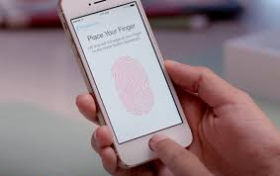
Example applications
Hardware
Software
Microkernel
Unlocking my phone with a fingerprint scanner:
If my phone needs my fingerprint to unlock itself, I’ll place my finger on the scanner
The Hardware (Scanner) will tell the kernel that a fingerprint has been recognized.
Now, the kernel will tell the Software to diagnose whether it is correct or not.
If my fingerprint is diagnosed as correct, my phone will start.
Notes:
Kernel establishes a connection between the Hardware and Software of your mobile or any device. They cannot connect each other directly. Kernel is just above the hardware. Other software run above it.

Slide 11










Example applications
The Muen Separation Kernel
Genode
Escape
MINIX 3
F9
NOVA Microhypervisor
seL4
Robigalia
Helen0S
Redox
Notes:
Kernel establishes a connection between the Hardware and Software of your mobile or any device. They cannot connect each other directly. Kernel is just above the hardware. Other software run above it.
http://www.microkernel.info/
Microkernels are operating systems that outsource the traditional operating system functionality to ordinary user processes while providing them with mechanisms requisite for implementing it. Microkernel-based operating systems come in many different flavours, each having a distinctive set of goals, features and approaches. Some of the most often cited reasons for structuring the system as a microkernel is flexibility, security and fault tolerance. Many microkernels can take on the role of a hypervisor too. Microkernels and their user environments are most often implemented in the C or C++ programming languages with a little bit of assembly, but other implementation languages are possible too. In fact, each component of a microkernel-based system can be implemented in a different programming language.
Here is a list of active free, open source microkernel projects.

Slide 12
Security implications
"COVID-19 has taught us all the value of 'distancing' in keeping any kind of system healthy and secure. That's what microkernels like seL4 do for software. What makes seL4 unique is that we know with mathematical certainty that the seL4 code implements its 'distancing' specification with zero functionality bugs. "
Former director of DARPA 120 John Launchbury. Apr 8th, 2020
Security benefits of microkernels in security
Small and isolated, for improved functionality. (Minimality is natural in a security-driven design.)
Fewer system crashes
Highly flexible
Features can be added without recompiling
[1]Wallen, J. (2020, April 8). The seL4 microkernel: Optimized for security and endorsed by the Linux Foundation. Retrieved from https://www.techrepublic.com/article/the-sel4-microkernel-optimized-for-security-and-endorsed-by-the-linux-foundation/
Notes:
https://www.techrepublic.com/article/the-sel4-microkernel-optimized-for-security-and-endorsed-by-the-linux-foundation/
The Linux Foundation is a fundamental organization for the promotion of open source software and has officially endorsed the seL4 microkernel. To further boost seL4, the Linux Foundation will host seL4 Foundation, which is a non-profit organization, established by Data61.
Former director of Defence Advanced research projects agency DARPA I20 commented about the new official endorsement of seL4 microkernel by the Linux Foundation

