Slide 1
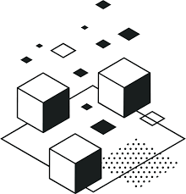
Software architecture: MicroSERVICES
Team 14 Keikaku:
Anthony DesArmier, David Rayner, Valentin Becerra
Angel Villalpando, Jorge Garcia, Mario Delgado
Notes:
Angel

Slide 2

What are Microservices?
Microservices are defined in many ways, however all definitions seem to lead to the same conclusion. Microservice is an architectural style in which we break apart monolithic code and divided into smaller easy to handle sections.
In a book titled, “Microservices: The Journey So Far and Challenges Ahead,” microservice architecture is described as a “well-established concept of modularization which emphasizes technical boundaries.”
According to research conducted by Madhuka Udantha, a graduate of the University of Moratuwa in Sri Lanka, Microservice Architecture has four goals: to reduce cost, increase release speed, improve resilience and enable visibility.
Notes:
What is it? What problem does it solve?

Slide 3
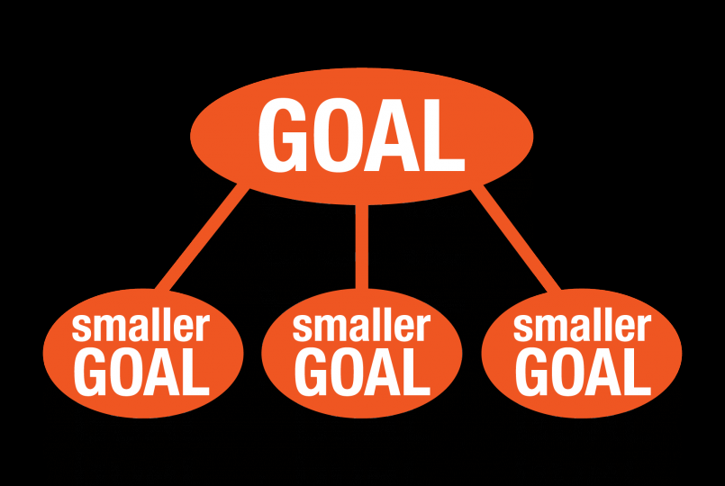
How it Works
The philosophy behind microservice architecture states, “Do one thing and do it well.”
Microservices helps organize an entire system into smaller simpler roles. It allows to grasp every component a system is required put them into individual containers and handle them independently.
Microservices allows for continuous delivery software development.
Microservices are also considered a specialization of an implementation approach for service-oriented architectures. Which is used to build flexible, independently deployable software.
Notes:
How does it solve the problem? jorge

Slide 4
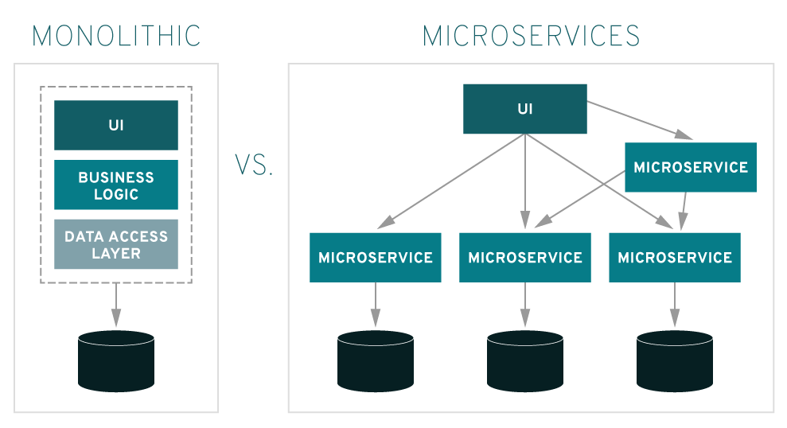
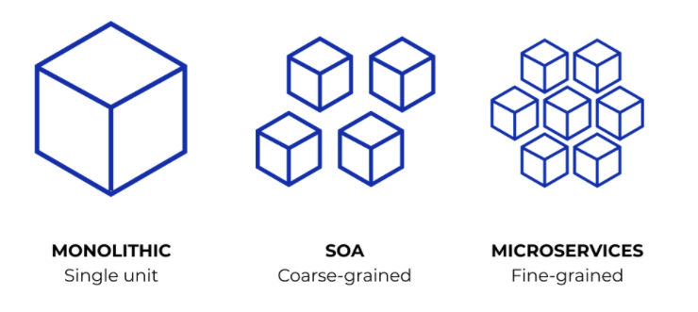
Benefits
We can consider microservices as small modules, these modules can be thought of small independent systems which focus in doing one job. By doing this the development, deployment, operations, versioning and scaling become simpler tasks.
By doing this we can decrease production time, because we focus of these individual containers and each can be independently deployed.
Another benefit of Microservices is the fact that they are loosely coupled which gives extreme flexibility.
Notes:
What are the strengths? Valentin

Slide 5
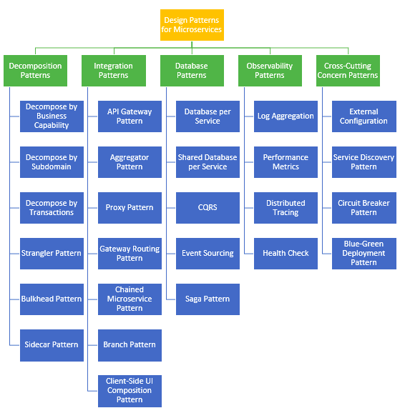
Design Patterns
Microservices can be split into five different design patterns. Each pattern demonstrates problem and solutions associated with Microservices. The Design patterns are as follows: Decomposition, Integration, Database, Observability and Cross-Cutting Concern. Each design pattern has different ways to approach them as demonstrated by the graph.
Notes:
Who are the actors? How do they relate to each other? Anthony

Slide 6
Decomposition
How do we decompose a system into small services that are loosely coupled?
One approach is by using decomposition by Business Capability. This decomposition focuses on dividing each capability into its own service. Depending on the type of “business” we set capabilities to said business.
Notes:
Anthony

Slide 7
Integration
When using microservices to build an application, there may be concerns for things such as having to deal with different platforms and their unique UI, or dealing with different types of protocols that might not be compatible with the producer microservice. Both these problems can be solved using an API getaway pattern, by using it as proxy to handle the specific platform requesting a service, and interchanging protocol requests so that the producer microservice can handle them properly.
A composite microservice is another way to handle data among the microservices, this would make calls to the necessary microservice, and after gathering their data and transforming it, send it back to the microservices. A composite microservice is usually used when planning to use business logic.
Notes:
Mario

Slide 8

Database per service
It is important that each service has its own database. As opposed to a monolithic architecture sharing a database. There is a good reason for this, it allows for an application to scale per service database (granular scaling). It only scales based on what is necessary.
Notes:
David

Slide 9
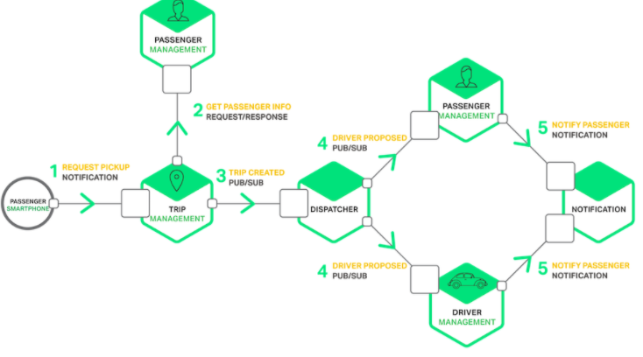
How do services communicate?
Services in a microservice communicate with one another through APIs. Typically by an http request or a publish/subscribe mechanism. Thus, a service A makes a request to another service B through the selected API and receives a response.
Notes:
David

Slide 10
Observability
How do we keep track of what our Microservices are doing?
For this we have several patterns to follow: Log Aggregation pattern, Performance Metrics pattern, Distributed Tracing pattern and Health Check pattern.
Each responsible in helping analyze the behavior and status of our microservices.
Log Aggregation help us, by allowing the user to search service instance generated logs in a standardized manner. This allows for easier monitoring of the service instance.
Performance Metrics helps us keep watch over patterns of the statistics or individual operations. This way when an irregularity occurs in the pattern, we know an issue occurred.
Distributed Tracing is as simple as keeping track of all services by given them unique IDs.
Health Check is tracking the health of the application. Every service must be doing something to contribute towards a specific goal. If a service has reached an endpoint it should check for the status of the host, connection to other services and any specific logic.
Notes:
David

Slide 11
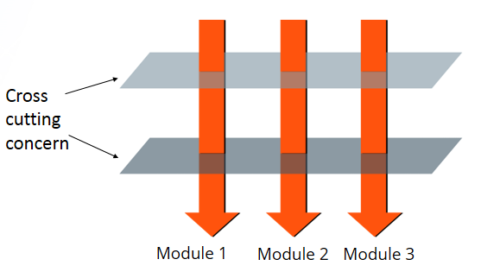
Cross-Cutting Concern
How do we avoid code modifications for configuration changes without re-building or re-deploying a service?
Usually a service calls databases or other services to accomplish a task, but sometimes this can cause some configuration problems when a service is changed.
In order to avoid that we can use a pattern called external configuration. This pattern externalizes all the configurations and makes it so the application loads them all in the startup or when needed.
Notes:
What is it? What problem does it solve? Angel

Slide 12
Conclusion
Microservice is an architectural style in which we break apart monolithic code and divided into smaller easy to handle sections.
We can consider microservices as small modules, these modules can be thought of small independent systems which focus in doing one job. By doing this the development, deployment, operations, versioning and scaling become simpler tasks.
Microservices helps organize an entire system into smaller simpler roles. It allows to grasp every component a system is required put them into individual containers and handle them independently.
Microservices can be divided into five different design patterns, which are Decomposition, Integration, Database, Observability and Cross-Cutting Concern.
Notes:
Angel

Slide 13
Potential Drawbacks
Can be complex to understand.
Requires careful planning.
Requires effort into implementing the mechanism of communication between the services.
Can be difficult to manage an application when new services are added.
Costly, as you need to maintain different server space for different business tasks.
Notes:
What are the drawbacks? Angel

Slide 14
Citations
P. Jamshidi, C. Pahl, N. C. Mendonça, J. Lewis and S. Tilkov, "Microservices: The Journey So Far and Challenges Ahead," in IEEE Software, vol. 35, no. 3, pp. 24-35, May/June 2018. doi: 10.1109/MS.2018.2141039
Pautasso, Cesare (2017). "Microservices in Practice, Part 1: Reality Check and Service Design". IEEE Software. 34 (1): 91–98. doi:10.1109/MS.2017.24
Udantha, M., 2020. Microservice Architecture And Design Patterns For Microservices. [online] Medium. Available at: <https://medium.com/@madhukaudantha/microservice-architecture-and-design-patterns-for-microservices-e0e5013fd58a> [Accessed 2 April 2020].
R. Bhojwani and R. Bhojwani, “Design Patterns for Microservices - DZone Microservices,” dzone.com, 17-Oct-2018. [Online]. Available: https://dzone.com/articles/design-patterns-for-microservices. [Accessed: 02-Apr-2020].
https://www.nginx.com/blog/building-microservices-inter-process-communication/
Notes:
Sources

