Slide 1

Shared-Nothing Architecture Style
Team 15: Spice Girls
Dima AbdelJaber
Scott Honaker
Luis Ochoa
Ricardo Sanchez
Ana Zepeda

Slide 2
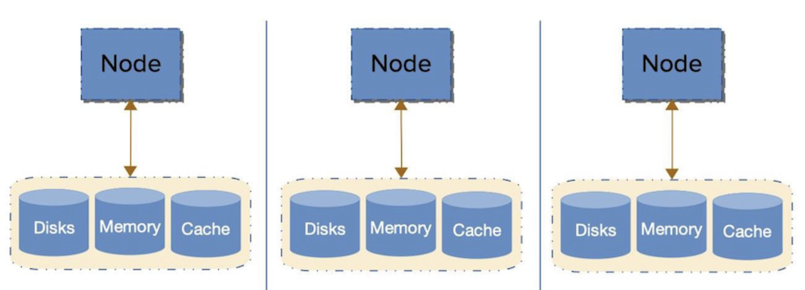
What is it?
A Shared-Nothing Architecture is a distributed-computing architecture in which nodes do not share (independently access) memory, storage, or resources with any other. The intent is to eliminate contention among nodes.
PHP is based around a shared-nothing model. In PHP, for every request a node starts from scratch with no memory shared from the prior request of the same node. It brings all the required objects into memory, performs the required processing, and then releases all the resources when the request has been fulfilled.

Slide 3
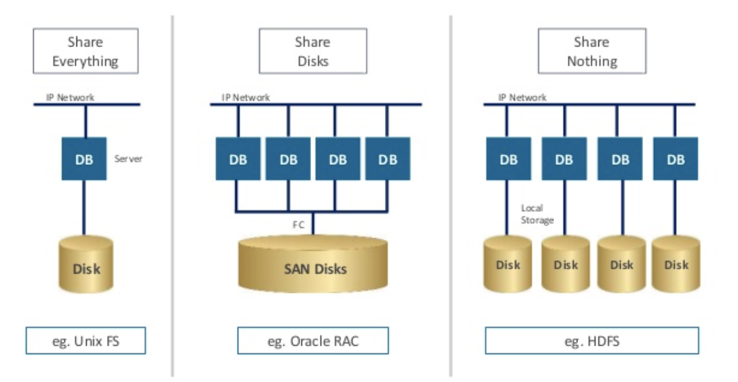
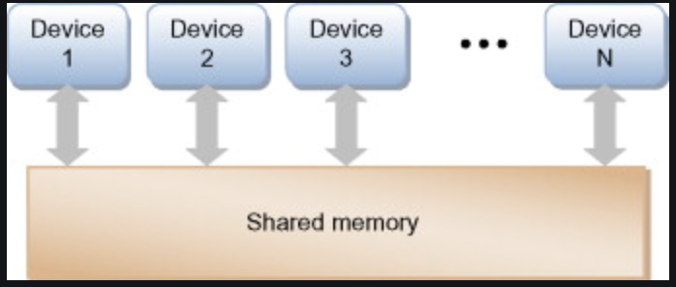
Shared-Nothing vs Shared-Disk vs Shared-Memory vs Shared-Everything
Shared-Nothing Architecture is when nodes do not share memory or storage with any other. The intent is to eliminate contention among nodes.
Shared-Disk Architecture is similar to shared-nothing, except that every node interacts with a shared disk, typically a database or a shared file system typically provided by a storage area network or network attached storage .
Shared-Memory Architecture is where each node makes use of a shared-memory resource.
Shared-Everything Architecture is when each node shares all resources with every other node.

Slide 4
What Problem Does it Solve?
Limited user availability - This architecture has the potential to support limitless amounts of users at a time
Disruptive upgrades - This architecture allows the change of hardware without having to take the entire system offline to do so
Single point of failure - Due to redundant hardware, if one node fails the entire system will not fail
Notes:
Shared nothing architecture style solves limited user availability by supporting more users with more machines. It ends disruptive upgrades by allowing tech support to work on some machines while leaving some intact and able handle user’s needs. It also prevents the system from collapsing if one node fails because other nodes’ resources do not rely on it.

Slide 5
How Does it Solve the Problem?
Horizontal Scaling
Add more servers to add throughput
Allows limitless scaling
Most popular technique in 2018
Does require shared nothing architecture
Notes:
This is all done through horizontal scaling, another way of saying adding more machines (as opposed to more power per machine) to get the job done. There are virtually no limits to how many servers can be added, something in contrast with vertical scaling that is limited by hardware available. Horizontal scaling only works by using shared nothing architecture because it is flexible enough to incorporate more machines without changing design.

Slide 6
Who are the Actors and How do they Relate to Each Other?
The actors in this architecture are the nodes and the resources they each have.
These resources include disk space and memory but also may include other resources that not all nodes have, such as databases.
Just as the name indicates, none of the nodes share their resources.
All nodes are connected through the program being run, but that is the only connection their resources have.
Notes:
The main actors in the share nothing model are going to be the independent nodes, and the resources they have access to such as disk space and memory. As the name implies, there is nothing shared between the nodes ideally, thus their only relationship is that they are run by the same program.

Slide 7
What are the Strengths?
The following are the key benefits to Shared-Nothing architecture:
It Eliminates Single Points of Failure: Since nodes don't share any resources, applications can continue functioning even if one or more nodes fail. However, application performance drops with each node that fails, but the application can continue to function.
Its Simpler to Scale: Since each node can serve requests to the application without having to deal with resource contention, as many nodes as required can be added to scale the application to provide sufficient capacity.
It Makes Upgrades Simpler: Individual nodes can be upgraded or replaced without shutting down the entire application. No node is aware of any other, so it doesn't matter if one is removed, upgraded, or improved. It makes upgrades simpler.
Avoids Unexpected Downtime: Shared-nothing architecture allows for some amount of self-healing that can be another line of defense against unexpected downtime. For example, when you have redundant copies of data or databases on different disks, a disk that loses data may be able to recover it when the redundancies are synced.

Slide 8
What are the Drawbacks?
Space restrictions - due to the nature of horizontal scaling, the amount of server space required is greatly increased.
Cost of utilities - The number of servers that are running, cooling and electricity becomes a problem
More equipment - The general cost of the equipment used is lower, but you do need a completely separate set of equipment for each node.
There can be complexity issues with transactional queries that span multiple nodes. In other words, if each node can not complete its “part” of the processing without needing data from any other node.
Notes:
Each node needs its own independent equipment, thus it creates a linear relationship between scaling, cost, and space. There can also be performance issues if nodes are not able to do their duties independently of each other.

Slide 9
Example Applications
Examples of database systems that implement a shared-nothing approach include Teradata, MySQL, and many NoSQL and NewSQL offerings. A common technique used is clustering.
MySQL clustering distributes the MySQL database across multiple independent nodes, with no possibility of failure (99.99% Availability).
It allows for almost infinite scaling of MySQL-based websites or applications.
The shared-nothing approach is based on splitting up the data into smaller subsets.
However, partitioning almost always involves trade-offs, one partitioning scheme may work well for certain specific applications and it may not work well with another.
Therefore, there is no universal way to partition data that is optimal for all applications.

Slide 10
Security Implications
In a distributed environment, there are more pieces to keep track of. This means security teams have more to analyze and monitor.
Automation issues: A challenge of a share-nothing architecture is that in practice, due to automation the configurations tend to change quickly and automatically in response to the usage.
A possible solution to this concern is dynamic baselining. Dynamic baselining just means, that your tools automatically reassess what constitutes normal behaviour.
Weak perimeters: Due to scalability, shared-nothing architecture environments tend to grow and shrink in size, which means they lack well defined perimeters, this is significant when dealing with firewalls, and their configurations.
A possible solution to this concern is dynamic firewalls configurations.

Slide 11
Resources
https://morpheusdata.com/blog/2017-02-28-shared-nothing-architecture
https://mobisoftinfotech.com/resources/mguide/shared-nothing-architecture-the-key-to-scale-your-app-to-millions-of-users/
https://github.com/vaquarkhan/vaquarkhan/wiki/Difference-between-scaling-horizontally-and-vertically
https://homes.cs.washington.edu/~arvind/papers/radiatus.pdf

