Slide 1
4311 Final Presentation
Prevent, Mitigate, and Recover (PMR) Insight Collective Knowledge System (PICK)
Software Engineering 2
Notes:
Updates
11/2019 Initial version
12/2020 added tests to V&V

Slide 2
Introduction

Slide 3
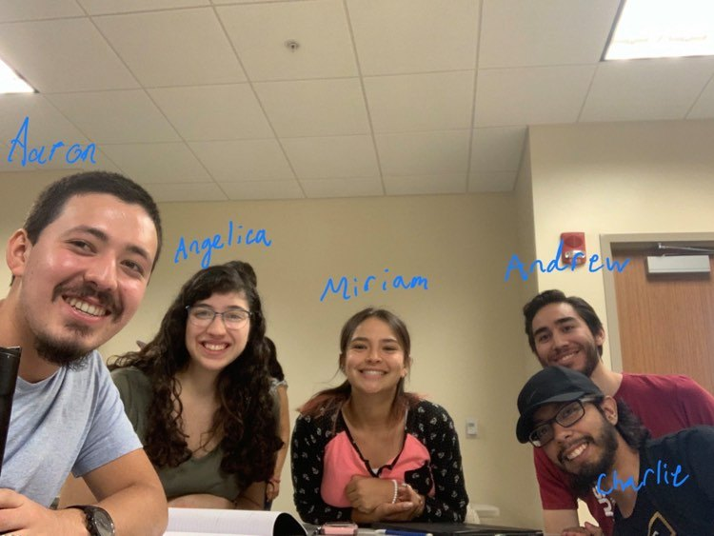
Team10-TeamWork
Miriam Juarez - Architect
Charlie Juarez - Lead Programer
Aaron Rodriguez- Analyst
Andrew Munoz - Designer
Angelica Marquez - V&V

Slide 4
Outline
Requirements
Development process
High Level Design
Detailed Design
Implementation
V&V
Final status
Lessons learned
Notes:
Section Suggested author
Requirements
Development process (Analyst)
High Level Design (Arch)
Detailed Design (Designer)
Implementation (Pgmr)
V&V (V&V)
Final status
Lessons learned

Slide 5
Requirements
<< This section should review the current understanding of the system requirements. It should summarize the use case scenarios as well as any non-functional requirements specified by the clients. In particular, this should provide Guidance Team members with an understanding of how your understanding of the requirements differ from the original SRS. This section is limited to no more than three slides. >>

Slide 6
Development process

Slide 7
Plan
Initial change request made on Google Drive
Lead programmer approves this change.
Initial change becomes formal change on Github.
Lead programmer decides who will implement this change.
Change is finally made on the branch of whoever made the change.
Lead programmer approves implemented change and puts it on the master branch.
Notes:
The exceptions would be the file and class names of the navigator, graph, and table files and classes.

Slide 8
Did We Follow the Plan
We partially followed the plan.
We mostly put initial change requests on Facebook Messenger.
Lead programmer would help us decide if the change should be made and who should make it.
No formal documentation of change on Github.
Whoever made the change would put it in on their own branch first.
Lead programmer would put this change on the master branch if approved.
Notes:
The exceptions would be the file and class names of the navigator, graph, and table files and classes.

Slide 9
High Level Design
<<This section should describe how a high-level design was created using CRC. Show examples of classes, responsibilities, collaborations, and contracts. Use models to explain the structure of your system. Identify the software engineering principles did you use to guide design decisions. Give an example that demonstrates the usefulness of your high-level design. This section is limited to no more than six slides. >>

Slide 10
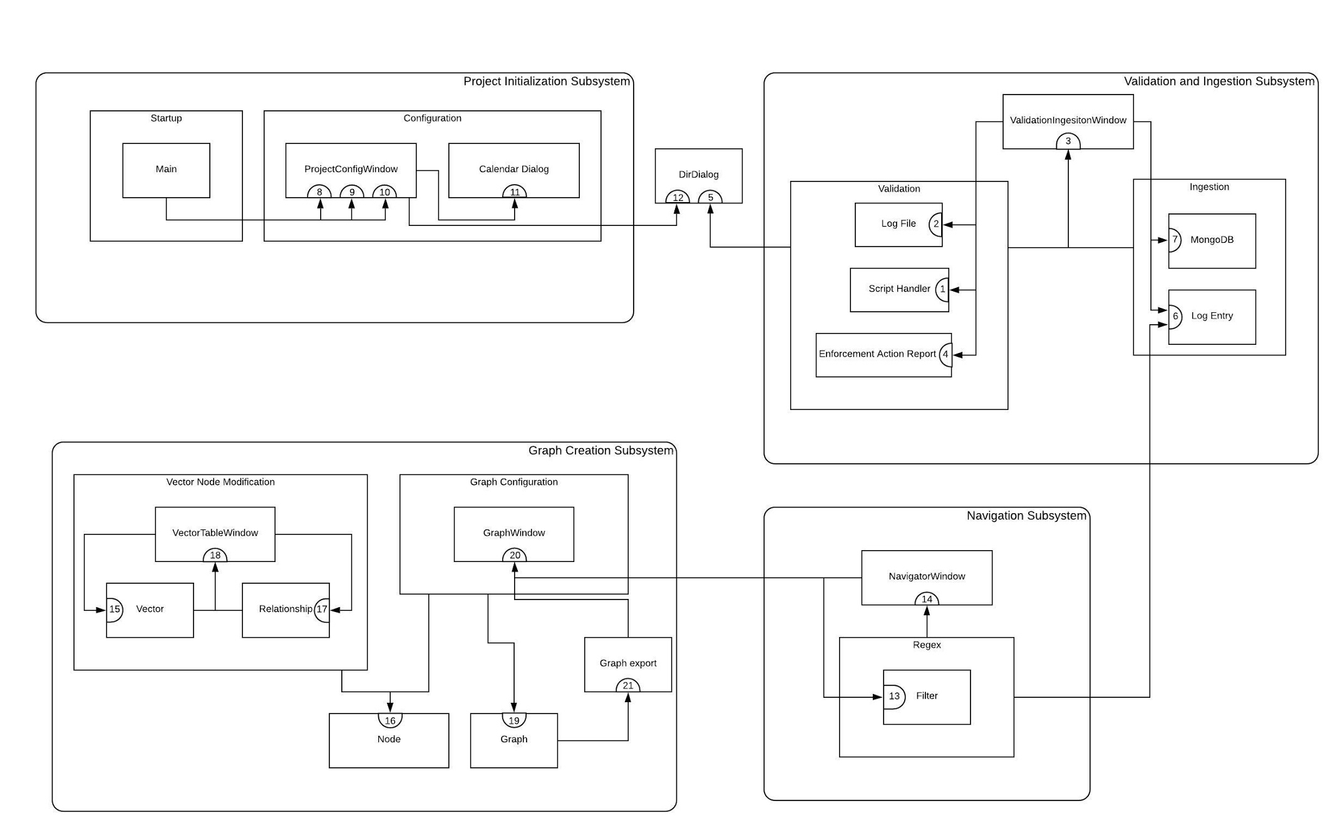
System Collaboration Diagram

Slide 11
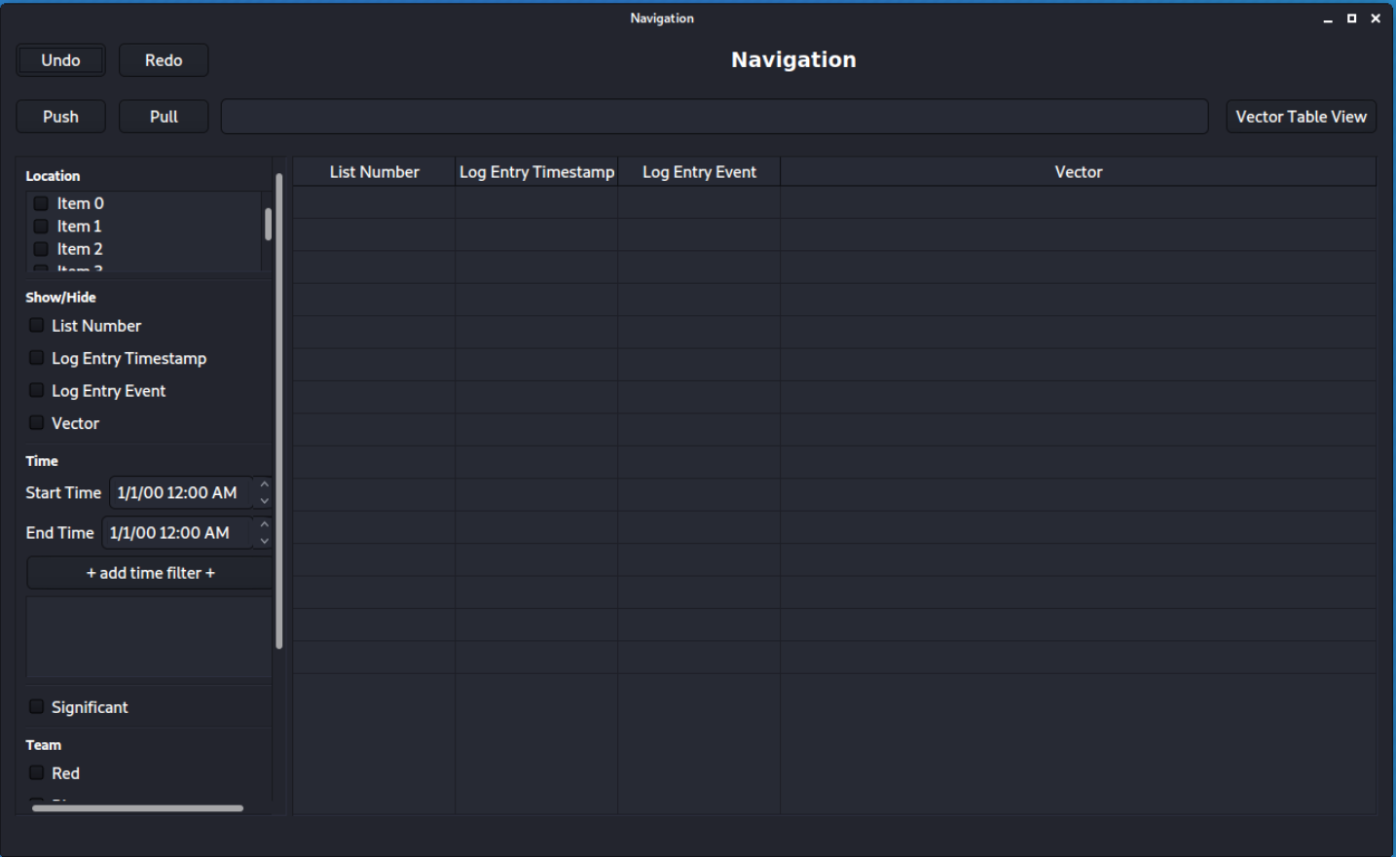
Contract
Contract Display Updated Table View
Contract number: 20
Contract Name: Display Graph Window
Contract Description: Display Graph Window
Protocol 1:
Signature: displayGraphWindow(graph)
Graph: Structure with graph information.
Output: graph displayed in window.
Pre-Condition: A pre-build graph to be displayed.
Post-Condition: Graph is created with relationships.
Notes:
It is responsible for displaying the graph, knowing the graph, and each one of the graph nodes.

Slide 12
Classes, Responsibilities and Collaborations
GraphWindow
Window in charge of graphing log entry in vector format.
Superclass: NavigatorWindow
Responsibilities | Responsibilities description | Collaborations
R.18-1 | Show graphical representation of vectors. | R.14-1 R.7-1 R.17-1 R.16-4 R.17-4 R.17-5 R.16-6
R.18-2 | Edit graphical representation of vectors.
R.18-3 | Create relationships among nodes.
R.18-4 | Create nodes.

Slide 13
Software engineering principles
SOLID Principles
S - SRP (Single Responsibility Principle)
O - OCP (Open Closed Principle)
L - LSP (Liskov Substitution Principle)
I - ISP (Interface Segregation Principle)
D - DIP (Dependency Inversion Principle)

Slide 14
Detailed Design
<<This section should describe how a high-level design was used to develop a detailed design. Show examples of classes, contracts, and protocols. Use models to explain the structure of your system. Identify the software engineering principles did you use to guide design decisions. Give an example that demonstrates the usefulness of your detailed design. This section is limited to no more than six slides. >>
Notes:
Pay attention to the pre and post conditions on your protocols. We will be looking at them.

Slide 15
Implementation
<<This section should describe the implementation. Describe the content of the various releases. Describe the process of refactoring and how well the implementation follows the design described in your SDD. Show examples of implemented code along with the protocols. Describe your coding standards and how they were identified. This section is limited to no more than seven slides. >>

Slide 16
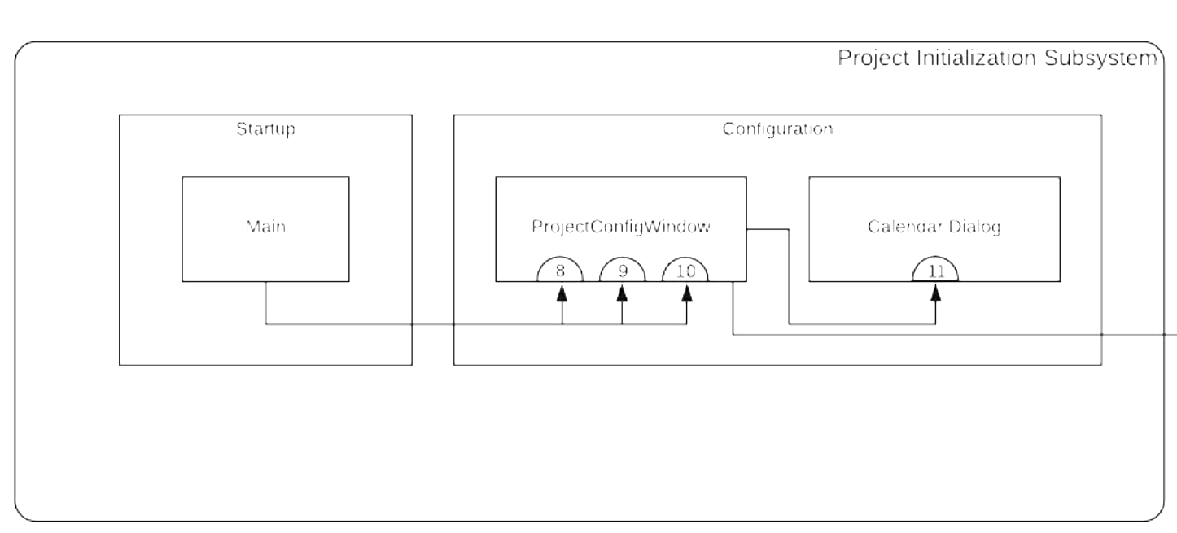
Contract: Start Date
Contract number: 9
Contract description: Display start date
Protocol 1:
Signature: on_startdate_button_clicked(self)
Output: None
Pre-Condition: A date has been chosen by CalendarDialog.
Post -Condition: Display the date that has been chosen.

Slide 17
Contract V4.0: Start Date
File Name: ProjectConfigWindow.py
Class Name: ProjectConfigWindow
def on_startdate_button_clicked(self):
self.start_date_calendar = True
self.end_date_calendar = False
calwindow = CalendarDialog(self)
calwindow.exec_()
datechosen = calwindow.date_picked
self.minimumdate = [calwindow.minimumdatelist[0], int(calwindow.minimumdatelist[1]), int(calwindow.minimumdatelist[2])] #[month, day, year]
self.selectstartdatelabel.setText('Start Date Selected: ' + datechosen)
print(datechosen)

Slide 18
Contract V5.0: Start Date
File Name: ProjectConfigWindow.py
Class Name: ProjectConfigWindow
def on_startdate_button_clicked(self):
self.start_date_calendar = True
self.end_date_calendar = False
calwindow = CalendarDialog(self)
calwindow.exec_()
datechosen = calwindow.date_picked
self.minimumdate = [calwindow.minimumdatelist[0], int(calwindow.minimumdatelist[1]), int(calwindow.minimumdatelist[2])] #[month, day, year]
self.selectstartdatelabel.setText('Start Date Selected: ' + datechosen)
basepath = path.dirname(__file__)
filepath = path.abspath(path.join(basepath, "../Data", "DateRange.txt"))
with open(filepath, 'r') as file:
data = file.readlines()
if not data:
data.append(str(self.minimumdate[2]) + '.' + str(self.minimumdate[0]) + '.' + str(self.minimumdate[1]) + '\n') #year.month.day
else:
data[0] = str(self.minimumdate[2]) + '.' + str(self.minimumdate[0]) + '.' + str(self.minimumdate[1]) + '\n' #year.month.day
with open(filepath, 'w') as file:
file.writelines( data )
self.enddatebutt.setEnabled(True)

Slide 19
Coding Standards:
Naming Conventions:
File: The whole name of the file is compounded into one with the start of every word capitalized.
Class: The whole name of the class is compounded into one with the start of every word capitalized.
Method: The whole name of the method is changed to have underscores instead of spaces.
Variables:The name of the variables have the name of their respective representation and in some cases the data type.
Notes:
The exceptions would be the file and class names of the navigator, graph, and table files and classes.

Slide 20
V&V (unit and integration strategies, development of system tests)

Slide 21
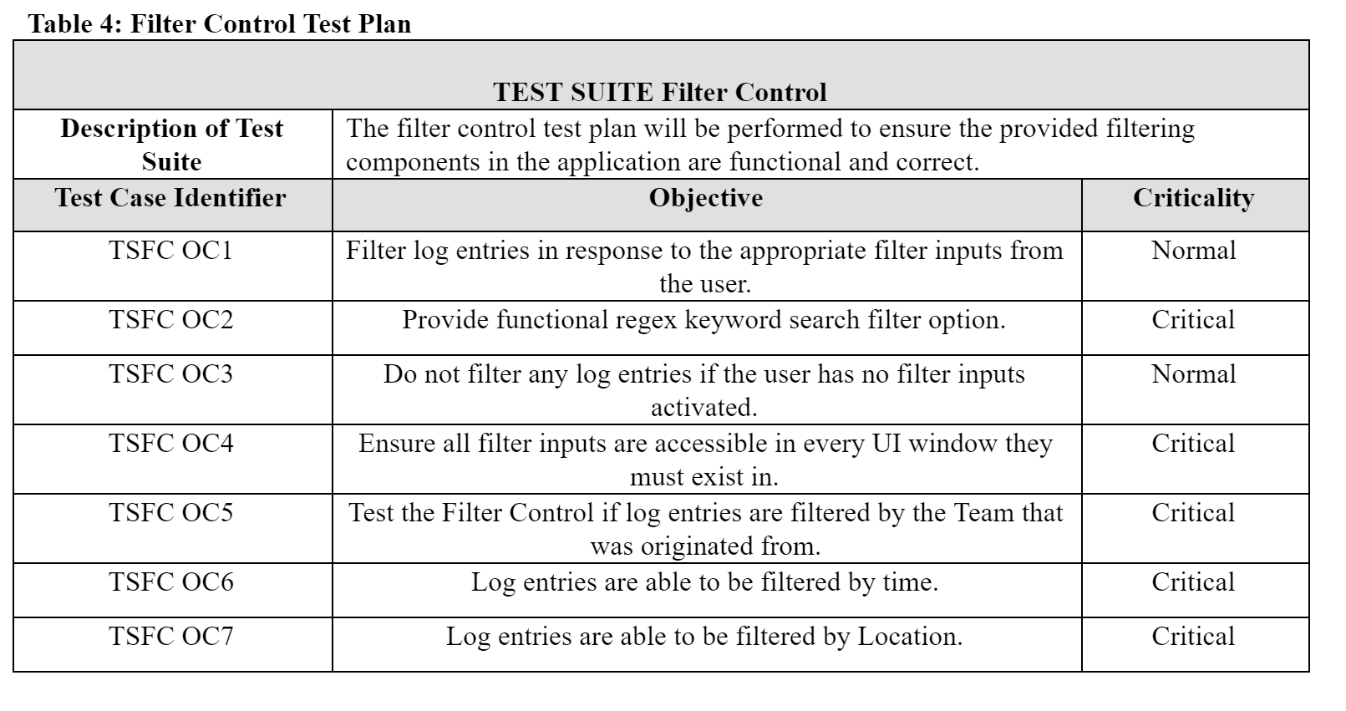
Test plan

Slide 22
Final status
<<This section describes the final status of the project. Describe which features have been implemented and which have not. Identify the deficiencies of your design. Identify the outstanding defects detected in system testing. This section is limited to no more than four slides. >>

Slide 23
Implemented Features
Project Configuration - UI and Integration
Validation and Ingestion - UI and Integration
Database Integration - Log Entries and Vectors
Log Entry Configuration - UI and Integration
Filter Configuration - UI and Integration
Graph Configuration - UI and Integration (no database integration)
Node Configuration - UI
Relationship COnfiguration - UI
Notes:
The exceptions would be the file and class names of the navigator, graph, and table files and classes.

Slide 24
Incomplete Features
OCR Tool Integration - None
STT Tool Integration - None
Syncing Integration (Push and Pull) - None
Nodes Configuration - Integration
Relationship Configuration - Integration
Maltego - Switched out for Graphviz
Notes:
The exceptions would be the file and class names of the navigator, graph, and table files and classes.

Slide 25
Deficiencies in Design
Notes:
The exceptions would be the file and class names of the navigator, graph, and table files and classes.

Slide 26
Lessons learned
<<Describe the lessons learned during the project. If your team were to develop another product together, what changes would you make? What changes would you have made to your processes? To your implementation strategies? This section is limited to no more than six slides. >>

