Slide 1
4311 Final Presentation
Prevent, Mitigate, and Recover (PMR) Insight Collective Knowledge System (PICK)
Software Engineering 2
Notes:
Updates
11/2019 Initial version
12/2020 added tests to V&V

Slide 2
Introduction

Slide 3
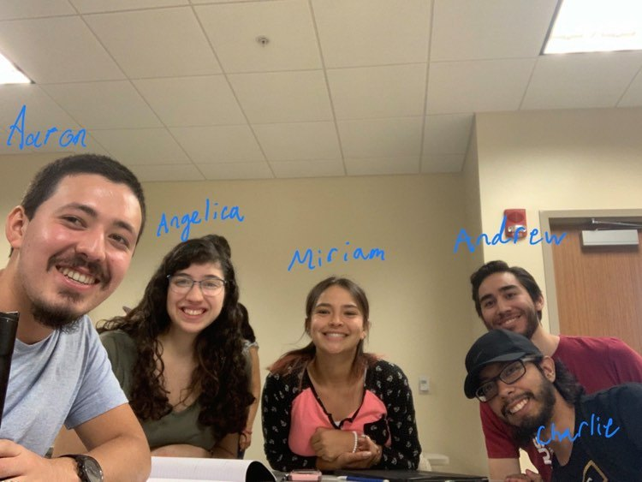
Team10-TeamWork
Miriam Juarez - Architect
Charlie Juarez - Lead Programer
Aaron Rodriguez- Analyst
Andrew Munoz - Designer
Angelica Marquez - V&V

Slide 4
Outline
Requirements
Development process
High Level Design
Detailed Design
Implementation
V&V
Final status
Lessons learned
Notes:
Section Suggested author
Requirements
Development process (Analyst)
High Level Design (Arch)
Detailed Design (Designer)
Implementation (Pgmr)
V&V (V&V)
Final status
Lessons learned

Slide 5
Requirements

Slide 6
Development process

Slide 7
Plan
Initial change request made on Google Drive
Lead programmer approves this change.
Initial change becomes formal change on Github.
Lead programmer decides who will implement this change.
Change is finally made on the branch of whoever made the change.
Lead programmer approves implemented change and puts it on the master branch.
Notes:
The exceptions would be the file and class names of the navigator, graph, and table files and classes.

Slide 8
Did We Follow the Plan
We partially followed the plan.
We mostly put initial change requests on Facebook Messenger.
Lead programmer would help us decide if the change should be made and who should make it.
No formal documentation of change on Github.
Whoever made the change would put it in on their own branch first.
Lead programmer would put this change on the master branch if approved.
Notes:
The exceptions would be the file and class names of the navigator, graph, and table files and classes.

Slide 9
High Level Design

Slide 10
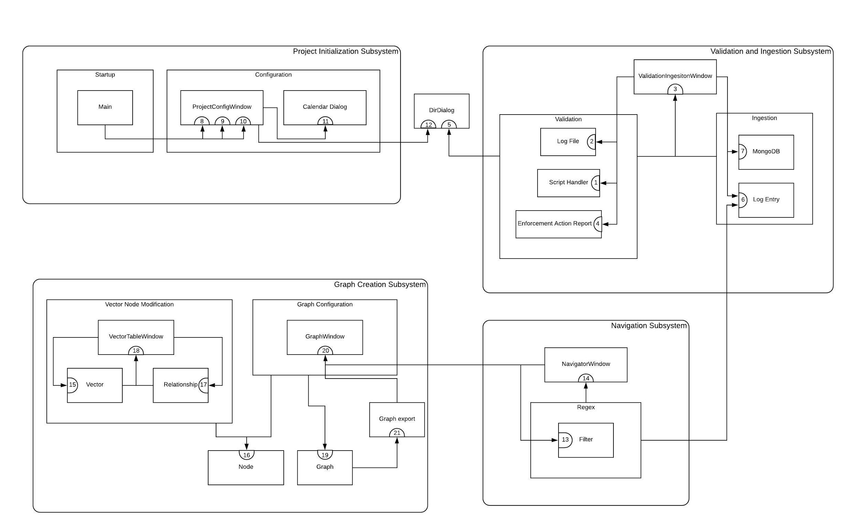
System Collaboration Diagram

Slide 11
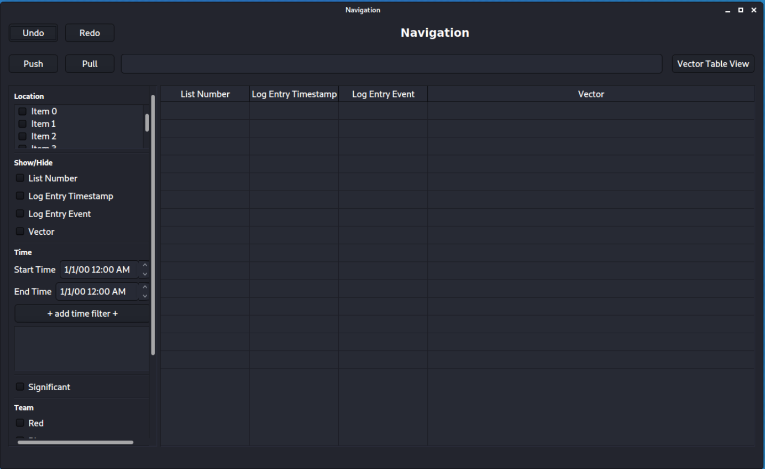
Contract
Contract Display Updated Table View
Contract number: 20
Contract Name: Display Graph Window
Contract Description: Display Graph Window
Protocol 1:
Signature: displayGraphWindow(graph)
Graph: Structure with graph information.
Output: graph displayed in window.
Pre-Condition: A pre-build graph to be displayed.
Post-Condition: Graph is created with relationships.
Notes:
It is responsible for displaying the graph, knowing the graph, and each one of the graph nodes.

Slide 12
Classes, Responsibilities and Collaborations
GraphWindow
Window in charge of graphing log entry in vector format.
Superclass: NavigatorWindow
Responsibilities | Responsibilities description | Collaborations
R.18-1 | Show graphical representation of vectors. | R.14-1 R.7-1 R.17-1 R.16-4 R.17-4 R.17-5 R.16-6
R.18-2 | Edit graphical representation of vectors.
R.18-3 | Create relationships among nodes.
R.18-4 | Create nodes.

Slide 13

Software engineering principles
SOLID Principles
S - SRP (Single Responsibility Principle)
O - OCP (Open Closed Principle)
L - LSP (Liskov Substitution Principle)
I - ISP (Interface Segregation Principle)
D - DIP (Dependency Inversion Principle)

Slide 14
Detailed Design
Notes:
Pay attention to the pre and post conditions on your protocols. We will be looking at them.

Slide 15
Use case scenario example
Scenario 1: Build Graph
Preconditions: Project configuration complete, must have corresponding vector
Postconditions: Graph is created
Actors: Analyst
1. Analyst selects graph view window.
2. System displays generated graph on graph view window.
3. Analyst selects export graph (ALT 1, ALT 2, ALT 4).
4. System displays options for export format
5. Analyst selects export option (ALT 3, ALT 4).
6. System exports graph as selected format.
7. End of use case.
ALT 1: Analyst modifies node
ALT1 -1: Analyst selects node.
ALT1 -2: Analyst modifies selected node.
ALT1 -3: Use case continues at step 3.
ALT 2: Analyst modifies relationship
ALT2 -1: Analyst selects relationship.
ALT2 -2: Analyst modifies selected relationship.
ALT2 -3: Use case continues at step 3.
ALT 3: Analyst cancels export
ALT3-1: Analyst selects cancel option
ALT3 -2: Use case continues at step 3.
ALT 4: Analyst exits graph view window
ALT4 -1: Analyst exits graph view window
ALT4 -2: use case continues at step 7.

Slide 16
Model-View Separation
Classes, contracts, and protocols example
Class Graph
Graph is a visual representation of a vector. Graph knows attributes of Orientation, Export Format, Interval Units, Interval, Position of Nodes, and Position of Relationships
Contract Create Graph
Contract number: 19
Contract Name: Create Graph
Contract Description: Creates Graph
Protocol 1:
Signature: createGraph(vectorOrientation, nodesPosition, relationPosition, interval, intervalUnits)
vectorOrientation: String with orientation, ID of the node to which it points to.
nodesPosition: String with node position by grid.
relationPosition: String of ID related nodes.
interval: String with interval of marks on a timeline.
intervalUnits: seconds, minutes, hours, days, weeks.
Output: none
Pre-Condition: Information on data base.
Post-Condition: Graph is created with relationships.
Class GraphWindow
It is responsible for displaying the graph, it has the responsibility to know the graph, and each one of the nodes
Contract Create Graph
Contract number: 20
Contract Name: Display Graph Window
Contract Description: Display Graph Window
Protocol 1:
Signature: build()
Output: graph displayed in Graph View window; the contents of the graph are painted.
Pre-Condition: Graph object exists to be displayed.
Post-Condition: Graph is displayed on the Graph View window with nodes and relationships.

Slide 17
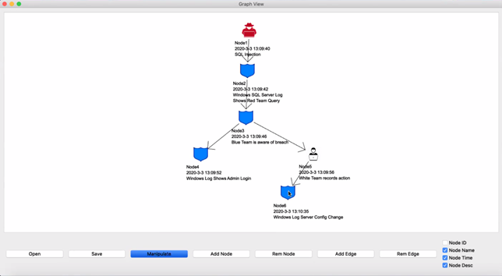
Model-View Separation result

Slide 18
Implementation

Slide 19
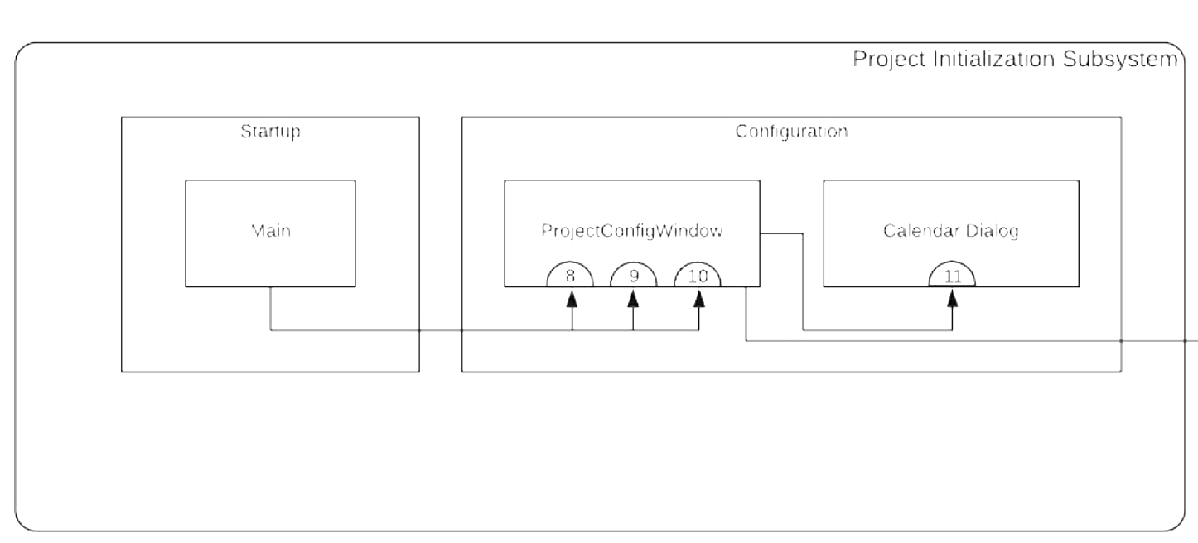
Contract: Start Date
Contract number: 9
Contract description: Display start date
Protocol 1:
Signature: on_startdate_button_clicked(self)
Output: None
Pre-Condition: A date has been chosen by CalendarDialog.
Post -Condition: Display the date that has been chosen.

Slide 20
Contract V4.0: Start Date
File Name: ProjectConfigWindow.py
Class Name: ProjectConfigWindow
def on_startdate_button_clicked(self):
self.start_date_calendar = True
self.end_date_calendar = False
calwindow = CalendarDialog(self)
calwindow.exec_()
datechosen = calwindow.date_picked
self.minimumdate = [calwindow.minimumdatelist[0], int(calwindow.minimumdatelist[1]), int(calwindow.minimumdatelist[2])] #[month, day, year]
self.selectstartdatelabel.setText('Start Date Selected: ' + datechosen)
print(datechosen)

Slide 21
Contract V5.0: Start Date
File Name: ProjectConfigWindow.py
Class Name: ProjectConfigWindow
def on_startdate_button_clicked(self):
self.start_date_calendar = True
self.end_date_calendar = False
calwindow = CalendarDialog(self)
calwindow.exec_()
datechosen = calwindow.date_picked
self.minimumdate = [calwindow.minimumdatelist[0], int(calwindow.minimumdatelist[1]), int(calwindow.minimumdatelist[2])] #[month, day, year]
self.selectstartdatelabel.setText('Start Date Selected: ' + datechosen)
basepath = path.dirname(__file__)
filepath = path.abspath(path.join(basepath, "../Data", "DateRange.txt"))
with open(filepath, 'r') as file:
data = file.readlines()
if not data:
data.append(str(self.minimumdate[2]) + '.' + str(self.minimumdate[0]) + '.' + str(self.minimumdate[1]) + '\n') #year.month.day
else:
data[0] = str(self.minimumdate[2]) + '.' + str(self.minimumdate[0]) + '.' + str(self.minimumdate[1]) + '\n' #year.month.day
with open(filepath, 'w') as file:
file.writelines( data )
self.enddatebutt.setEnabled(True)

Slide 22
Coding Standards:
Naming Conventions:
File: The whole name of the file is compounded into one with the start of every word capitalized.
Class: The whole name of the class is compounded into one with the start of every word capitalized.
Method: The whole name of the method is changed to have underscores instead of spaces.
Variables:The name of the variables have the name of their respective representation and in some cases the data type.
Notes:
The exceptions would be the file and class names of the navigator, graph, and table files and classes.

Slide 23
V&V (unit and integration strategies, development of system tests)

Slide 24
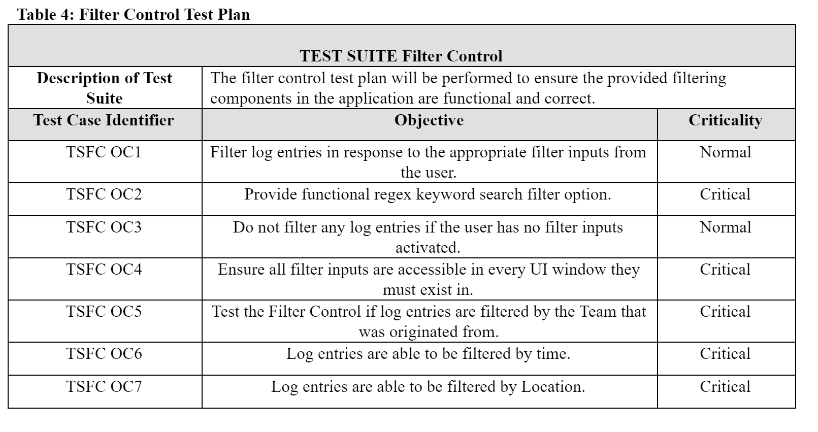
Test plan

Slide 25
Final status

Slide 26
Implemented Features
Project Configuration - UI and Integration
Validation and Ingestion - UI and Integration
Database Integration - Log Entries and Vectors
Log Entry Configuration - UI and Integration
Filter Configuration - UI and Integration
Graph Configuration - UI and Integration (no database integration)
Node Configuration - UI
Relationship COnfiguration - UI
Notes:
The exceptions would be the file and class names of the navigator, graph, and table files and classes.

Slide 27
Incomplete Features
OCR Tool Integration - None
STT Tool Integration - None
Syncing Integration (Push and Pull) - None
Nodes Configuration - Integration
Relationship Configuration - Integration
Maltego - Switched out for Graphviz
Notes:
The exceptions would be the file and class names of the navigator, graph, and table files and classes.

Slide 28
Deficiencies in Design
Notes:
The exceptions would be the file and class names of the navigator, graph, and table files and classes.

Slide 29
Lessons learned

