Slide 1
Project 2
CSC 4370
Group 4
Jared McKinney (Leader)
Michael Dinh
Shuang Li

Slide 2
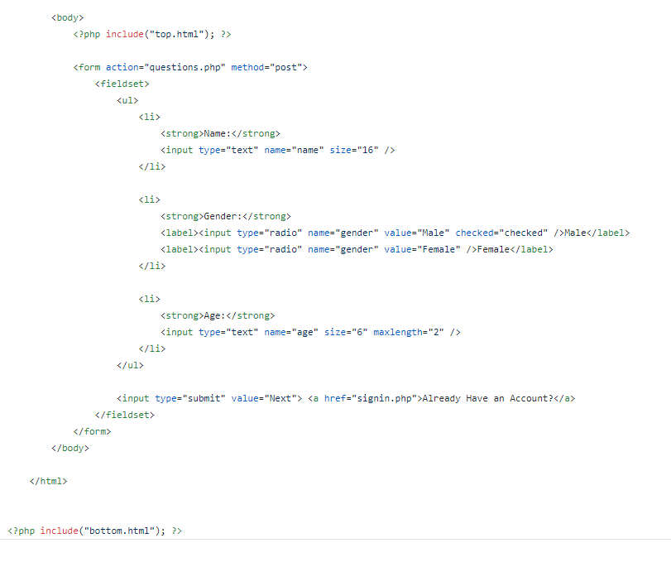
Index.php

Slide 3
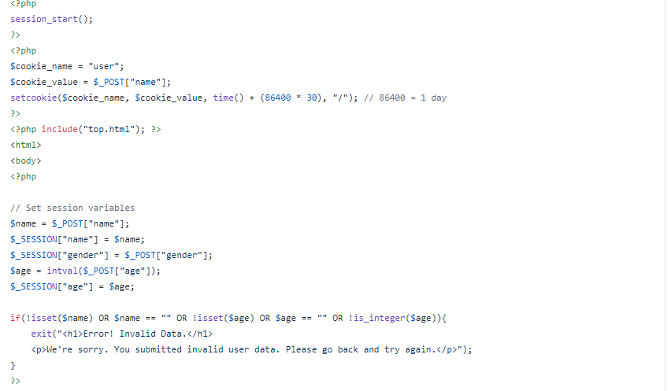
Questions.php

Slide 4
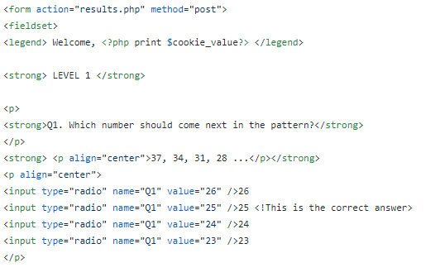
Questions.php(continued)

Slide 5
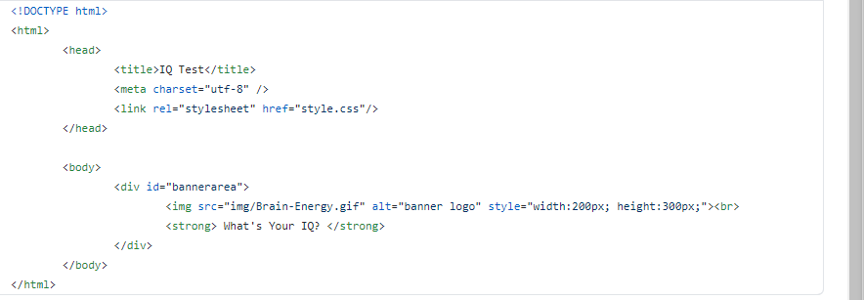
Top.html

Slide 6
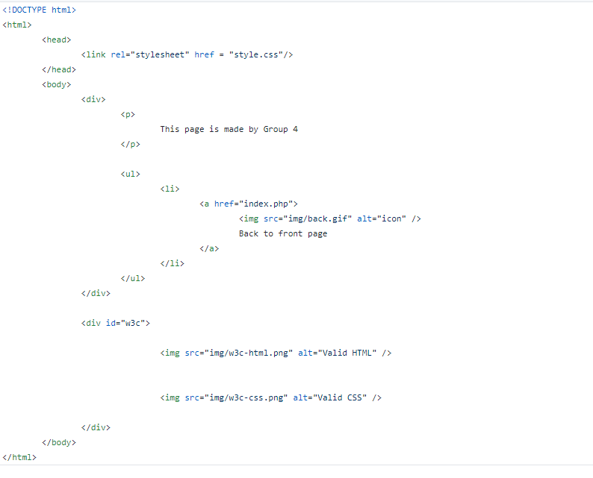
Bottom.html

Slide 7
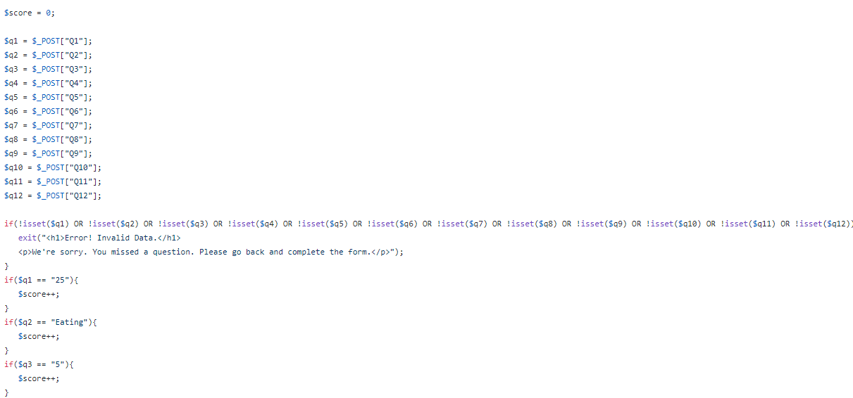
Results.php

Slide 8
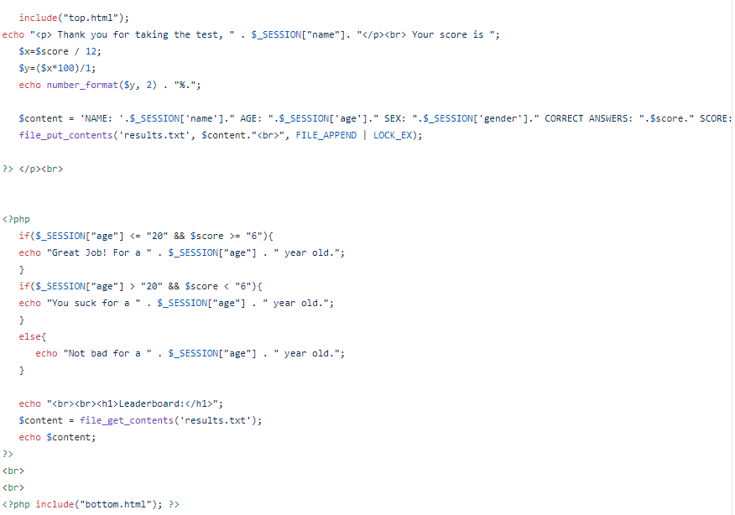
Results.php(continued)

Slide 9
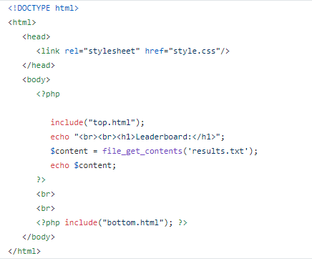
Scores.php

Slide 10
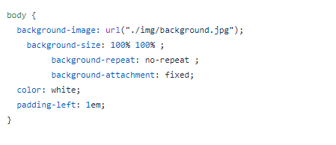
Style.css

