Slide 1
Android Team
Gary Graham Tim schonberger Michael colistro cody rozic

Slide 2
So Far
ISBN Scanner
Listings Showing
Books Showing
Courses Showing.
Registration/login activities created.
Settings menu created
Select major
Displayed Name
Only Books currently using API.

Slide 3
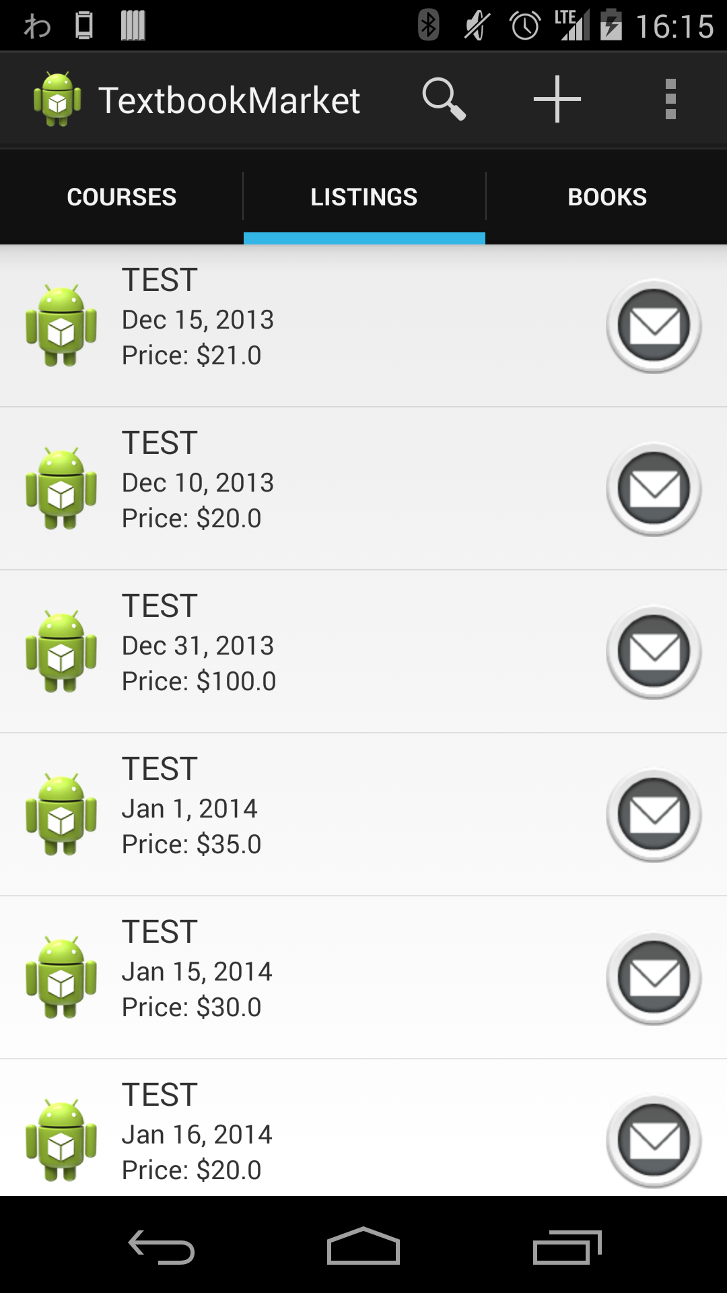
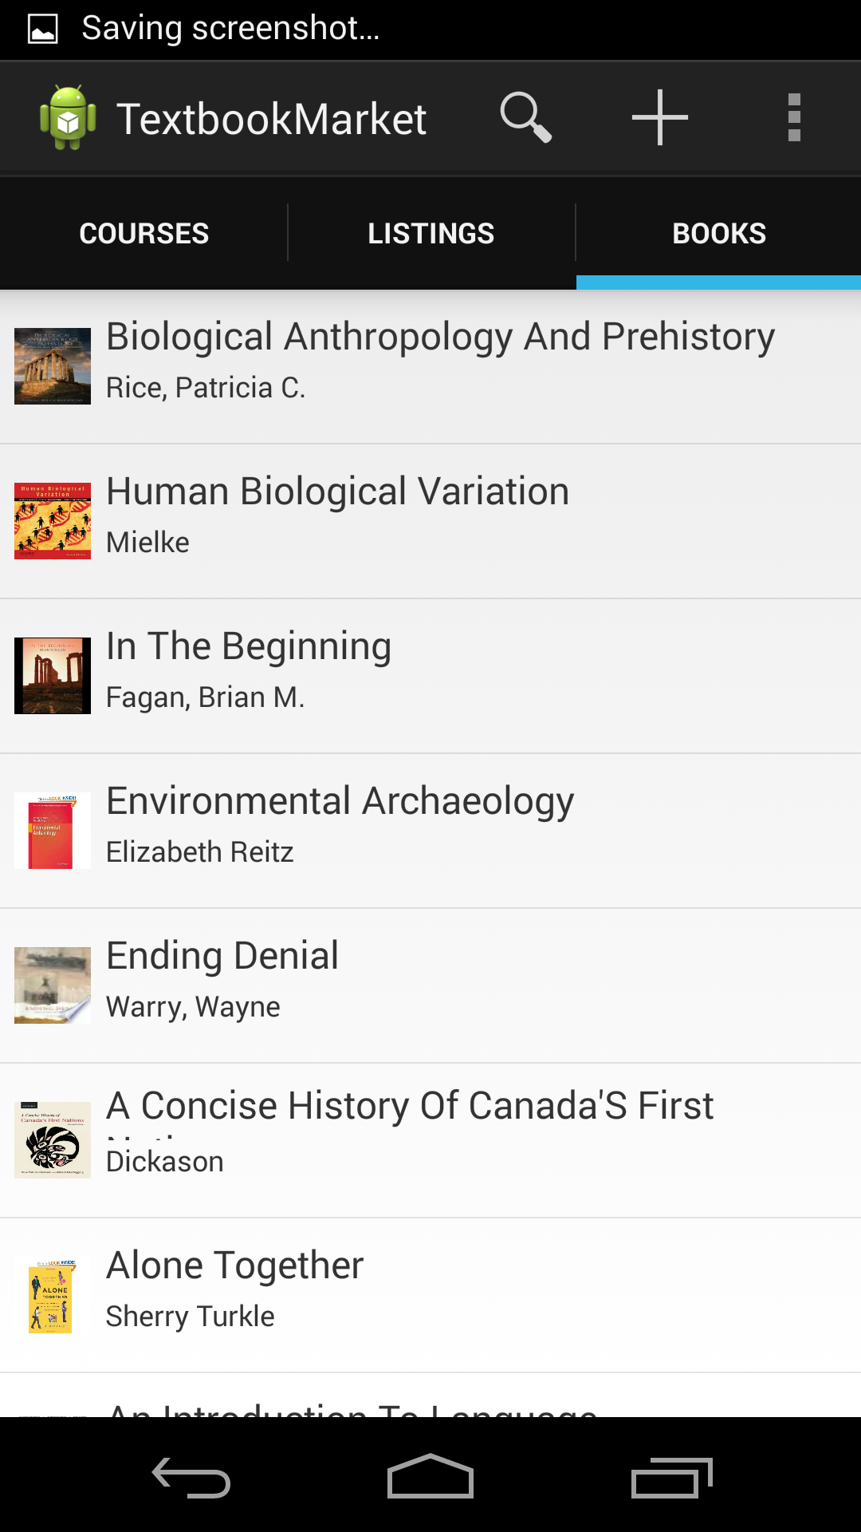
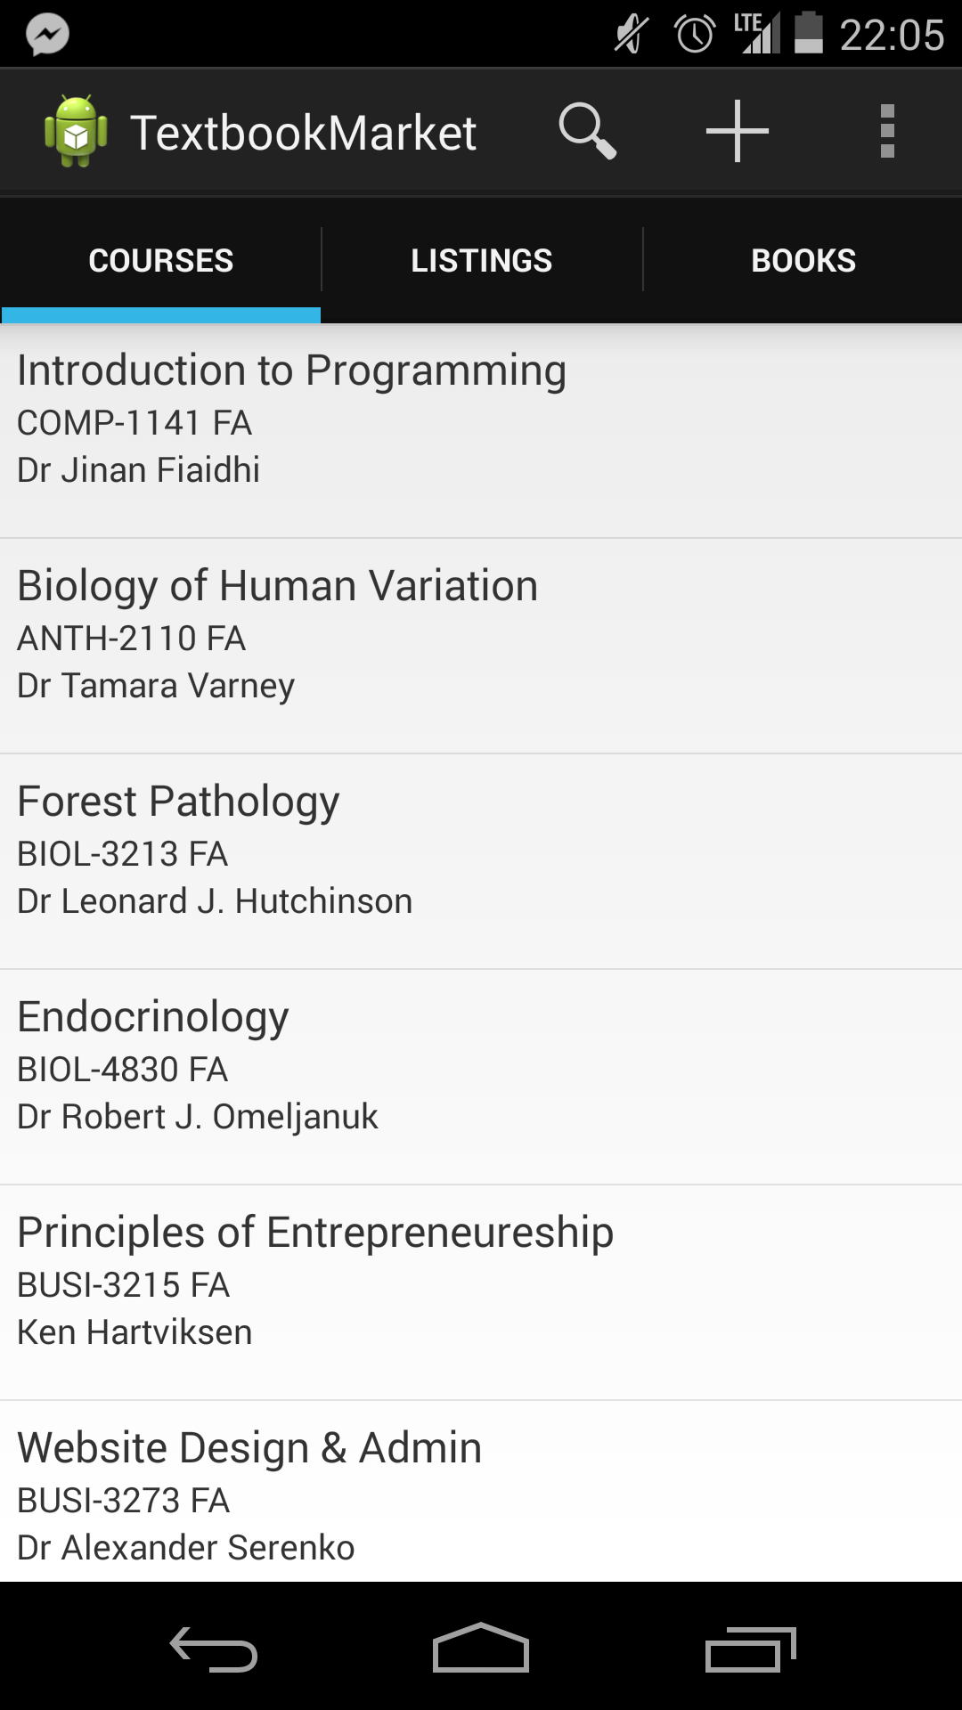
Pictures!

Slide 4
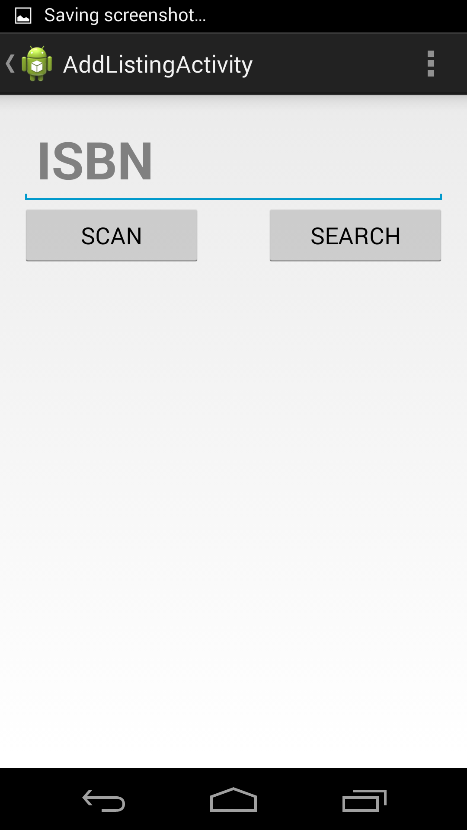
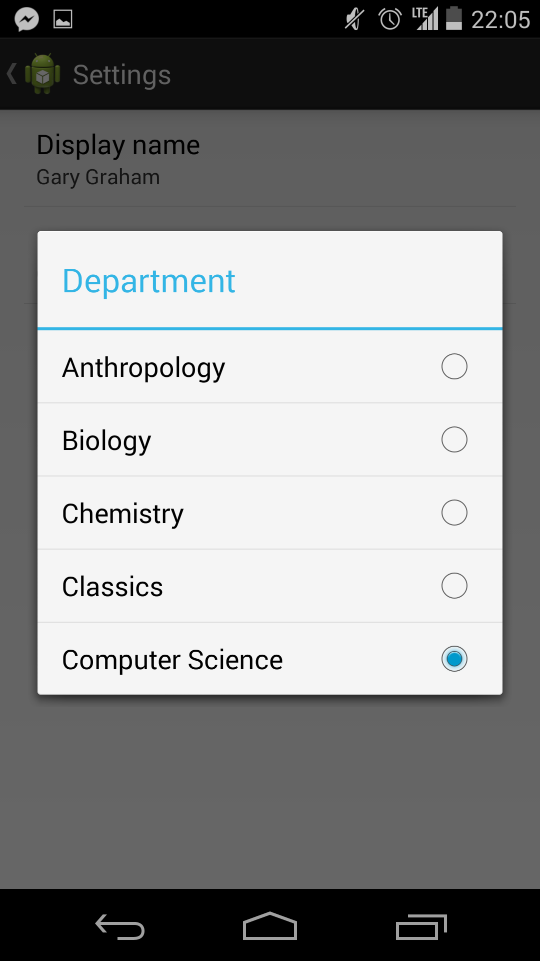

Slide 5
In progress
Detail Views for each tab
Add Listing View
Infinite Scroll
Expandable List View for Courses

