Slide 1
LU Used Books Portal
Android Team

Slide 2
Members
Mike Colistro
Cody Rozic
Timothy Schonberger
Gary Graham

Slide 3
Activities
Development of an android application to access the web API provided by the API/DB team.
Ensure high level UX through usability testing

Slide 4
Ideal Functionality
Register/login to application.
Encrypt login over the line.
Peruse List of currently available books and their associated pictures and courses.
Sorting by course number/book name/available listings.
Input course number, get book(needs buy/sell buttons).
In course list, have a "I want to sell this book/I want to buy this book" button.
Option to add books not in the list, by ISBN(camera scanner)

Slide 5
By the midterm:
Register/login
peruse list of available books
Get in contact with listing owner.("I want to buy this" button)
Input course number, get book.

Slide 6
By end of term:
Display full course list with ability to look through old editions.
In course list, have a "I want to sell this book/I'm looking for this book" buttons.
Option to add books not in the list, by ISBN(camera scanner)
More sophisticated Searching
Polished UI

Slide 7
Work distribution
Work will be assigned via github’s issue-tracking system.
Contributions can be tracked via commit logs.

Slide 8
Time estimates
Partially functional non-database-touching prototype: 35 hours
Functional but ugly database-utilising application: 80 hours
Polished application: 120 hours.

Slide 9
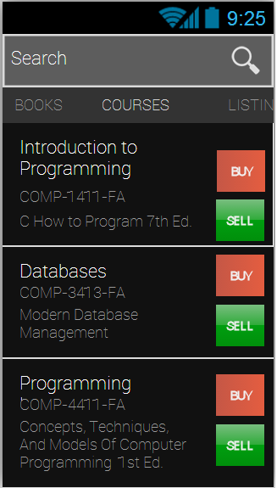
Mockup

