Slide 1

Scalability
Notes:
stackoverflow <- stack exchange
Q&A site

Slide 2
Big Scaling Event
2009
2011
2014
Microsoft Full Stack
Big Change
Nowaday

Slide 3
2009
Microsoft Full Stack

Slide 4
16 Millions
3 Millions
30%
Page views a month
Unique visitors a month
Programmer in the world use stackoverflow

Slide 5

Hardware
2 Web Servers
1 Database Server
1 NAS (Backup)
Notes:
Web Server use Microsoft IIS
Database Server use Microsoft SQL Server
NAS for Backup ‘coz can’t rent 5GB cloud bandwidth

Slide 6
Problems
Database design
Bottleneck at Database Server
Full-text Search
Notes:
some part of Database Design copy from Wikipedia then refactor by avoidance worst Query
almost 90% of using time, fixed by increasing CPU, RAM of Database
many fault, can’t adapt, Team focus Lucene

Slide 7
Scaling
Upgrade Database CPU Speed
Upgrade Database Ram to 48 GB
Update Network Driver
Notes:
Vertical Scaling
CPU speed from 1.86 GHz to 2.5 GHz and 3.5 GHz 1.86 GHz
update driver -> 4x speed

Slide 8

Why don’t use NoSQL?
“NoSQL is hard”
Notes:
NoSQL -> high maintenance cost
Relational SQL -> many fault but low cost

Slide 9
2011
Big Change

Slide 10
95 Millions
16 Millions
600%
Page views a month
Unique visitors a month
Pageviews growth rate from 2009
Notes:
800 (HTTP) + 180 (DNS) per second

Slide 11
Hardware
3 Web Servers
2 Database Servers
2 HAProxy Servers
2 Redis Servers
1 Backup Server
1 Log Server
2 Domain Controllers
Notes:
10 Web Servers but StackOverflow take 3 → Microsoft IIS
Database still Microsoft SQL
HAProxy → Ubuntu → Load Balancer (Free, Easy, Work Good)
Redis → CentOS → cache server (Distributed Memory Caching, Key-value, Easy to share)
Still Use Backup (Bacula) Server → cloud is expensive
Log → Nagios
DC → decide to give User use across server resource

Slide 12
Difference from 2009?
A Lot More of More
Linux
NoSQL
Fault Tolerance
Notes:
More User, Server, Database, Everything
Linux is coming (HAProxy, Redis, Bacula, Nagios)
Redis → caching layer
duplicate server for a lot of user, move some function to another datacenter

Slide 13
Else?
CDN isn’t Stackoverflow’s Choice
Full-text Search
Cache Everything
Manage Peak HTTP Requests
Notes:
CDN is cheap but expense than Own Hosting
FTS → change to Lucene (Full text indexing is better)
Cache at 3 level (local → user session, site → question id, global → API Quota)
Peak time to make sure that StackOverflow can handle user

Slide 14
2014
Nowaday

Slide 15
560 Millions
26.9 Millions
54th
Page views a month
Unique visitors a month
Trafic ranking
Notes:
make 2600 - 3000 request per second

Slide 16
8 Millions
40 Millions
100%
Questions
Answers
Year over year growth

Slide 17
Hardware
11 Web Servers
4 Database Servers
2 HAProxy Servers
3 Application Servers
3 Search Servers
2 Redis Servers
2 Networks
2 Firewalls
2 Routers
Notes:
IIS Server move to 2 SSDs (Raid 1)
Microsoft SQL move to SSD (10% usage)
Load Balancer ( 1 Active , 1 Standby)
Tag engine
ElasticSearch move to SSD
Cache

Slide 18
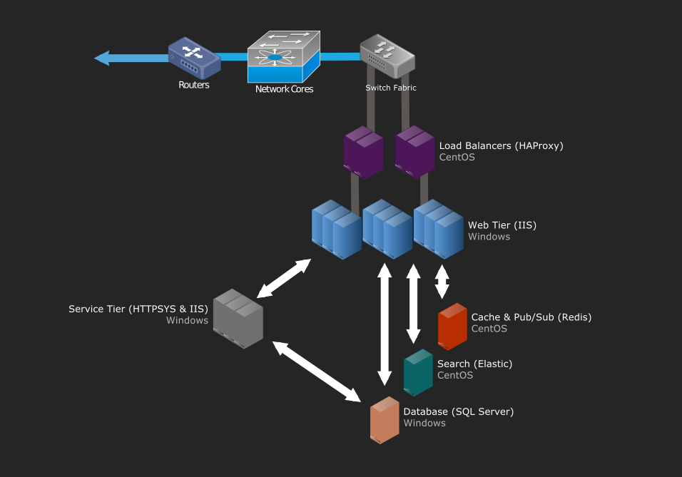

Slide 19

Caches
5 Levels of stackoverflow caching

Slide 20
Caches
Level 1: Network Cache
Level 2: Server Cache
Level 3: Redis Cache
Level 4: SQL Server Cache
Level 5: SSD Cache
Notes:
Network Caching → Browser Cache, Proxy, CDN
Server Cache → .Net, In-memory of Server
Distributed mem cache → Redis
MS SQL Server cache
Disk Cache → mostly used when Level 4 Cache doesn’t have data

Slide 21

Performance
Performance As A Feature

Slide 22
Performance
Cloud Server
Load Main Page in 50ms
Can be as low as 28ms
Record Single Request
Notes:
Hardware is cheaper than Developer, Best Code bad server then Bottleneck but you can’t control cloud to 50ms all the time
Stack overflow goal
Record for make next time better

Slide 23

Code Lifecycle
Move fast and break things

Slide 24
Stackoverflow Code Lifecycle
Step 1
Initialize New Feature
Step 6
Step 2
If there are errors,
Revert to Latest Version
Coding and Testing
Step 5
Step 3
Test at meta.stackexchange.com
Push Code to Code Repository
Step 4
CI Build, Test and Deploy

Slide 25
Conclusion
Scalable @ stackoverflow

Slide 26
Scaling
Vertical Scaling
Upgrade and Update (2009)
Use SSD
Horizontal Scaling
Add More Servers (2011& 2014)
Notes:
Adding more I/O capacity
คือการเพิ่มความจุของ server ด้วยการทำ RAID1
Improving I/O access times
ทำโดยการเปลี่ยนไปใช้ SSD
Reducing I/O operation
มีการเพิ่ม RAM เข้าไปใน server ดังที่เห็นอย่างชัดเจนในปี 2009
Switching to servers with more processors or more virtual cores
มีการเพิ่มความเร็ว CPU ในปี 2009
Horizontal scaling ได้แก่
Multiple server dedicated to each role เห็นได้จากจำนวนเครือง server ที่มีหน้าที่เหมือนกันหลายๆตัว

Slide 27
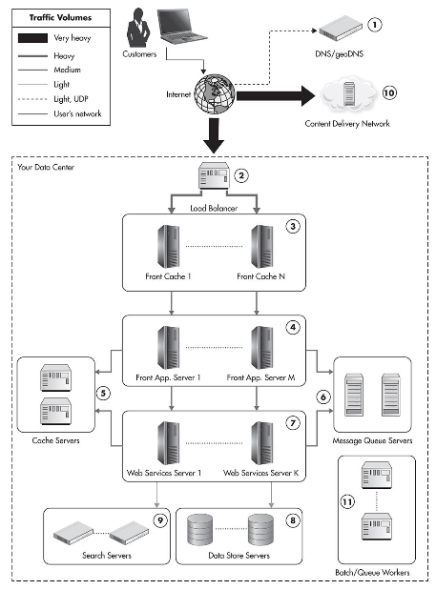
Notes:
don’t use GeoDNS, All of stackoverflow server is in America
HAProxy Server
use .NET, In-memory Server
use ASP.NET on Microsoft IIS
Cache Server use Redis
don’t have any reference to prove
IIS Server with HTTP.SYS for Provide API
Still Microsoft SQL Server
ElasticSearch
at last stackoverflow use CDN
don’t have any reference to prove

Slide 28
COPY AND PASTE
IS A DESIGN ERROR.
DAVID PARNAS

