Slide 1
YouTube Scalability

Slide 2
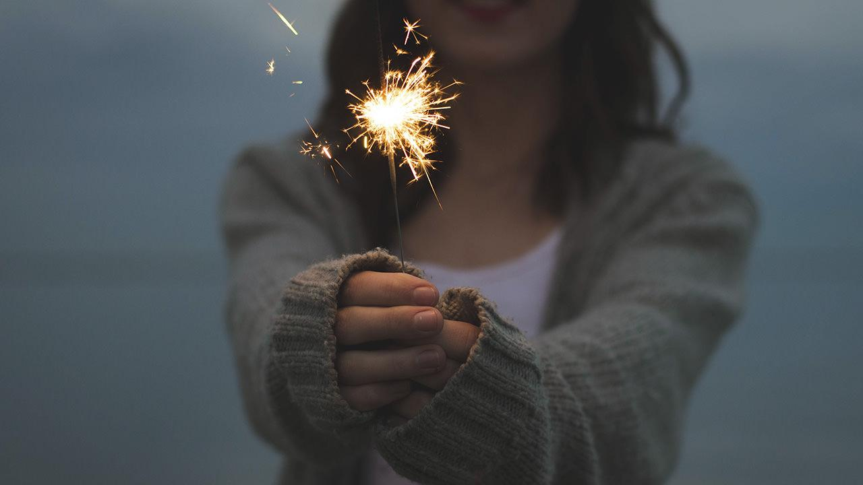
Hello!
I am Supanut Boonsuebpan 5709611916
CS447 Operating System2

Slide 3
Agenda
What is YouTube Service
What is YouTube Problem
The problem solution
The result
Knowledge in classroom
Reference

Slide 4
What is YouTube Service

Slide 5

YouTube allows users to upload, view, rate, share, add to favorites, report, comment on videos

Slide 6
What is YouTube Problem

Slide 7
4 Billion users
60 hours of video
24 / 7
Views a day
is uploaded every minute

Slide 8
Bottleneck
The stage in a process that causes the entire process to slow down or stop

Slide 9
The problem solution

Slide 10
CDN
The most popular content
YouTube Colo 1
Internet
YouTube Colo 2
Moderately Played
and
Long-tail content
YouTube Colo 3
YouTube Colo 4

Slide 11
The result

Slide 12
1. Bottlenecks can be resolved 2. More users can access the website 3. Users can access videos faster 4. Reduce the network traffic 5. Reduce costs 6. Online Backup

Slide 13
Knowledge in classroom

Slide 14
Availability
Scalability
CDN
Cache
Replication

Slide 15
Reference

Slide 16
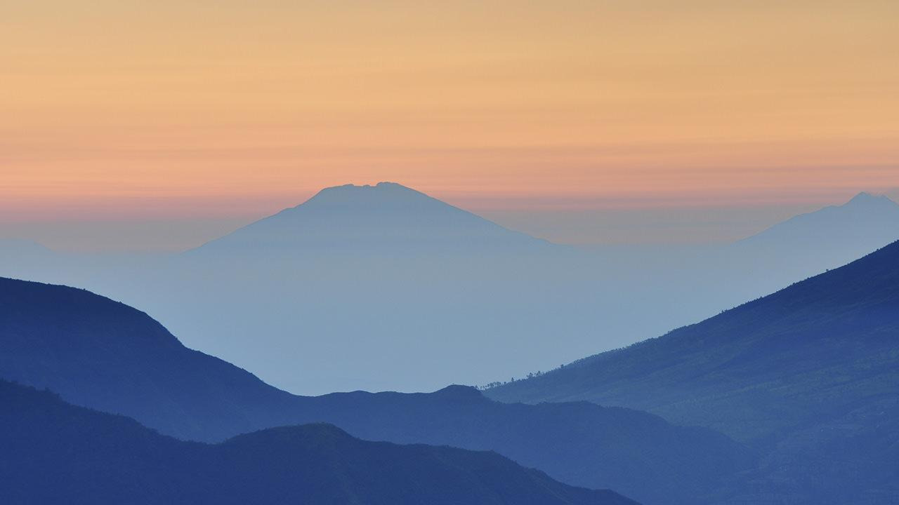
[1] https://www.infoq.com/presentations/YouTube-Scalability-Lessons [2] http://highscalability.com/youtube-architecture [3] http://www.beenets.com/bee_link_bandwidth [4] http://www.technointrend.com/what-is-youtube [5] https://www.techtalkthai.com/akamai-next-generation-content-delivery-network [6] http://ibe.travox.co.th

Slide 17
YOU NEVER GET BORED WITH

Slide 18
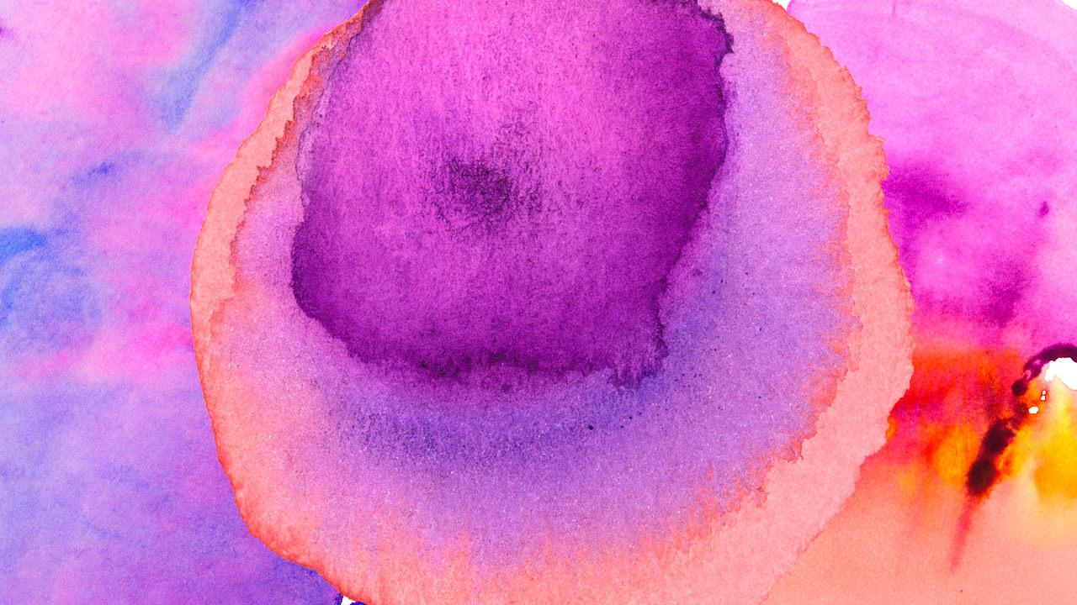
Thanks!
Any questions?

Slide 19
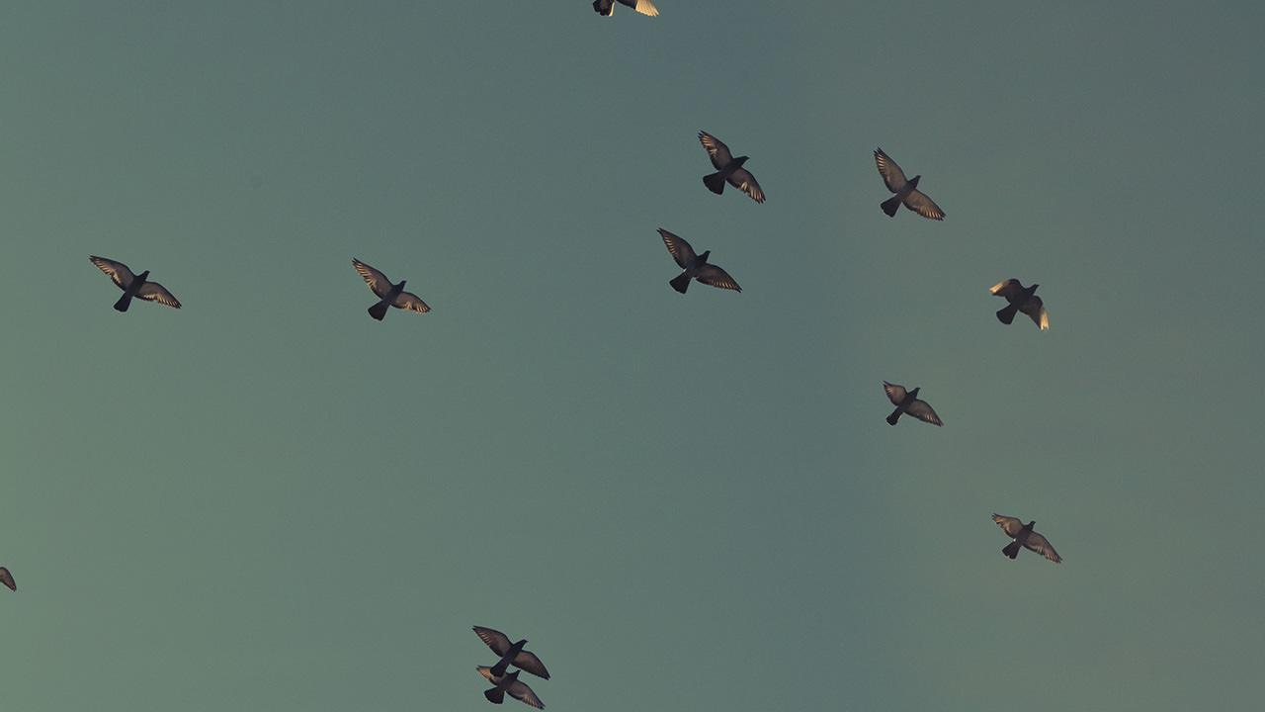

Slide 20
Use charts to explain your ideas
White
Gray
Black

Slide 21
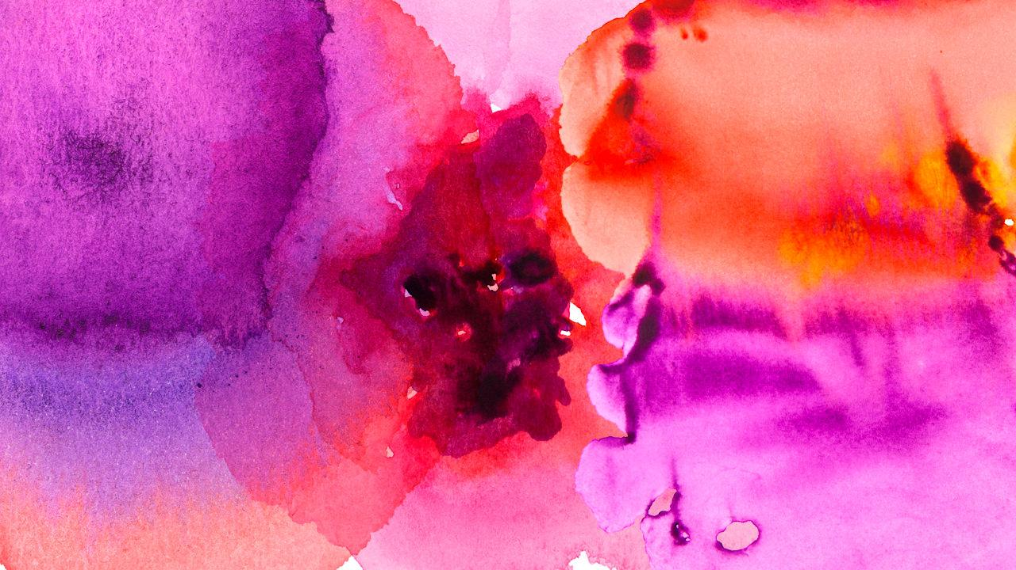
And tables to compare data
 | A | B | C
Yellow | 10 | 20 | 7
Blue | 30 | 15 | 10
Orange | 5 | 24 | 16

Slide 22
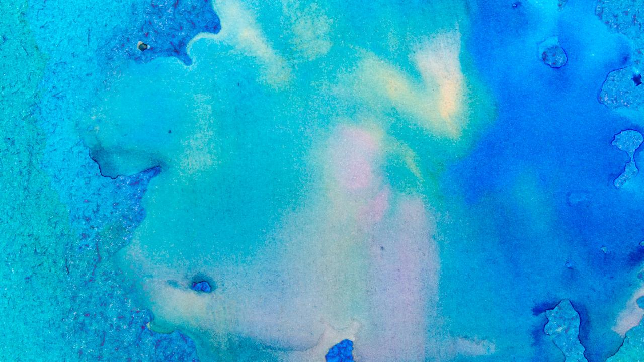

Slide 23
Our process is easy
first
second
last

Slide 24
Let’s review some concepts
Yellow
Is the color of gold, butter and ripe lemons. In the spectrum of visible light, yellow is found between green and orange.
Blue
Is the colour of the clear sky and the deep sea. It is located between violet and green on the optical spectrum.
Red
Is the color of blood, and because of this it has historically been associated with sacrifice, danger and courage.
Yellow
Is the color of gold, butter and ripe lemons. In the spectrum of visible light, yellow is found between green and orange.
Blue
Is the colour of the clear sky and the deep sea. It is located between violet and green on the optical spectrum.
Red
Is the color of blood, and because of this it has historically been associated with sacrifice, danger and courage.

Slide 25
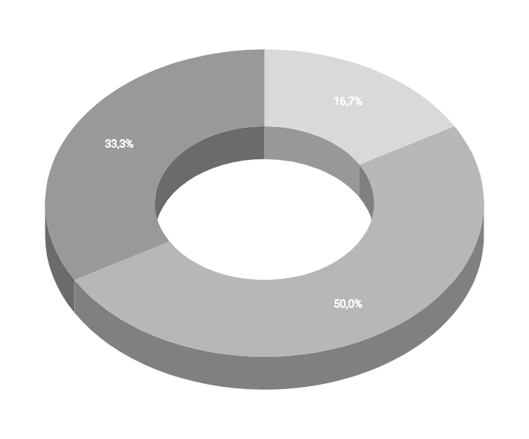
You can insert graphs from Google Sheets

Slide 26
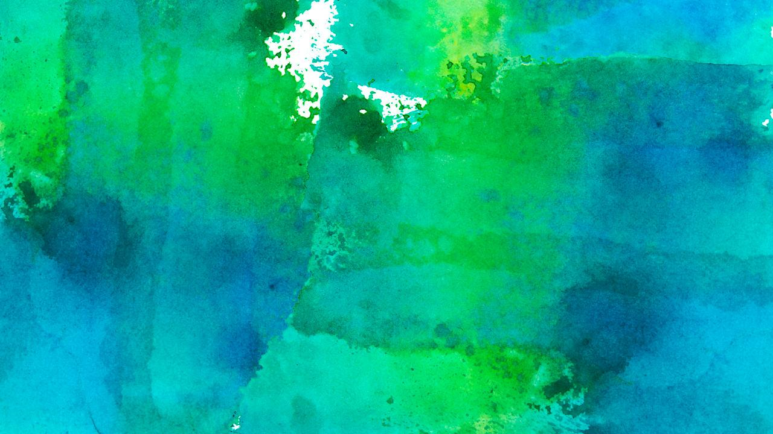
Android project
Show and explain your web, app or software projects using these gadget templates.
Place your screenshot here

Slide 27
iPhone project
Show and explain your web, app or software projects using these gadget templates.
Place your screenshot here

Slide 28
Tablet project
Show and explain your web, app or software projects using these gadget templates.
Place your screenshot here

Slide 29
Desktop project
Show and explain your web, app or software projects using these gadget templates.
Place your screenshot here

Slide 30
Credits
Special thanks to all the people who made and released these awesome resources for free:
Presentation template by SlidesCarnival
Photographs by Unsplash
Watercolor textures by GraphicBurguer

Slide 31
Presentation design
This presentation uses the following typographies and colors:
Titles: Lato Thin
Body copy: Lato Light
You can download the fonts on this page:
http://www.latofonts.com/lato-free-fonts/
You don’t need to keep this slide in your presentation. It’s only here to serve you as a design guide if you need to create new slides or download the fonts to edit the presentation in PowerPoint®

Slide 32
SlidesCarnival icons are editable shapes.
This means that you can:
Resize them without losing quality.
Change fill color and opacity.
Isn’t that nice? :)
Examples:

Slide 33
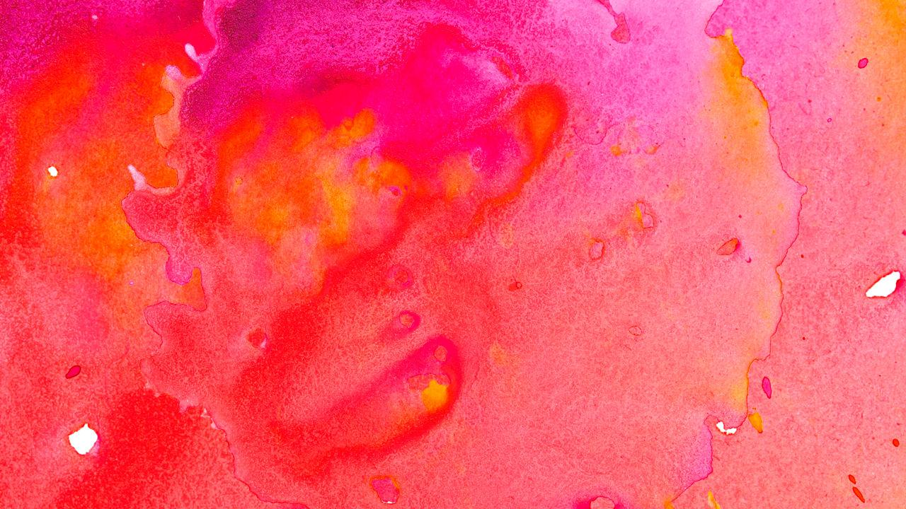
😉
Now you can use any emoji as an icon!
And of course it resizes without losing quality and you can change the color.
How? Follow Google instructions https://twitter.com/googledocs/status/730087240156643328
✋👆👉👍👤👦👧👨👩👪💃🏃💑❤😂😉😋😒😭👶😸🐟🍒🍔💣📌📖🔨🎃🎈🎨🏈🏰🌏🔌🔑 and many more...

